Slide 1
Nourishing the Future: Sustainable Food Systems for Nutrition and Dietetic Students
Presented by:
Johns Hopkins Center for a Livable Future
Food + Planet
Notes:
Welcome to Nourishing the Future: Sustainable Food Systems Learning Modules for Nutrition and Dietetic Students.

Slide 2
Aquatic Foods, Nutrition, and Sustainability
Module 4
Presented by:
Johns Hopkins Center for a Livable Future
Food + Planet
Notes:
This lecture series was produced by the Johns Hopkins Center for a Livable Future in partnership with Food plus Planet.

Slide 3
Four Modules
Module 1 Introduction to Sustainable Food Systems
Module 2 Food Systems for All
Module 3 Food and our Climate
Module 4 Aquatic Foods, Nutrition, and Sustainability
Notes:
The series is composed of four modules. The initial module in the series is an Introduction to Sustainable Food Systems. The second is Food Systems for All. The third is Module 3, Food and our Climate.
Let’s get started with Module 4: Aquatic Foods, Nutrition, and Sustainability.

Slide 4
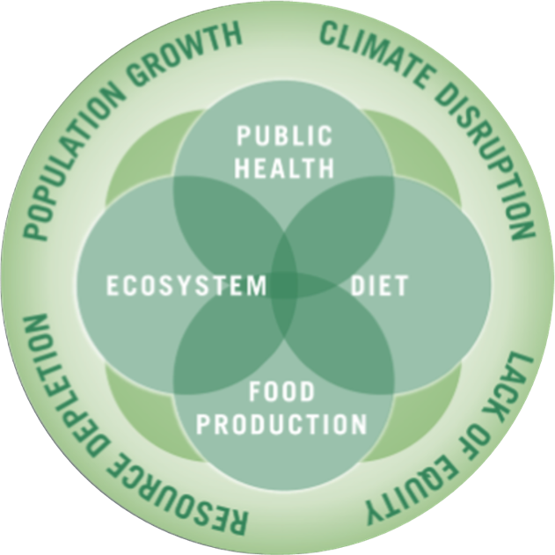
The Johns Hopkins Center for a Livable Future
Interdisciplinary academic center at the Johns Hopkins Bloomberg School of Public Health
Education, research, policy, and practice
Vision: a healthier, sustainable and resilient food system for all
Image source: Johns Hopkins Center for a Livable Future.
Notes:
The Johns Hopkins Center for a Livable Future is an inter-disciplinary academic center at the Johns Hopkins Bloomberg School of Public Health. The Center is engaged in education, research and practice at the intersection of public health, diet, food production and ecosystem health, which are all influenced by and connected to population growth, climate, resource depletion and equity. The Center collaborates with researchers, community groups and advocates at the local, state, national and international level and provides technical assistance to partner organizations. The Center’s vision is a healthier, sustainable and resilient food system for all.
This lecture series is based on the expertise and teaching resources of many faculty and staff at the Center, our collaborators across Johns Hopkins University and our many non-academic partners. We graciously acknowledge their work and thank them for allowing us to share it with you.

Slide 5
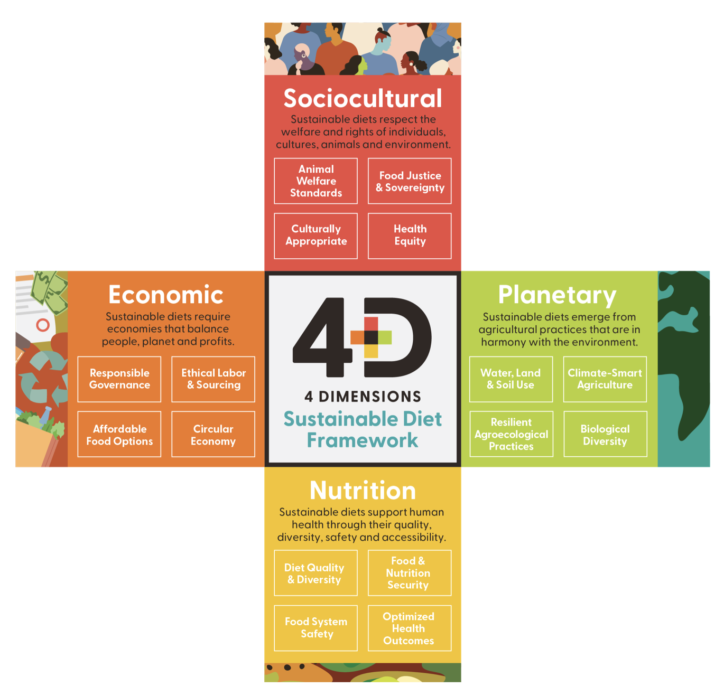
Food + Planet
Vision: a science and practice of nutrition that honors nature as the foundation of health through the four dimensions of sustainability
A collective, visionary 501c3 founded by four registered dietitians with varied experience in the food system
Aim: empower health care professionals to be leaders in sustainable food systems
Image source: Vogliano, C., Geagan, K., Chou, S., Palmer, S. (2021). Figure 1. The 4 dimensions of sustainable diets. [Infographic]. Empowering nutrition professionals to advance sustainable food systems [White Paper]. Food and Planet. Retrieved September 14, 2025, from https://7157e75ac0509b6a8f5c-5b19c577d01b9ccfe75d2f9e4b17ab55.ssl.cf1.rackcdn.com/GVISUTJI-PDF-1-675987-4519061561.pdf
Notes:
Food + Planet is a collective, visionary 501c3 founded by four registered dietitians with varied experience in the food system. Our aim is to empower healthcare professionals to be leaders in sustainable food systems. We envision a science and practice of nutrition that honors nature as the foundation of health through the four dimensions of sustainability: Sociocultural, Economic, Planetary and of course, Nutrition.

Slide 6
Blue Foods and Sustainable Foods
Sociocultural
A rich variety of blue foods are culturally relevant and play a role in traditional diets and medicine
Production can support indigenous, small-scale, local producers
Blue foods’ versatility offers abundant opportunity to explore delicious diverse flavors and culinary applications
Planetary
Blue foods, such as bivalves and sea vegetables, can improve water quality and provide habitat
Well-managed production and harvest of blue foods can support human health and planetary health
Replacing more carbon-intensive animal food sources with blue foods can reduce climate impact of diets
Four themes:
Sociocultural
Economic
Planetary
Nutrition
Economic
Many Americans already enjoy diverse options prepared in culturally appropriate, affordable formats
Sustainable practices con support long-term economic viability for producers and boost community resilience
Affordable formats (such as canned, dried, or frozen) support access, affordability, and convenience
Nutrition
Blue foods are an essential protein source for over three billion people
Blue foods are rich in micronutrients and essential fatty acids, helping close nutrient gaps
Blue foods are prominently featured in a variety of dietary guidelines and food-as-medicine frameworks
Source: Food + Planet.
Notes:
The four themes in Food + Planet’s 4D diagram can be uses to frame and assess Aquatic or Blue Foods and Sustainable diets.
Review the bullets in the four themes before moving on to the next slide.

Slide 7
Learning Objectives
Define aquatic foods
Describe how aquatic foods are sourced
Explain five challenges in the aquatic foods sector
Explain three health benefits of consuming aquatic foods
Discuss the evidence about the health benefits of consuming aquatic foods
Gain confidence in providing advice and guidance on selection and preparation of aquatic foods
Notes:
This talk includes three sections. Just a quick note, we’ll sometimes use the terms seafood and fish or sometimes we may say aquatic foods. You may also hear the term ‘blue foods’. These are all generally interchangeable. At CLF, we prefer the term Aquatic Foods.
At the end of this module, you will be able to:
Define aquatic foods
Describe how aquatic foods are sourced
Explain five challenges in the aquatic foods sector
Explain three health benefits of consuming aquatic foods
Discuss the evidence about the health benefits of consuming aquatic foods
Gain confidence in providing advice and guidance on selection and preparation of aquatic foods.

Slide 8
Section A: Aquatic Food Production
Notes:
In the first section, we’ll explore Aquatic Food Production.

Slide 9

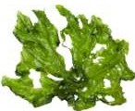

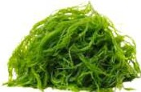

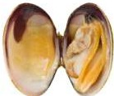

What Are Aquatic Foods?
Finfish: Mahi-mahi, tuna, swordfish, trout, salmon, pollack, sardines
Aquatic plants: Water spinach; aquatica
Crustaceans: Crabs, shrimp
Algae: Seaweed
Cephalopods: Octopus, squids
Other mollusks: Clams, oysters, snails
Aquatic animals: Insects, sea cucumbers
Source: Golden, C., Koehn, Z., Shepon, A., Passarelli, S., Free, C., Viana, D., Matthey, H., Eurich, J., Gephart, J., Fluet-Chouinard, E., Nyboer, E., Lynch, A., Kjellevold, M., Bromage, S., Charlebois, P., Barange, M., Vannuccini, S., Cao, L., Kleisner, K., … Thilsted, S. (2021). Aquatic foods to nourish nations. Nature, 598, 315–320. https://doi.org/10.1038/s41586-021-03917-1
Image source: Food + Planet, used with permission.
Notes:
Let’s start with basic terminology.
Aquatic foods are defined as animals, plants and microorganisms for human consumption, grown in or harvested from water, as well as cell- and plant-based foods of aquatic origin emerging from new technologies. Aquatic foods can be farmed or wild­ caught, and can be sourced from inland (for example, lakes, rivers and wetlands), coastal (estuaries, mangroves and near­ shore) and marine waters, producing a diversity of foods across all seasons and geographic regions.
When we talk about seafood, we’re actually referring to a wide range of species that include finfish such as mahi-mahi, tuna, swordfish, trout, salmon, pollack and sardines; crustaceans such as crab, shrimp and lobster; cephalopods such as octopus and squid (though there is increasing controversy surrounding the farming of these creatures as we learn more about their higher levels of cognitive abilities); mollusks such as clams, oysters and sea snails; aquatic plants including seaweed and nori; and other aquatic foods that include a variety of insects and sea cucumbers.
-----
Information
Golden, C., Koehn, Z., Shepon, A., Passarelli, S., Free, C., Viana, D., Matthey, H., Eurich, J., Gephart, J., Fluet-Chouinard, E., Nyboer, E., Lynch, A., Kjellevold, M., Bromage, S., Charlebois, P., Barange, M., Vannuccini, S., Cao, L., Kleisner, K., … Thilsted, S. (2021). Aquatic foods to nourish nations. Nature, 598, 315–320. https://doi.org/10.1038/s41586-021-03917-1

Slide 10
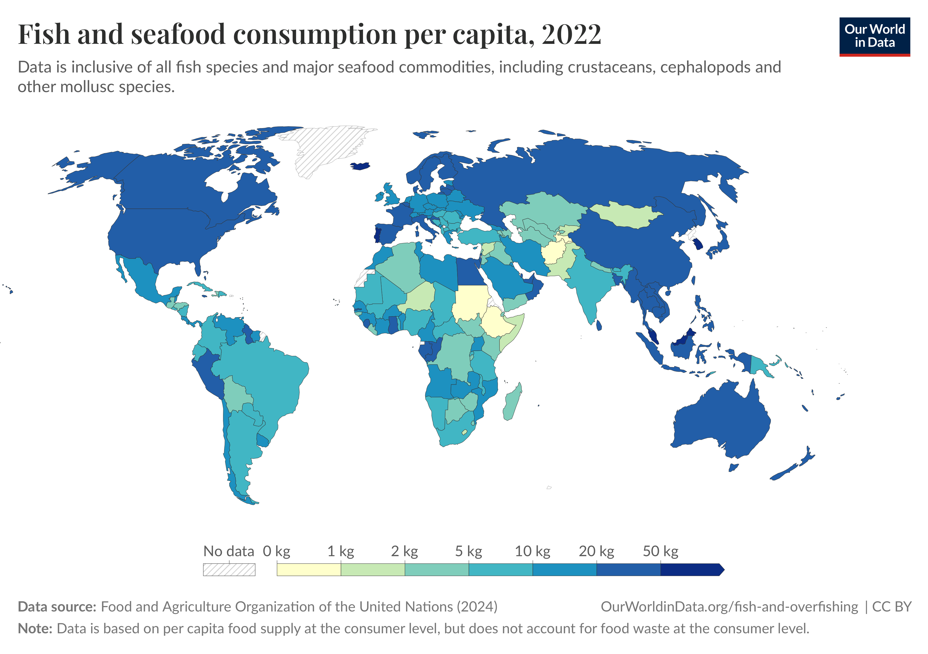
Per Capita Fish and Seafood Consumption, 2022
Source: Our World in Data. (2025). Yearly per capita supply of fish and seafood. https://ourworldindata.org/grapher/fish-and-seafood-consumption-per-capita
Notes:
This map presents country level patterns in per capita fish and seafood consumption. The darker blue represents the highest fish and seafood consumption.
That includes Asia, parts of Europe, particularly in northern Europe, and certain coastal countries throughout the world
Combined, fisheries and aquaculture provide 20% of animal protein consumed by about 3.3 billion people. Over 1 billion people get most of their animal protein from seafood.. In some countries like Bangladesh, Cambodia, Ghana, Indonesia and Sri Lanka, seafood contributed more than half of the total animal protein consumed, so seafood is very important for food security in many places.
Seafood consumption is increasing worldwide. The growth in consumption has been driven by rising incomes, increased awareness about the health benefits of fish consumption, increases in production and availability, and technological developments in processing, cold chain, shipping and distribution.
-----
Graphic
Our World in Data. (2025). Yearly per capita supply of fish and seafood. Our World in Data. https://ourworldindata.org/grapher/fish-and-seafood-consumption-per-capita
(data inclusive of all fish species and major seafood commodities, including crustaceans, cephalopods and other mollusk species)

Slide 11
Where Do Aquatic Foods Come From?
Capture fisheries
Caught in the wild with fishhooks, nets, or pots
Aquaculture
Farmed in ponds, cages, pens, tanks
Marine
Oceans
Seas
Bays
Estuaries
Inland
Freshwater lakes, ponds, rivers, streams, reservoirs
Notes:
Aquatic foods can come from a wide variety of sources. Capture fisheries, often referred to as just “fisheries”, are seafood caught in the wild with hooks, nets, or pots. Aquaculture means the seafood was raised on farms in ponds, cages, pens, or tanks.
Both wild fisheries and aquaculture can be from either marine sources or inland sources. Marine refers to our oceans and seas, including estuaries and bays. It’s salt-water. Inland production comes from rivers, lakes, ponds, streams, canals and other land-locked bodies of fresh water.

Slide 12
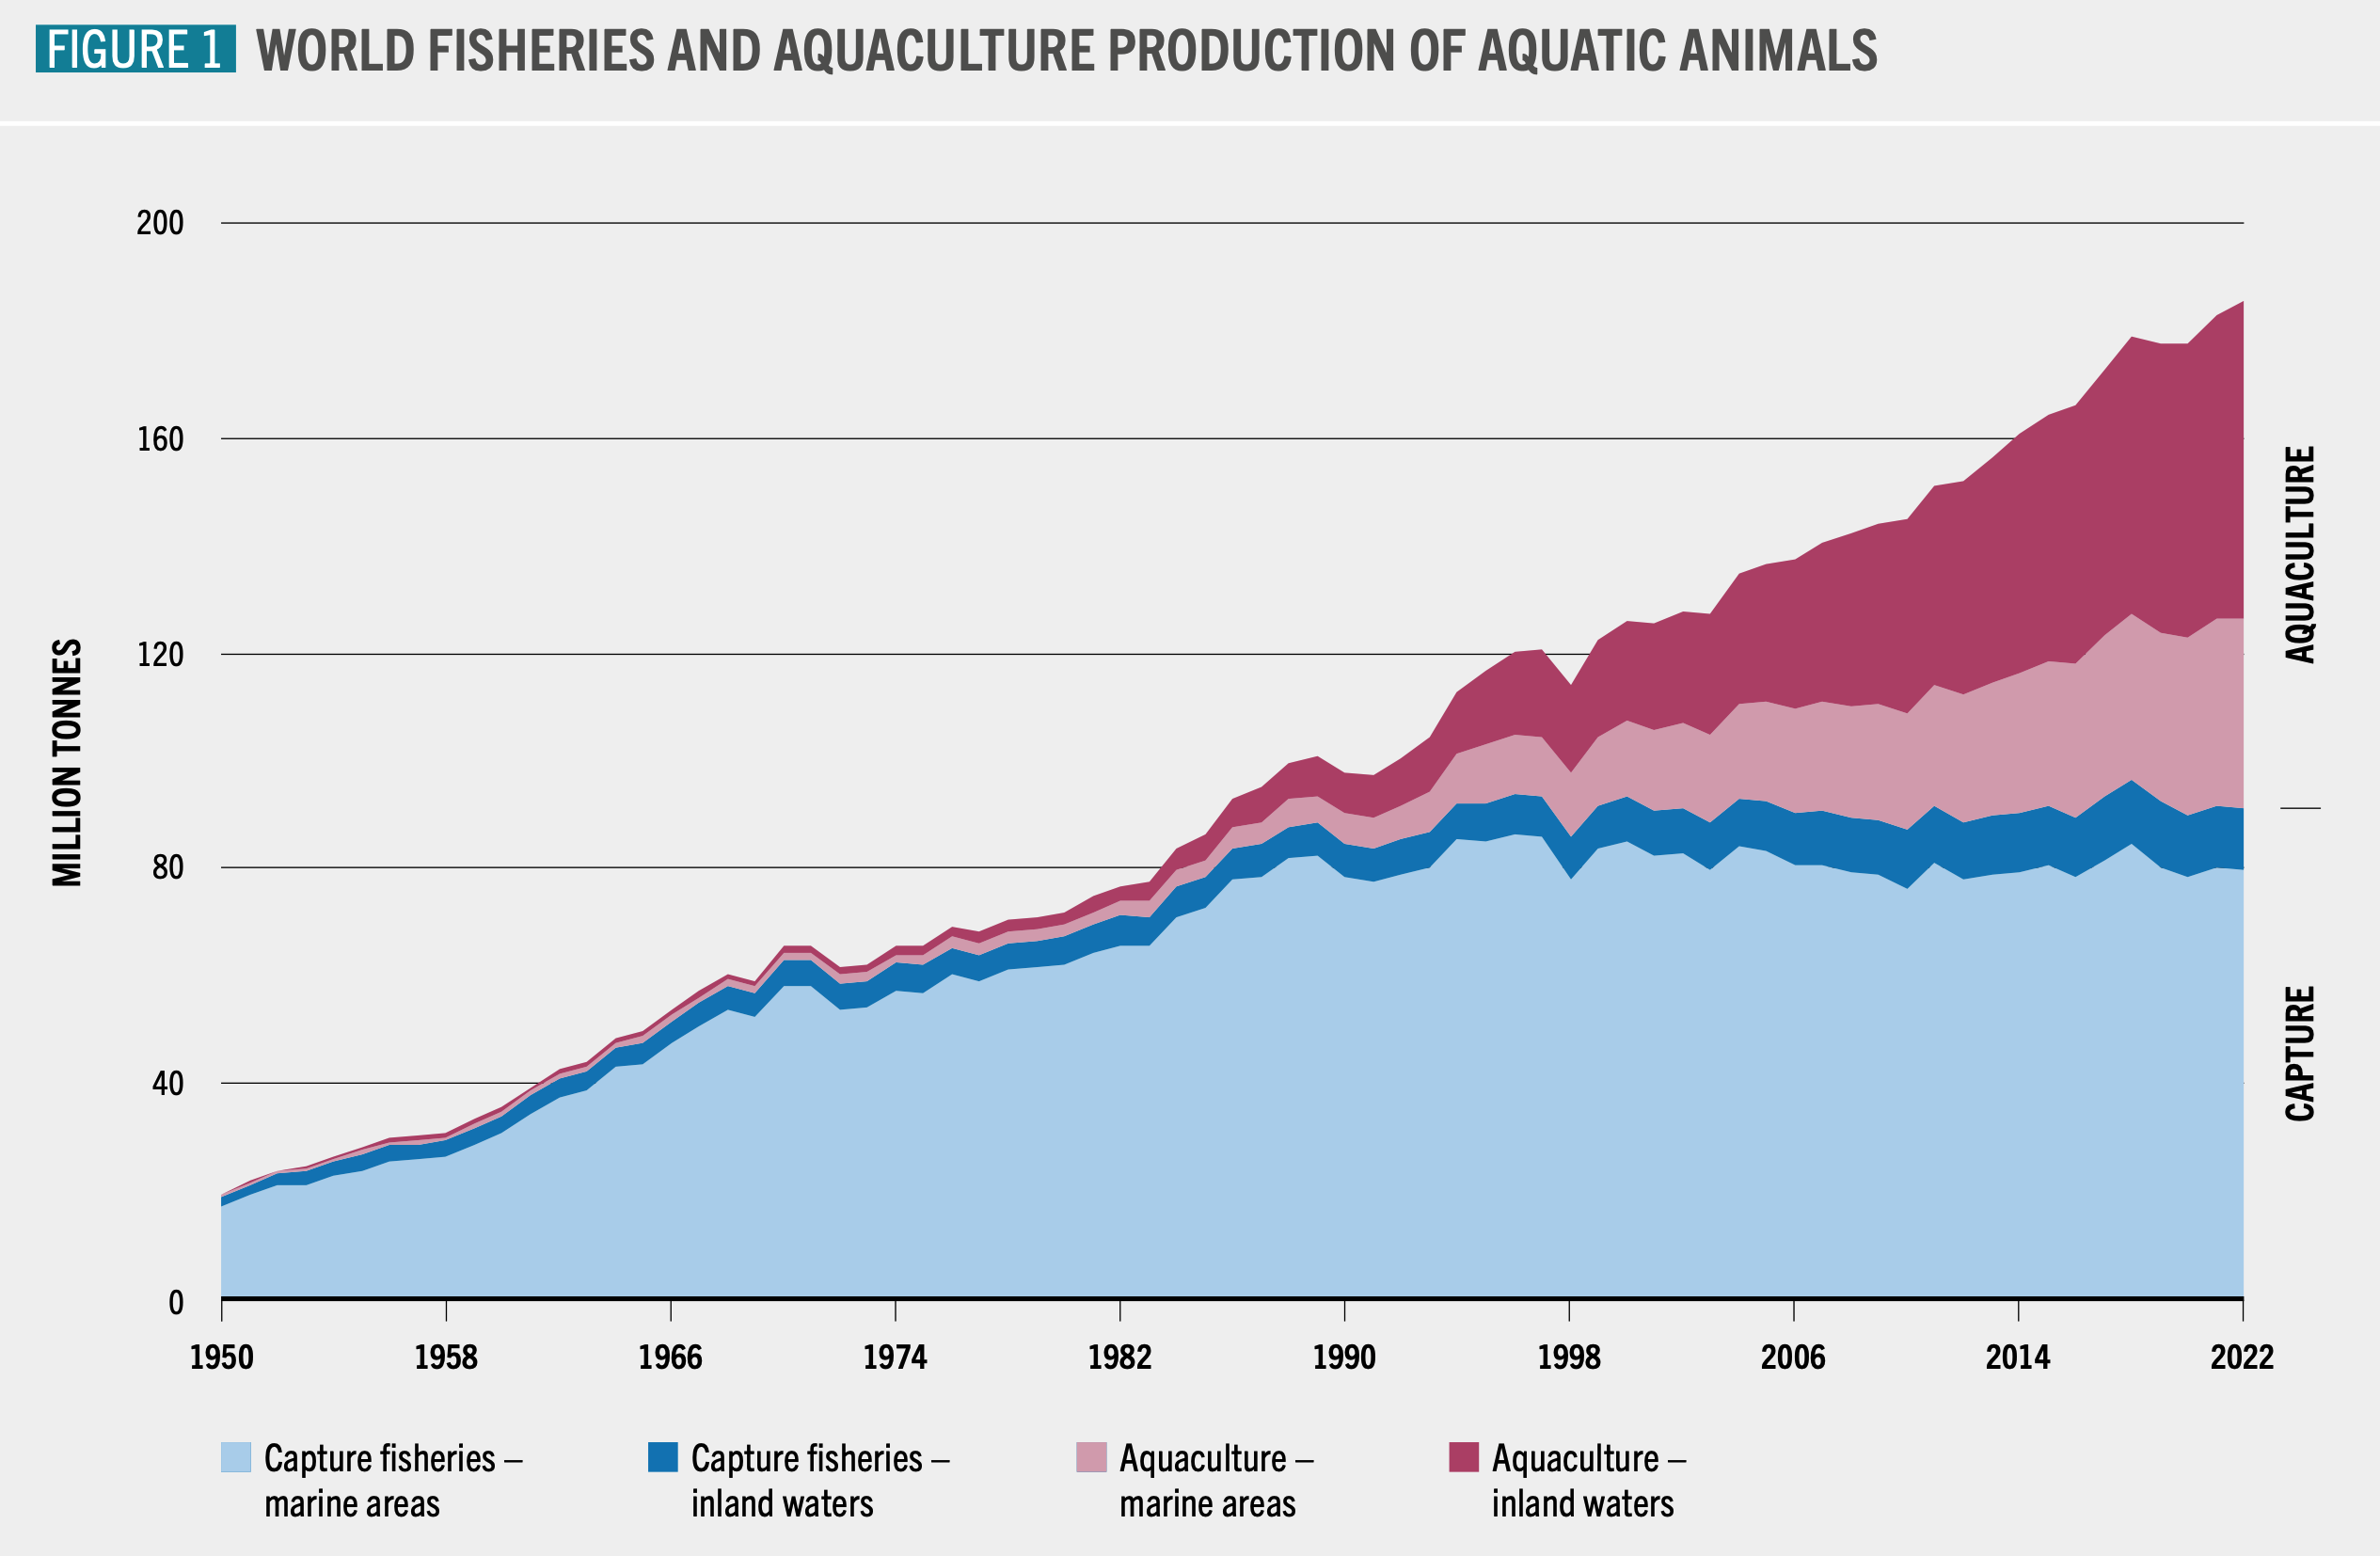
Production from Capture Fisheries and Aquaculture
Image source: FAO. (2024). Figure 1. World fisheries and aquaculture production of aquatic animals [Chart]. The state of world fisheries and aquaculture 2024. Blue transformation in action. Food and Agriculture Organization of the United Nations. https://doi.org/10.4060/cd0683en
Notes:
The production of seafood from capture fisheries and aquaculture now occurs on every continent, and in freshwater, estuaries, and oceans. Fisheries historically made up most of the global seafood production, but there has been a leveling off in marine capture fisheries starting in the 1980s. Since the 1990s, most of the increased demand for seafood has been met by the rapid expansion in aquaculture in marine and inland waters. The production of aquaculture now surpasses the production from capture fisheries. Globally, aquaculture production has also surpassed beef production.
-----
Graphic
FAO. (2024). The State of World Fisheries and Aquaculture 2024 – Blue Transformation in Action. Food and Agriculture Organization of the United Nations. https://doi.org/10.4060/cd0683en

Slide 13
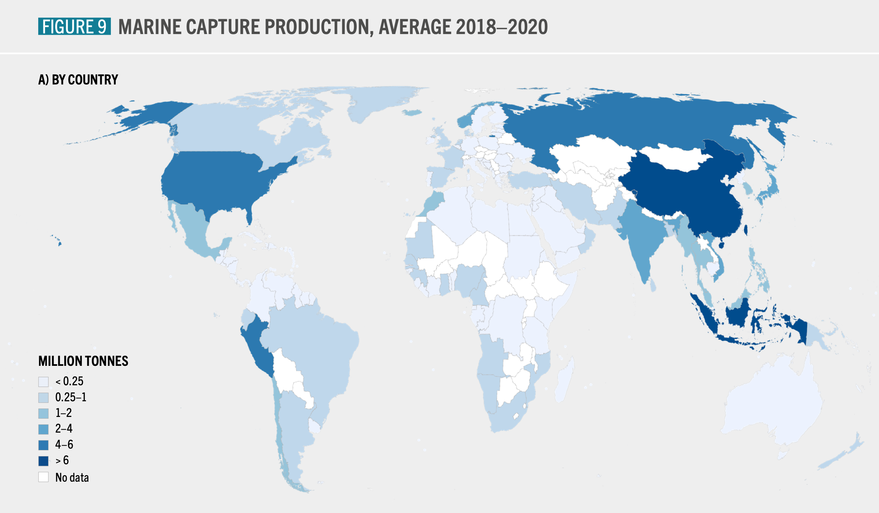
Marine Capture Fisheries, Average 2018–2020
Image source: FAO. (2022). Figure 9. Marine capture production, average 2018–2020 [Chart]. The state of world fisheries and aquaculture 2022. Towards blue transformation. Food and Agriculture Organization of the United Nations. https://doi.org/10.4060/cc0461en
Notes:
This slide, the color intensity from least to greatest, shows you the millions of tons of aquatic foods that are caught by different countries around the world.
China and Indonesia produce the most, followed by Russia, the U.S., India and Vietnam. And these combined account for a little less than half of the total marine harvest.
Finfish represent about 85% of the total marine capture, which is largely made up of small forage fish. Forage fish include mackerel and sardines eaten by humans. Most forage fish, however, are ground up for fish oil supplements or turned into fishmeal for livestock feed, pet food, and fertilizer. Ironically, it’s also the key ingredient in the feed manufactured for farmed fish.
Other commonly caught marine fish include cod and tuna.
-----
Graphic
FAO. (2022). The State of World Fisheries and Aquaculture 2022: Towards Blue Transformation. Food and Agriculture Organization of the United Nations. https://openknowledge.fao.org/items/11a4abd8-4e09-4bef-9c12-900fb4605a02

Slide 14
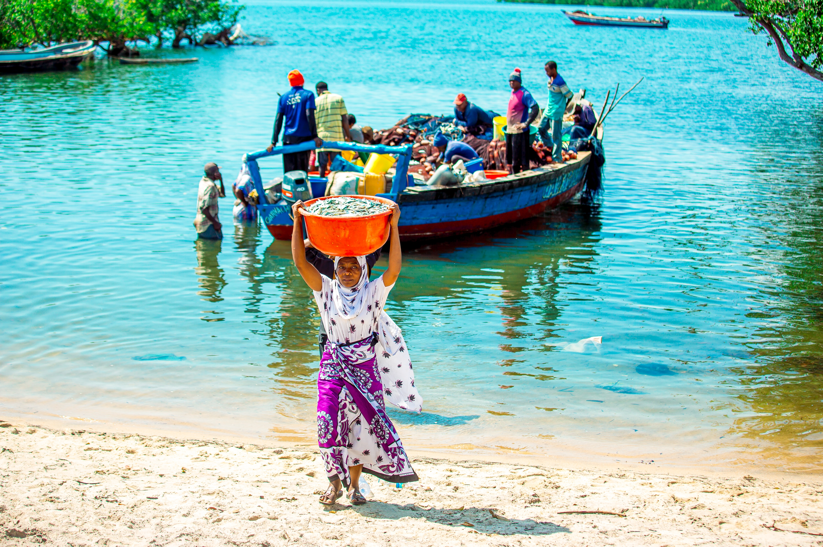
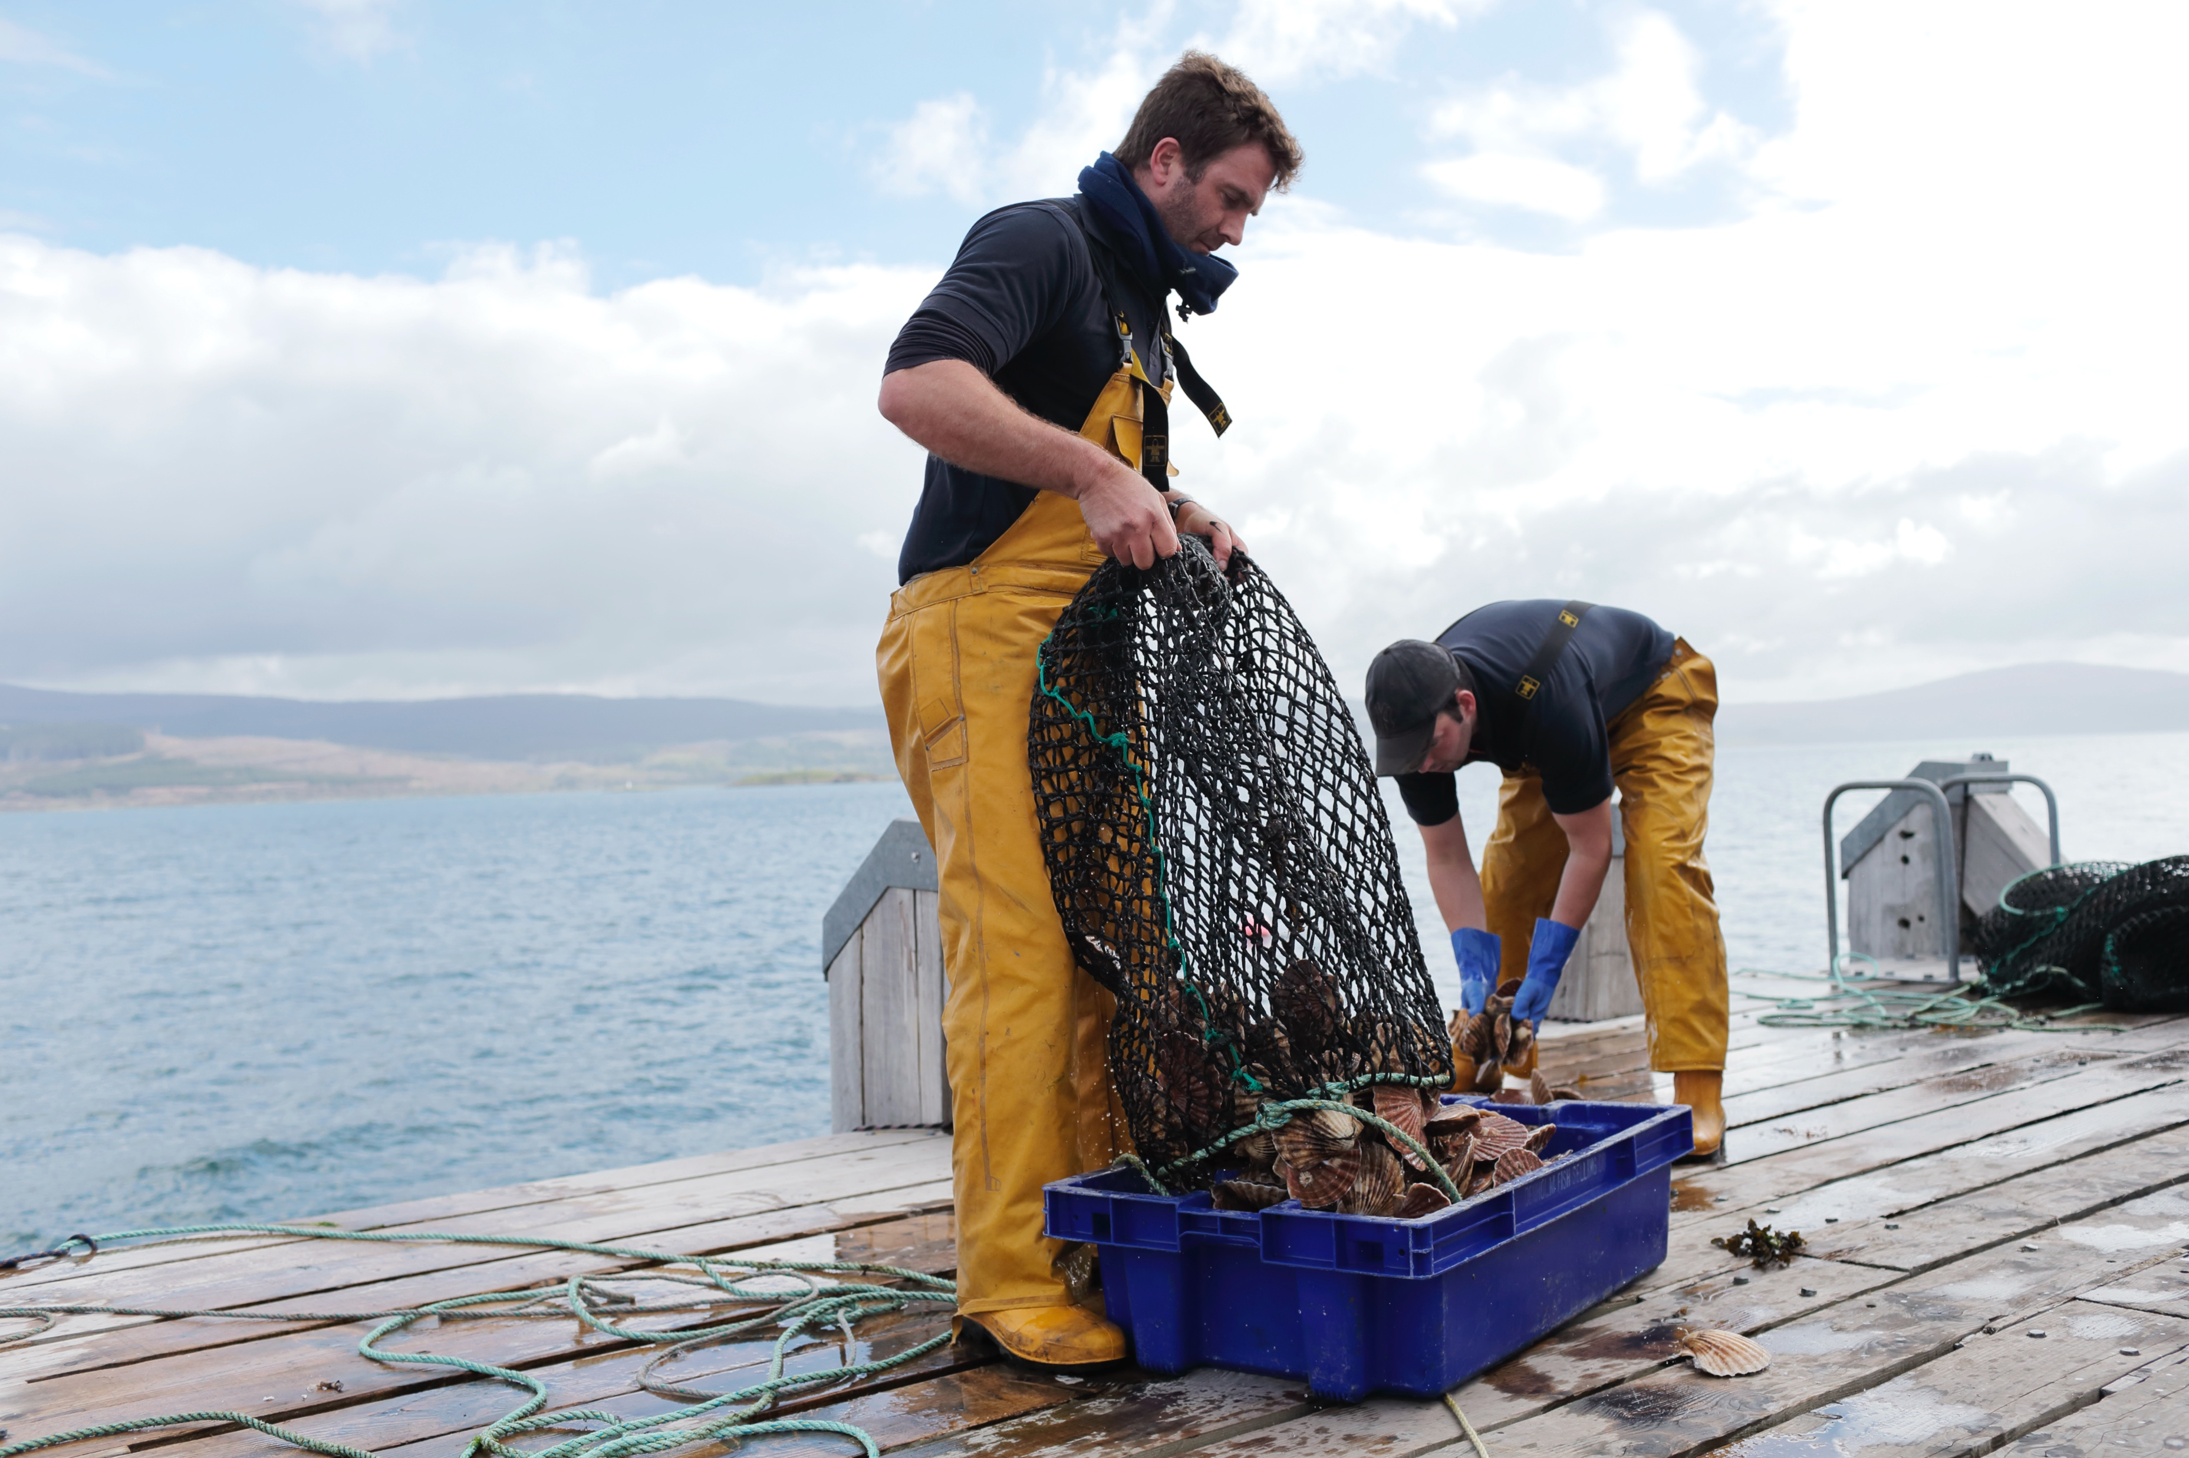
Smaller-Scale Capture Fisheries
Smaller fishing vessels
Shorter trips
Less capital and energy
Important for lower-income countries
Contribute half of the global seafood harvest
Employ 90% of fishing sector
Image sources: Top, Lumwe, Festo. (n.d.). WorldFish. CC BY-NC-ND 2.0. https://flic.kr/p/2qyWCtT; Bottom, Microsoft Stock Images.
Notes:
Like land-based agriculture, seafood production is quite diverse in size and scale, the types of practices that are used, and much of the diversity will be influenced by location, the environment, technology, regulations, and values. Smaller-scale fisheries shown here in this slide are more traditional fisheries that involve fishing households that use a small amount of capital and energy and small fishing vessels. They make short trips out from shore. They can be subsistence – meaning just to feed themselves or their family -- or they might be commercial, selling into local or regional markets, possibly also for export if their catch is grouped with the catch of other small-scale producers. Small-scale is relative, however – depending on the context. Small scale in the US fishing industry is not necessarily small-scale in a lower income country.
Small-scale fisheries are very important part of the global seafood sector and are particularly common across Asia and Africa. They contribute about half of the harvest from global fisheries – yet they employ 90% of people in the fisheries sector. And most fisheries workers live in low-income countries and many small-scale fishing communities experience high levels of poverty and food insecurity.

Slide 15
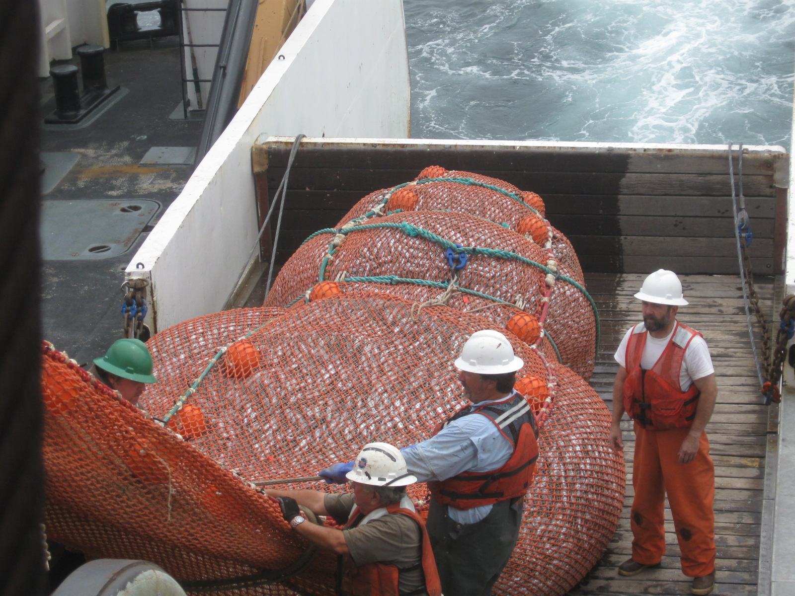
Larger-Scale Capture Fisheries
Larger boats, travel further and stay out to sea longer
More technology and energy
Include catcher-processor vessels
Image source: NOAA. (2010). A full cod end of the trawl on deck. https://www.noaa.gov/media/digital-collections-photo/fis00508jpg
Notes:
Larger scale or industrial operations use much larger and more expensive boats and fleets that rely on more sophisticated technology and use more energy. They spend longer periods of time on the water, sometimes weeks or more. There are even catcher-processor vessels where the fish are caught and processed and frozen aboard. Sometimes other vessels come remove the catch to transport back to the port and refresh supplies and gear, allowing some fishing fleets and crew to stay out for many months at a time. We’ll talk about some of the human rights implications of this in a later section of this talk.

Slide 16
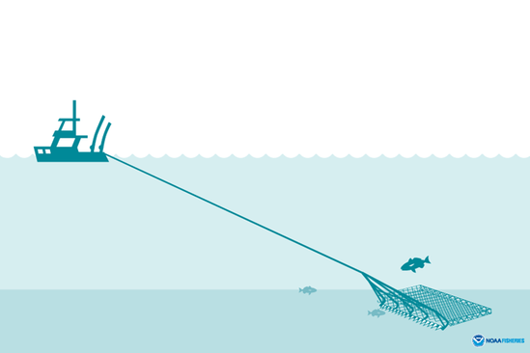
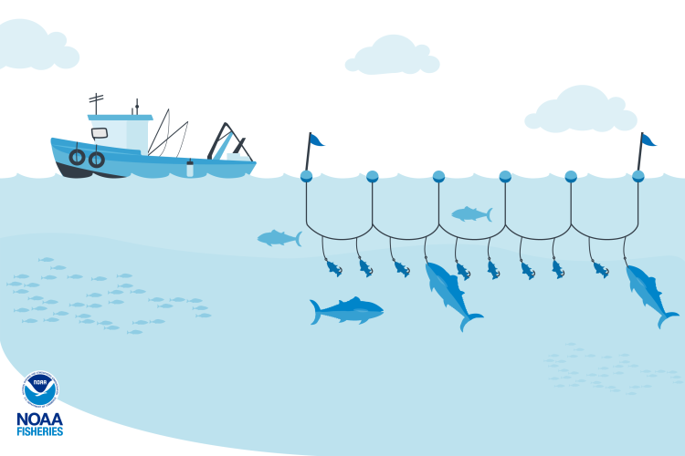
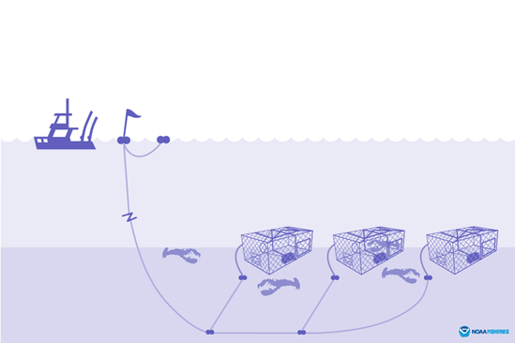
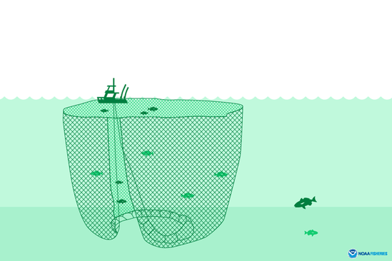
Common Commercial Fishing Techniques
A. Dredge (Raking the seabed floor)
B. Longline (Baited hooks trailing boat)
C. Pots and traps (For crustaceans)
D. Purse seine (For schools of fish)
Image source: NOAA Fisheries. (2022). Fishing gear and risks to protected species. https://www.fisheries.noaa.gov/national/bycatch/fishing-gear-and-risks-protected-species
Notes:
Let’s look briefly at a few of the techniques used to catch large numbers of fish and other aquatic animals.
Image A shows a boat pulling a large rake called a dredge across the sea floor to harvest scallops, oysters, clams, mussels, crabs, sea urchins and conch. The environmental impact of dredging varies depending upon the gear but can be severe in some fisheries. Bottom trawlers, not shown here, are similar to dredges in that they can cause extensive damage to seabed floors.
Image B shows Longline fishing boats trail a line of baited hooks attached to nets. Species such as tuna and swordfish are often targeted using longlines, though they can often unintentionally catch any species looking for a meal, specifically sharks. The average U.S. longline set is 28 miles long. In some areas, there are limits on longline length.
Image C shows stationary traps, or pots used to catch crustaceans such as lobsters and crabs, and eels deeper in the sea. Exclusion devices can be added prevent larger marine animals such as sea lions from accidentally entering the pots or traps.
Large nets, like the purse seine shown in Image D, are used in the open ocean to target dense schools of single-species mid-water fish like tuna, mackerel, or anchoveta. Purse-seine fishing in open water is generally considered to be an efficient form of fishing and targets a single species. Larger mesh sizes allow smaller fish to escape, but not larger marine mammals such as bottlenose dolphins and whales that are not the target species.
-----
Graphics
NOAA Fisheries. (2022). Fishing Gear and Risks to Protected Species. NOAA Fisheries. https://www.fisheries.noaa.gov/national/bycatch/fishing-gear-and-risks-protected-species

Slide 17
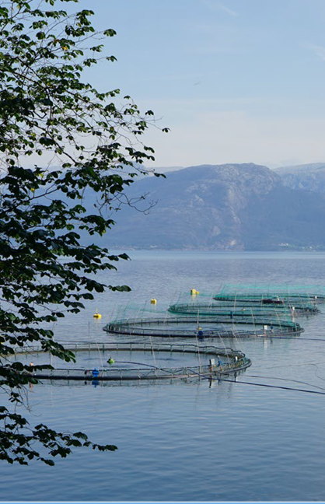
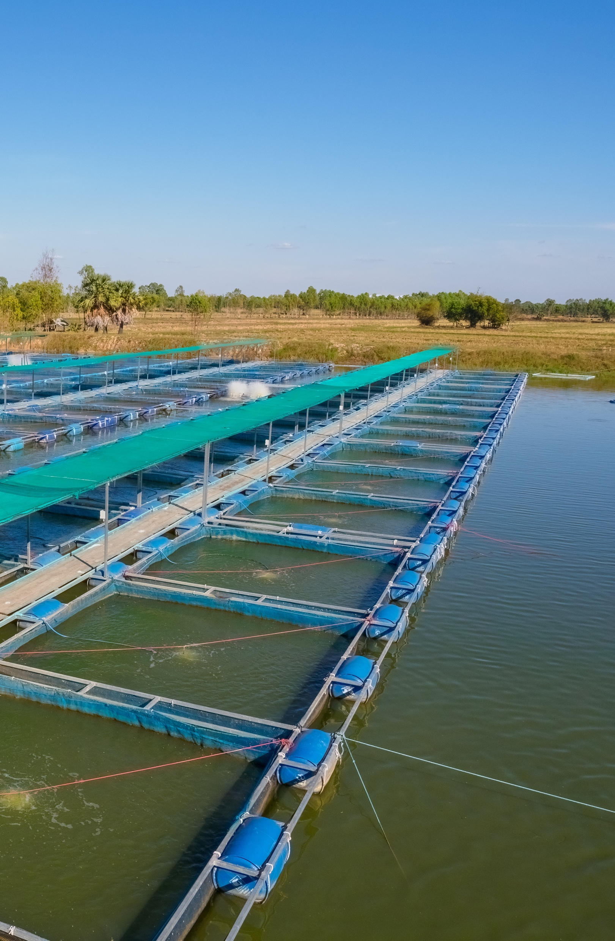
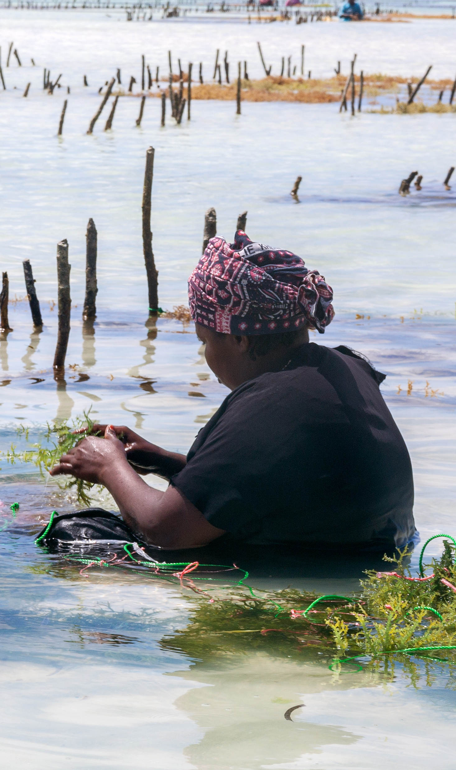
Aquaculture
Diverse in size, scale, methods
Produces 52% of all seafood available for consumption
Predicted to rise to 62% by 2030
Image sources: Left, courtesy of Dave Love, Johns Hopkins Bloomberg School of Public Health; Center and right, Shutterstock.
Notes:
Now let’s talk about Aquaculture. Like capture fisheries, aquaculture can occur at different scales and uses a wide variety of production methods, depending on the species, location, climate, technology and capital available for the operation. You can see some examples in this slide.
The photo on the left shows net pen Atlantic salmon aquaculture. These types of farms are found primarily in Norway, Chile, the Faroe Islands, and Canada. Farmed Atlantic salmon make up 90% of all salmon sales in the US, which come from farms just like the one in the photo. There are a few drawbacks of net pen aquaculture— the waste and uneaten feed sink to the bottom and can pollute waterways, some farmed fish escape, which weakens the genetics of wild fish, and any antimicrobials, antifungals or chemicals used in the farm can spread in the environment.
On the top, left is a kelp farm in Tanzania. Seaweed production is associated with numerous ecological benefits, such as habitat creation and carbon sequestration, while also serving as a valuable resource for food, biofuels and cosmetics.
On the bottom right is a typical freshwater pond cage system, which is common in warmer climates. Tilapia, catfish, trout, and carp and often grown in these types of systems. These systems have some of the same risks as marine net pen systems common in salmon aquaculture.

Slide 18
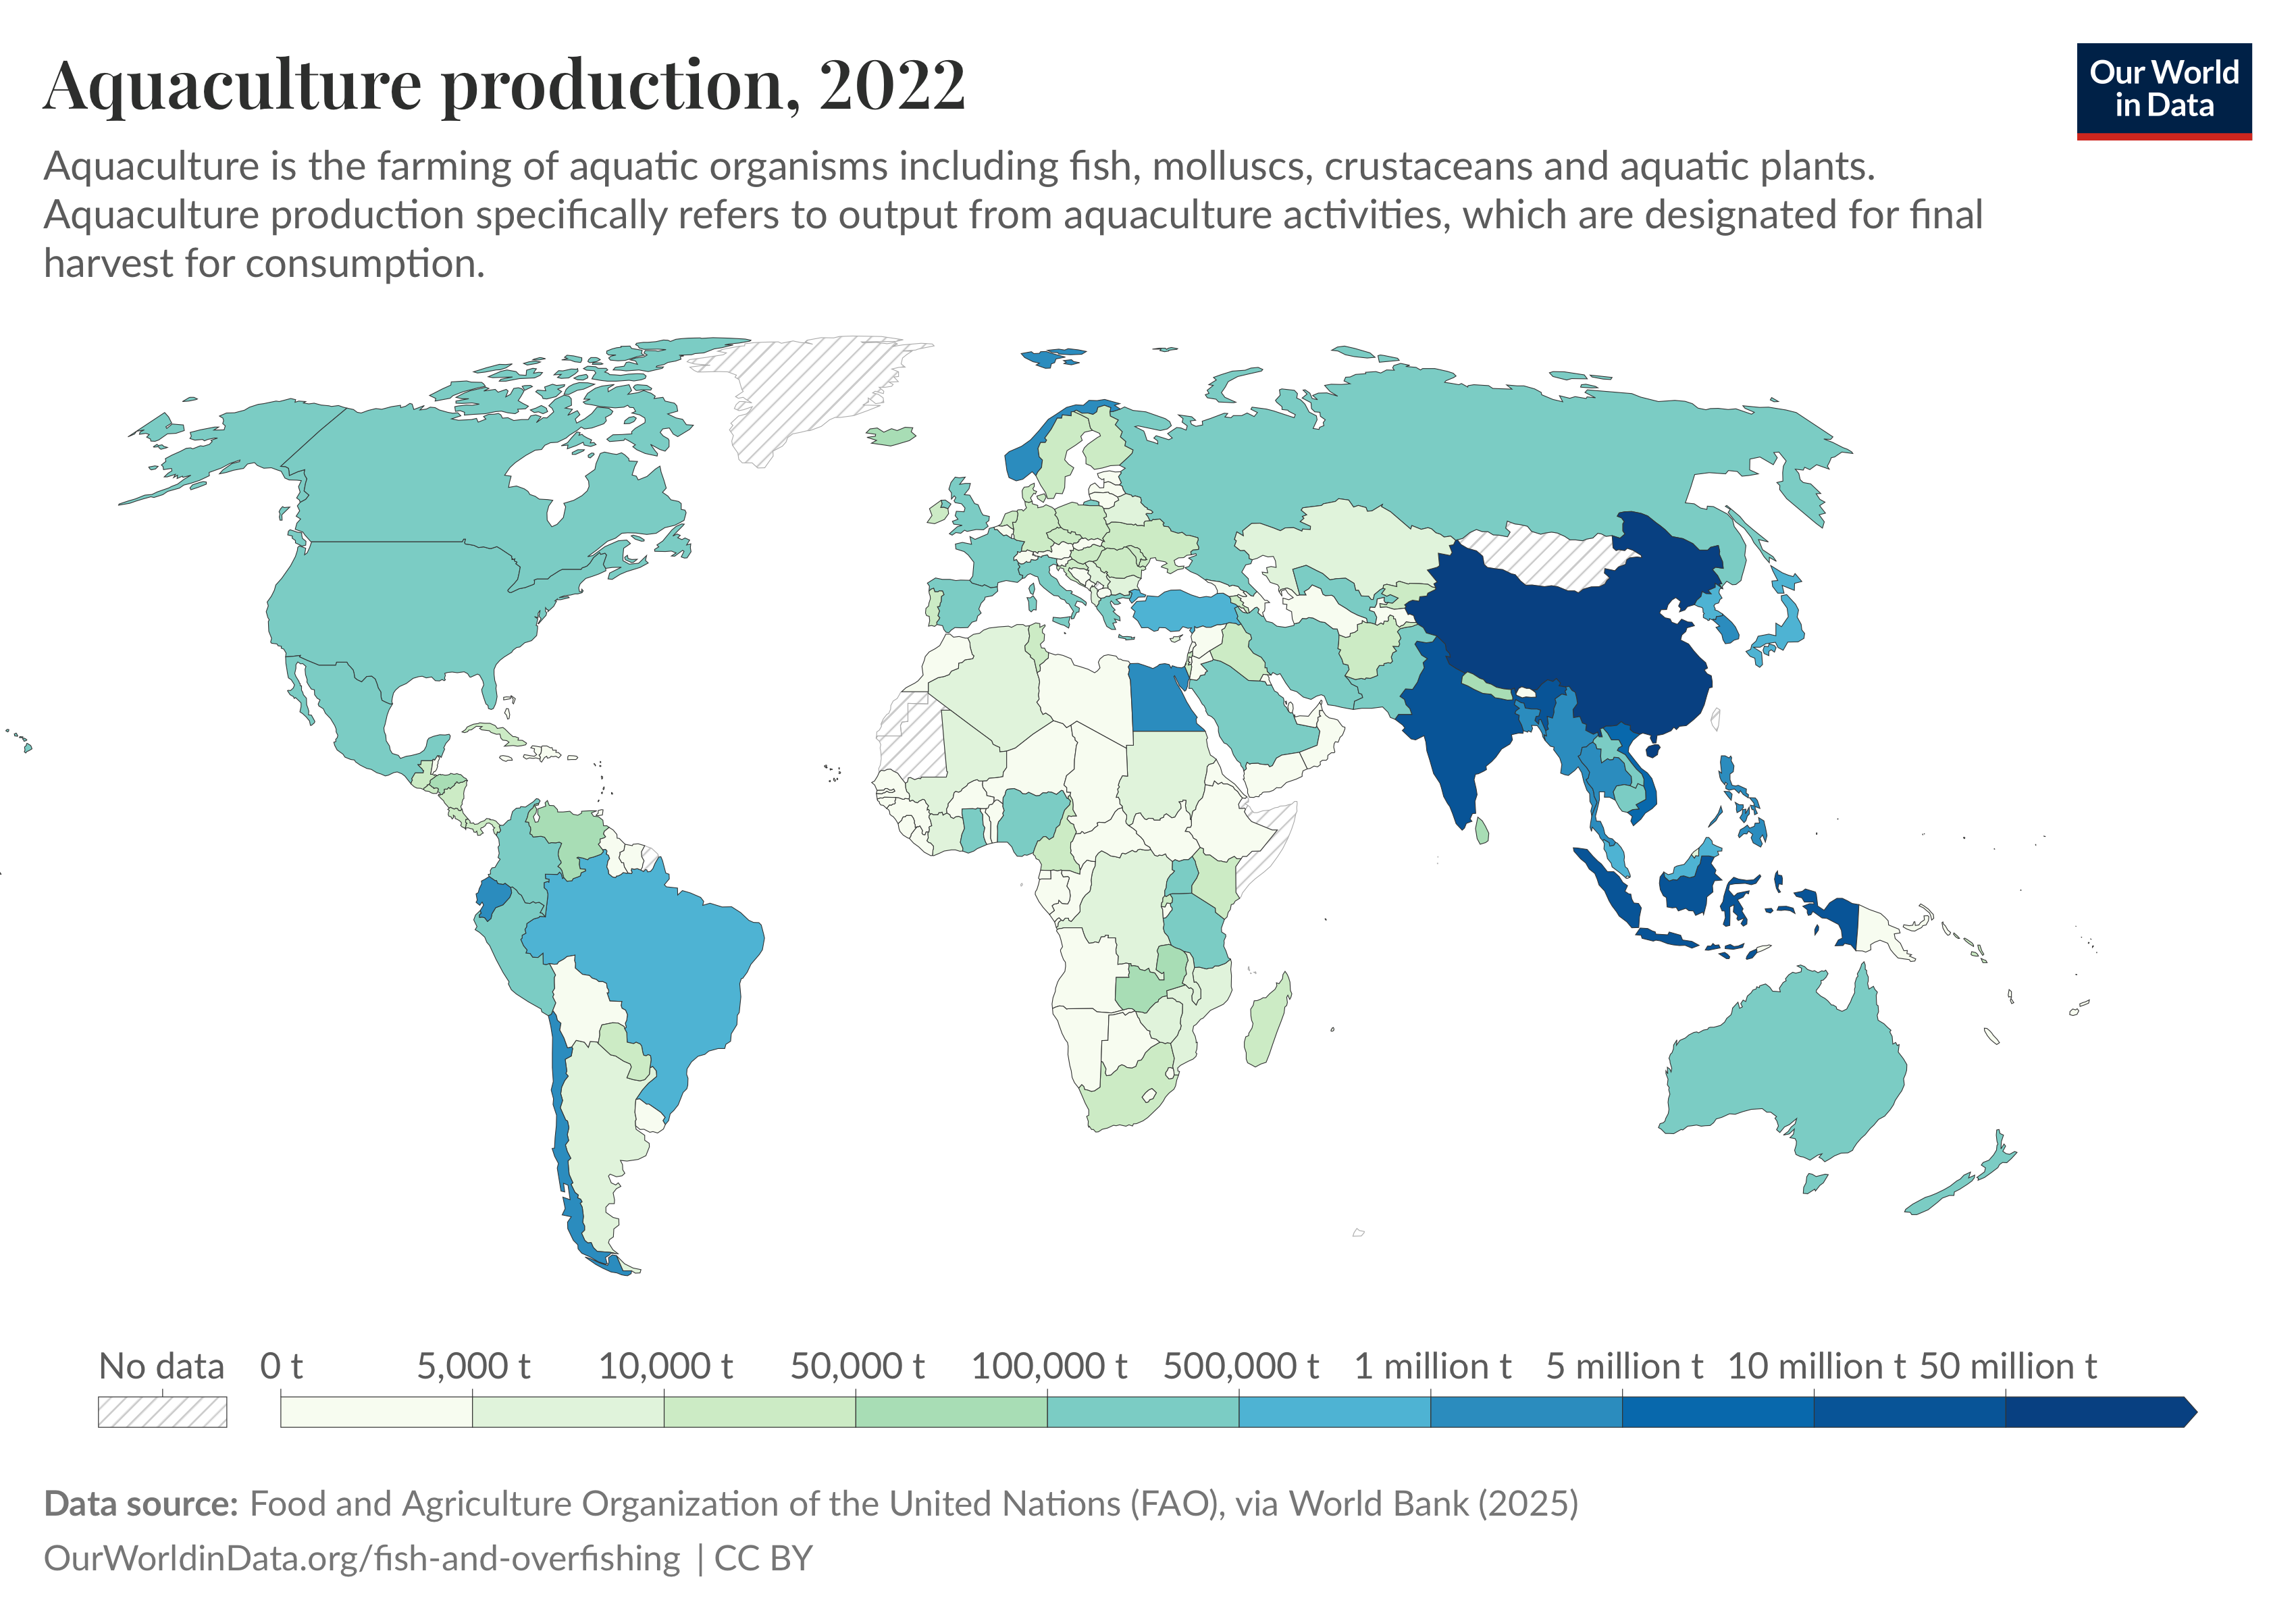
Aquaculture Production by Country, 2022
Image source: Our World in Data. (2025). Aquaculture production. https://ourworldindata.org/grapher/aquaculture-farmed-fish-production?tab=map
Notes:
Similar to wild capture fisheries, Asia dominates in aquaculture production. About 90% of all aquaculture production occurs in Southeast Asia, and particularly China. Aquaculture has made fish more available and more affordable for many regions, leading to improved nutrition and food security. Almost all the growth in aquaculture is expected to come from Asia though aquaculture is also growing rapidly in Africa.
-----
Graphic
Our World in Data. (2025). Aquaculture production. Our World in Data. https://ourworldindata.org/grapher/aquaculture-farmed-fish-production?tab=map

Slide 19
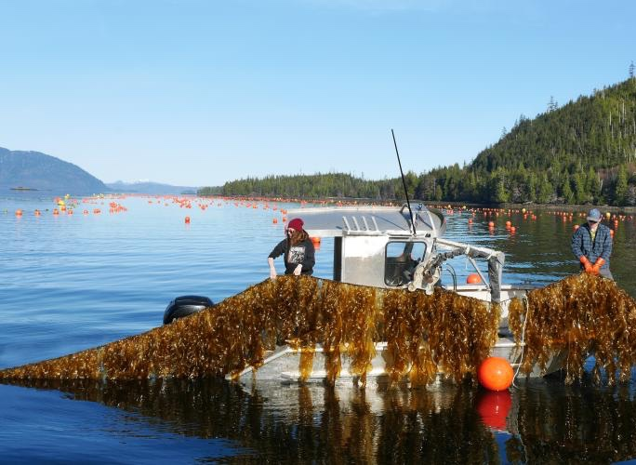
Aquaculture in the United States
Small compared to Asia but growing rapidly
Valued at almost $2 billion (2023)
Top production: Mississippi, Washington, Louisiana, Florida, Alabama
Species include catfish, oysters, trout, tilapia, clams, Atlantic salmon, kelp
Sources: USDA National Agriculture Statistics Service. (2024). 2023 Census of aquaculture. https://www.nass.usda.gov/Publications/AgCensus/2022/Online_Resources/Aquaculture/index.php; USDA National Agriculture Statistics Service. (2024). USDA releases the 2023 census of aquaculture results. https://www.nass.usda.gov/Newsroom/2024/12-16-2024.php; Image is from NOAA Fisheries/Jordan Hollarsmith.
Notes:
The U.S. aquaculture industry is quite small compared to Asia, but it’s also experiencing significant growth. The industry was worth almost $2 billion in 2023. Five states—Mississippi, Washington, Louisiana, Florida, and Alabama—accounted for over half of all aquaculture sales. Catfish, oysters, trout, tilapia, clams, Atlantic salmon and kelp are some of the most commonly produced aquaculture species in the U.S.
-----
Data
USDA National Agriculture Statistics Service. (2024). 2023 Census of Aquaculture. USDA NASS. https://www.nass.usda.gov/Publications/AgCensus/2022/Online_Resources/Aquaculture/index.php
USDA National Agriculture Statistics Service. (2024). USDA Releases the 2023 Census of Aquaculture Results. USDA NASS. https://www.nass.usda.gov/Newsroom/2024/12-16-2024.php

Slide 20
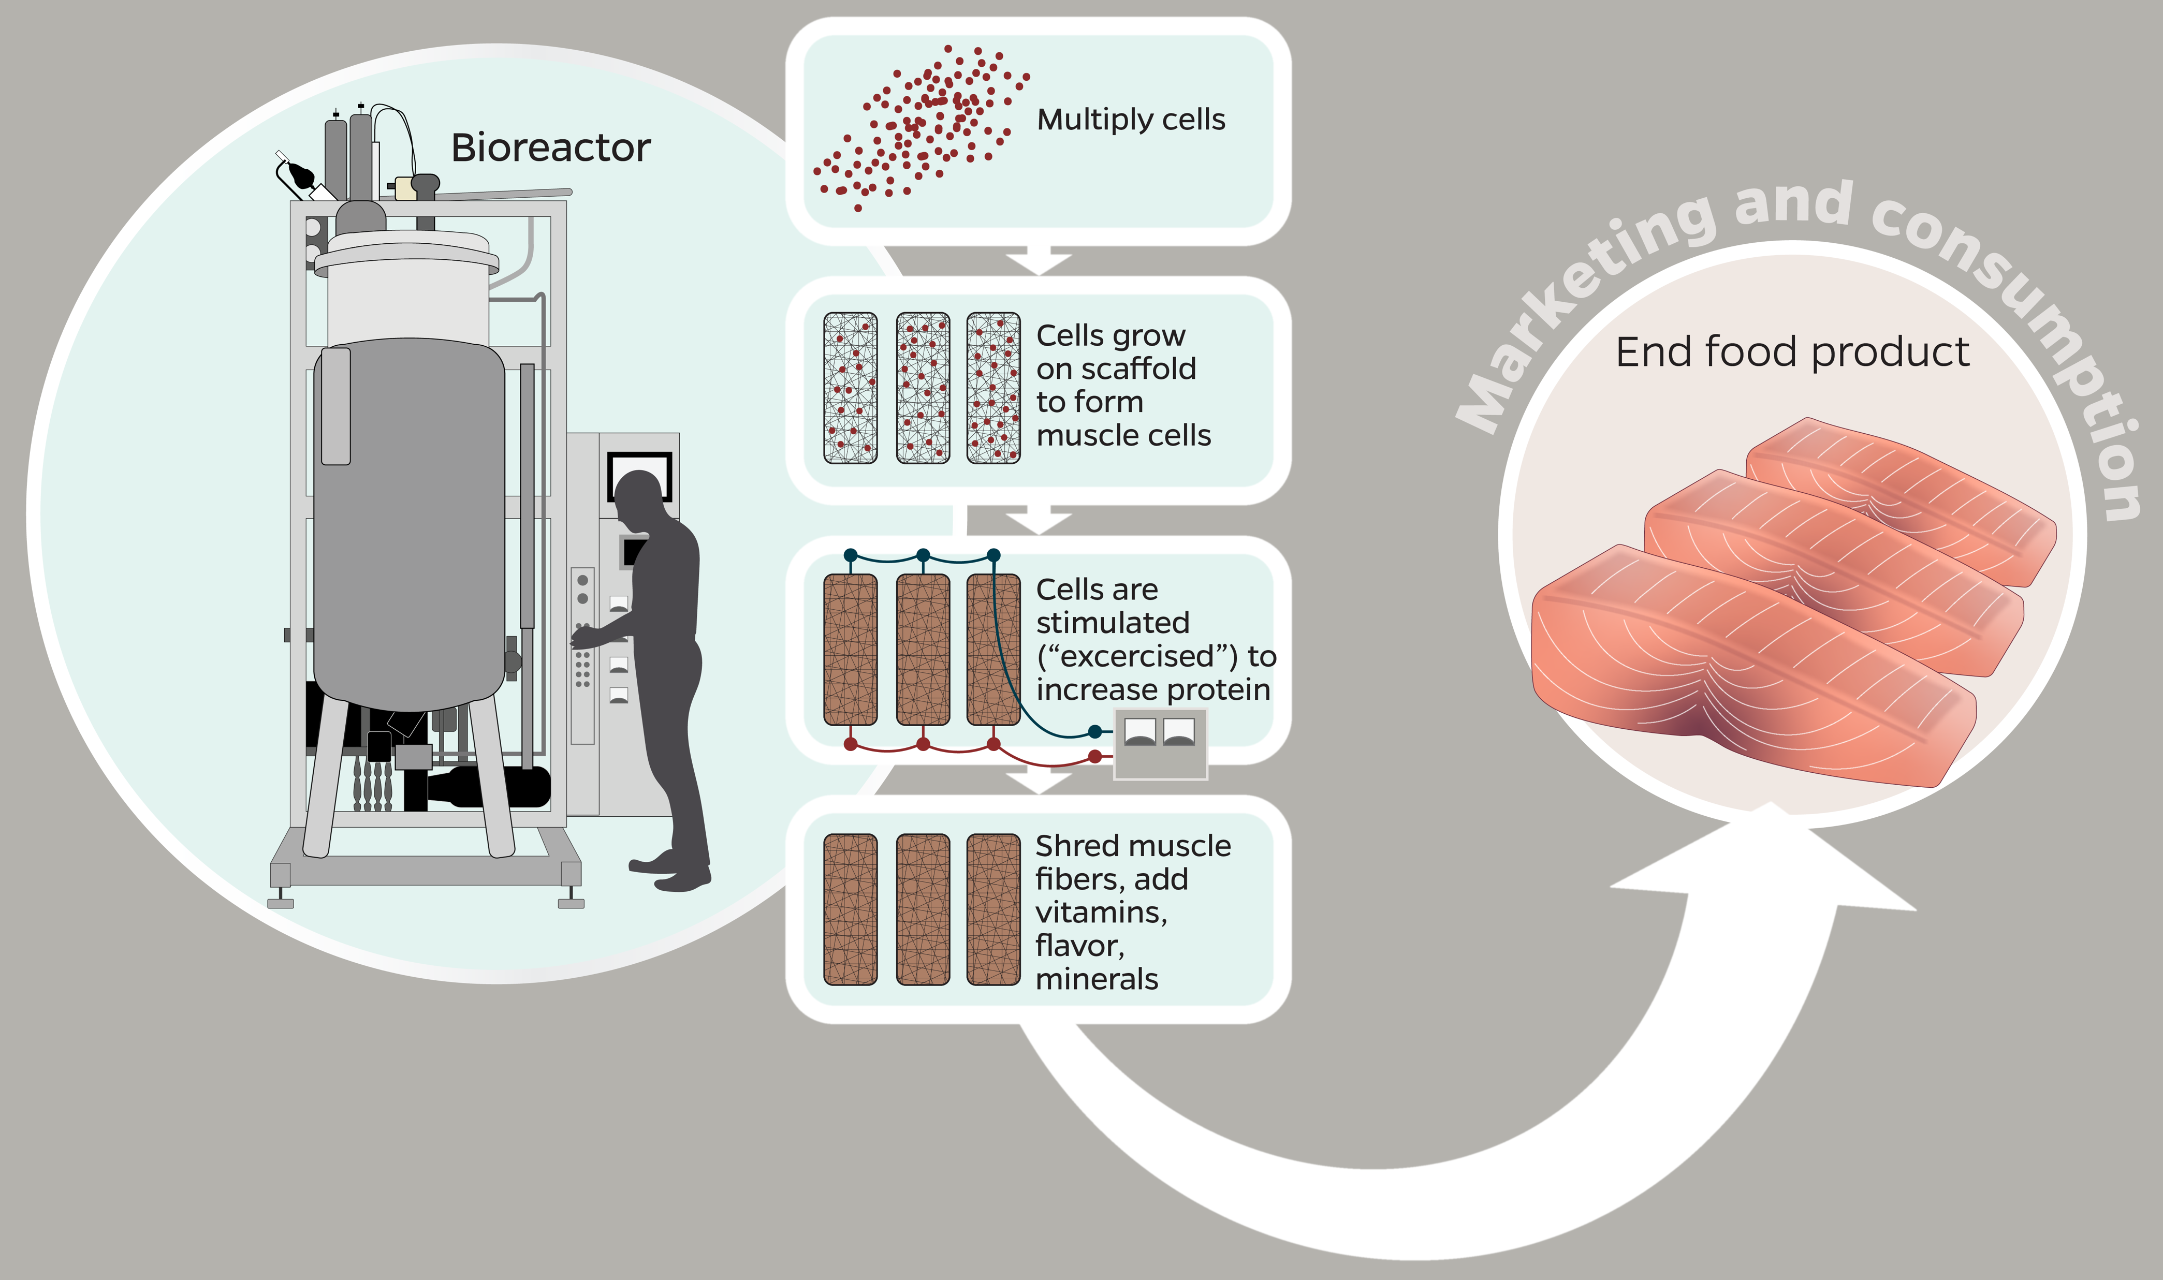
Cell-Based Seafood Production
Sources: Food and Agriculture Organization of the United Nations. (2022). The pros and cons of cell-cultured seafood. https://openknowledge.fao.org/server/api/core/bitstreams/a6a1fedf-f368-479c-b143-58cbcdd095e7/content
Image source: Johns Hopkins Center for a Livable Future.
Notes:
Though cell-cultured seafood is not yet widely available, it may be coming to a restaurant or store near you. Cell-cultured or cell-based meat is a new technology that uses real cells from animals to grow meat in labs, rather than growing and killing the animals for their meat. Like all cell-based meats, the technology is very new and is not being done on a wide-scale. However, it is a potentially promising technology with huge implications.
We will not cover cell-based seafood more than that in this module, but we will provide resources for you to explore this on your own and consider what the benefits and risks of this growing technology might be for consumers, for the fishing industry and the communities that rely on fish for their nutritional needs.
-----
Information
FAO. (2022). The pros and cons of cell-cultured seafood. Food and Agriculture Organization of the United Nations. https://openknowledge.fao.org/server/api/core/bitstreams/a6a1fedf-f368-479c-b143-58cbcdd095e7/content

Slide 21
Section B: Sustainability Challenges in the Seafood Sector
Notes:
How sustainable are aquatic foods? Like most foods, that’s a complicated answer. Let’s take a closer look…

Slide 22
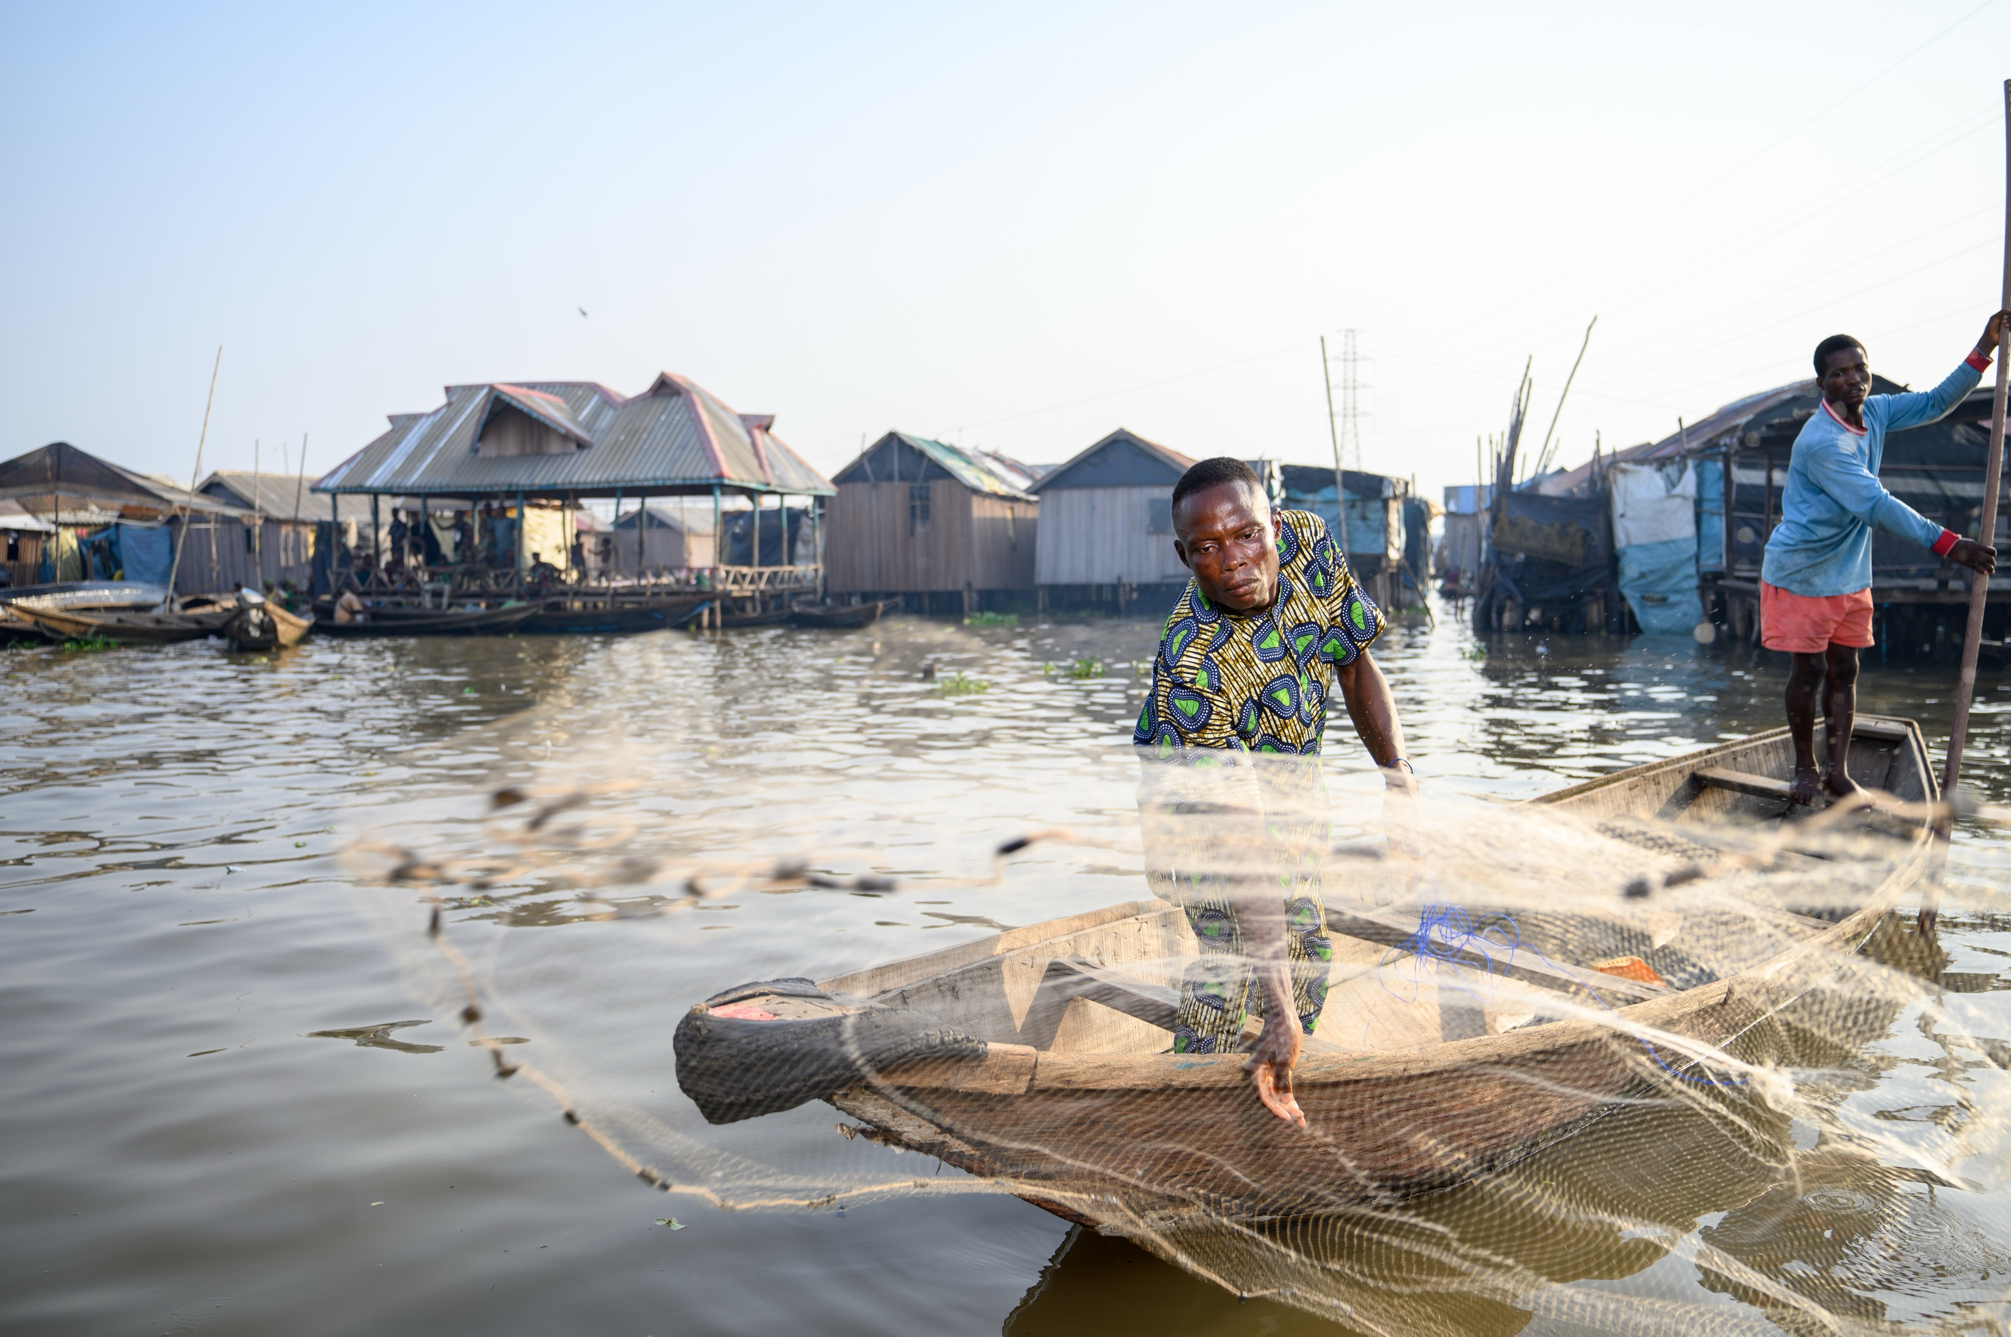
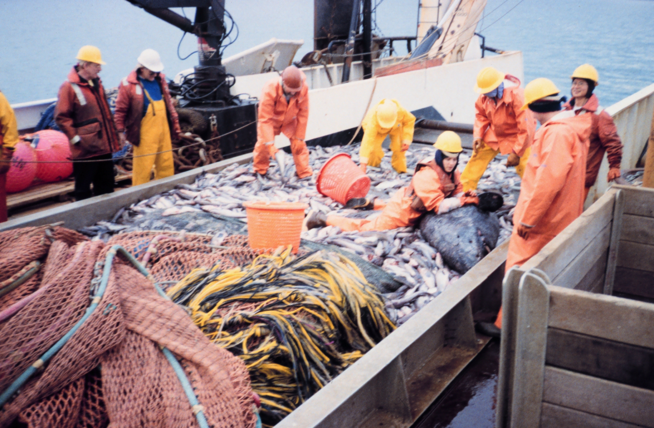
Sustainability Challenges in the Seafood Sector
Governance of vast oceans
Globalization and trade
Mislabeling, fraud, food safety
Illegal fishing, bycatch/discards
Occupational health and human trafficking
Aquaculture challenges
Climate and Water Impacts
Microplastic pollution
Image sources: Top, Shutterstock. Bottom, NOAA/Allen M. Shimada.
Notes:
There are many challenges related to the sustainability of the global seafood sector. In this section we’ll discuss some that are specifically tied to public health. These include governance of our vast oceans, globalization and trade; mislabeling, fraud and food safety; illegal fishing, bycatch and discards of non-target species; occupational health and human rights abuses, challenges specific to the intensive farming of fish, climate and water impacts, and microplastic pollution of our oceans and freshwater bodies.

Slide 23
Why Aquatic Resource Governance Is Complex
Oceans are interconnected and cover 70% of the planet
Beyond 200 nautical miles from a nation’s coastline, the ocean and its resources are owned by everyone (and no one)
Fish stocks migrate and some have higher rates of overfishing or illegal fishing, making management difficult
Inland and marine aquaculture can involve many resource users and pose resource conflict challenges
Source: NOAA Fisheries. (2012). Fish stock assessment 101 series: Part 1—Data required for assessing U.S. fish stocks (National). https://www.fisheries.noaa.gov/feature-story/fish-stock-assessment-101-series-part-1-data-required-assessing-us-fish-stocks
Notes:
First, let’s talk about aquatic resource governance because it’s one of the drivers of the other challenges we’ll talk about.
Fisheries are better managed today than in the past 50 years, yet, there are still significant challenges in governing and managing both the oceans and inland waterways.
Our oceans are a vast, interconnected resource. They cover 70% of the planet, and almost all of the water on this planet is found in our oceans.
Countries govern their own coastlines and about 200 nautical miles from their coastline. These are called a country’s “exclusive economic zone”. The high seas, the area beyond exclusive economic zones, are owned by everyone and no one at the same time.
Governing resources like fish stocks is very difficult because it is hard to accurately count and measure this resource. Fish stocks migrate and move around. Overfishing and illegal fishing makes accurate measurement even more complicated.. Climate change is also affecting fish populations and where they have historically been located.
In the case of aquaculture, especially inland operations, upstream and downstream users of a water body, like the vast Mekong River delta, may not always communicate and govern the resource collectively, which creates a lot of challenges and potential conflict.
Having large numbers of participants sharing a resource, like the oceans and inland waterways will always be a challenge to develop and agree on rules, and enforcement.
-----
Data
NOAA Fisheries. (2012). Fish Stock Assessment 101 Series: Part 1—Data Required for Assessing U.S. Fish Stocks (National). NOAA Fisheries. https://www.fisheries.noaa.gov/feature-story/fish-stock-assessment-101-series-part-1-data-required-assessing-us-fish-stocks

Slide 24
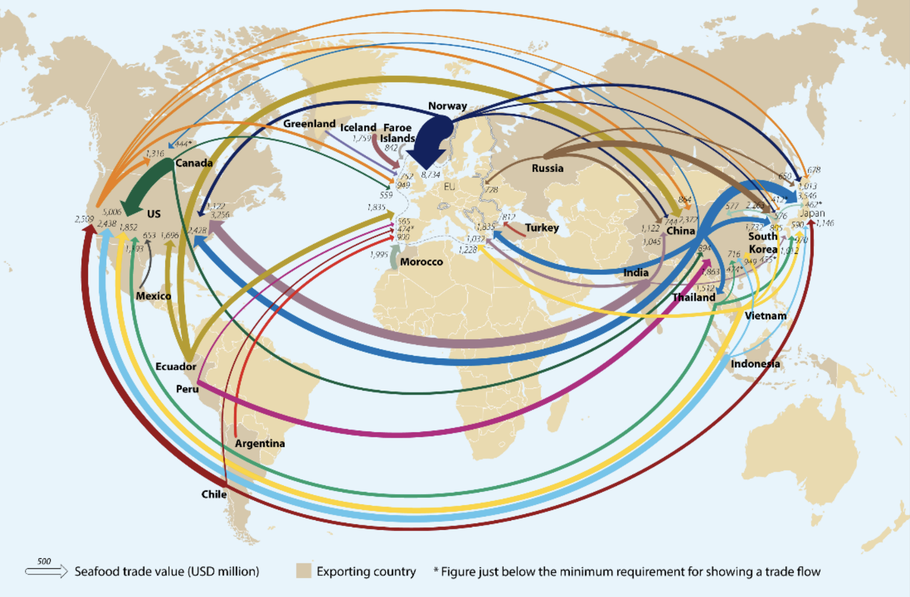
Global Seafood Trade
Source: Holland, J. (May 23, 2022.) Rabobank: Global seafood trade value rebounds to USD 164 billion. https://www.seafoodsource.com/news/supply-trade/rabobank-global-seafood-trade-value-rebounds-to-usd-164-billion
Image source: CFSI Staff. (2022). Global seafood trade value rebounds to USD 164 billion. California Fisheries and Seafood Institute. https://calseafood.net/2022/05/23/global-seafood-trade-value-rebounds-to-usd-164-billion
Notes:
Another huge challenge with the seafood sector is that seafood is one of the most highly traded food commodities. This map shows you trade pathways for seafood. The thicker size indicates more trades happening. China the largest producer of seafood and it's also the top seafood importer and exporter.
Approximately 38% of seafood that is caught or produced in aquaculture is traded internationally. Global seafood trade was valued at about $164 billion US in 2018 and accounts for approximately 11% of global agricultural exports and 1% of total global trade. China is the leading exporter, followed by Norway and Viet Nam. The European Union, U.S. and Japan top the list of importing countries.
Between 70-85% of seafood consumed in the U.S. is imported – about half from aquaculture. A significant portion of imported seafood is caught by US fishing fleets but exported overseas for processing and then reimported to the United States.
-----
Graphic
CFSI Staff. (2022). Global seafood trade value rebounds to USD 164 billion. California Fisheries and Seafood Institute. https://calseafood.net/2022/05/23/global-seafood-trade-value-rebounds-to-usd-164-billion/

Slide 25
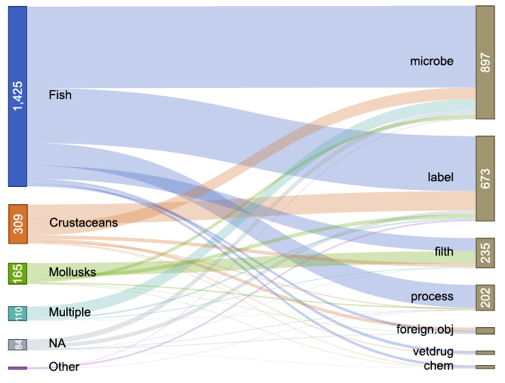
Food Safety
Image source: David C. Love, D. & Nussbaumer, E. (2021). Fig. 6. IFSAC species groups and reason for U.S. seafood recalls [Chart]. Risks shift along seafood supply chains. Global Food Security 28(3):100476. https://doi.org/10.1016/j.gfs.2020.100476
Notes:
Long, globalized supply chains have implications for food safety. Food safety challenges occur at many points along the value chain from catch to plate. In the U.S., hazards are generally identified and managed through three mechanisms: 1) imported food inspection at the port of entry reported to F D A or U S D A; 2) food recalls issued by distributors or retail outlets and reported to the F D A; and 3) food outbreaks tracked by local health departments and reported to the C D C.
This slide shows seafood recalls in the United States from 2003-2019. On the left side are the types of products implicated in recalls and on the right side are the reasons for the recall. The main reason for recalls are the presence of microbes, such as bacteria. Recalls due to "labeling" are for products where seafood is missing from the label, which is a concern for people with seafood allergies.
The riskiest products for consumers are shellfish consumed raw due to Vibrio bacteria or Norovirus, processed seafood such as smoked salmon that can contain Listeria, and tropical or reef fish which can cause scrombriod poisoning due to a toxin.

Slide 26
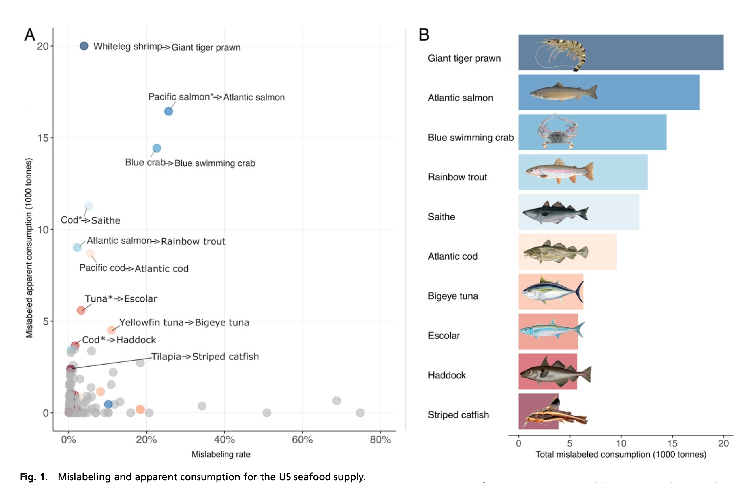
Mislabeling, Fraud, and Traceability
Image source: Kroetz, K., Luque, G. M., Gephart, J. A., Jardine, S. L., Lee, P., Chicojay Moore, K., Cole, C., Steinkruger, A., & Donlan, C. J. (2020). Figure 1. Mislabeling and apparent consumption for the US seafood supply [Chart]. Consequences of seafood mislabeling for marine populations and fisheries management. Proceedings of the National Academy of Sciences of the United States of America, 117(48), 30318–30323. https://doi.org/10.1073/pnas.2003741117
Notes:
Mislabeling and seafood fraud are also symptoms of our global supply chains and a lack of traceability in those supply chains. Most species have very low rates of mislabeling, but there are some outliers, as you can see on the x-axis of the left figure. On the right, after factoring in the amount of seafood consumed, the species with the most consumption of mislabeled items are giant tiger prawns, Atlantic salmon, blue swimming crabs and rainbow trout.
Illegal or fraudulently labelled fish undercuts the legal fishing industry, making it difficult for honest players to compete. One study found that fish laundering results in an economic loss of $26billion to $50billion dollars a year.
But mislabeling also has implications for public health and food safety. Studies conducted by the group Oceana found tilefish mislabeled as red snapper and halibut in New York City, and king mackerel mislabeled as grouper in South Florida. These are two types of fish that are on the FDA’s Do-Not-Eat list for sensitive groups such as pregnant women and children because of their high mercury content.
There are efforts to increase traceability in value chains using new technology, such as blockchain. Trade tracking programs monitor the international trade of some species such as bluefin tuna, swordfish, bigeye tuna, and Chilean sea bass by requiring that imports include documentation of details on catch—such as what gear was used and when and where the fish was caught.
-----
Graphics
Kroetza, K., Luquec, G. M., Gephartd, J. A., Jardinee, S. L., Leeb, P., Chicojay Moore, K., Cole, C., Steinkruger, A., & Donlan, J. C. (2020). Consequences of seafood mislabeling for marine populations and fisheries management. PNAS, 117(48), 30318–30323. https://doi.org/10.1073/pnas.2003741117

Slide 27
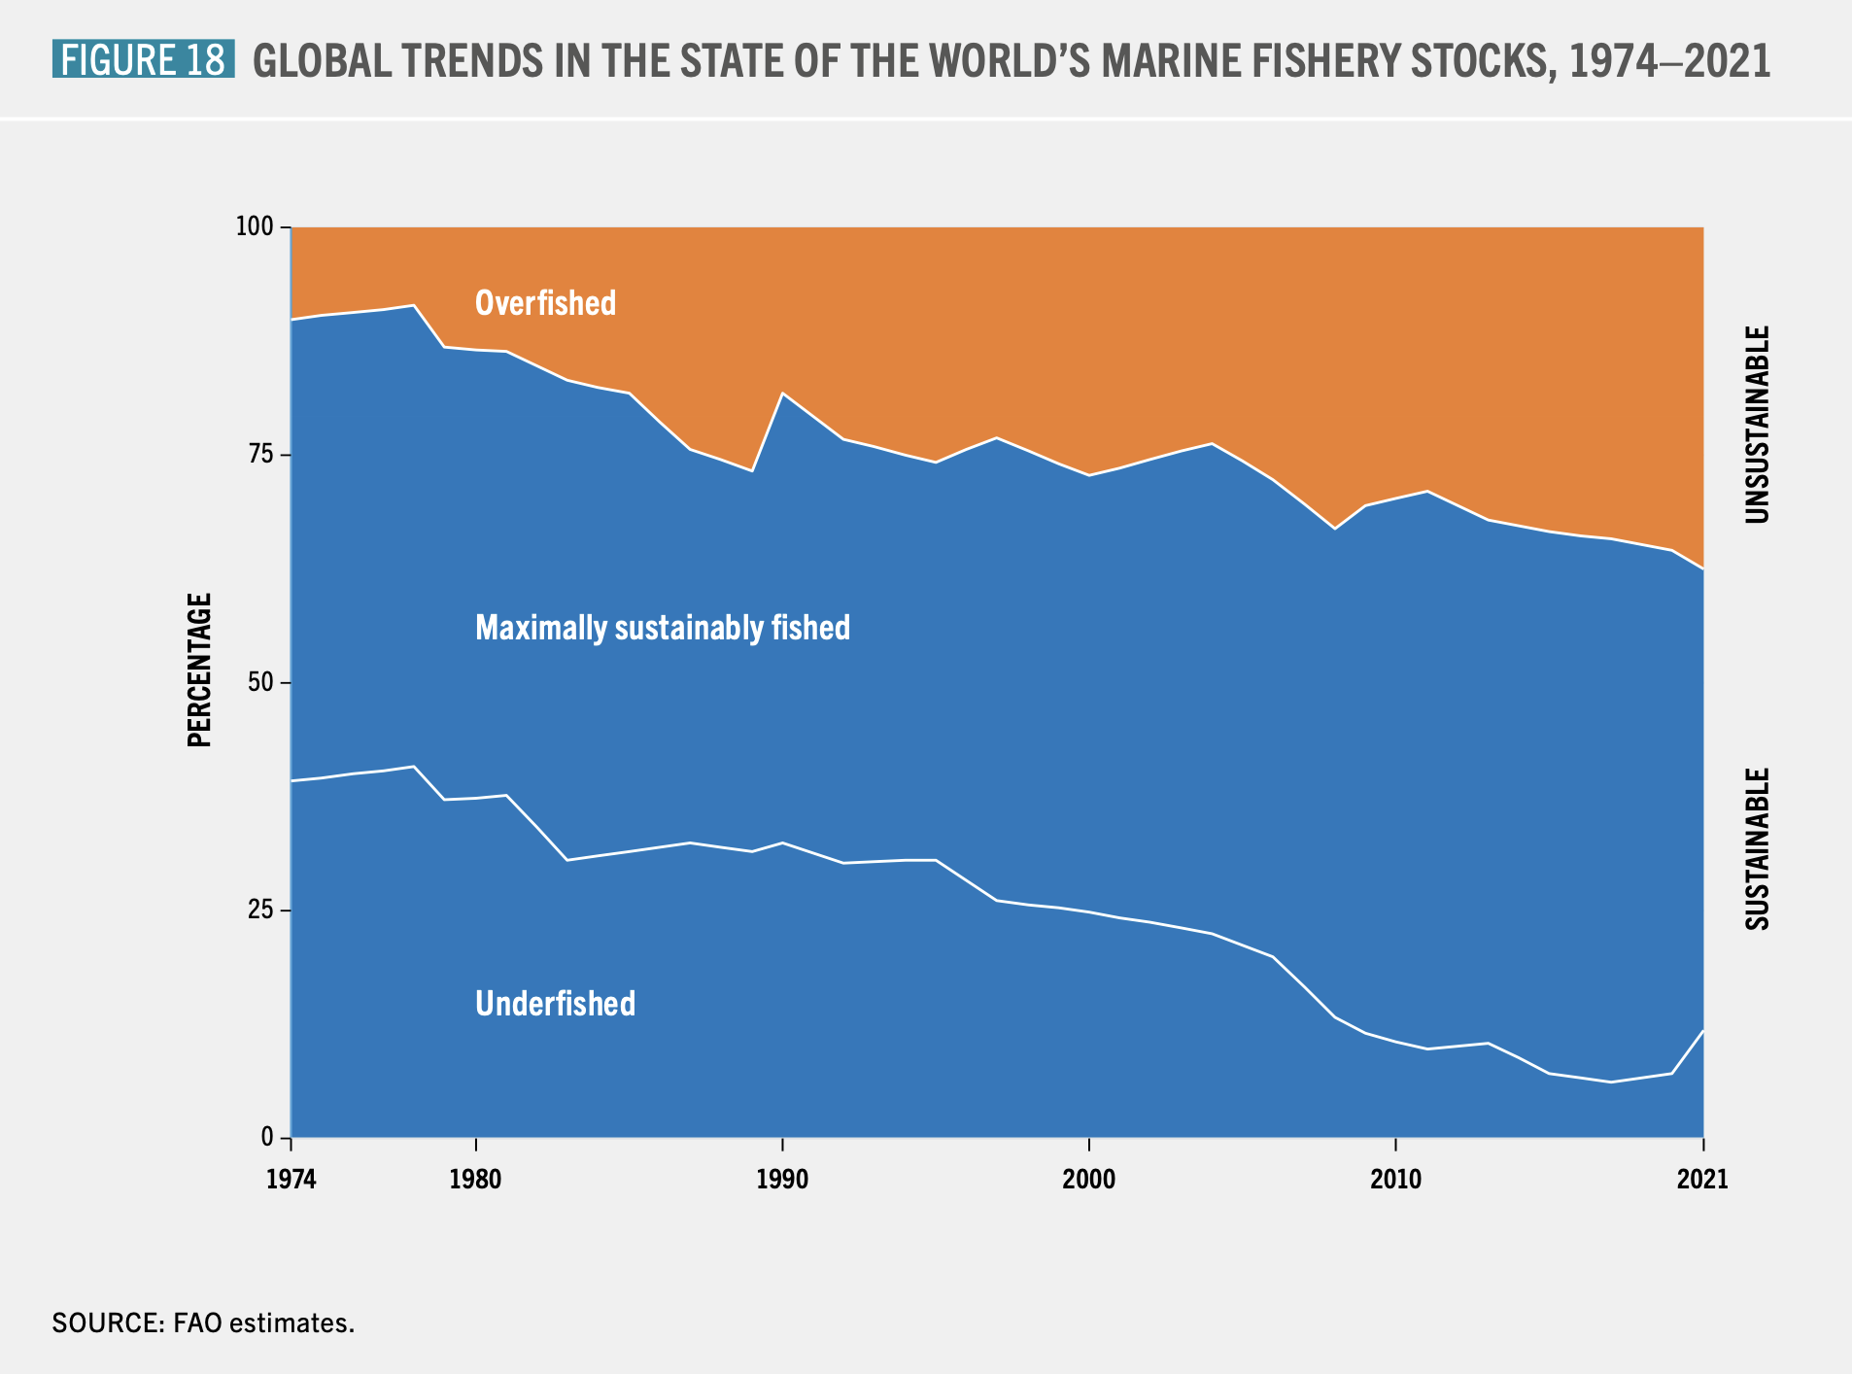
State of the World’s Fisheries
Global Trends in the State of the World’s Marine Fishery Stocks, 1974–2021
Image source: FAO. (2024). Figure 18. Global trends in the state of the world’s marine fishery stocks, 1974–2021 [Chart]. Blue transformation in action. Food and Agriculture Organization of the United Nations. https://doi.org/10.4060/cd0683en
Notes:
Let’s now look at the environmental sustainability of our fisheries. The picture is mixed. According to this data by the FAO, the percentage of fish stocks that are within biologically sustainable levels decreased from 90 percent in 1974 to 62 percent in 2021. Very few fish are considered underfished, and most are fished to the very limits of what has been defined as sustainable. Though that has recently improved just a bit.
However, when sustainability is measured by the WEIGHT of the production – which is not shown here -- the data looks more optimistic, suggesting that the majority of fish that is captured is in fact coming from more sustainable stocks of fish.
-----
Graphic
FAO. (2024). The State of World Fisheries and Aquaculture 2024 – Blue Transformation in Action. Food and Agriculture Organization of the United Nations. https://doi.org/10.4060/cd0683en

Slide 28
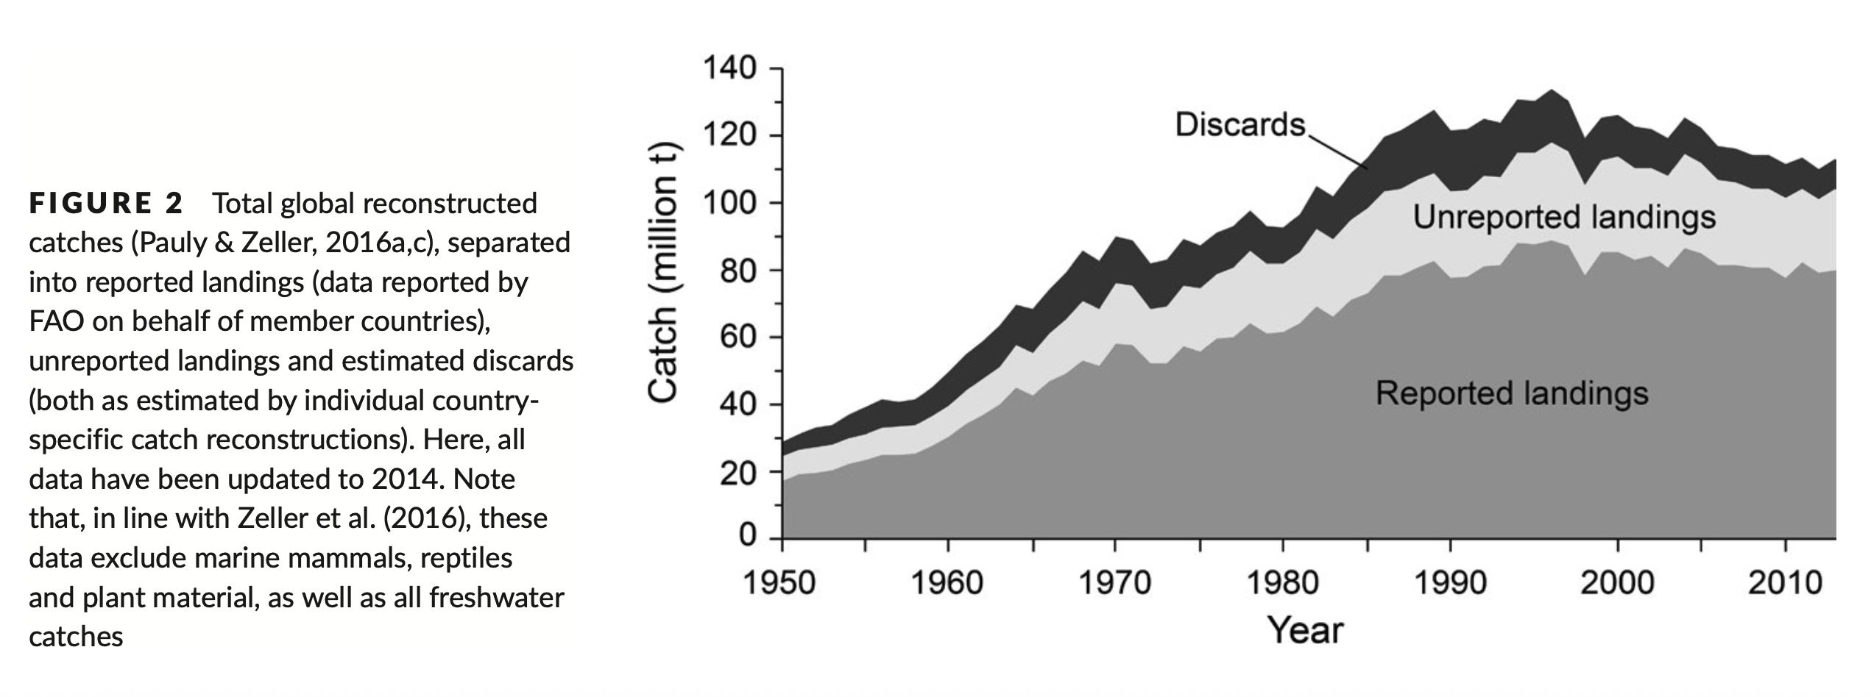
Discards and Unreported Catch in Marine Fisheries: Illegal, Unreported, Unregulated (IUU)
Image source: Zeller, D., Cashion, T., Palomares, M., & Pauly, D. (2017). Figure 2. Total global reconstructed catches separated into reported landings, unreported landings and estimated discards [Chart]. Global marine fisheries discards: A synthesis of reconstructed data. Fish and Fisheries, 9(2), 30–39. https://doi.org/10.1111/faf.12233
Notes:
Measuring and tracking sustainability is complicated and challenging because there is activity that happens out on the open seas that is not easily tracked and recorded. The catch of a fishing fleet can be categorized into fish that are caught and sold (referred to as reported landings in the bottom portion of this graph) and fish that are discarded (the darkest line at the top of the chart). The third category is unreported landings (the middle section of this chart), which goes by the technical term "Illegal, Unreported, and Unregulated" fishing.
IUU fishing includes all fishing that breaks fisheries laws or occurs outside the reach of fisheries laws and regulations. IUU might include fishing in a restricted area, with prohibited gear, over a quota, or fishing prohibited species. IUU undermines national and regional efforts to manage fisheries sustainably, as well as efforts to conserve marine biodiversity.
When estimated volumes of illegal or unreported or unregulated catch are accounted for, the total volume of catch in a given year is likely much higher than what is reported. This has serious implications for fish stock management and ensuring sustainable resource management since stock management cannot easily be based on correct catch estimates.
Fortunately, innovative technology is increasingly used as a tool to prevent illegal, unreported, and unregulated fishing. This includes using satellite data, mapping, observer cameras on board vessels and tracking beacons. And these are all used to better enforce the management tools that we know work.
-----
Graphic
Zeller, D., Cashion, T., Palomares, M., & Pauly, D. (2017). Global marine fisheries discards: A synthesis of reconstructed data. Fish and Fisheries, 9(2), 30–39. https://doi.org/10.1111/faf.12233

Slide 29
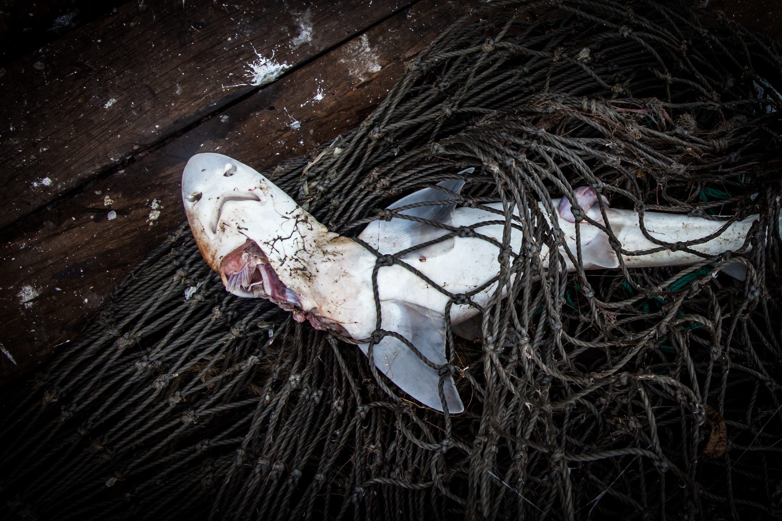
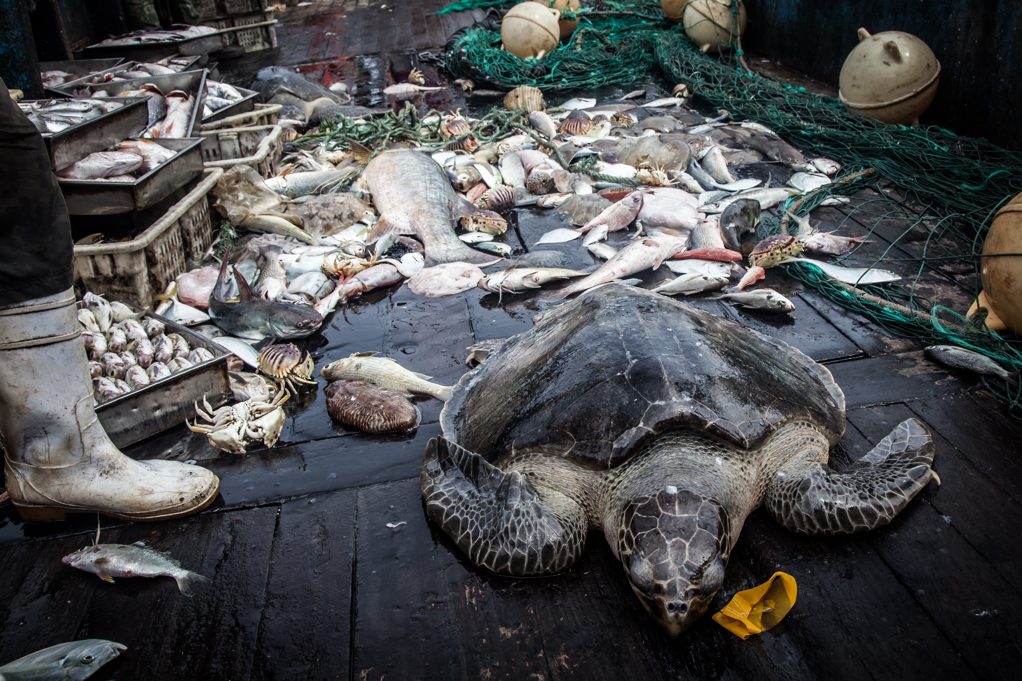
Discarded Seafood: Bycatch
Images source: Shutterstock.
Notes:
Bycatch is another issues related to discarded fish. Many large-scale fishing techniques are highly efficient, catching huge volumes of fish at a time. But they may not be very selective or specific to a single target species. One of the greatest challenges of capture fisheries, besides overfishing, is bycatch. Each year, an estimated 10 million tons of aquatic species are caught or killed that fisheries do not want, cannot sell, or are not allowed to keep.
Bycatch can be fish, but also marine mammals, sea turtles, and seabirds that become hooked or entangled in fishing gear. Larger scale fishing is the leading cause of marine species endangerment and death worldwide. In fact, bycatch is the leading cause of death to small whales, dolphins and other porpoises.

Slide 30
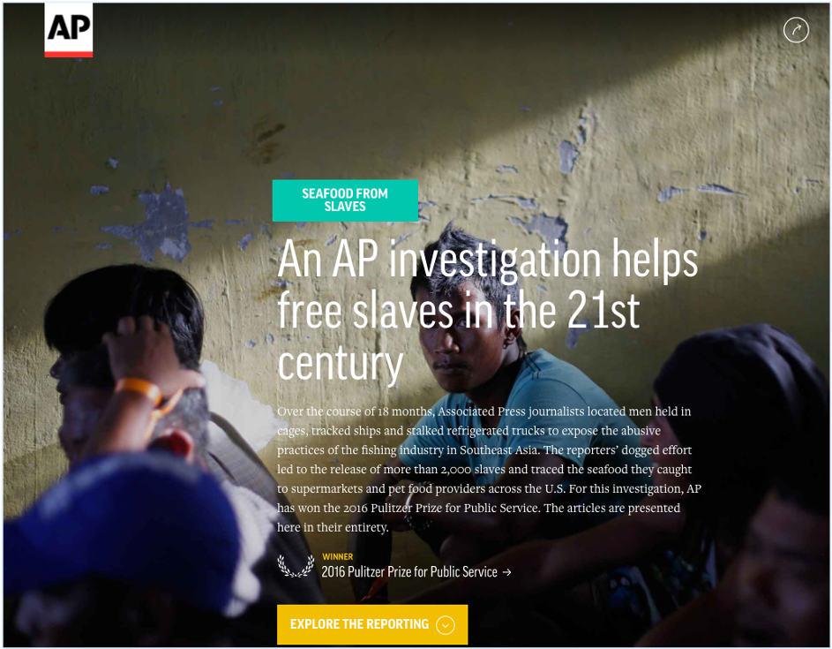
Human Rights Abuses: Closely Tied to Illegal, Unreported, and Unregulated Fishing
Image source: Screenshot of Mendoza, M., McDowell, R., Htusan, E., & Mason, M. (2015). AP Investigation: Are slaves catching the fish you buy? The Associated Press. https://apnews.com/general-news-b9e0fc7155014ba78e07f1a022d90389
Notes:
Human rights abuses have been documented across the seafood sector. The issue of IUU fishing- – Illegal, Unreported and Unregulated - is closely tied with human rights abuses of workers in the seafood sector.
The practice of transshipment in the capture fisheries sector is a driver of this problem. A cargo vessel meets a fishing fleet at sea, especially on the high seas far away from shore. The fishing vessel will offload their fish catch to the cargo ship, and the fishing vessel receives things like additional crew and supplies. This practice creates efficiencies by allowing fishing vessels to stay at sea longer, rather than making multiple trips back to port to unload their catch. However, it also obscures activities like illegal fishing, human trafficking, slavery, drug trades, and other nefarious activities.
Many country-level and international policies have been deployed to address human rights abuses in the seafood supply chains, and it remains a top concern in need of urgent action and resolution.
-----
Information
Mendoza, M., McDowell, R., Htusan, E., & Mason, M. (2015). AP Investigation: Are slaves catching the fish you buy? The Associated Press. https://apnews.com/general-news-b9e0fc7155014ba78e07f1a022d90389

Slide 31
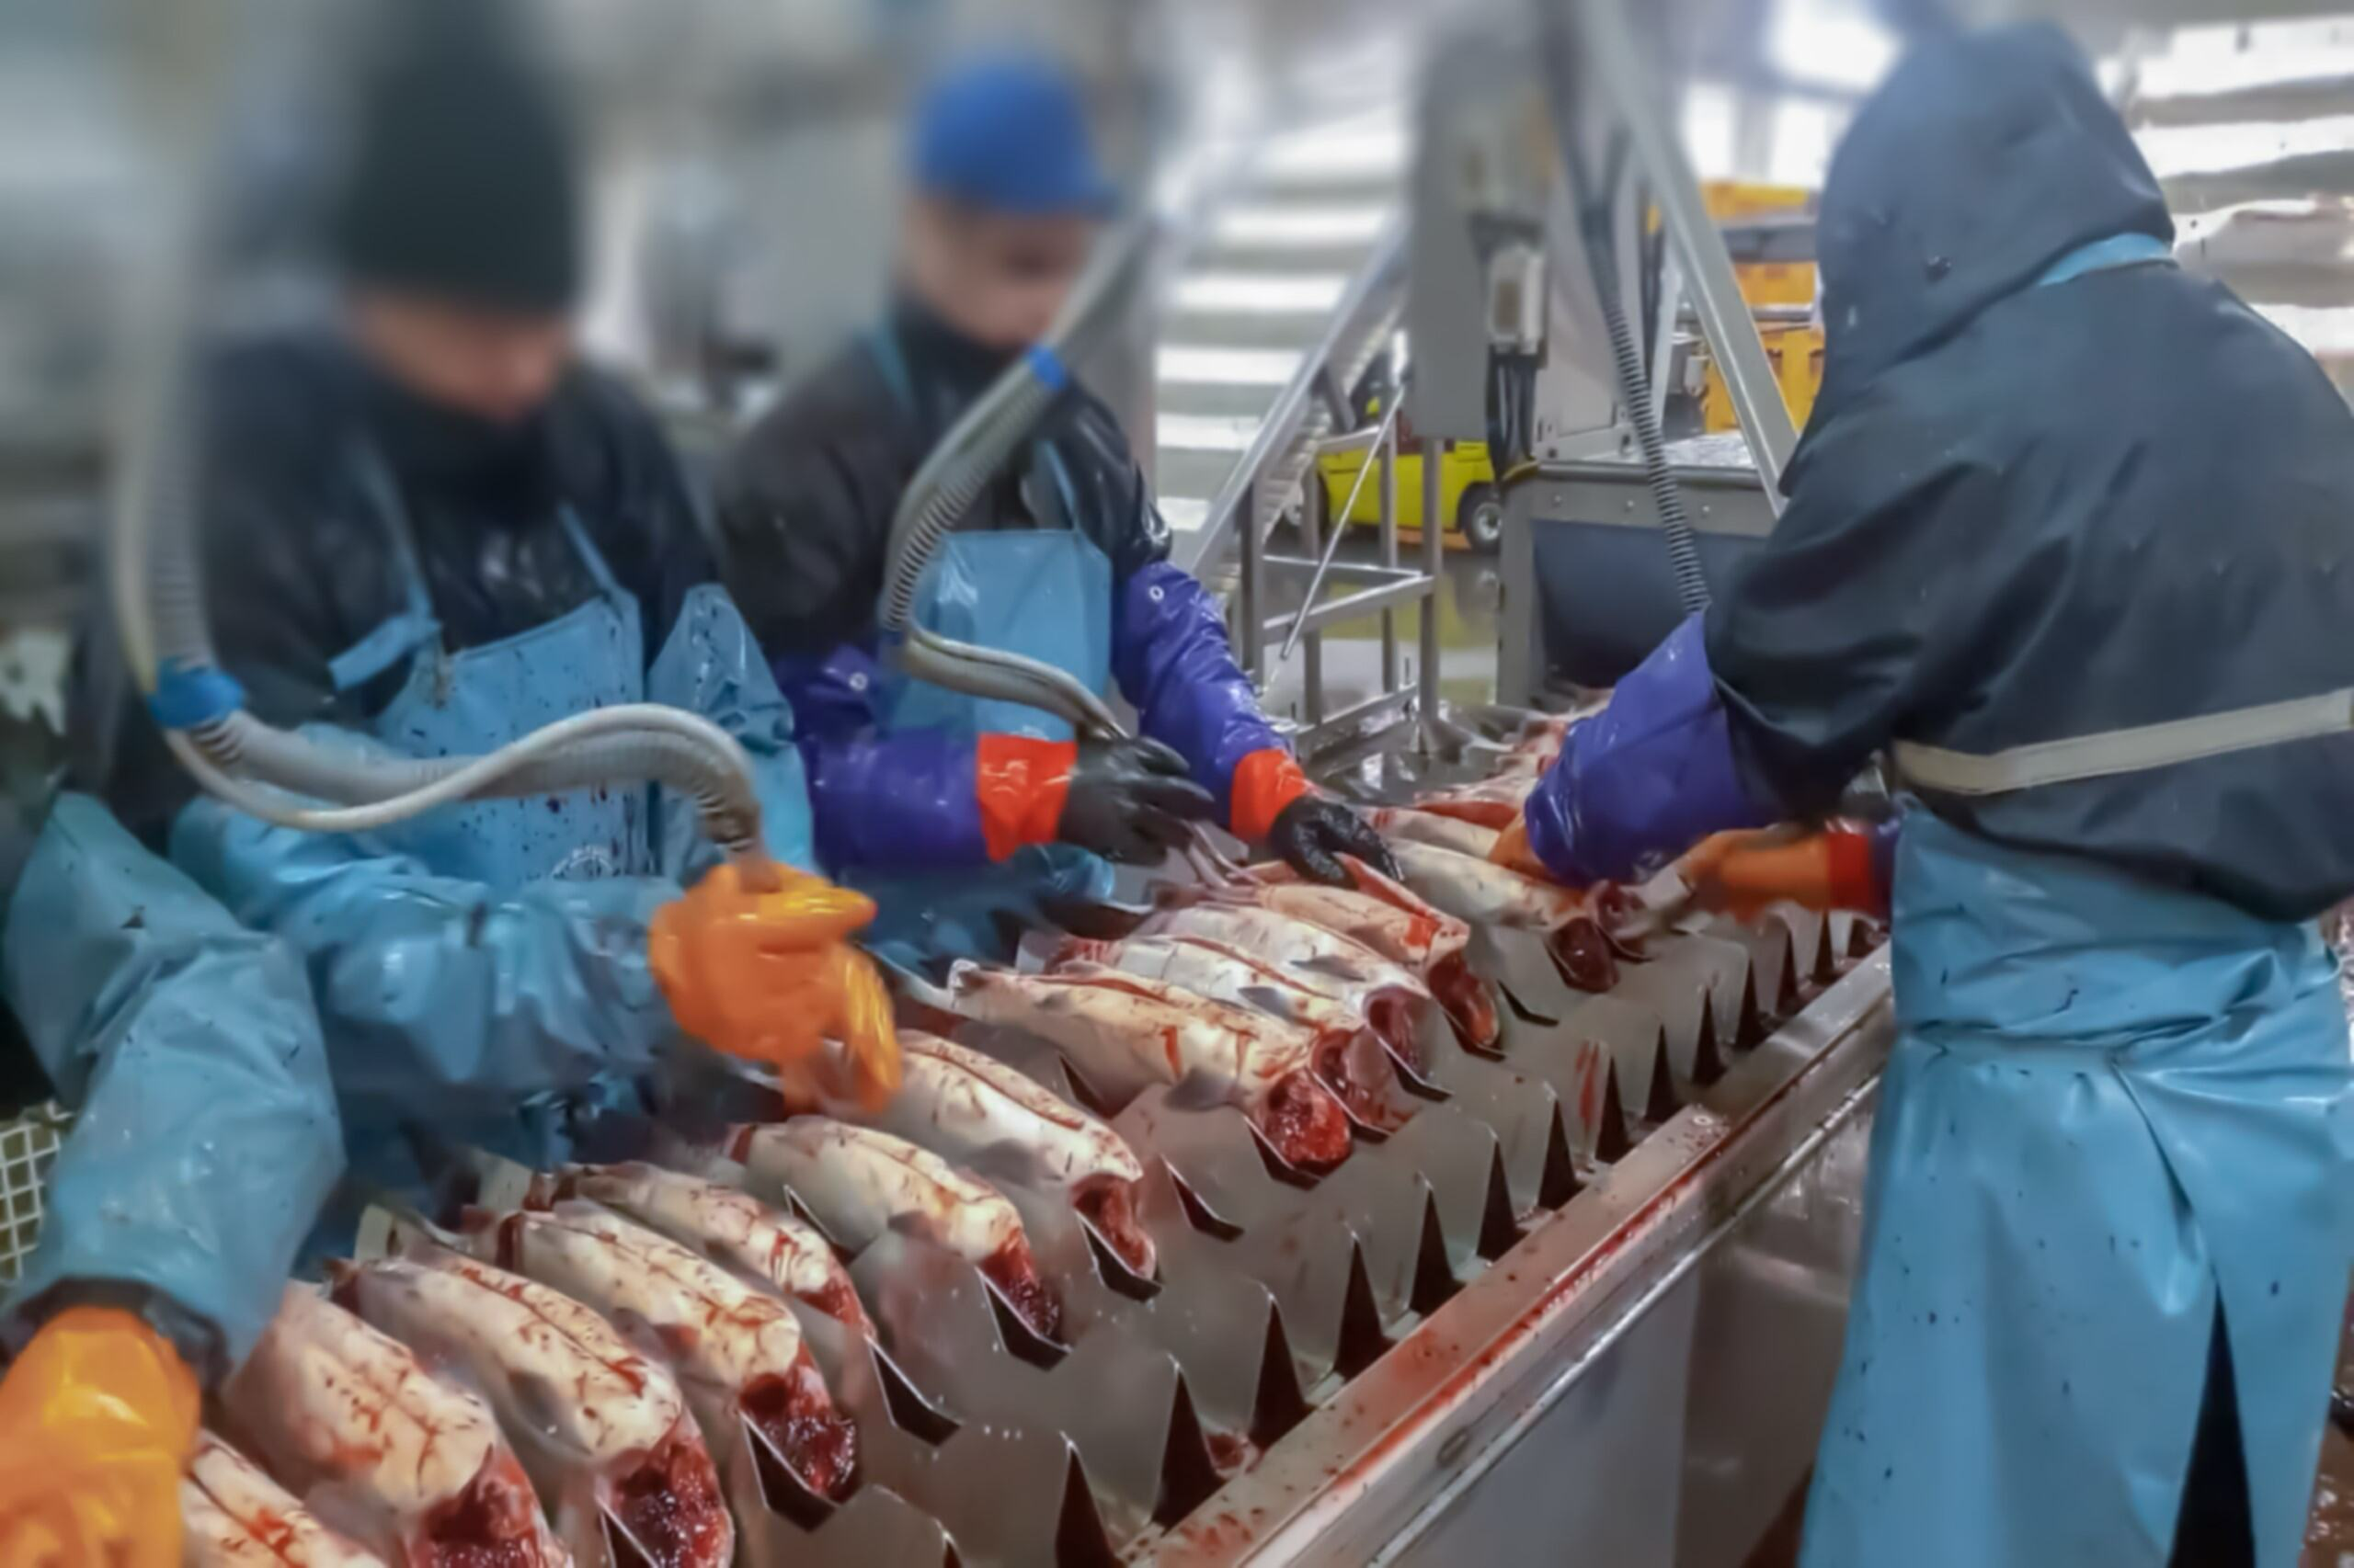
Occupational Health and Safety
Estimated 61 million people employed in aquatic foods sector
65% capture fisheries
35% aquaculture
Capture fisheries: among highest occupational fatality rates
Noise and ergonomic risks (repetitive motion injuries)
Exposure to chemicals and allergens
Source: FAO. (2024). Blue transformation in action. Food and Agriculture Organization of the United Nations. https://doi.org/10.4060/cd0683en
Image source: Shutterstock.
Notes:
As of 2022, approximately 61 million people are thought to be employed in some fashion in the production of aquatic foods – more in capture fisheries than aquaculture but that is changing as the aquaculture sector grows. Most workers in the fishing industry are from Asia.
Capture fisheries have one of the highest occupational fatality rates in the world. Exact figures are hard to establish due to imperfect reporting, but conservative estimates put fatalities in fishing at more than 32,000 deaths per year.
Aquaculture workers similarly face dangerous conditions, since many workers are employed in precarious arrangements, and these workers are often drawn from vulnerable populations.
The processing of seafood is also an area that has widespread occupational health and safety issues. Workers are exposed to high noise levels and facilities, which can result in hearing loss. Ergonomic hazards can cause musculoskeletal disorders, and chemicals and seafood allergens can increase the risk of occupational dermatitis and asthma.
The drivers and enablers of occupational health and safety issues are similar to the challenges facing many workers in land-based agriculture – lack of power, language barriers, many are migrant workers, and there are weak labor standards and lack of enforcement of the standards that do exist. In the U.S, and some other regions, seafood-related companies track workplace injuries and develop solutions to minimize occupational hazards and worker injuries. But this does not happen everywhere.
Data sources: https://www.fao.org/publications/fao-flagship-publications/the-state-of-world-fisheries-and-aquaculture/en (2024)

Slide 32
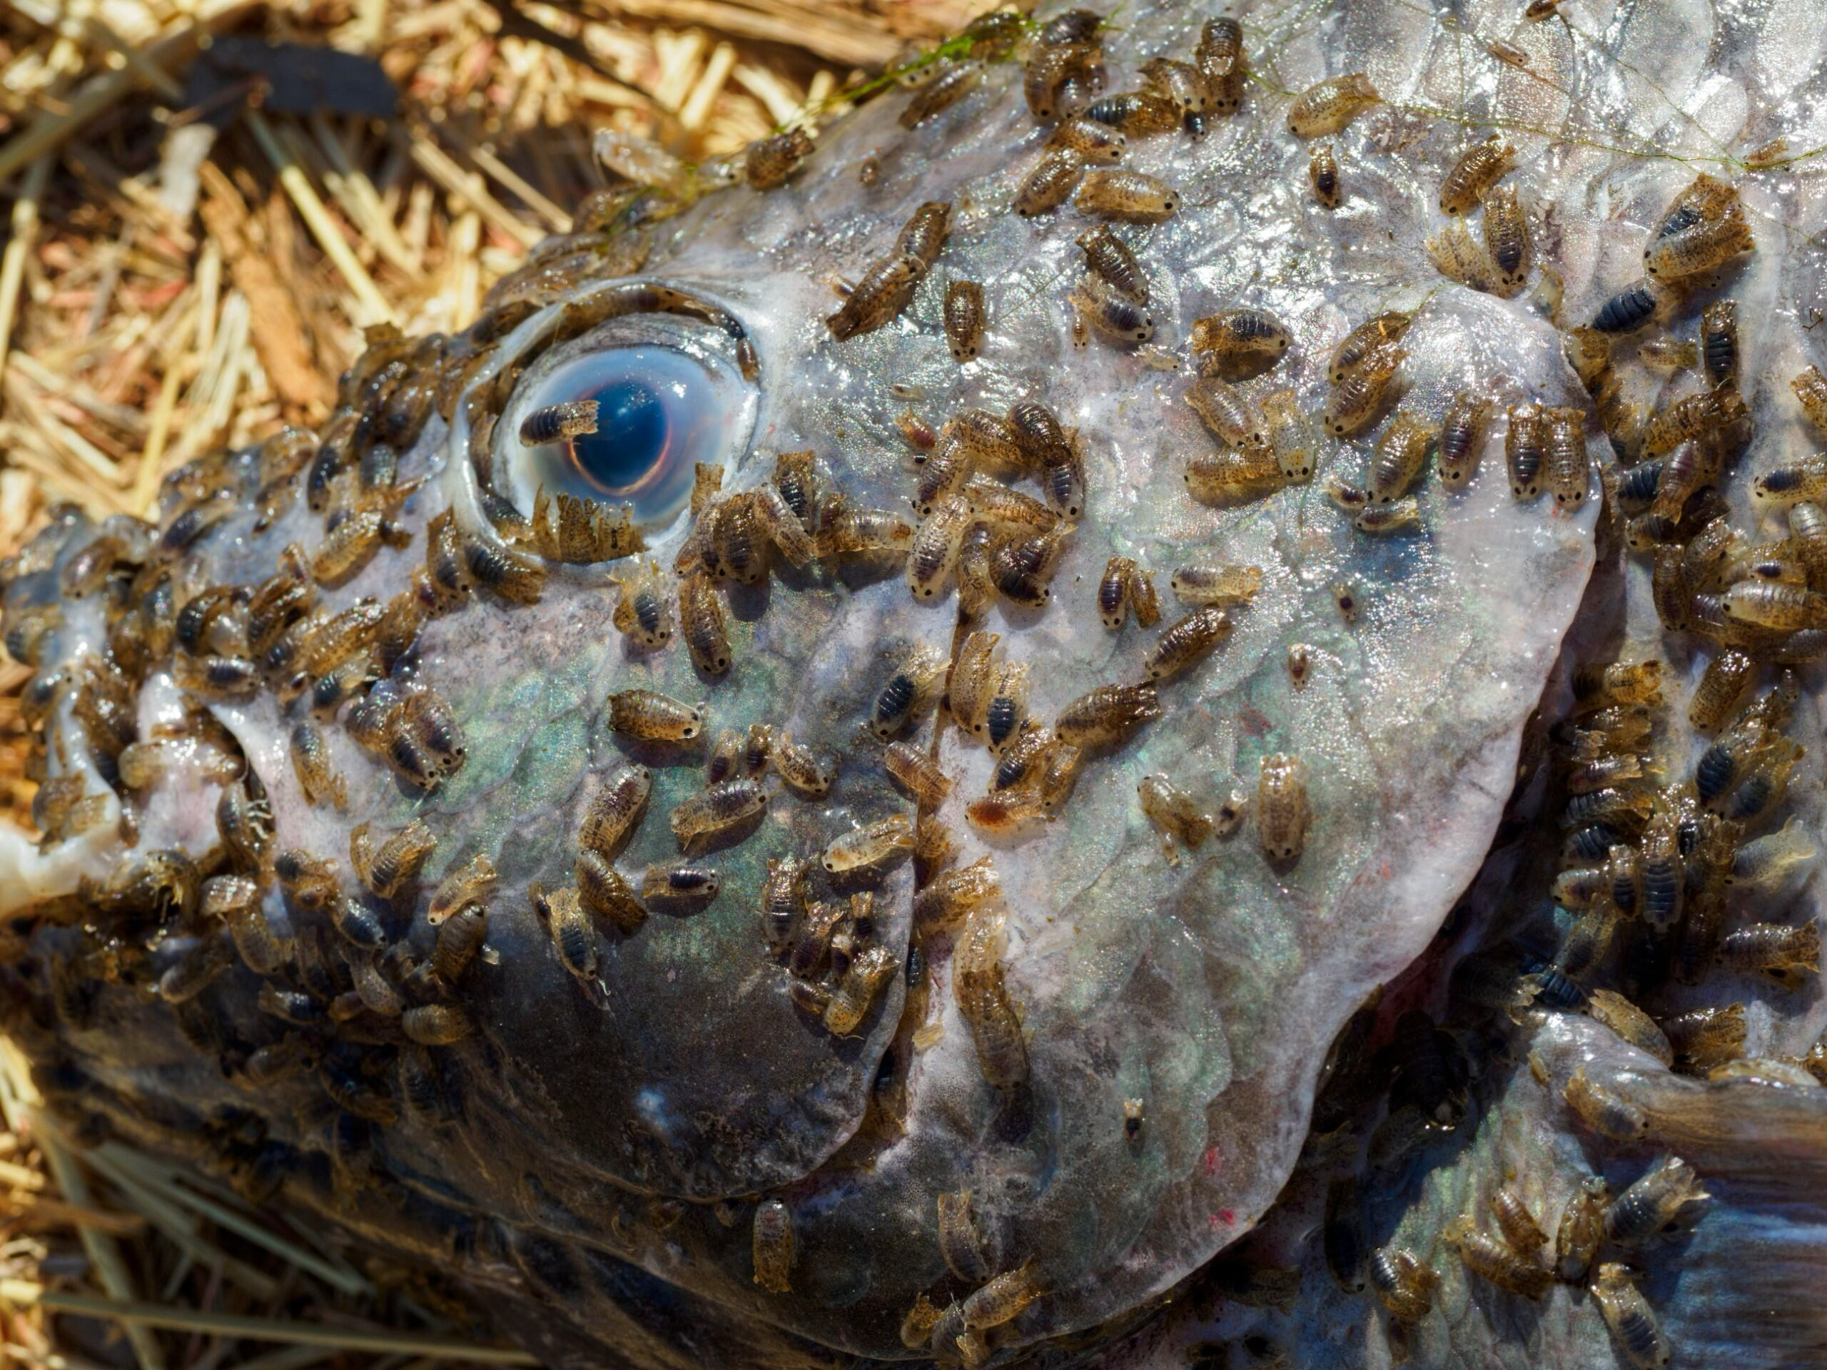
Challenges Specific to Aquaculture
Sourcing of fish feed
Antimicrobial use and risk of resistance
Escapes
Sea lice
Nutrient contamination and water quality
Image source: Shutterstock.
Notes:
Aquaculture presents some specific challenges. When confining large numbers of animals in one location – whether on land or in water – there will be challenges.
One of the greatest of these stems from raising large numbers of fish in a controlled environment. This practice – like on land-- generally requires providing food. As aquaculture grows it is competing with land animals and wild fish for food. We’ll talk about that more on the next slide.
The second challenge is – like livestock raised in industrial food systems on land – animals raised in close confinement in the water outside of their natural environment will tend to get sick. So there is widespread use of antimicrobials in aquaculture. We’ll also look at this more closely in this section.
Another challenge with aquaculture is fish escaping into the wild and, in some cases, breeding with native populations. That weakens the gene pool.
Fish can also be infected by sea lice as shown in this image. Sea lice are parasites that attach to the fish and destroy tissue, causing illness and potentially death.
The areas surrounding aquaculture sites can also suffer from nutrient contamination and water quality issues from the excess waste and the breakdown of fish feed.

Slide 33
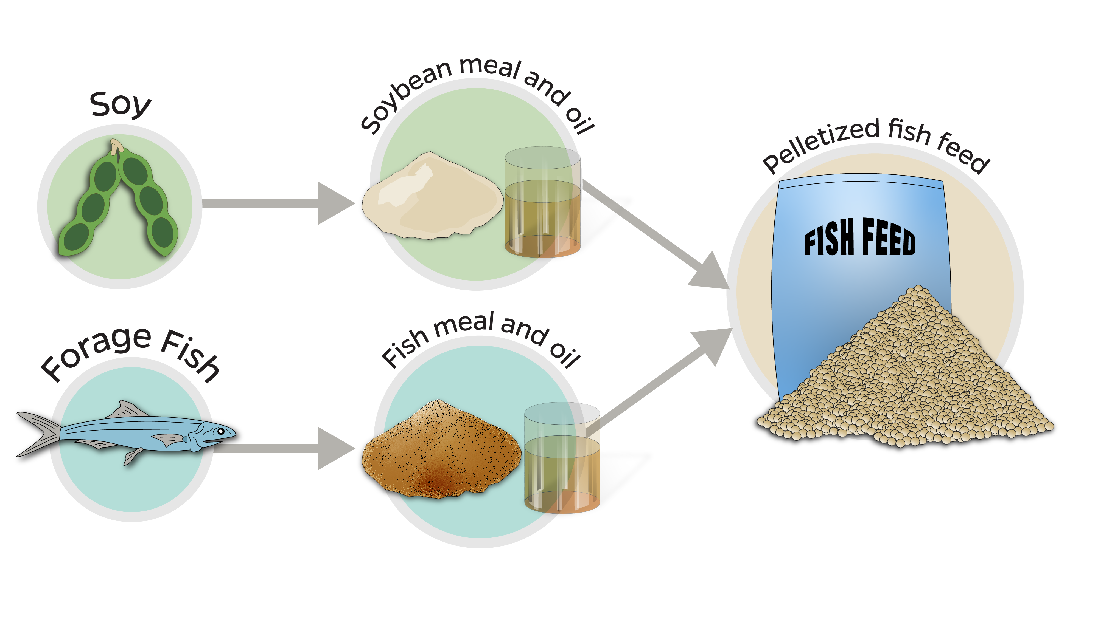
Sourcing of Fish Feed
Image source: Johns Hopkins Center for a Livable Future.
Notes:
Let’s look more closely at the challenge of feeding a growing number of farmed fish.
There are basically two different types of feed inputs. One is fish-based ingredients. A good example of these are fish meal and fish oil. So fish meal is a great protein source, and fish oil is a fat source. Fish meal and oil come from the smaller sized forage fish, such as anchoveta and sardines. Approximately 20% of seafood caught in the wild is used as aquaculture feed, mostly for large, carnivorous fish such as Atlantic salmon.
The anchoveta fishery off the coast of Peru is one of the largest fisheries by volume in the world. And, not surprisingly, most of that catch goes to feed farmed fish and other animals. Beyond the sustainability of fish stocks, there are also food security concerns because much of the fish used for this fishmeal in aquaculture in Europe and Asia comes from the seas around West Africa and Latin America where fishing is a critically important source of nutrition and economics.
Because of sustainability concerns, the aquaculture industry is turning to plant-based aquaculture feed, such as soybean meal and oil. Feeding soybeans and other grains to fish is not without sustainability concerns, too, since it’s adding pressure on land-based agriculture, which is a primary driver of deforestation. It’s estimated that the land area the size of Virginia is being used to grow crops to feed aquaculture.
In the next section, we’ll talk about the impacts of reducing or eliminating fish oil in feed on the ratio of omega 3 to 6 fats in the fish.
There is research on using algae, fungi, bacteria, and other things like single-celled organisms and insects being raised as fish feed. But this is not yet being done at scale.

Slide 34
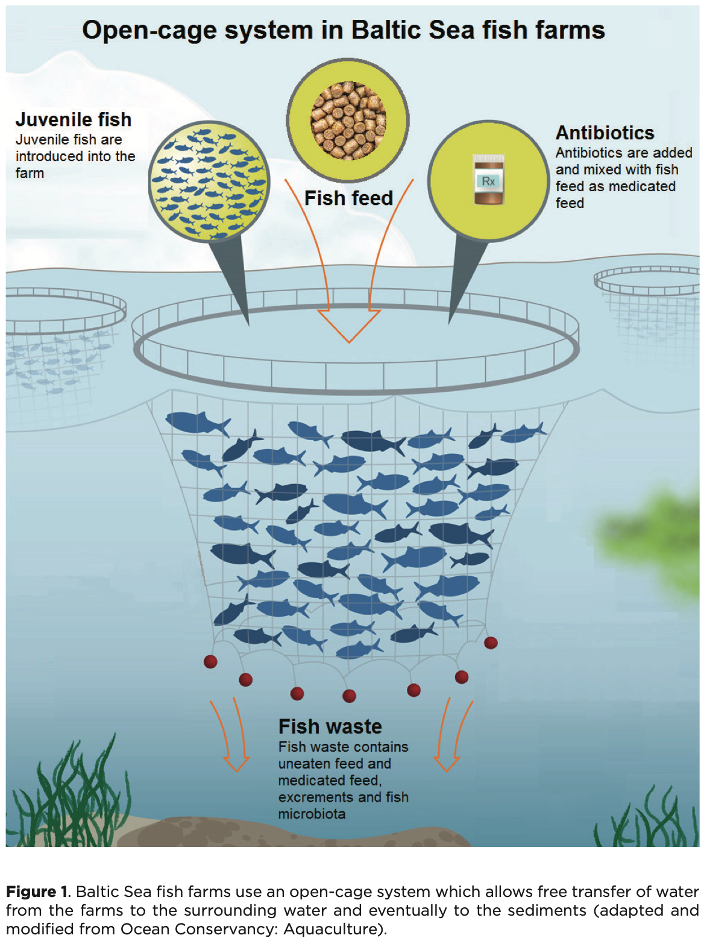
Antimicrobial Use in Aquaculture
Image source: Muziasari, W. (2016). Figure 1. Baltic Sea fish farms use an open-cage system [Chart]. In: Impact of fish farming on antibiotic resistome and mobile elements in Baltic Sea sediment [Academic Dissertation]. University of Helsinki Division of Microbiology and Biotechnology. https://helda.helsinki.fi/server/api/core/bitstreams/616b50f8-718a-437d-85c4-c0d27439e98e/content
Notes:
Animal diseases are one of the largest concerns for the aquaculture sector. Sometimes sick animals need to be treated with medication, much like a doctor would treat human infections. Because fish live in large groups, it is not feasible to pull out individual sick animals out of the population, so the entire pond or net-pen is treated as a whole. Antibiotics are often fed to entire populations of farmed fish to prevent the rapid spread of illness in an environment where the fish are kept in very close quarters. This is very similar to the concerns about the widespread use of antibiotics in farmed animals raised in confinement.
It is estimated that 6% of all antibiotics used globally are used in aquaculture.
Animal drugs are often given as medicated feed and any uneaten feed of fish waste can contain drugs or drug residues. These drugs or drug residues can settle in the sediments below a fish farm. Irresponsible antimicrobial use can lead to the development of antimicrobial resistant bacteria often called "superbugs". Antimicrobial use has led some companies in the US to limit or halt purchases of some types of fish.
The density of fish and other production practices, and environmental factors such as water quality can suppress or promote diseases. In many higher income countries, vaccines are given to prevent disease which decreases the need for therapeutic treatments.
-----
Graphic
Muziasari, W. (2016). Impact of Fish Farming on Antibiotic Resistome and Mobile Elements in Baltic Sea Sediment [Academic Dissertation]. University of Helsinki Division of Microbiology and Biotechnology. https://helda.helsinki.fi/server/api/core/bitstreams/616b50f8-718a-437d-85c4-c0d27439e98e/content

Slide 35
Case Study 1

Slide 36
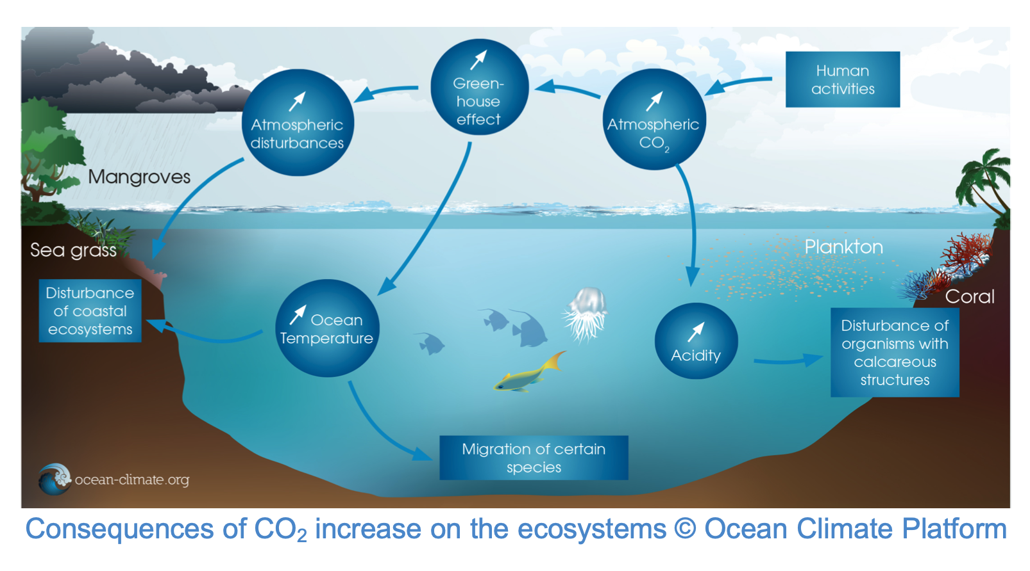
Climate Change and Oceans
Image source: Ocean & Climate Platform. (2021). Our infographics. https://i0.wp.com/ocean-climate.org/wp-content/uploads/2021/01/ocean-climate-climate-change-6.png?ssl=1
Notes:
Climate change is another grand challenge that is relevant across the seafood sector, but particularly marine fisheries. As the global temperature rises, we’re experiencing ocean warming, where water temperatures are rising and driving fish species to migrate to cooler waters. Ocean acidification, which affects the pH of water, degrades the shells of mollusks and other sea life with calcified shells. We’re also seeing more frequent and severe extreme weather events and eutrophication caused by nutrient pollution, which decreases oxygen levels in the water making it hard for fish to breath underwater. Overfishing and urbanization of coastlines and other factors are further degrading fisheries and fish habitat.
Ultimately these impacts affect marine ecosystems, the business of fishing, and food security, particularly for those who depend on seafood for nutrition and livelihoods.
-----
Graphic
Ocean & Climate Platform. (2021). Our infographics. https://i0.wp.com/ocean-climate.org/wp-content/uploads/2021/01/ocean-climate-climate-change-6.png?ssl=1
Also found in: IUCN. (2017). The Ocean and Climate Change (Issue Briefs). International Union for Conservation of Nature. https://iucn.org/sites/default/files/2022-07/the_ocean_and_climate_change_issues_brief-v2.pdf

Slide 37
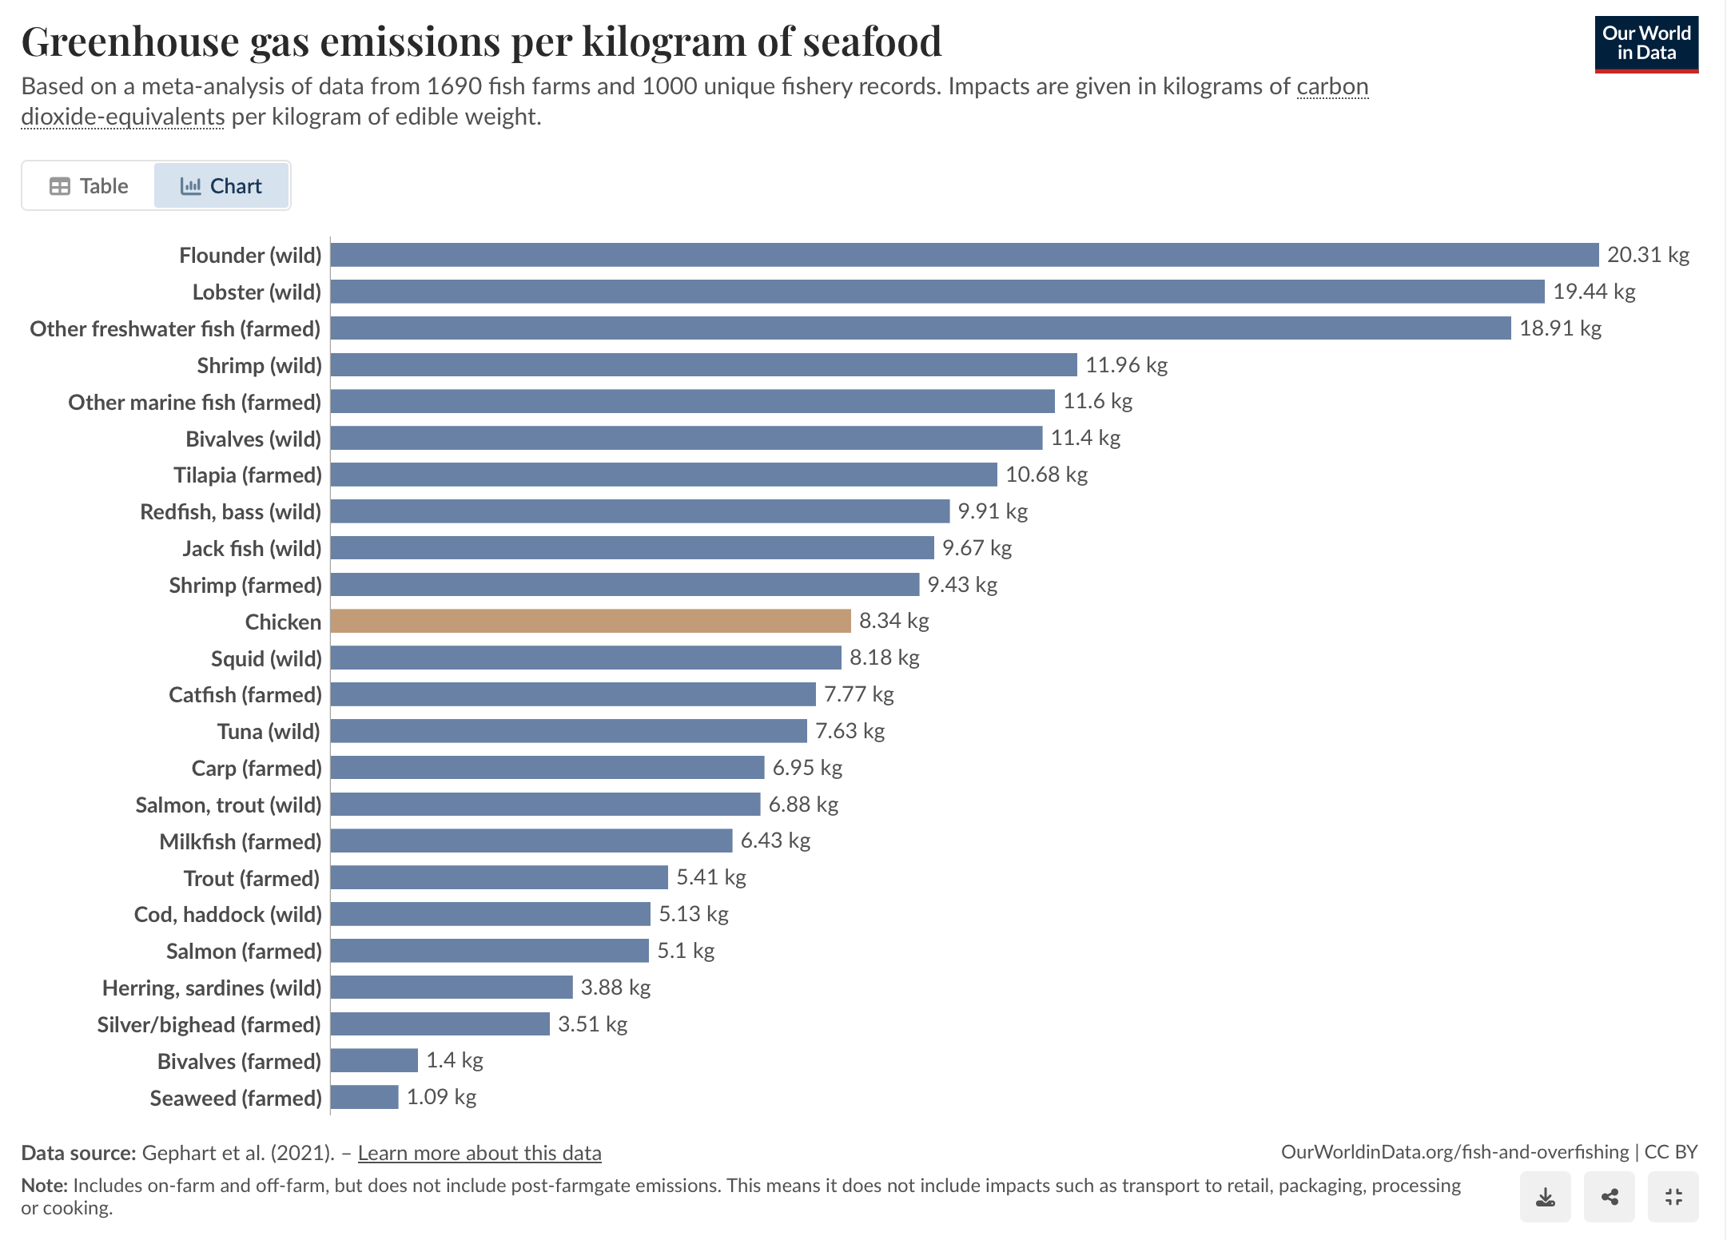
Greenhouse Gas Emissions per Kilogram of Seafood
Image source: Ritchie, H., & Roser, M. (2021). Greenhouse gas emissions per kilogram of seafood [Chart]. In: Fish and Overfishing. Our World in Data. https://ourworldindata.org/grapher/ghg-emissions-seafood
Notes:
How much does the seafood sector contribute to climate change?
Here we can see the estimated greenhouse gas emissions per kilogram of different types of seafood based on an analysis of many different studies. These results include all inputs into production, such as fish feed and fuel use in fisheries. It does not include processing, transport to retail, packaging or cooking.
Wild flounder and lobster rank high primarily due to the fuel-intensive methods used to catch them and the transportation to market. There can be wide variability, however, within the same species, particularly for capture fisheries. The impact of wild salmon, for example, can range from 2 to 17 kilograms of CO2 equivalents depending on where and how it’s caught, whereas the carbon footprint of farmed salmon ranges only from about four to six kilograms. This adds to the complexity for seafood buyers when trying to make decisions about sustainable seafood, and why labels and traceability are so important.
-----
Graphic
Ritchie, H., & Roser, M. (2021). Fish and Overfishing. Our World in Data. https://ourworldindata.org/fish-and-overfishing#environmental-footprint-of-fishing

Slide 38
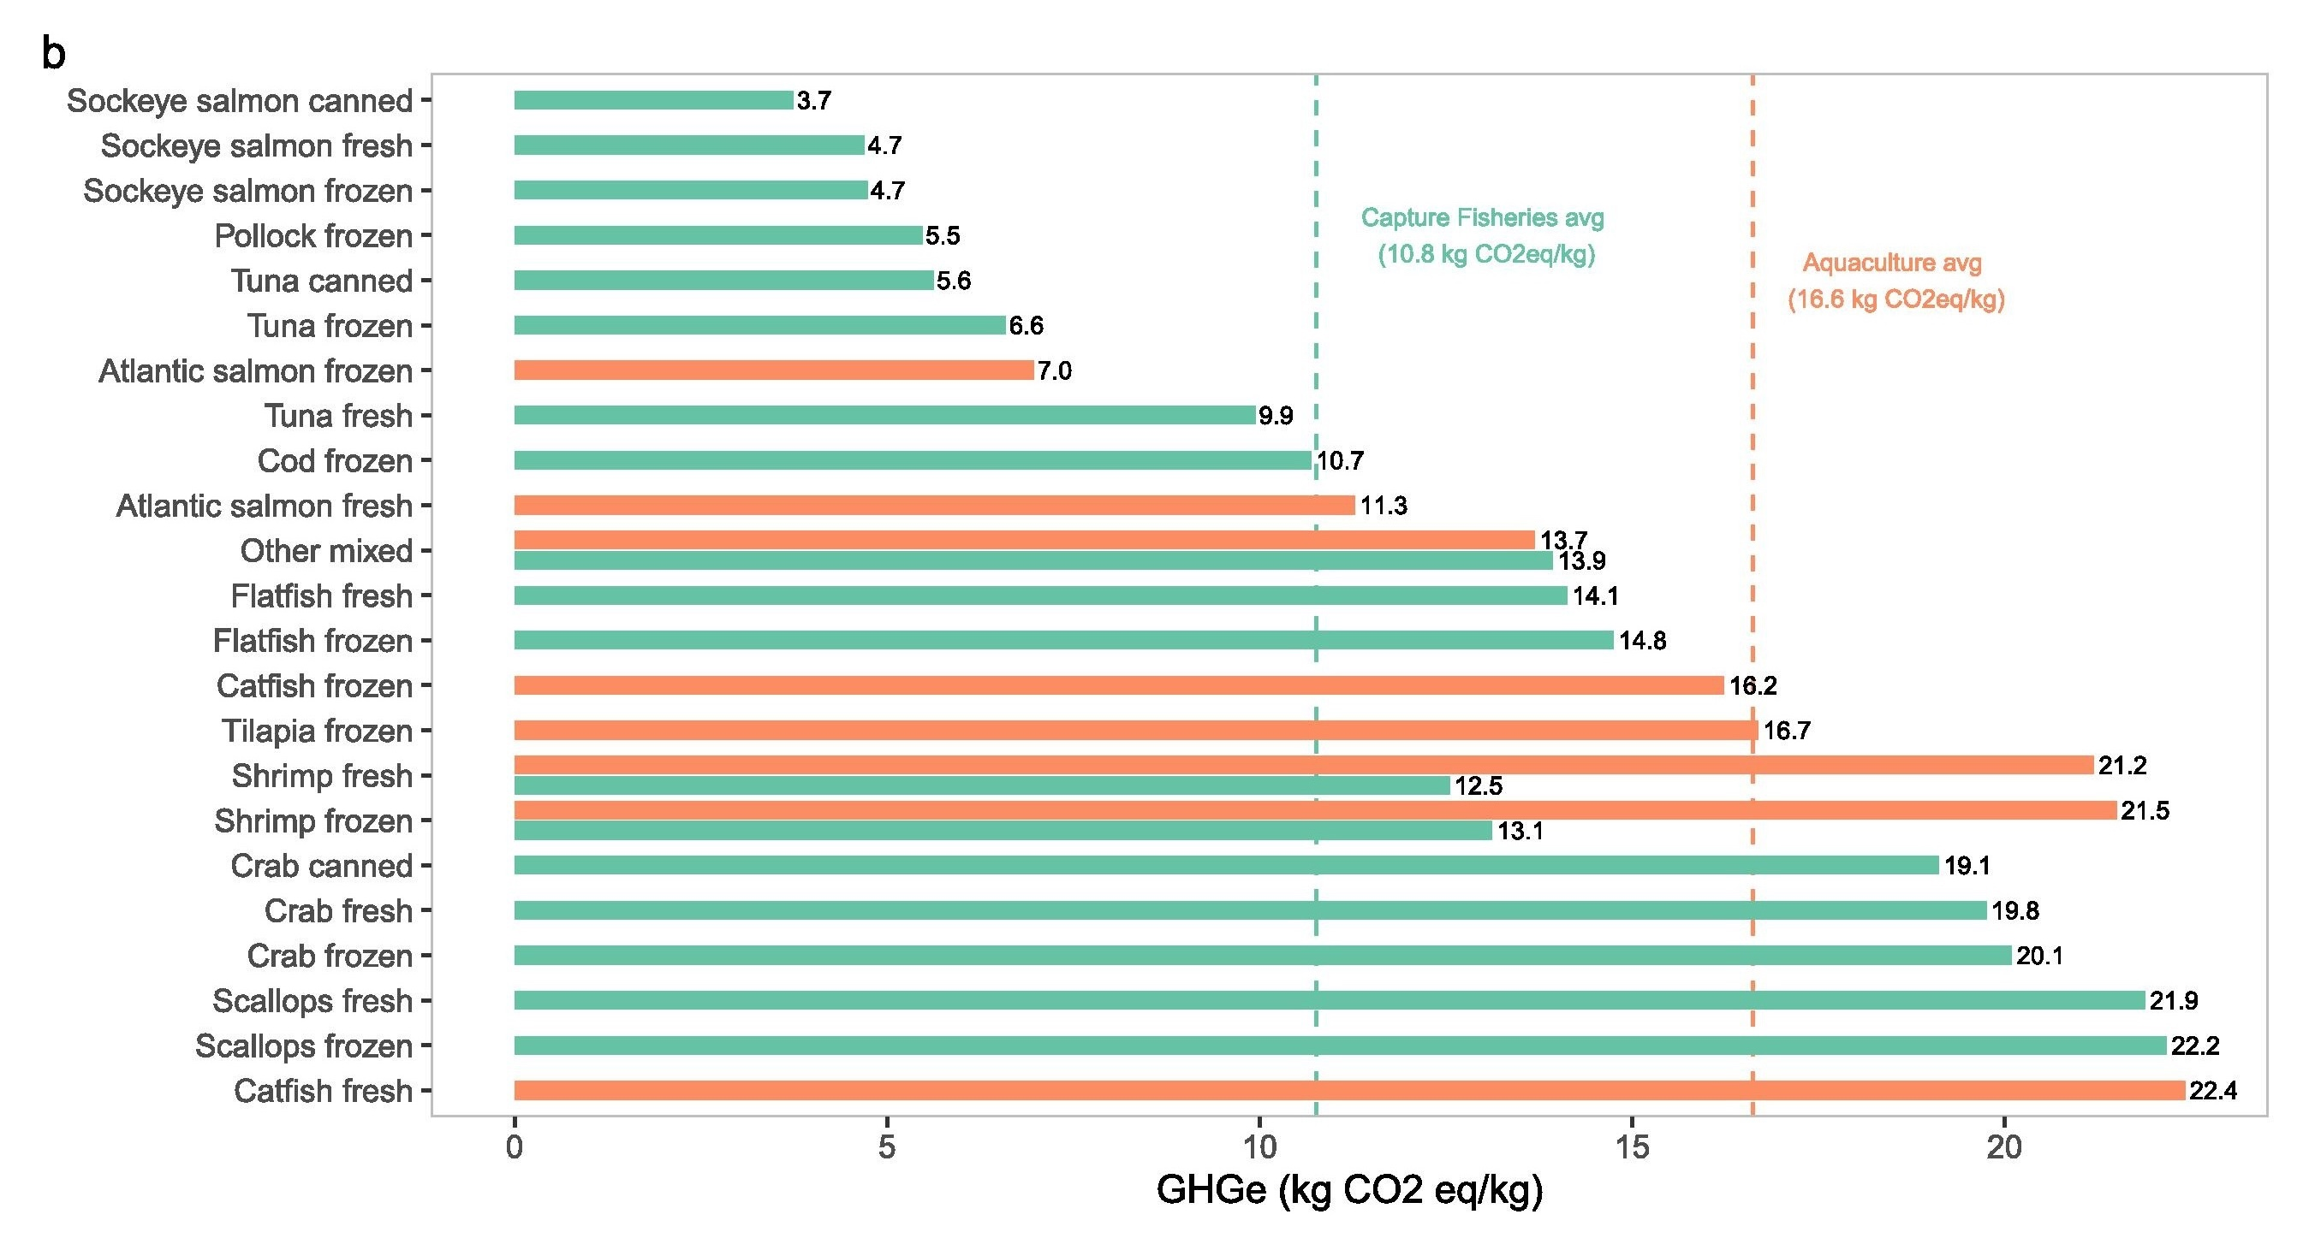
Greenhouse Gas Emissions Footprint of Top 10 Seafood Species Consumed in the United States
Lowest greenhouse gas emissions
Canned, fresh, and frozen sockeye salmon
Frozen pollock
Canned and frozen tuna
Frozen Atlantic salmon
Image source: Love, D., Brown, M., Viglia, S., Asche, F., Fry, J., Garlock, T., Jenkins, L., Nguyen, L., Anderson, J., Nussbaumer, E., & Neff, R. (2025). Figure 1b, Environmental impacts of the top-10 aquatic food species in the United States by production method and product form [Chart]. Environmental impacts and food loss and waste in the U.S. aquatic food system. Global Environmental Change, 90. https://www.sciencedirect.com/science/article/pii/S0959378025000019
Notes:
In a 2025 study, researchers from the Center for a Livable studied the greenhouse gas and water footprints of the most commonly consumed seafood species in the U.S.
This figure displays the GHGE per kg Of different types of seafood.
Note that products with the lowest GHGe were canned, fresh, and frozen sockeye salmon, frozen pollock, canned and frozen tuna, and frozen Atlantic salmon.
All wild caught species had lower blue water use that farmed products, as would be expected.
-----
Graphic
Love, D., Brown, M., Viglia, S., Asche, F., Fry, J., Garlock, T., Jenkins, L., Nguyen, L., Anderson, J., Nussbaumer, E., & Neff, R. (2025). Environmental impacts and food loss and waste in the U.S. aquatic food system. Global Environmental Change, 90. https://www.sciencedirect.com/science/article/pii/S0959378025000019

Slide 39
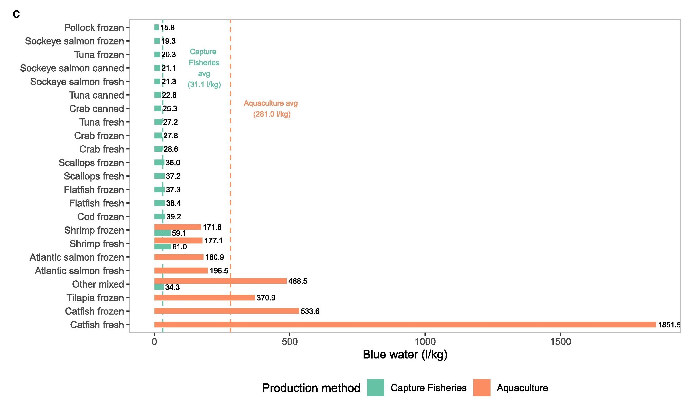
Water Footprint of Top 10 Seafood Species Consumed in the United States
All wild caught species had significantly lower blue water use impacts than farmed products
Image source: Love, D., Brown, M., Viglia, S., Asche, F., Fry, J., Garlock, T., Jenkins, L., Nguyen, L., Anderson, J., Nussbaumer, E., & Neff, R. (2025). Figure 1c, Environmental impacts of the top-10 aquatic food species in the United States by production method and product form [Chart]. Environmental impacts and food loss and waste in the U.S. aquatic food system. Global Environmental Change, 90. https://www.sciencedirect.com/science/article/pii/S0959378025000019
Notes:
In a 2025 study, researchers from the Center for a Livable studied the greenhouse gas and water footprints of the most commonly consumed seafood species in the U.S.
Note that products with the lowest GHGe were canned, fresh, and frozen sockeye salmon, frozen pollock, canned and frozen tuna, and frozen Atlantic salmon.
All wild caught species had lower blue water use that farmed products, as would be expected.
-----
Graphic
Love, D., Brown, M., Viglia, S., Asche, F., Fry, J., Garlock, T., Jenkins, L., Nguyen, L., Anderson, J., Nussbaumer, E., & Neff, R. (2025). Environmental impacts and food loss and waste in the U.S. aquatic food system. Global Environmental Change, 90. https://www.sciencedirect.com/science/article/pii/S0959378025000019

Slide 40
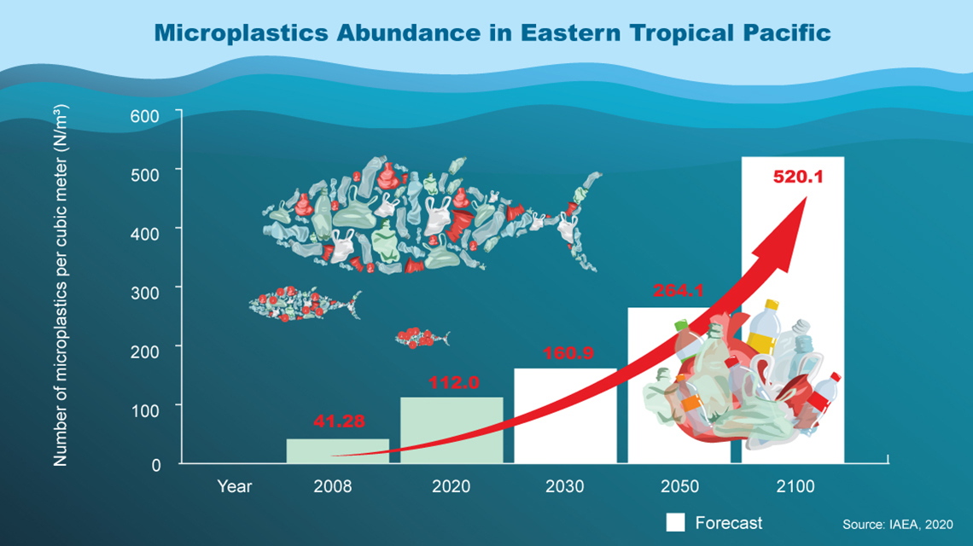
Microplastic Pollution in the Ocean
Image source: Orayeva, J. (2020). World oceans day 2020: new IAEA research records dramatic increase in microplastic pollution in Eastern Tropical Pacific Ocean. International Atomic Energy Agency (IAEA). https://www.iaea.org/newscenter/news/world-oceans-day-2020-new-iaea-research-records-dramatic-increase-in-microplastic-pollution-in-eastern-tropical-pacific-ocean
Notes:
We’ll end this section with an emerging issue that is only beginning to get the research attention it deserves. Microplastics, which are tiny plastic particles, are a growing environmental threat in the world’s oceans. Microplastic comes from plastic trash like disposable water and soda bottles that are not recycled, discarded fishing gear, and industrial runoff. It is estimated that over 170 trillion plastic particles, weighing approximately 2.3 million tons, are floating in the world’s oceans. Additionally, around 11 million metric tons of plastic waste enter the ocean every year, and this number could nearly triple by 2040 without significant intervention.
These particles accumulate in marine ecosystems, where they are ingested by plankton, fish, shellfish, and other seafood species, leading to potential health risks throughout the food chain. Microplastics can disrupt marine life by causing physical damage, disrupting feeding behaviors, and exposing organisms to toxic chemicals that leach from plastics. There are increasing concerns about the potential impacts on consuming seafood contaminated with microplastics. The widespread presence of microplastics in marine food webs underscores the urgent need for reducing plastic pollution, improving waste management, and developing sustainable alternatives to protect ocean health and food safety.
-----
Graphic
Orayeva, J. (2020). World Oceans Day 2020: New IAEA Research Records Dramatic Increase in Microplastic Pollution in Eastern Tropical Pacific Ocean. International Atomic Energy Agency; IAEA. https://www.iaea.org/newscenter/news/world-oceans-day-2020-new-iaea-research-records-dramatic-increase-in-microplastic-pollution-in-eastern-tropical-pacific-ocean

Slide 41
Discussion—1
Based on the information presented, what questions do you have about seafood safety and the aquatic food system?
Would this impact your seafood consumption recommendations?
What additional information would help inform your guidance?

Slide 42
Section C: Aquatic Foods and Nutrition
Notes:
Now let’s look at the aquatic foods that we eat in the U.S. and the nutritional considerations that are important to keep in mind.

Slide 43
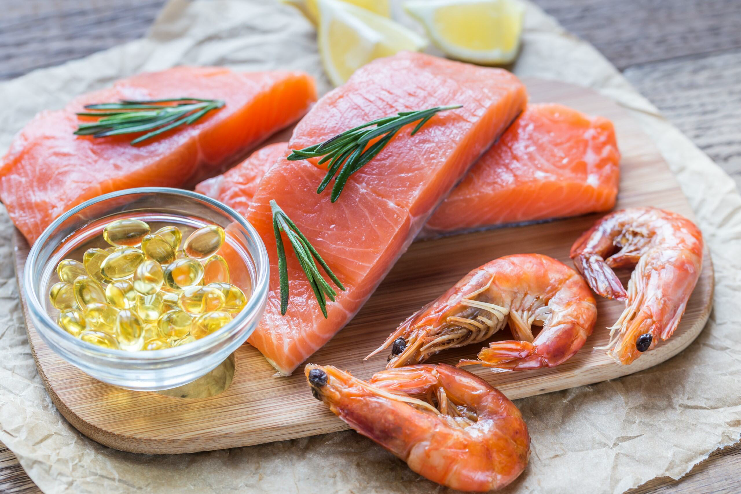
Health Benefits of Consuming Aquatic Foods
Reduce all-cause mortality
Improve heart health
Aid in absorption of nutrients from other foods
Have benefits for cognitive development
Improve birth outcomes
Image source: Shutterstock.
Notes:
The current body of evidence indicates there are benefits of aquatic food consumption –including for all-cause mortality and heart, but the evidence is also mixed – we’ll get to some of the reasons why later in this section.
There are components of fish that seem to enhance the absorption of micronutrients from other parts of the meal. It’s not discussed often, but the research indicates this is one important benefit of even a small intake of fish.
There’s evidence that fish consumption has benefits for cognitive development and improved birth outcomes, but there are also risks depending on type of fish.
Part of the mixed evidence on nutrition is related to the reality that aquatic food is a widely diverse category with more than 2,500 species that are captured or cultivated in the oceans, rivers, lakes and ponds, and each species differs in its nutritional profile.

Slide 44
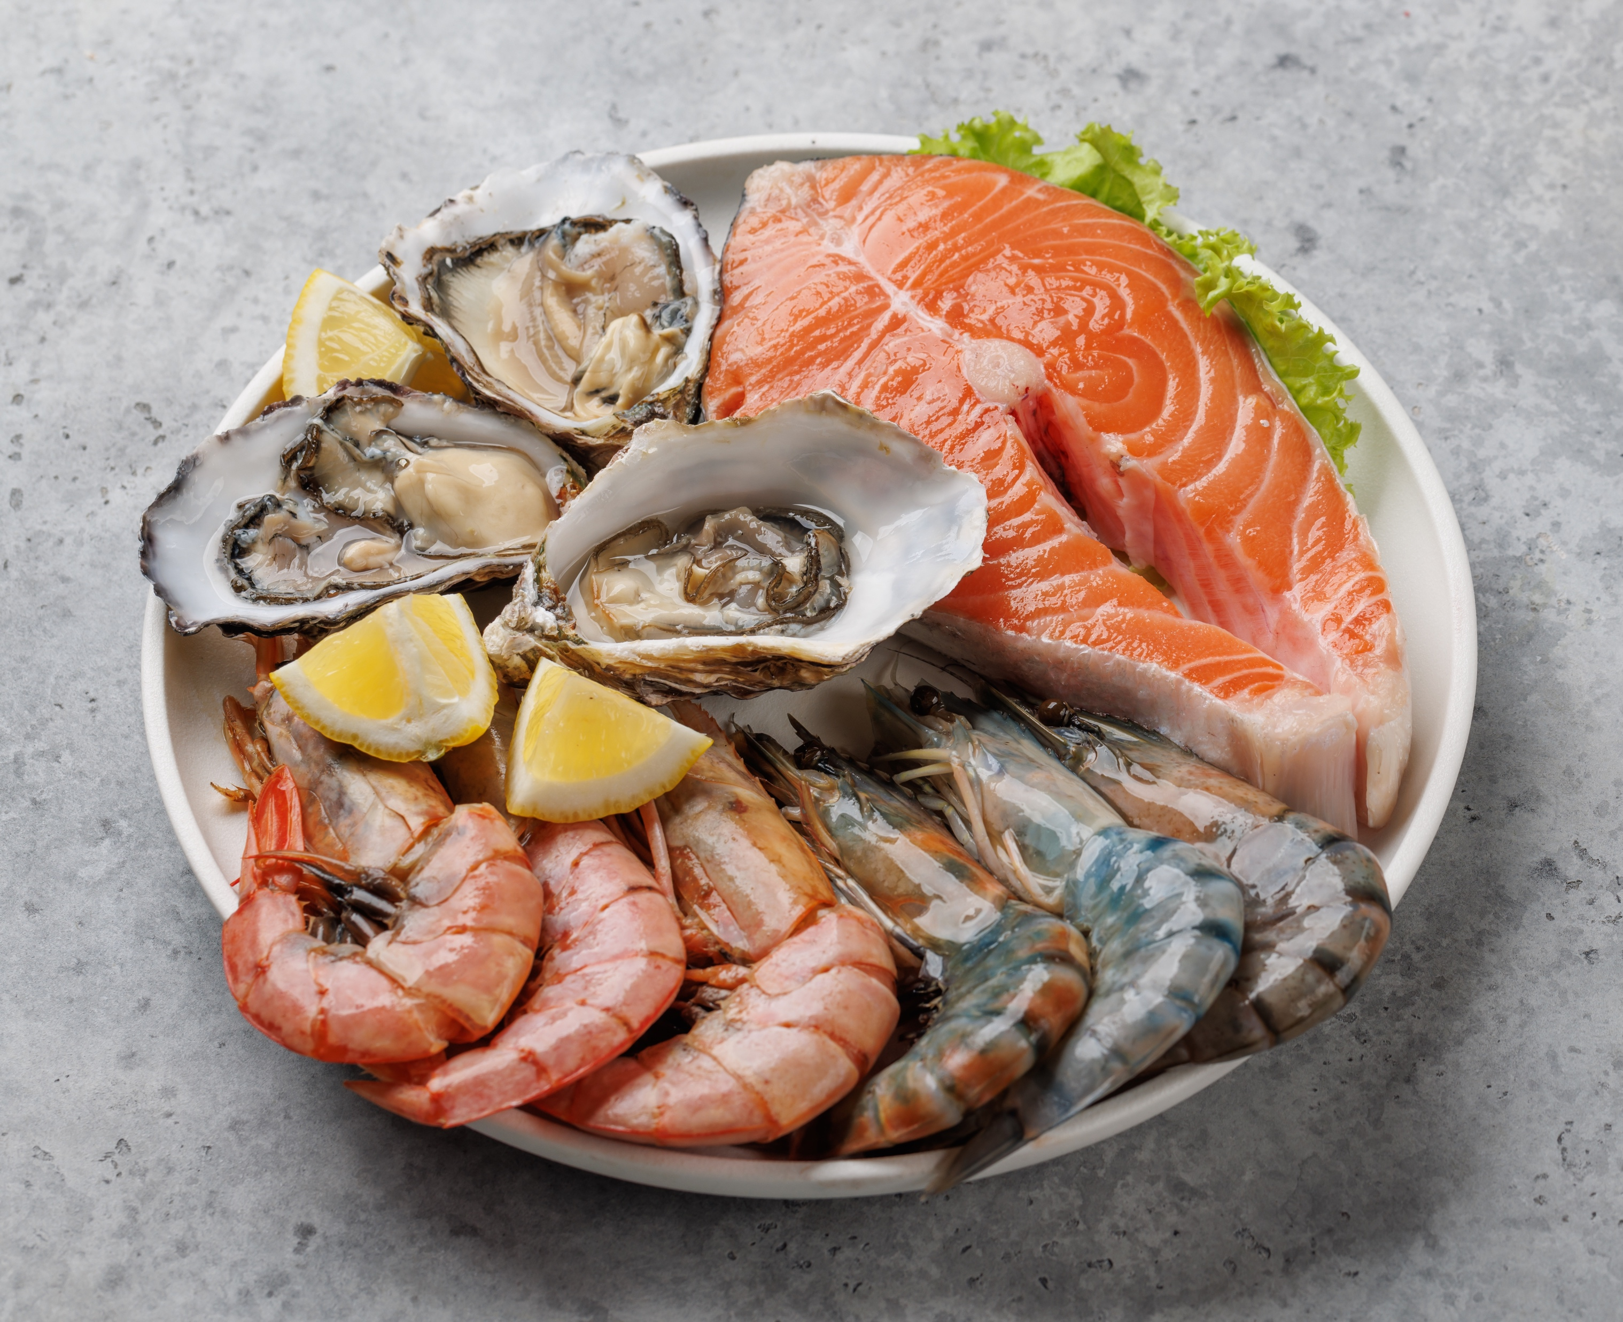
Nutritional Attributes of Aquatic Foods
Protein
Low in saturated fat and total fat
Natural source of long-chain polyunsaturated omega-3 fatty acids
Eicosapentaenoic acid (EPA)
Docosahexaenoic acid (DHA)
Alpha-linolenic acid (ALA): converted to EPA and DHA
Micronutrients
Calcium, iron, zinc, vitamin A, vitamin B12
Source: Maire, E., Graham, N. A. J., MacNeil, M. A., Lam, V. W. Y., Robinson, J. P. W., Cheung, W. W. L., & Hicks, C. C. (2021). Micronutrient supply from global marine fisheries under climate change and overfishing. Current Biology, 31(18), 4132-4138.e3. https://doi.org/10.1016/j.cub.2021.06.067
Image source: Shutterstock.
Notes:
Overall, fish and other aquatic foods are an important source of protein but also have several other important nutritional attributes that make aquatic foods desirable from a human nutrition and health perspective.
The overall fat and saturated fat content of seafood is lower than most red meats and fattier servings of poultry (dark meat and skin). The fattiest fish have similar total fat content as lean meats.
Fish are one of the few natural sources of long-chain polyunsaturated omega-3 fatty acids in the human diet, which are an important part of our cell membranes. The three main omega-3 fatty acids are alpha-linolenic acid (ALA), eicosatetraenoic acid (EPA), and docosahexaenoic acid (DHA). ALA is found in nuts, seeds and plant oils, such as flax, soy and canola oils as well as seafood. But, DHA and EPA are found only in fish and other seafood. We're particularly interested in the health benefits of consuming EPA and DHA – the longer chain fatty acids – because humans do not efficiently convert ALA – the shorter-chain fatty acids – to the longer-chain fatty acids DHA and EPA.
Omega-3 fatty acids from seafood are associated with multiple important health benefits, such as improving heart health through management of cholesterol, triglycerides and blood pressure, supporting fetal brain development, and possibly fighting inflammation and supporting mental health.
Though micronutrients vary by type of species and how it’s consumed, seafood is a good, reliable source of Iron, zinc and calcium and vitamin A – which are particularly important during growth and development as well as overall health.
-----
Information
Maire, E., Graham, N. A. J., MacNeil, M. A., Lam, V. W. Y., Robinson, J. P. W., Cheung, W. W. L., & Hicks, C. C. (2021). Micronutrient supply from global marine fisheries under climate change and overfishing. Current Biology, 31(18), 4132-4138.e3. https://doi.org/10.1016/j.cub.2021.06.067

Slide 45
Omega-3 Long-Chain Polyunsaturated Fatty Acids (PUFAs) and Cardiovascular Disease (CVD)
Mechanisms through which omega-3 long-chain PUFAs could affect CVD outcomes
Changes in circulating blood lipids
Reduced blood pressure and systemic vascular resistance
Improved arterial wall compliance
Lower platelet aggregation, reduced endothelial cell dysfunction, and decreased plaque inflammation
Notes:
This slides lists some of the mechanisms through which it is thought that Omega-3 fatty acids may work to affect CVD outcomes.
(Changes in Circulating Blood Lipids) Omega-3 fatty acids significantly lower triglyceride levels and may increase high-density lipoprotein (HDL) cholesterol, improving the overall lipid profile and reducing atherosclerotic plaque formation.
(Reduced Blood Pressure and Systemic Vascular Resistance) Omega-3s contribute to lower systolic and diastolic blood pressure by promoting vasodilation through nitric oxide production. This reduction in blood pressure and vascular resistance is vital for managing hypertension and minimizing cardiovascular risks.
(Improved Arterial Wall Compliance) Omega-3s enhance arterial compliance, allowing blood vessels to expand and contract effectively, which is essential for maintaining proper blood flow and reducing vascular damage.
(Lower Platelet Aggregation, Reduced Endothelial Cell Dysfunction, and Decreased Plaque Inflammation) Omega-3s exhibit anti-inflammatory effects, decreasing platelet aggregation and improving endothelial function. They stabilize atherosclerotic plaques, lowering the risk of rupture and subsequent cardiovascular events.

Slide 46
Interpreting Observational Studies of Fish Intake
2016 meta-analysis: Twelve prospective cohort studies with 672,389 participants and 57,641 deaths
Compared with the lowest category, the highest category of fish intake was associated with about a 6% lower risk of all-cause mortality
Compared with never consumers, consumption of 60 g of fish per day was associated with a 12% reduction in risk of total death
Note:
Observational studies
Many nutritional and lifestyle factors associated with fish consumption
Image source: Zhao, L., Sun, J., Yang, Y., Ma, X., Wang, Y., & Xiang, Y. (2016). Figure 3. Relative risks of all-cause mortality associated with fish consumption (from seven studies) [Chart]. Fish consumption and all-cause mortality: A meta-analysis of cohort studies. European Journal of Clinical Nutrition, 70(2), 155–161. https://doi.org/10.1038/ejcn.2015.72
Notes:
Many studies have examined fish intake with varied results.
This 2016 study is a meta-analysis of twelve prospective cohort studies that have looked at fish consumption and related it to all-cause mortality. The associations in most of the studies that were pooled into this meta-analysis did adjust for confounders like smoking and alcohol consumption. Even with some moderate heterogeneity in some of the studies, the results indicated that a higher intake of fish was associated with about a 6% significantly lower risk of all-cause mortality, and this is higher when compared to those who never consume fish. The numbers here indicate that the findings were significant.
This study found an overall risk of death was lowest among those who eat around 60-80 grams of fish per day. That is about 14 ounces/week, or 3.5 to 4-ounce servings/week. The effects begin to drop as fish consumption declines.
A couple of caveats with this type of study. In the field of nutrition, a lot of what we know comes from observational studies. Observational studies are studies where we follow a cohort of a healthy population, usually at baseline. And we study what they eat, usually over time and then see what their health outcomes are. And then we can try to understand what the risk is associated with a given exposure. Most of the studies have used food frequency questionnaires to study fish consumption, some with greater detail than others.
It is not surprising that research finds that fish consumption is associated with lower all-cause mortality. It is rich in omega-3 PUFAS, which we know are beneficial for good health. Fish can also be a good source of vitamins, protein and trace elements. But it’s also important to consider that higher fish consumption is often associated with healthier dietary patterns and a higher socioeconomic status, which are also associated with better healthcare and lower mortality.
-----
Note
Compared with never consumers, consumption of 60 g of fish per day was associated with a 12% reduction in risk of total death ← (RR=0.88, 95% CI: 0.83, 0.93)
Compared with the lowest category, the highest category of fish intake was associated with about a 6% lower risk of all-cause mortality ← (RR=0.94, 95% CI: 0.90, 0.98; I²=39.1%, P=0.06)
Information
Zhao, L., Sun, J., Yang, Y., Ma, X., Wang, Y., & Xiang, Y. (2016). Fish consumption and all-cause mortality: A meta-analysis of cohort studies. European Journal of Clinical Nutrition, 70(2), 155–161. https://doi.org/10.1038/ejcn.2015.72

Slide 47
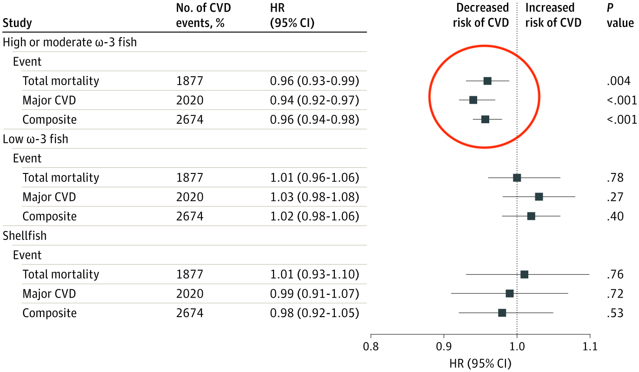
Associations Between Type of Fish and CVD for Each Five-Gram Increment in Consumption in the ORIGIN Study
Omega-3 fish
High: Herring, mackerel, sable, salmon, tuna (steak), and sardine Moderate: Anchovy, bluefish, oyster, tuna (can), salmon (can), and trout Low: Bass, barramundi, bream, flathead, flounder, perch, snapper, octopus, sword fish, tile fish, and shark
*Adjusted for age, sex, study center, BMI, education, smoking, physical activity, alcohol intake, urban rural location, diabetes, cancer, statin/antihypertension medication, intake of fruit, vegetables, red meat, poultry, dairy and total energy
Image source: Adapted from Mohan, D., Mente, A., Dehghan, M., Rangarajan, S., O’Donnell, M., Hu, W., Dagenais, G., Wielgosz, A., Lear, S., Wei, L., Diaz, R., Avezum, A., Lopez-Jaramillo, P., Lanas, F., Swaminathan, S., Kaur, M., Vijayakumar, K., Mohan, V., Gupta, R., … PURE, O., TRANSCEND, and ORIGIN investigators. (2021). Figure 2. Associations between types of fish (per 5-g increment) and clinical events in the outcome reduction with initial glargine intervention (ORIGIN) trial [Chart]. Associations of fish consumption with risk of cardiovascular disease and mortality among individuals with or without vascular disease from 58 countries. JAMA Internal Medicine, 181(5), 631–649. https://doi.org/10.1001/jamainternmed.2021.0036
Notes:
A larger study looked at the the impact of fish consumption for those with a prior history of CVD compared to those with no prior history. The results of the meta-analysis showed that only those with a history of CVD had significant results.
Notably, one of the study cohorts looked specifically at types of fish consumed which they categorized into 3 groups: high to moderate omega-3 fish, low omega 3 fish, and shellfish.
The data was from the Origin study, which was an RCT focused on 12,000 people aged 63.5 years at baseline with cardiovascular risk factors and impaired fasting glucose or diabetes. They nested a detailed FFQ in as part of their study. The results are pictured here.
And here you see benefits for total mortality, major CVD of about 4-7% lower risk of mortality for each 5 g/day consumption of fish.
Fish with higher amounts of omega-3 fatty acids were strongly associated with a lower risk of CVD (per 5-g increment of intake), whereas other fish were neutral
Similar protective associations of high omega-3 fish were found for sudden cardiac death, per 5-g increment of intake;( P < .001), whereas other types of fish were found to be neutral (P = .69).
These type of findings require confirmation from randomized clinical trials evaluating the effects of increasing fish consumption (especially oily fish) on the clinical outcomes of people with vascular disease. However, they do show that fish with higher levels of omega-3 fatty acids may play a role in desired outcomes.
-----
Data
Mohan, D., Mente, A., Dehghan, M., Rangarajan, S., O’Donnell, M., Hu, W., Dagenais, G., Wielgosz, A., Lear, S., Wei, L., Diaz, R., Avezum, A., Lopez-Jaramillo, P., Lanas, F., Swaminathan, S., Kaur, M., Vijayakumar, K., Mohan, V., Gupta, R., … PURE, O., TRANSCEND, and ORIGIN investigators. (2021). Associations of Fish Consumption With Risk of Cardiovascular Disease and Mortality Among Individuals With or Without Vascular Disease From 58 Countries. JAMA Internal Medicine, 181(5), 631–649. https://doi.org/10.1001/jamainternmed.2021.0036

Slide 48

Consumption During Pregnancy: Benefits and Risks
Benefits
Risks
Cognitive and language development
Lower risks of hypertension
Reduced risk of preterm birth
Essential nutrients: iron, iodine, choline
Large predator fish can contain high levels of mercury, a neurotoxin
Shark, swordfish, orange roughy, some types of tuna
Image source: Shutterstock.
Notes:
There is a positive association between fish consumption and pregnancy, including outcomes such as language and communication development of the children of mothers who consume fish. Consumption during pregnancy may also be related to reduced risk of hypertensive disorders and preterm birth. Beyond the omega-3 and 6 fatty acids, nutrients considered essential during pregnancy that come from fish include iron, iodine and choline. The data is not abundant, but it does support the recommendation to consume 8 to 10 ounces of fish per week.
However, some types of larger predator fish should be avoided because of the risk of mercury contamination, including shark, swordfish, orange roughly and some tuna.

Slide 49
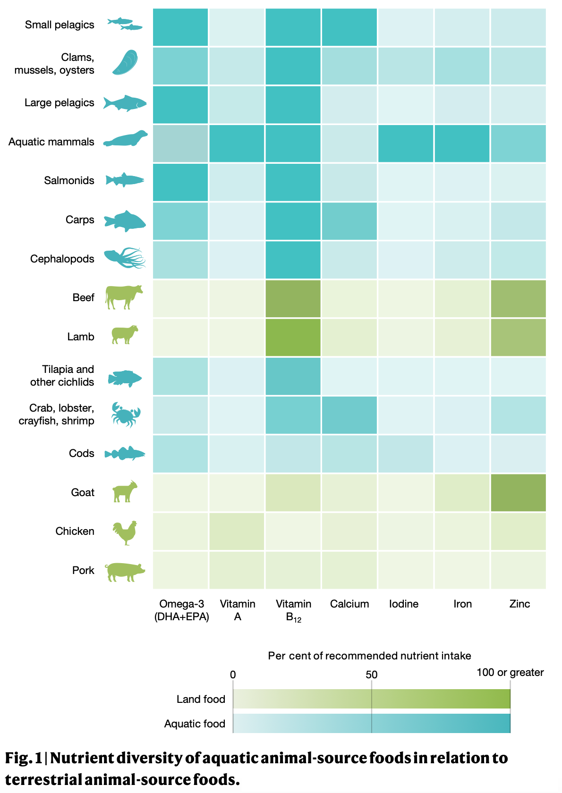
Nutrient Diversity of Aquatic-Source Foods
Image source: Golden, C., et al. Fig. 1, Nutrient diversity of aquatic animal-source foods in relation to terrestrial animal-source foods [Chart]. Aquatic foods to nourish nations. Nature, 598, 315–320. https://doi.org/10.1038/s41586-021-03917-1
Notes:
Aquatic foods are a highly diverse food group supplying a variety of important nutrients across different species.
Relative to land-based animal-source foods (beef, pork, poultry), aquatic foods have much more variation in nutrients.
Researchers in this 2021 Nature study created a comprehensive database of nutrients across over 3700 aquatic foods globally. As shown in this figure looking at omega-3 fatty acids, Vitamins A and B12, Calcium, iodine and zinc, the top 7 categories of nutrient rich animal source foods are all aquatic foods, including pelagic fish, bivalves and salomids such as trout, salmon and whitefish.
The main message is to consume a variety of aquatic foods. From small pelagic fish high in calcium, to oysters and bivalves high in Vitamin D, there is value in moving beyond the limited species we typically consume in the U.S.
-----
Graphic
Golden, C., Koehn, Z., Shepon, A., Passarelli, S., Free, C., Viana, D., Matthey, H., Eurich, J., Gephart, J., Fluet-Chouinard, E., Nyboer, E., Lynch, A., Kjellevold, M., Bromage, S., Charlebois, P., Barange, M., Vannuccini, S., Cao, L., Kleisner, K., … Thilsted, S. (2021). Aquatic foods to nourish nations. Nature, 598, 315–320. https://doi.org/10.1038/s41586-021-03917-1

Slide 50
Top Five Aquatic Species Consumed in the United States
Species group | Primary origin | Primary production method
Shrimp | Import (Asia) | Farmed
Salmon | Import (Canada, Chile, Norway) | Farmed
Canned tuna | Import (Pacific region) | Wild caught
Tilapia | Import (Asia, South America) | Farmed
Catfish | Import (Asia) / Domestic (Mississippi) | Farmed
Alaska pollock | Domestic (Alaska) | Wild caught
Notes:
Compared to many other countries, however, the U.S. eats less seafood per capita, and a lower diversity or variety of seafood. The top species consumed in the U.S. are shrimp, salmon, tuna, tilapia, catfish and Alaska pollock. That last one might surprise you. How often do you buy Alaska pollock at the grocery store? If you eat a McDonald’s fillet o’ fish, you are eating Alaska Pollock. Pollock is often used in many frozen white fish products – along with cod, hake or haddock.
Some are wild caught and some are from aquaculture. The trend is towards consumers eating more farmed species, which largely come from other countries. The US is the world’s largest seafood importer in terms of value, and second largest by quantity after China.

Slide 51
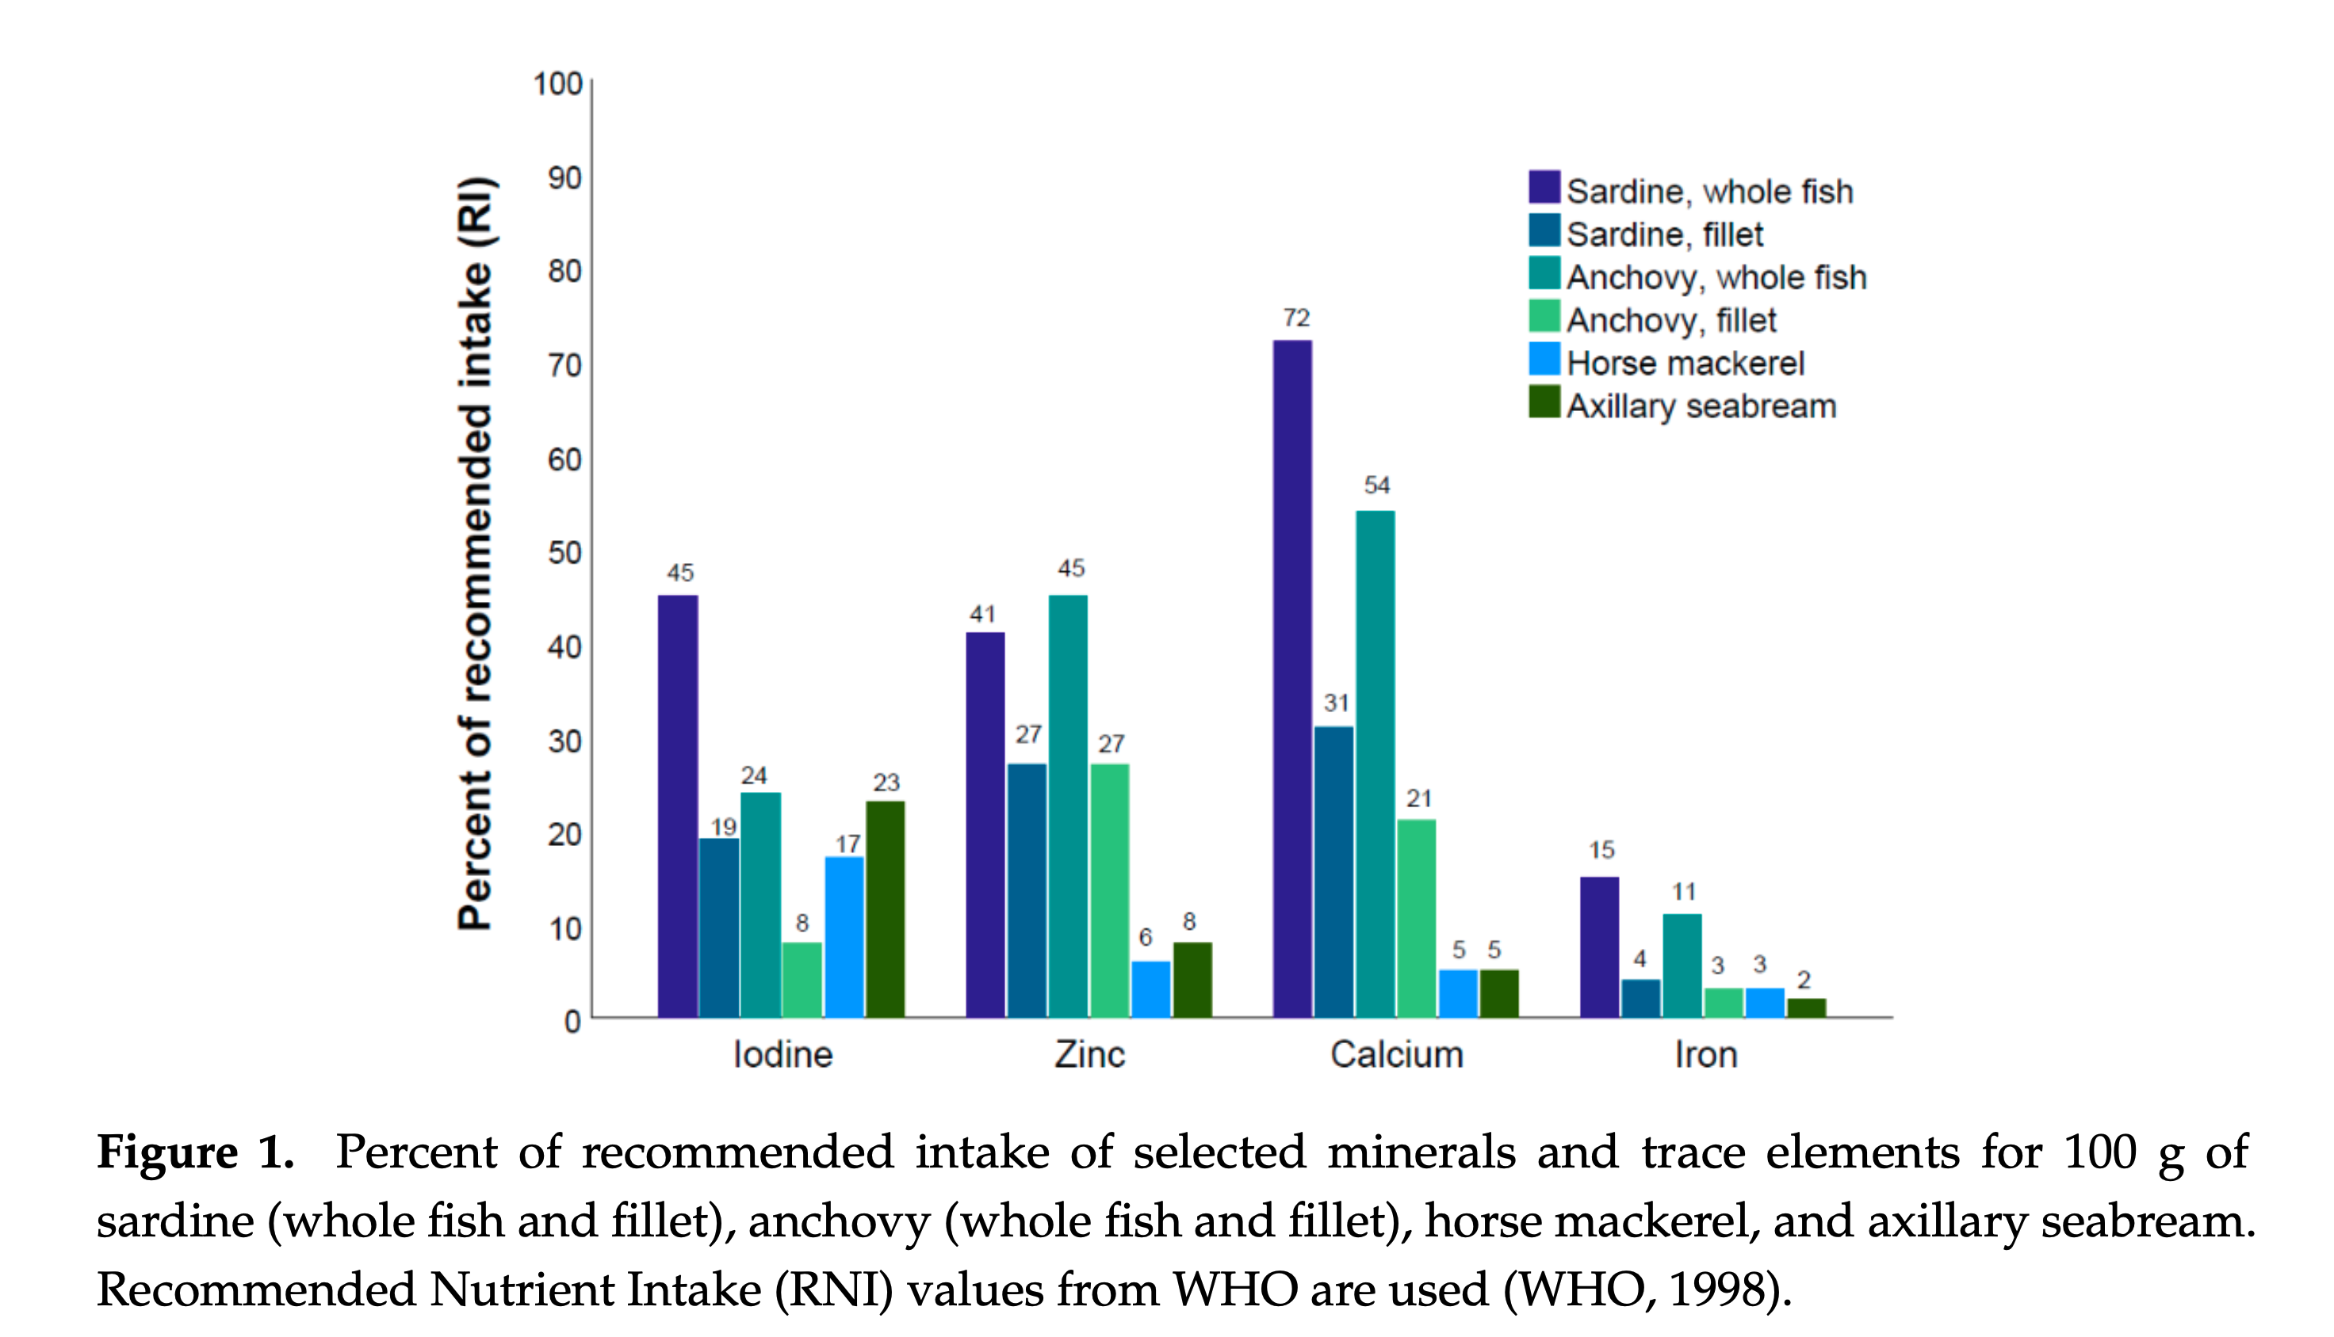
Micronutrient Content Depends on Edible Portion
Image source: Aakre, I., Bøkevoll, A., Chaira, J., Bouthir, F. Z., Frantzen, S., Kausland, A., & Kjellevold, M. (2020). Figure 1. Percent of recommended intake of selected minerals and trace elements for 100 g of sardine (whole fish and fillet), anchovy (whole fish and fillet), horse mackerel, and axillary seabream [Chart]. Variation in nutrient composition of seafood from North West Africa: implications for food and nutrition security. Foods, 9(10), Article 10. https://doi.org/10.3390/foods9101516
Notes:
Micronutrient value of aquatic foods depends on what part of the fish we eat. In this image from a 2020 analysis, whole fish were substantially more nutrient dense than fillets, especially with regard to vitamin A, iodine, zinc, calcium, and iron.
For other vitamins and the omega-3 fatty acids (not pictured here), the variance is greater by type of species with whole fish generally more nutrient rich. However, sardines and anchovies were the most nutrient dense species sampled, highlighting the nutrient contribution of smaller, oily and typically more affordable species of fish.
-----
Graphic
Aakre, I., Bøkevoll, A., Chaira, J., Bouthir, F. Z., Frantzen, S., Kausland, A., & Kjellevold, M. (2020). Variation in Nutrient Composition of Seafood from North West Africa: Implications for Food and Nutrition Security. Foods, 9(10), Article 10. https://doi.org/10.3390/foods9101516

Slide 52
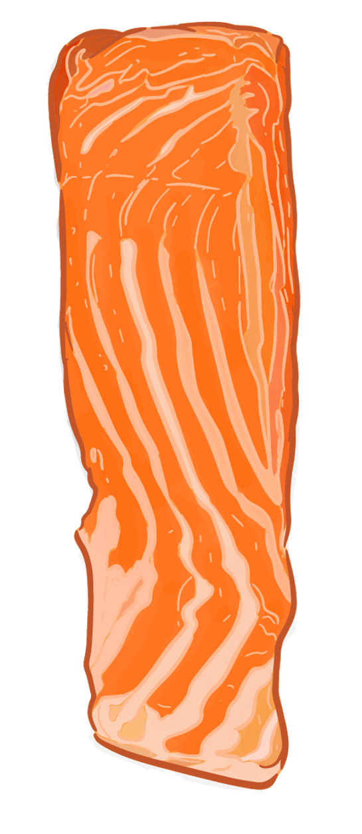
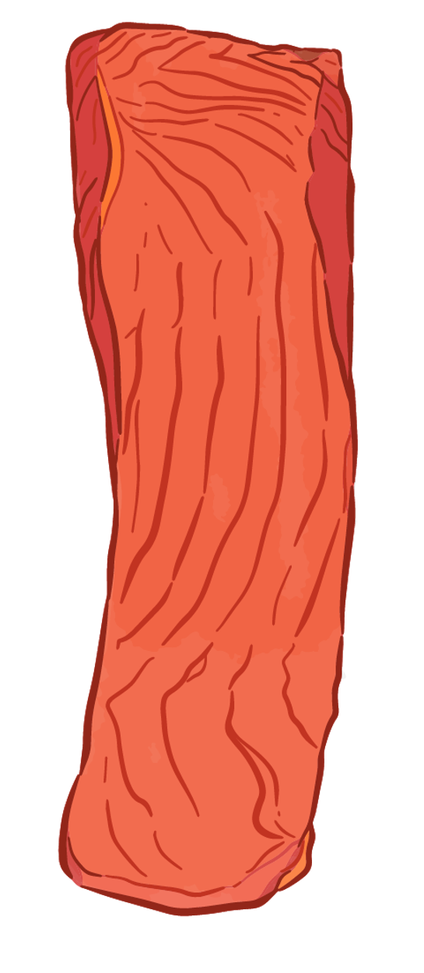
Wild-Caught or Farmed Salmon: Does it Matter for Nutrition?
Farmed salmon | Nutrients per 100g serving (raw) | Wild salmon
20.5 g | Protein | 20 g
13 g | Fat | 6 g
0.3 mg | Iron | 0.8 mg
Data from USDA FoodDataCentral: https://fdc.nal.usda.gov/food-details/173686/nutrients; https://fdc.nal.usda.gov/food-details/2684441/nutrients
Notes:
Let’s explore the question, Does the production method matter for nutrition? If you look at the picture, you see, they look very different.
Wild salmon on the RIGHT is very lean. The farmed salmon on the LEFT is a fattier fish. All farmed salmon do all day is swim in circles in their pen. They don't put on muscle tissue like a wild salmon does.
What makes such a huge difference, however, is the feed.
The two sources of protein and fat most commonly found in fish feed are plant-based crops and fish-based ingredients. The farmed salmon diet includes crops, soybean meal, cottonseed meal, corn, and distiller, grain and oats, and also oils pressed from the seed. So this gives these farmed animals a much different nutritional profile.
How does the nutrition profile stack up?
Wild and farmed salmon have about the same protein, but the fat content is quite variable. Wild salmon can have anywhere from 4 to 8 grams of fat per 100 grams, while farmed salmon is closer to 13 grams per 100 grams. As noted earlier, the ratio of Omega 3 to 6 fatty acids vary in farm raised fish based on the feed they are given. Farmed salmon can be lower in n-3 and higher n-6 from the vegetable oil in the feed. But overall, both farmed and wild salmon have very high levels of fatty acids. Much higher than generic whitefish or shrimp, for example.
Wild salmon also has slightly more iron and are darker in color. Wild salmon get their color by eating shrimp and krill. But farm-raised salmon generally have carotenoids added to their feed, either natural forms from ground-up crustaceans or synthetic forms created in a lab.
Nutrient data:
https://fdc.nal.usda.gov/food-details/173686/nutrients – Wild caught Atlantic salmon, raw 100g
https://fdc.nal.usda.gov/food-details/2684441/nutrients - Farm raised Atlantic salmon, raw 100g
More detailed nutrition comparison: https://www.sciencedirect.com/science/article/pii/S2666154320300375

Slide 53

Exploring Complexities: Seafood and Health Outcomes
Nutrition research is complicated!
Diversity of seafood types and form, including fish oil supplements
Contribution of other dietary and lifestyle factors
Dietary substitutions
Shifts in other risk factors (such as statin use, removal of trans fats) may be changing the risk profile
Image source: Microsoft Stock Images.
Notes:
Like the recommendations for pregnant women, the evidence about the nutrition and health benefits of consuming fish and seafood is nuanced.
Unlike chicken, pork, beef or milk, there is tremendous diversity in seafood species and many different factors affect the nutrition profiles of each. Fish is also consumed in different forms – from grilled with light herbs to breaded and fried. Some studies also look at fish oil supplementation together with fish consumption, which may influence the outcome.
Observational studies are also subject to confounding. Fish consumption is often associated with many other positive lifestyle factors that would likely be associated with better health outcomes. Another important concept is that fish confer nutrition benefits directly from the fish itself, but also as a substitute for something less healthy. So, if you’re trading seafood for two pieces of pepperoni pizza, that is very likely a double bonus for nutritional health.
Another challenge with developing evidence-based recommendations is that there have been changes in risk factors for cardiovascular disease such as the removal of trans fats from the food supply and the increased use of statins, that make it challenging to interpret the evidence for fish and fish oil supplementation.
So, while this makes it more challenging to understand the impact of fish intake on health, it’s also one of the most important reasons to eat a variety of fish and seafood.

Slide 54
Case Study 2

Slide 55
Section D: Aquatic Foods as Part of a Healthy and Sustainable Diet
Notes:
It's no wonder that consumers are confused about the sustainability of seafood. But there are some choices that are both healthier and more sustainable.
In the following slides, we’ll provide guidance on how you as nutrition professionals can help address these challenges.

Slide 56
Dietary Patterns and Healthy Eating Guidance
US Dietary Guidelines (2020)
Compatible with other dietary guidance and patterns
Pregnancy and postpartum
8–12 ounces/week, high omega-3 sources (best choices list)
Children 6 months and older
2 servings/week (best choices list)
Adults
8–12 ounces/week or 2 servings/week
American Heart Association
American Diabetes Association
American Pediatric Association
Mediterranean
Dietary Approaches to Stop Hypertension (DASH)
Mediterranean-DASH Intervention for Neurodegenerative Delay (MIND)
Engage, Act, Transform (EAT)-Lancet Planetary Health
Fermentable Oligosaccharides, Disaccharides, Monosaccharides, and Polyols (FODMAP)
Gluten-free
Source: USDA & HHS. (2020). Dietary Guidelines for Americans, 2020-2025 (No. 9th Edition; DGA). United States Department of Agriculture & United States Department of Health and Human Services. https://www.dietaryguidelines.gov/sites/default/files/2021-03/Dietary_Guidelines_for_Americans-2020-2025.pdf
Notes:
The 2020-25 US Dietary Guidelines recommend seafood consumption at all ages and stages. For adults - at least twice weekly, and children over 6 months - 2 servings of species that are lower in mercury. Guidance for pregnant and lactating women include choosing types that are lower in mercury and higher in Omega-3 fats.
Weekly seafood consumption is compatible with many other dietary recommendations from health-related organizations, such as American Heart Association and American Diabetes Association. Many healthy dietary patterns also include regular seafood consumption, including the Mediterranean diet, DASH, Planetary Health and even FODMAP and gluten-free patterns, among others.
-----
Information
USDA & HHS. (2020). Dietary Guidelines for Americans, 2020-2025 (No. 9th Edition; DGA). United States Department of Agriculture & United States Department of Health and Human Services. https://www.dietaryguidelines.gov/sites/default/files/2021-03/Dietary_Guidelines_for_Americans-2020-2025.pdf

Slide 57
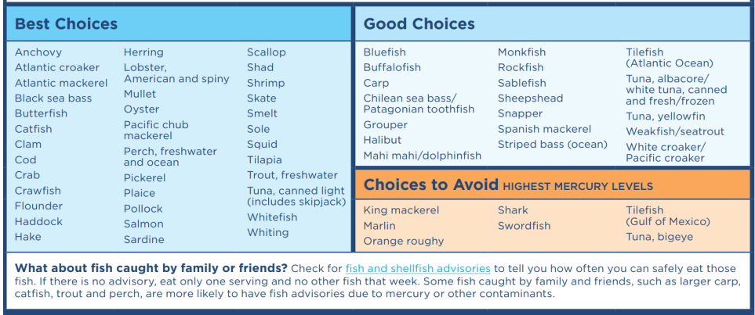
Choosing Lower Mercury Fish (EPA)
Image source: Adapted from US EPA. (2025). EPA-FDA advice about eating fish and shellfish: for females who might become pregnant, are pregnant, are breastfeeding, and for children. United States Environmental Protection Agency. https://www.fda.gov/media/102331/download
Notes:
The Environmental Protection Agency (EPA) has a list of seafood choices that are lower in mercury, categorized by best and good choices, as well as a few to avoid altogether that is useful in particular for pregnant women or children choosing seafood.
For more information, EPA has a fact sheet with guidance on choosing lower mercury fish that is useful in particular for pregnant women or children choosing seafood.
-----
Table
US EPA. (2025). EPA-FDA Advice about Eating Fish and Shellfish: For Females Who Might Become Pregnant, Are Pregnant, Are Breastfeeding, and for Children. United States Environmental Protection Agency. https://www.epa.gov/choose-fish-and-shellfish-wisely/epa-fda-advice-about-eating-fish-and-shellfish

Slide 58
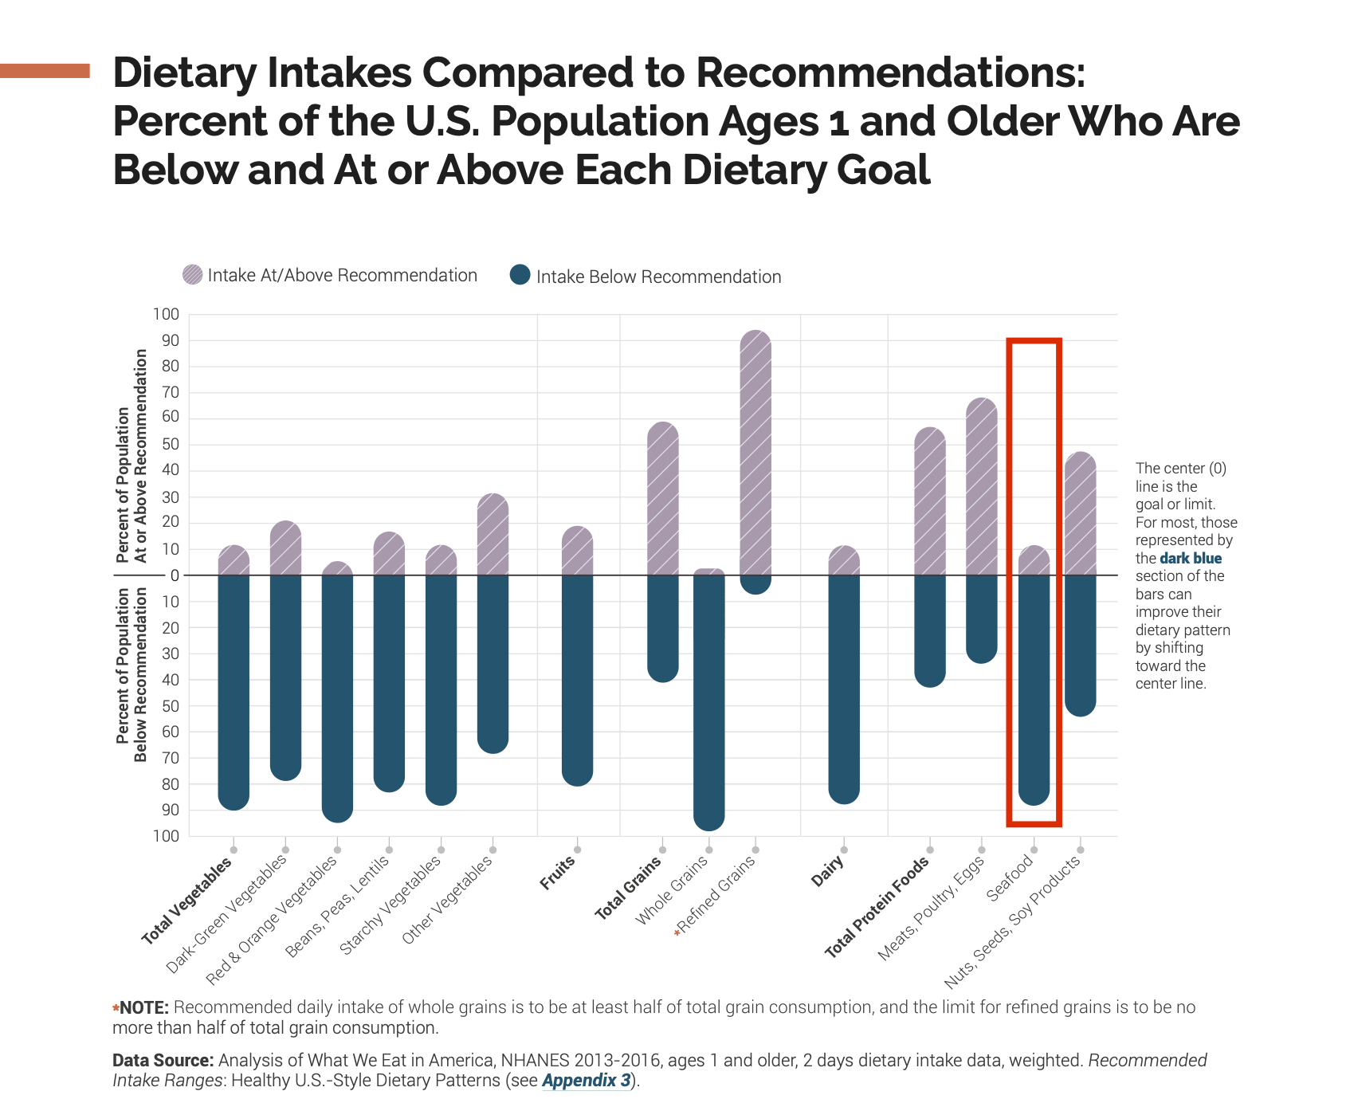
Dietary Intakes Compared to Recommendations
Image source: DGA. (2021). Dietary intakes compared to recommendations: percent of the U.S. population ages 1 and older who are below and at or above each dietary goal. Dietary Guidelines for Americans, 2020–2025. https://www.dietaryguidelines.gov/sites/default/files/2021-11/DGA_2020-2025_CurrentIntakesSnapshot.pdf
Notes:
Current data indicates that nearly 90 percent of Americans do not meet the DGA servings for seafood. Compare that to meat, poultry and eggs on the left where most people meet or exceed recommendations for the combined group. Reasons for this include unfamiliarity with preparation methods, affordability and dislike of fishy foods.
-----
Graph
DGA. (2021). Dietary Intakes Compared to Recommendations: Percent of the U.S. Population Ages 1 and Older Who Are Below and At or Above Each Dietary Goal. Dietary Guidelines for Americans, 2020-2025. https://www.dietaryguidelines.gov/sites/default/files/2021-11/DGA_2020-2025_CurrentIntakesSnapshot.pdf

Slide 59
Optimizing Omega-3
Current recommendations:
450–500 mg/day—Academy of Nutrition and Dietetics
World Heath Organization (WHO) 250 mg/day
American Heart Association: 8–12 ounces of fatty fish/week, preferably different types
If at higher risk for cardiovascular disease: up to 1,000 mg/day often recommended
Image source: Seafood Nutrition Partnership. (2023). Which Fish is the Richest in Omega-3s? (Per 4 Ounce Cooked Portion) [Graphic]. https://www.seafoodnutrition.org/wp-content/uploads/2023/06/New-Omega-3-Seafood-Chart.pdf
Notes:
Seafood varies in its Omega-3 fatty acid content.
The current recommendation range from an average of 250 to 500 milligrams per day for most, more if you have a higher risk of coronary artery disease¹. Given that consumers don't eat fish every day, incorporating more varieties of fatty fish – listed in the left columns of the table – will help consumers reach this target. The fish richest in Omega-3s include anchovies, herring, certain types of mackerel, oysters, sablefish and salmon, sardines, bluefin tuna and whitefish.
-----
Chart
Seafood Nutrition Partnership. (2023). Which Fish is the Richest in Omega-3s? (Per 4 Ounce Cooked Portion) [Graphic]. https://www.seafoodnutrition.org/wp-content/uploads/2023/06/New-Omega-3-Seafood-Chart.pdf
¹https://www.nhlbi.nih.gov/news/2024/omega-3s-heart-health-exploring-potential-benefits-and-risks

Slide 60
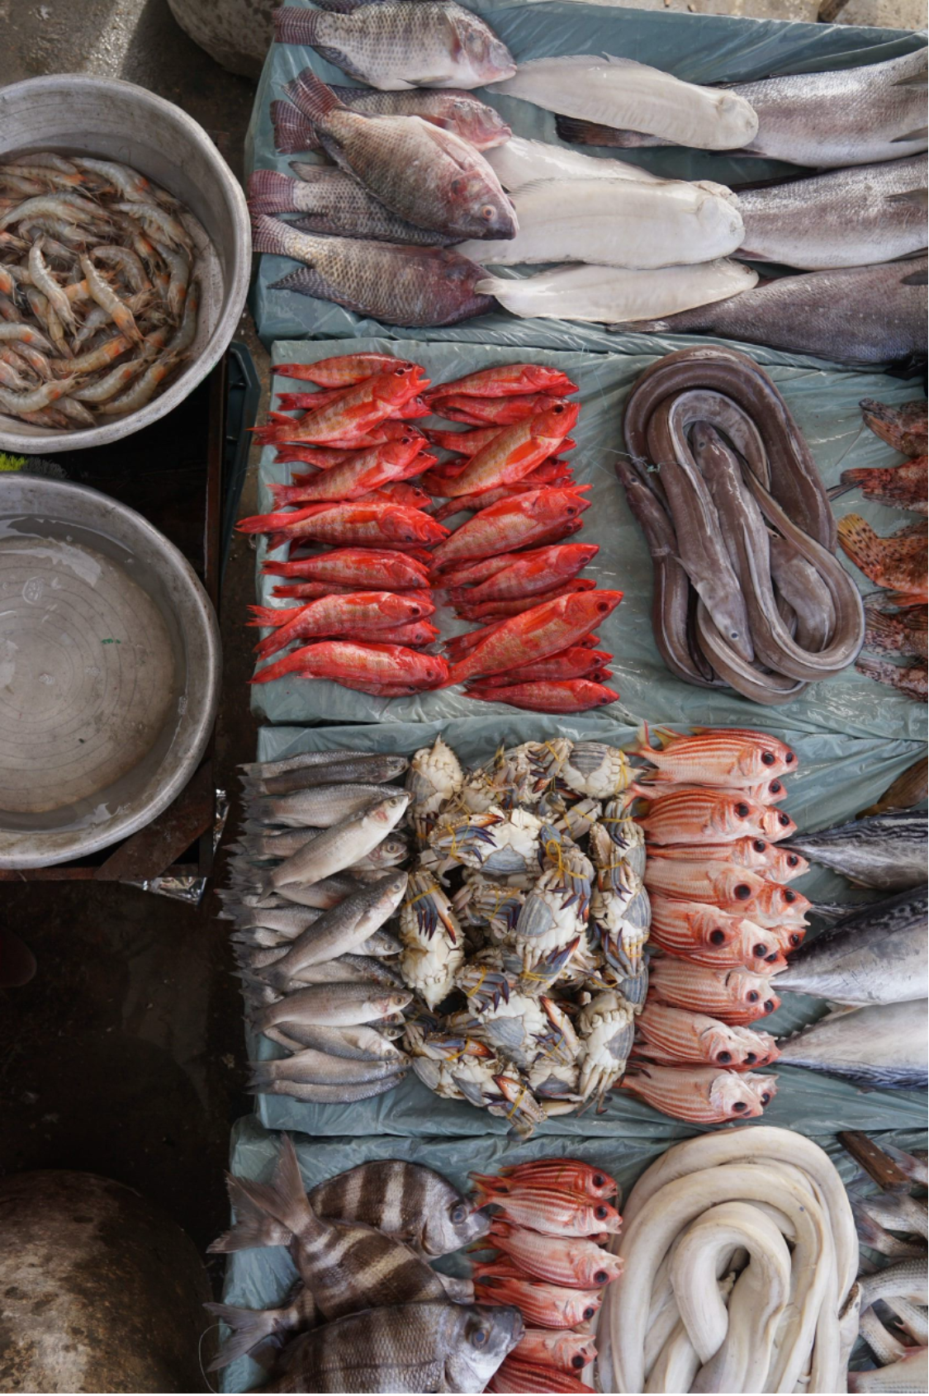
Diversify Seafood Choices
Use lesser-known varieties, such as:
Arctic char, lionfish, cobia
Incorporate filter feeders into menus
Oysters, mussels, clams, and scallops
Fish does not have to be a “center of the plate” protein
In many countries, it is consumed more like a vegetable
Image source: Shutterstock.
Notes:
As mentioned earlier, the most consumed types of seafood in the US include shrimp salmon, tuna, tilapia, catfish and Alaska Pollock. With around 1700 species available for consumers, nutrition and food professionals have a unique opportunity to highlight different species and creative, tasty recipes and menus using species such as arctic char, lionfish, and cobia just to name a few.
In particular, filter feeders – such as oysters, clams, scallops and mussels - don't require feed and also help remove excess nitrogen from waters by incorporating it into their shells and tissue as they grow. However, these types of seafood are more typically consumed away from home. Increasing the familiarity and acceptance of these less familiar types of seafood is an important step in ensuring consumer uptake.

Slide 61

Sea Vegetables
Definition: A vast, diverse group of edible marine algae and plants that grow in or near oceans, rivers, and lakes
Also called seaweeds, sea greens, sea plants
There are over 10,000 types of seaweed across our oceans, though just a handful of edible varieties reach our plates in the US
Though traditionally foraged, 96% of sea vegetables are cultivated today
Sources: Cherry, P., O’Hara, C., Magee, P., McSorley, E., & Allsopp, P. (2019). Risks and benefits of consuming edible seaweeds. Nutrition Reviews, 77(5), 307–329. https://doi.org/10.1093/nutrit/nuy066
Image source: Shutterstock.
Notes:
Sea Vegetables include a vast, diverse group of edible marine algae and plants that grow in or near the ocean, rivers and lakes.
They are also called seaweeds, sea greens, sea plants
There are over 10,000 types of seaweed across our oceans, though just a handful of edible varieties reach our plates in the U.S.
Sea vegetables have traditionally been collected along coastal shores; however, 96% percent of sea vegetables consumed today are cultivated
Seaweed cultivation does not require arable land or freshwater. In most cases does not require fertilization.
-----
Data
Cherry, P., O’Hara, C., Magee, P., McSorley, E., & Allsopp, P. (2019). Risks and benefits of consuming edible seaweeds. Nutrition Reviews, 77(5), 307–329. https://doi.org/10.1093/nutrit/nuy066

Slide 62

Nutritious Seaweed
Sea vegetables are considered the world’s most nutrient-dense foods
Have been used for food and medicine for millennia in most coastal regions of the world
Contain a variety of essential nutrients, including vitamin A, folate, omega-3 fatty acids (DHA/EPA) iron, iodine and magnesium
A staple ingredient in the “Blue-Zone” Okinawan and Mediterranean diet patterns
Image source: Shutterstock.
Notes:
Sea vegetables have a lot to offer nutritionally. In fact, they are considered one of the world’s most nutrient dense foods.
They have been used for food and medicine for millennia in most coastal regions of the world
Sea vegetables contain a variety of essential nutrients, including Vitamin A, folate, Omega-3 fatty acids (DHA/EPA) iron, iodine and magnesium, though they vary by type. They are an especially good source of iodine, as seen in this example of Nori Seaweed.
They are a staple ingredient in the “Blue-Zone” Okinawan and Mediterranean diet patterns.

Slide 63

Social and Ecological Impacts of Seaweed Farming
Cultivation does not require arable land or freshwater
In most cases, grown without fossil-fuel-based agricultural inputs (pesticides, fertilizers)
Local context and conditions play a large role in socioecological impacts
Image source: Spillias, S., Kelly, R., Cottrell, R. S., O’Brien, K. R., Im, R.-Y., Kim, J. Y., Lei, C., Leung, R. W. S., Matsuba, M., Reis, J. A., Sato, Y., Sempert, K., & McDonald-Madden, E. (2023). Fig 1, Twenty social and environmental impact categories of seaweed farming as identified by our systematic review. [Chart.] The empirical evidence for the social-ecological impacts of seaweed farming. PLOS Sustainability and Transformation, 2(2). https://doi.org/10.1371/journal.pstr.0000042
Notes:
Sea vegetables or seaweed offer many environmental and social benefits as well. Their cultivation does not require arable land or freshwater, and they can be produced without fossil fuel based agricultural inputs, such as pesticides or fertilizers. They also have a beneficial effect on the water quality where they grown.
The diagram here is from a 2023 review of the evidence for socio-ecological impacts of seaweed farming, which found consistent evidence for beneficial socio-ecological impacts of seaweed farming, including positive effects on water quality, carbon management, livelihood generation, gender equality, and living standards, a deleterious facilitation of algal blooms, and a benign impact in terms of invasiveness. Other indicators had more mixed findings, including biodiversity, acidification, hydrodynamics, human health, and community culture and resilience. Local context and conditions play a large role in mediating this variability
------
This comprehensive review found consistent evidence for beneficial socio-ecological impacts of seaweed farming, including positive effects on water quality, carbon management, livelihood generation, gender equality, and living standards, a deleterious facilitation of algal blooms, and a benign impact in terms of invasiveness (Fig 1). There was a lack of consistent data to determine whether seaweed farming had an overall negative, positive, or neutral effect in several of the categories that emerged from this review, including biodiversity, acidification, hydrodynamics, human health, and community culture and resilience. Local context and conditions play a large role in mediating this variability.
-----
Graphic
Spillias, S., Kelly, R., Cottrell, R. S., O’Brien, K. R., Im, R.-Y., Kim, J. Y., Lei, C., Leung, R. W. S., Matsuba, M., Reis, J. A., Sato, Y., Sempert, K., & McDonald-Madden, E. (2023). The empirical evidence for the social-ecological impacts of seaweed farming. PLOS Sustainability and Transformation, 2(2). https://doi.org/10.1371/journal.pstr.0000042

Slide 64
Summary: Choosing Seafood for Health and Sustainability
Nutrition/health choices
Sustainability choices
Higher in omega-3 fatty acids
Higher in micronutrients
Zinc, calcium, iron, vitamin A, selenium
Low in mercury and pollutants
Note allergies and food safety
Healthy preparation/cooking methods and added ingredients
Lower greenhouse gas footprint, freshwater use, nutrient pollution
Fewer chemicals and pesticides
Human rights and occupational concerns
Transportation and processing
Third-party certified for sustainability
Notes:
In summary, choosing seafood that is good for us and good for the planet often requires considering multiple factors at once. We have talked about many of these factors, but let’s review. Nutritional and health considerations include the levels of Omega-3 fatty acids and micronutrients such as iodine, zinc, calcium, iron and selenium just to name a few. You also want fish that are less likely to be contaminated with harmful metals like mercury. There can be issues with allergies and food safety. And of course, like many foods, the nutritional profile of seafood can be impacted by how it is cooked and prepared.
Many factors influence the sustainability of various seafood options. First is the carbon and water footprint of various species, the methods used in their production, and how the fish are managed. There may be concerns with the chemicals and pesticides that are used, particularly in aquaculture, and this will have implications on the health of waterways and the surrounding ecosystems. may be used, particularly in aquaculture, labor and human rights concerns and transportation and processing. Commercial seafood buyers often know about sustainability considerations but may be less aware of the nutritional attributes and health considerations, and hearing both perspectives can help them make a balanced choice. whether or not there are third-party certifications that can verify the claims made on a label.

Slide 65
Case Study 3

Slide 66




Sustainability Labels
Image sources: Courtesy of the Monterey Bay Aquarium; Marine Stewardship Council; Aquaculture Stewardship Council (ASC).
Notes:
Sustainability labels can be an important tool for helping consumers make purchasing decisions. However, current labels vary greatly in their reliability. Beyond labels, some organizations have developed guides to choosing aquatic foods that address safety, nutrition and sustainability.
The Monterey Bay Aquarium has been tracking the sustainability of different farmed and wild caught aquatic animal species for decades for their “Seafood Watch” guide. Because the environmental impact of a fish depends on where and how it was caught or raised, Seafood Watch guides developed recommendations for specific regions and production methods such as different fishing gear or different farming methods.
Seafood with the blue Marine Stewardship Council label can be traced back to a sustainable source and are verified Independent surveillance audits and DNA testing.
The Aquaculture Stewardship Council is newer and monitors the sustainability of fish grown in aquaculture systems. The label only appears on food from farms that have been independently assessed and certified as being environmentally and socially responsible.

Slide 67

Preparation Methods are Important
Cooking and preparation influence nutritional content
High heat may alter fatty acid and key vitamins
Breading and frying change fatty acid profile, reducing overall percent of omega-3 fatty acids
Healthiest options include:
Bake
Grill or broil
Sauté
Poach or steam
Sous vide
Image source: Shutterstock.
Notes:
How fish is prepared also has an impact on its nutrient profile and health.
Seafood served in restaurants and quick serve venues is often breaded and fried or otherwise prepared with added fats and ingredients that alter the overall nutrition profile and add extra calories.
Cooking can change the lipid profile through the absorption of cooking fats into the fish, leaching of fats out of the fish or oxidation with free radicals. High heat methods, such as deep frying, may reduce the fatty acid profile. It doesn’t appear that EHA and DHA are impacted greatly; however, other fats – MUFA and ALA’s – may be impacted.
There are many quick and delicious alternative methods to frying seafood that preserve flavor and nutrition. The healthiest options include baking, grilling, broiling or sautéing. Poaching, steaming and sous vide are also excellent ways to preserve moisture and nutrition. Try to avoid deep frying, heavy batters, cream and other cheese-based sauces.

Slide 68

Messaging Tips for Aquatic Foods
Highlight sourcing and safety
79% of eaters say “safe to eat” is the most important criterion
Educate on best choices, transparent and sustainable sourcing, and honest evaluations of benefits and risks
Showcase culturally relevant recipes and ideas that save time
Share ideas that connect with your audience
Compare to land-based agriculture
Connecting aquatic foods to familiar, land-based food production examples can help paint a clearer picture of health and sustainability
Sources: Food + Planet. (n.d.). Explore our toolkits! Aquatic Foods. Retrieved November 24, 2025, from https://eataquaticfoods.org/toolkits; Image courtesy of Vanessa Stump, Food + Planet.
Notes:
Here are some ideas to help your clients to fully embrace aquatic foods.
First, highlight simple ways to ensure the safest and best sourcing of aquatic foods.
Second, showcase preparation methods and recipes that are simple, quick and culturally relevant
Third, demonstrate the health and sustainability advantages of aquatic foods over land-based (terrestrial) animal foods
And finally, remember that fish does not have to be consumed as a filet or main course. Fish can be a side dish, or part of a mix of rice, and other grains and vegetables, the way it’s consumed in many parts of the world. This is a great way to add fish to our diets in a way that balances nutritional needs with sustainability concerns. It may also make seafood a more affordable option for your clients.
-----
Information
Food + Planet. (n.d.). Explore Our Toolkits!. Aquatic Foods. Retrieved November 24, 2025, from https://eataquaticfoods.org/toolkits

Slide 69

Blue Foods Toolkit—1
Image source: Courtesy of Food + Planet. (n.d.). Blue Food as Medicine Curriculum Four-Part Series. Aquatic Foods. https://eataquaticfoods.org/curriculum
Notes:
There are many ways that dietitians and nutrition professionals can work with clients and organizations to incorporate more healthy and sustainable aquatic foods into their weekly meals. Food and Planet developed a four-part curriculum for understanding and promoting aquatic or blue foods that can be accessed free of charge.
-----
Graphic
Food + Planet. (n.d.). Blue Food as Medicine Curriculum Four-Part Series. Aquatic Foods. Retrieved November 24, 2025, from https://eataquaticfoods.org/curriculum

Slide 70

Blue Foods Toolkit—2
Image source: Courtesy of Food + Planet. (2023). Blue Food As Medicine Cookbook. Eat Aquatic Foods. https://eataquaticfoods.org/cookbook
Notes:
They have also developed a cookbook to facilitate the use of a variety of diverse species of seafood and sea vegetables.
-----
Graphic
Food + Planet. (2023). Blue Food As Medicine Cookbook: 20 Healthy, Delicious Recipes Featuring Sea Vegetables, Clams, Mussels, Oysters, and Scallops. Eat Aquatic Foods. https://eataquaticfoods.org/cookbook

Slide 71
Discussion—2
Consider the audience you work with most or will work with in the future
What values and beliefs might they hold that impact choices to consume aquatic foods?
What might be barriers to consuming more aquatic foods?
Develop three messages to help consumers consider including more aquatic foods in their weekly meals
Consider health, sustainability, affordability, taste, and time restrictions

Slide 72
Key Points: Moving Towards Sustainable Seafood
Seafood provides many important nutrients and is critically important for many low-income regions
Fisheries and aquaculture can help meet rising demand only if managed sustainably
Both are likely to be impacted by climate change
Rising sea levels, increasing water temperature, ocean acidification
Governance and policy must balance demand, sustainability, and the food security needs for low-income coastal communities who rely on seafood for nutrition and livelihoods
Dietitians and nutrition professionals have important roles communicating the advantages and nuances of aquatic food consumption and making them more accessible and familiar
Notes:
Let’s wrap up and summarize what was shared in this talk.
Seafood provides many important nutrients and is critically important for many low-income regions.
We seem to be moving towards more sustainable fisheries and aquaculture that can meet rising demand with less impact on the environment and natural resources.
Both fisheries and aquaculture are being impacted by climate change and related risks, such as sea level rise, increasing sea water temperature, and ocean acidification. And these are stressors that are contributing to an already tenuous system.
Good policy and governance can and should balance demand for seafood, food security for communities who rely on seafood, protection for workers, and long-term sustainability of fisheries. We're relying on aquatic foods to feed many people around the world. And, if we can mitigate the environmental impacts and also create nutritious, healthy food, that's going to be a win-win.

Slide 73

Thank You!
Image source: Johns Hopkins Center for a Livable Future. Text is available from https://www.seafoodwatch.org/recommendations/download-consumer-guides/popular

Slide 74
Practice and Resources Booklet

Slide 75

About This Presentation
© Copyright 2026 Johns Hopkins University.
Attribution-NonCommercial-ShareAlike 4.0 International
Produced by the Center for Teaching and Learning at the Johns Hopkins Bloomberg School of Public Health.
S2601

