Slide 1
Nourishing the Future: Sustainable Food Systems for Nutrition and Dietetic Students
Presented by:
Johns Hopkins Center for a Livable Future
Food + Planet
Notes:
Welcome to Nourishing the Future: Sustainable Food Systems Learning Modules for Nutrition and Dietetic Students.

Slide 2
Food and Our Climate
Module 3
Presented by:
Johns Hopkins Center for a Livable Future
Food + Planet
Notes:
This lecture series was produced by the Johns Hopkins Center for a Livable Future in partnership with Food plus Planet.

Slide 3
Four Modules
Module 1
Introduction to Sustainable Food Systems
Module 2
Food Systems
for All
Module 3
Food and
our Climate
Module 4
Aquatic Foods, Nutrition, and Sustainability
Notes:
The series is composed of four modules. The initial module in the series is an Introduction to Sustainable Food Systems. The second is Food Systems for All. This is Module 3, Food and our Climate.

Slide 4
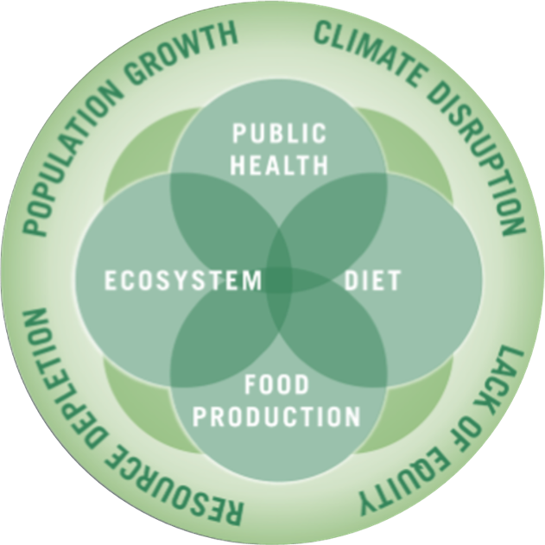
The Johns Hopkins Center for a Livable Future
Interdisciplinary academic center at the Johns Hopkins Bloomberg School of Public Health
Education, research, policy, and practice
Vision: a healthier, sustainable and resilient food system for all
Image source: Johns Hopkins Center for a Livable Future.
Notes:
The Johns Hopkins Center for a Livable Future is an inter-disciplinary academic center at the Johns Hopkins Bloomberg School of Public Health. The Center is engaged in education, research and practice at the intersection of public health, diet, food production and ecosystem health, which are all influenced by and connected to population growth, climate, resource depletion and equity. The Center collaborates with researchers, community groups and advocates at the local, state, national and international level and provides technical assistance to partner organizations. The Center’s vision is a healthier, sustainable and resilient food system for all.
This lecture series is based on the expertise and teaching resources of many faculty and staff at the Center, our collaborators across Johns Hopkins University and our many non-academic partners. We graciously acknowledge their work and thank them for allowing us to share it with you.

Slide 5
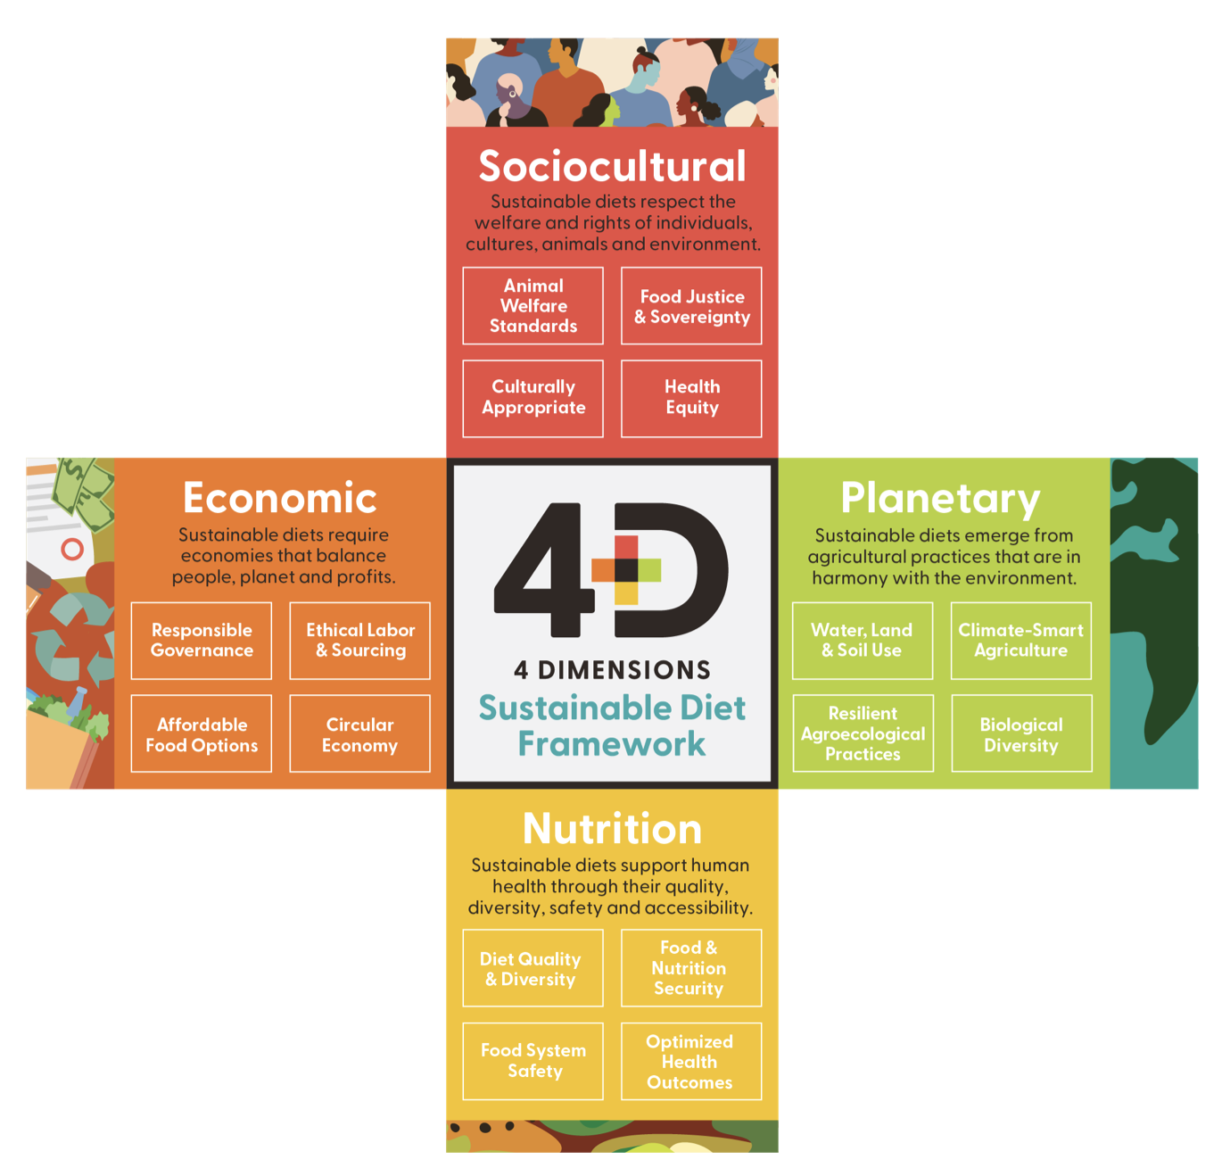
Food + Planet
Vision: a science and practice of nutrition that honors nature as the foundation of health through the four dimensions of sustainability
A collective, visionary 501c3 founded by four registered dietitians with varied experience in the food system
Aim: empower health care professionals to be leaders in sustainable food systems
Image source: Vogliano, C., Geagan, K., Chou, S., Palmer, S. (2021). Figure 1. The 4 dimensions of sustainable diets. [Infographic]. Empowering nutrition professionals to advance sustainable food systems [White Paper]. Food and Planet. Retrieved September 14, 2025, from https://7157e75ac0509b6a8f5c-5b19c577d01b9ccfe75d2f9e4b17ab55.ssl.cf1.rackcdn.com/GVISUTJI-PDF-1-675987-4519061561.pdf
Notes:
Food + Planet is a collective, visionary 501c3 founded by four registered dietitians with varied experience in the food system. Our aim is to empower healthcare professionals to be leaders in sustainable food systems. We envision a science and practice of nutrition that honors nature as the foundation of health through the four dimensions of sustainability: Sociocultural, Economic, Planetary and of course, Nutrition.

Slide 6
Learning Objectives
Summarize the relationship between food systems and climate change
Explain risks to our food systems from a changing climate
Evaluate dietary shifts to reduce the greenhouse gas contributions from food systems
Describe the role of RDNs as leaders in food system change
Notes:
After completing this module, you should be able to (read learning objectives).

Slide 7
Section A: Primer on Climate Change
Notes:
Section A will be a quick review of climate change as a primer for the remaining sections.

Slide 8
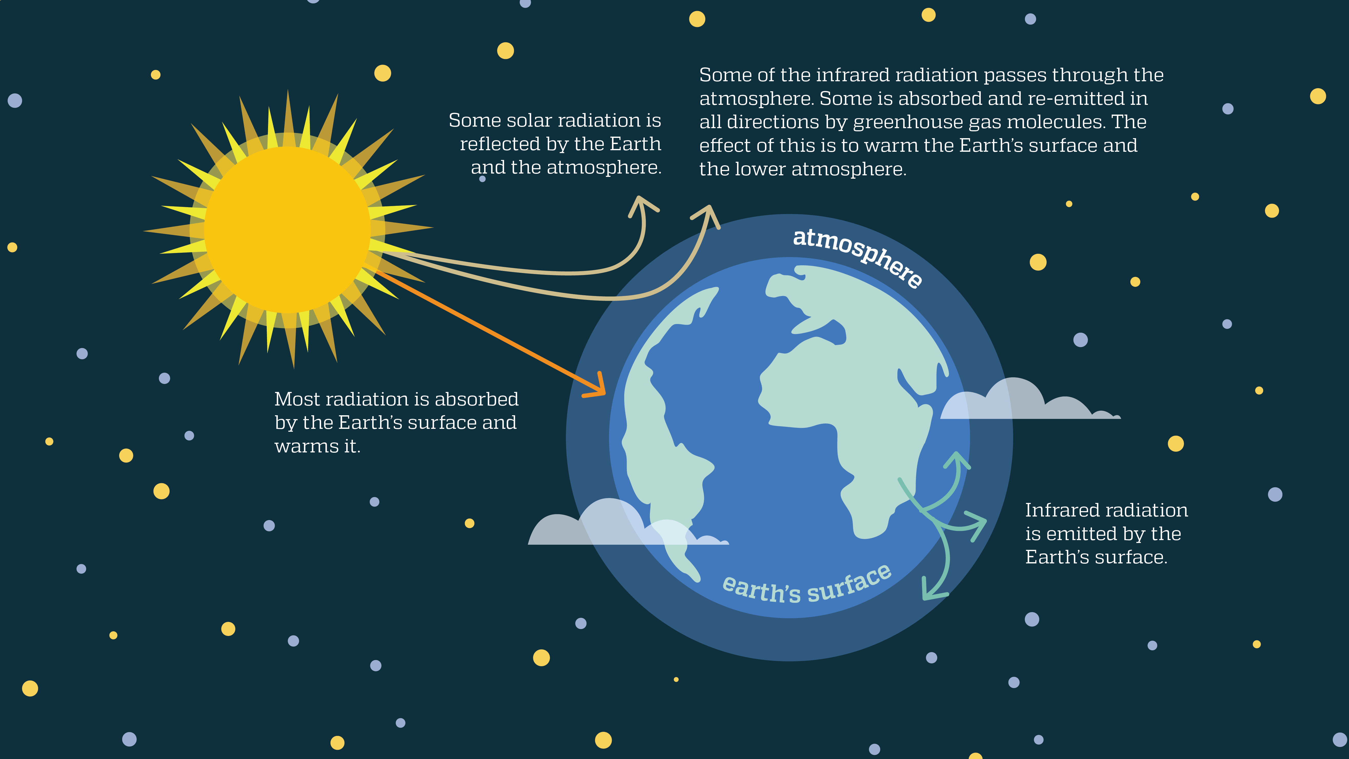
The Greenhouse Effect
Image source: Adapted by the Johns Hopkins Center for a Livable Future from U.S. Environmental Protection Agency. (2014). The greenhouse effect [Chart on page 4]. Climate change indicators in the United States, 2014. Third edition. EPA 430-R-14-004. https://www.epa.gov/sites/default/files/2016-07/documents/climateindicators-full-2014.pdf
Notes:
Let’s start with the basics, which may be a review for many of you. Why are carbon dioxide and other gases called “Greenhouse Gases”? Gases in Earth's atmosphere trap the Sun's heat, keeping the surface of our planet warm. The greenhouse effect is one of the things that makes Earth a comfortable place to live.
These gases are called greenhouse gases, and the warming of earth is called the greenhouse effect. This is part of normal planetary systems that have existed for millions of years.
Over the last 800,000 years, we know there have been natural cycles and fluctuations that have caused the earth’s climate to very gradually change several times. However, the rapid warming we have seen in the past century or so is not from natural cycles. Since the start of the industrial revolution when humans began burning fossil fuels as energy, greenhouse gas emissions have been increasing rapidly. Greenhouse gasses are also released when we cut down forests and produce food. These gasses accumulate, trapping more and more of that solar energy in the atmosphere and keep it from radiating out. And our planet gets warmer and warmer.

Slide 9
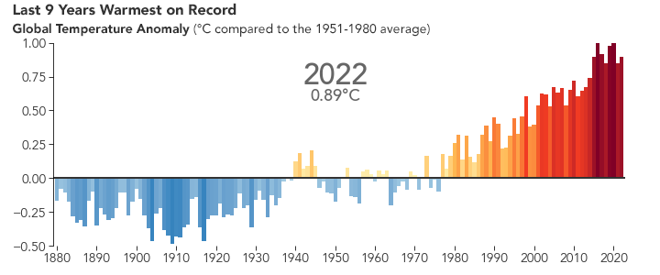
Average Global Temperature Increases
Sources: NOAA Climate. (2023). Global average surface temperature in 2022 compared to the 1991–2020 average. Climate.gov. https://www.climate.gov/media/15007;
Image is from NASA. (2020). Last 9 years warmest on record [Chart]. World of change: global temperatures. NASA Earth Observatory. https://earthobservatory.nasa.gov/world-of-change/global-temperatures
Notes:
How much has the planet already warmed? Climate scientists track the global temperature anomaly by comparing each year’s average temperature to the 20th century average. The blue bars in this image show that between 1880 and the middle of the 20th century, the average global temperature was almost always slightly below our current average. During the middle of the 20th century, some years were ABOVE the average, and some were below. But since about 1980, as you can see by the red bars, average global temperature each year have been above the average. 2024 was the warmest year on record, surpassing the previous record, which was 2023.
-----
Graph
NASA. (2020). World of Change: Global Temperatures. NASA Earth Observatory; NASA Earth Observatory. https://earthobservatory.nasa.gov/world-of-change/global-temperatures
NOAA Climate. (2023). Global average surface temperature in 2022 compared to the 1991-2020 average. Climate.gov. https://www.climate.gov/media/15007

Slide 10
Trends in Global Temperature Changes
In 2024, Earth was 2.6 degrees Fahrenheit (1.47 degrees Celsius) warmer than the 1800s prior to the Industrial Revolution
The warmest years have all occurred in the recent past: 2014–2024
If humans do nothing to reduce greenhouse gas emissions, temperatures are predicted to rise another 2.5–10 degrees Fahrenheit over the next century
Sources: UN. (n.d.). Climate action fast facts. United Nations Climate Action. Retrieved July 31, 2025, from https://www.un.org/en/climatechange/science/key-findings; NOAA. (2023). It’s official: 2022 was the world’s 6th-warmest year on record. Climate.gov. https://www.climate.gov/media/15007; Bardan, R. (2025). Temperatures rising: NASA confirms 2024 warmest year on record. NASA. https://www.nasa.gov/news-release/temperatures-rising-nasa-confirms-2024-warmest-year-on-record/
Notes:
Data in early 2025 showed that Earth is 2.6 degrees Fahrenheit warmer than in the 1800’s prior to the industrial revolution. This is the equivalent of 1.47 degrees Celsius. You’ll notice most of the reports on climate change refer to temperature in Celsius. In this presentation, we will provide temperatures in both Celsius and Fahrenheit.
And the past 10 years were all the warmest years on record.
At this rate, if we do nothing to address greenhouse gas emissions, temperatures could increase UP TO 10 degrees over the next century.
-----
Data
UN. (n.d.). Climate Action Fast Facts. United Nations Climate Action; United Nations. Retrieved July 31, 2025, from https://www.un.org/en/climatechange/science/key-findings
NOAA Climate. (2023). It’s Official: 2022 was the world’s 6th-warmest year on record. Climate.gov. https://www.climate.govhttps://www.climate.gov/media/15007
Bardan, R. (2025). Temperatures Rising: NASA Confirms 2024 Warmest Year on Record. NASA. https://www.nasa.gov/news-release/temperatures-rising-nasa-confirms-2024-warmest-year-on-record/

Slide 11
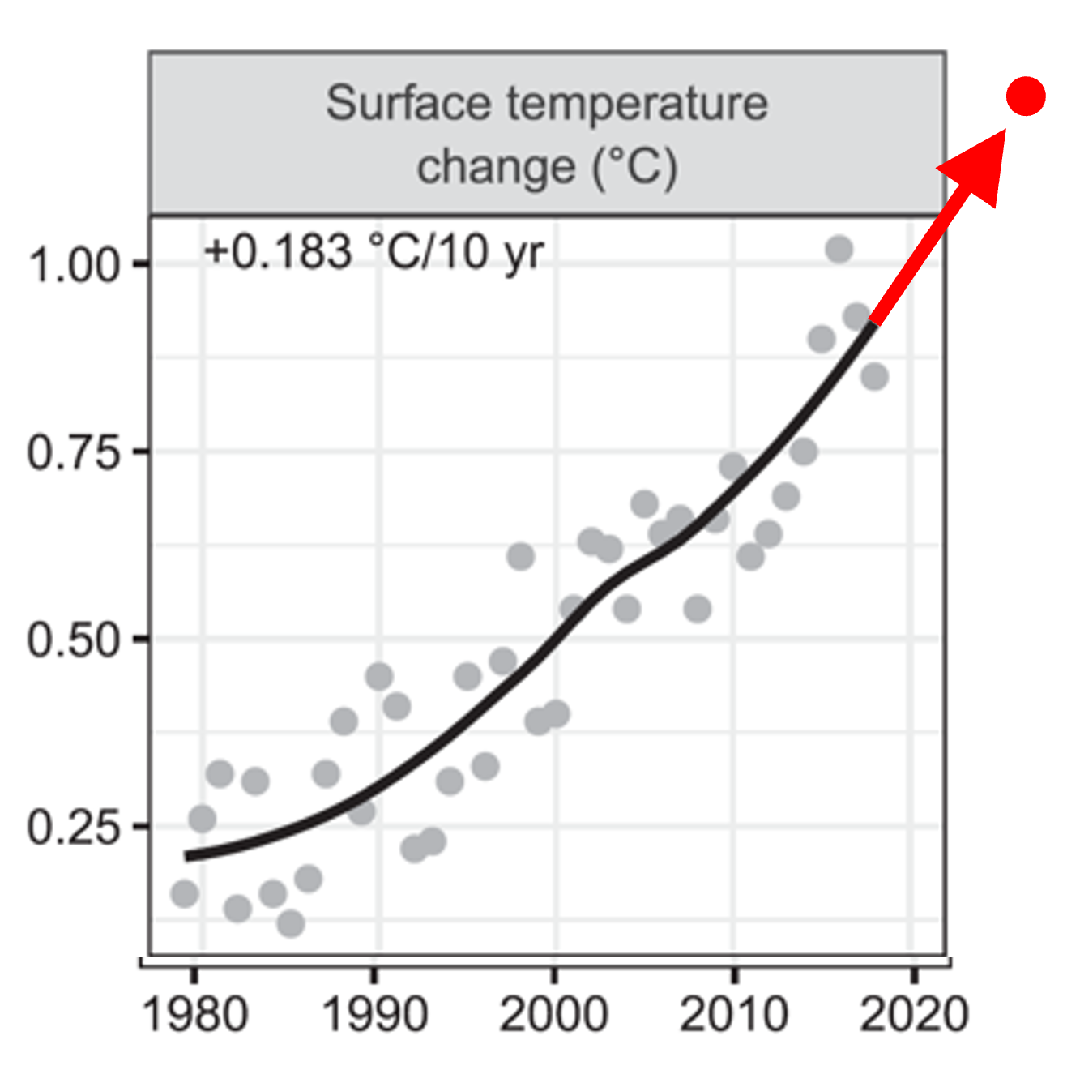
Climate Mitigation Targets
Average global temperature rise:
  < 1.5 degrees Celsius (2.7 degrees Fahrenheit)
  < 2 degrees Celsius (3.6 degrees Fahrenheit)
    Less ambitious
    More feasible
    More dangerous
How are we doing?
  2024 averages: ~1.4 degrees Celsius
Sources: UNFCCC. (2022). Nationally determined contributions under the Paris Agreement: Synthesis report by the secretariat (No. GE.22-17490(E)). United Nations Framework Convention on Climate Change. https://unfccc.int/documents/619180; Climate Central. (2023). The hottest 12-month stretch in recorded history: How carbon pollution affected countries and major cities worldwide from November 2022 to October 2023. Climate Central. https://www.climatecentral.org/report/the-hottest-12-month-stretch-in-recorded-history-2023; Graph is adapted by the Center for a Livable Future from Ripple, W. J., Wolf, C., Newsome, T. M., Barnard, P., & Moomaw, W. R. (2020). Figure 2. Climatic response time series from 1979 to the present (Graph). World scientists’ warning of a climate emergency. BioScience, 70(1), 8–12. Scopus. https://doi.org/10.1093/biosci/biz088
Notes:
So where do we need to be, as a civilization, to avoid the most catastrophic climate change scenarios? Originally, global leaders and scientists agreed that global average temperature rise needed to stay at or below 1.5 degrees Celsius (2.7 degrees F) relative to pre-industrial temperatures. Unfortunately, it's looking like we're not on track for that goal.
In fact, several months crossed that 1.5 degree Celsius threshold in late 2024. But scientists use longer-scale global average temperatures rather than any single month or year due to fluctuations in natural variability, including El Niño and La Niña patterns. However, a breach of 1.5°C for several months or a full year are signs we are perilously close to exceeding that long-term limit. As of 2025, the average global temperature rise is around 1.4 degrees Celsius.
So now most are working with a less ambitious but more feasible target of capping global average temperature rise at 2 degrees Celsius (which is 3.6 degrees Fahrenheit). Unfortunately, this higher target will mean more chaotic weather patterns and other risks. And, keep in mind, global average temperatures have already risen 2 degrees Fahrenheit -- so we’re already about halfway there.
Unfortunately, countries are projecting increasing fossil fuel production, so it seems virtually impossible to keep warming below 1.5 degrees Celsius and less and less likely we’d be able to keep warming even below 2 degrees Celsius without dramatic action.
-----
Graph
Ripple, W. J., Wolf, C., Newsome, T. M., Barnard, P., & Moomaw, W. R. (2020). World Scientists’ Warning of a Climate Emergency. BioScience, 70(1), 8–12. Scopus. https://doi.org/10.1093/biosci/biz088
Data
UNFCCC. (2022). Nationally determined contributions under the Paris Agreement: Synthesis report by the secretariat (No. GE.22-17490(E)). United Nations Framework Convention on Climate Change. https://unfccc.int/documents/619180
Climate Central. (2023). The hottest 12-month stretch in recorded history: How carbon pollution affected countries and major cities worldwide from November 2022 to October 2023. Climate Central. https://www.climatecentral.org/report/the-hottest-12-month-stretch-in-recorded-history-2023

Slide 12


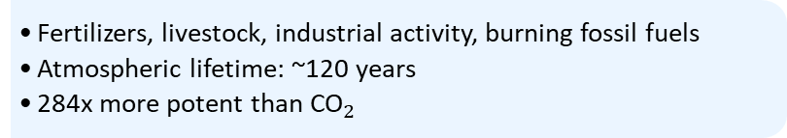


Greenhouse Gasses
Carbon dioxide
$${\text{CO}}_{2}$$
  Burning fossil fuels, industrial activity, and deforestation
  Atmospheric lifetime: 200+ years (or more)
Methane
$${\text{CH}}_{4}$$
Greenhouse gas (GHG) equivalents
  Livestock, landfills, oil/gas extraction, rice paddies
  Atmospheric lifetime: ~12 years
  84x more potent than ${\text{CO}}_{2}$
Nitrous oxide
$${\text{N}}_{2}\text{O}$$
  Fertilizers, livestock, industrial activity, burning fossil fuels
  Atmospheric lifetime: ~120 years
  284x more potent than ${\text{CO}}_{2}$
Total US emissions in 2022 = 6,343 million metric tons of CO₂ equivalent (excludes land sector). Percentages may not add up to 100% due to independent rounding. Land use, land-use change, and forestry in the United States is a net sink and offsets 13% of these greenhouse gas emissions. This net sink is not shown in the above diagram. All emission estimates are sourced from the Inventory of U.S. Greenhouse Gas Emissions and Sinks: 1990–2022.
Source: US EPA. (2025). Inventory of U.S. greenhouse gas emissions and sinks. https://www.epa.gov/ghgemissions/inventory-us-greenhouse-gas-emissions-and-sinks
Notes:
The three most common greenhouse gases are carbon dioxide, which you’ll often hear referred to as CO2, methane, and nitrous oxide.
About three-quarters of our GHG emissions are from carbon dioxide which come from burning fossil fuels for energy, transportation and machinery, and the clearing of forests. Trees capture and store carbon, so when you clear forests, you're releasing that carbon into the atmosphere. It can last in the atmosphere for a very long time.
Food system sources of methane include livestock, decomposing food waste in landfills, the mining and combustion of fossil fuels, and decomposing organic material in flooded rice paddies. Only about 16% of our GHG emissions are methane and it does not stay in the atmosphere for long, but it is a much more potent greenhouse gas, which means it has a much stronger effect on warming.
About 6% is nitrous oxide, mostly from agricultural activity. It lasts a long time and is far more potent than carbon dioxide.
There has been a dramatic rise in the concentrations of all three greenhouse gases since the pre-industrial times.
Not listed on this slide, but other greenhouse gasses affiliated with the food system are refrigerants, such as chlorofluorocarbons and hydrochlorofluorocarbons – CFCs and HCFCs. These are used to keep food cold, which is very important for food safety. We emit far fewer refrigerants, but they are way more potent greenhouse gasses than even methane or nitrous oxide.
So when it comes to reducing food systems emissions from greenhouse gasses, reductions from all these sources are needed.
-----
Data
US EPA. (2025). Inventory of U.S. Greenhouse Gas Emissions and Sinks. United States Environmental Protection Agency. https://www.epa.gov/ghgemissions/inventory-us-greenhouse-gas-emissions-and-sinks

Slide 13
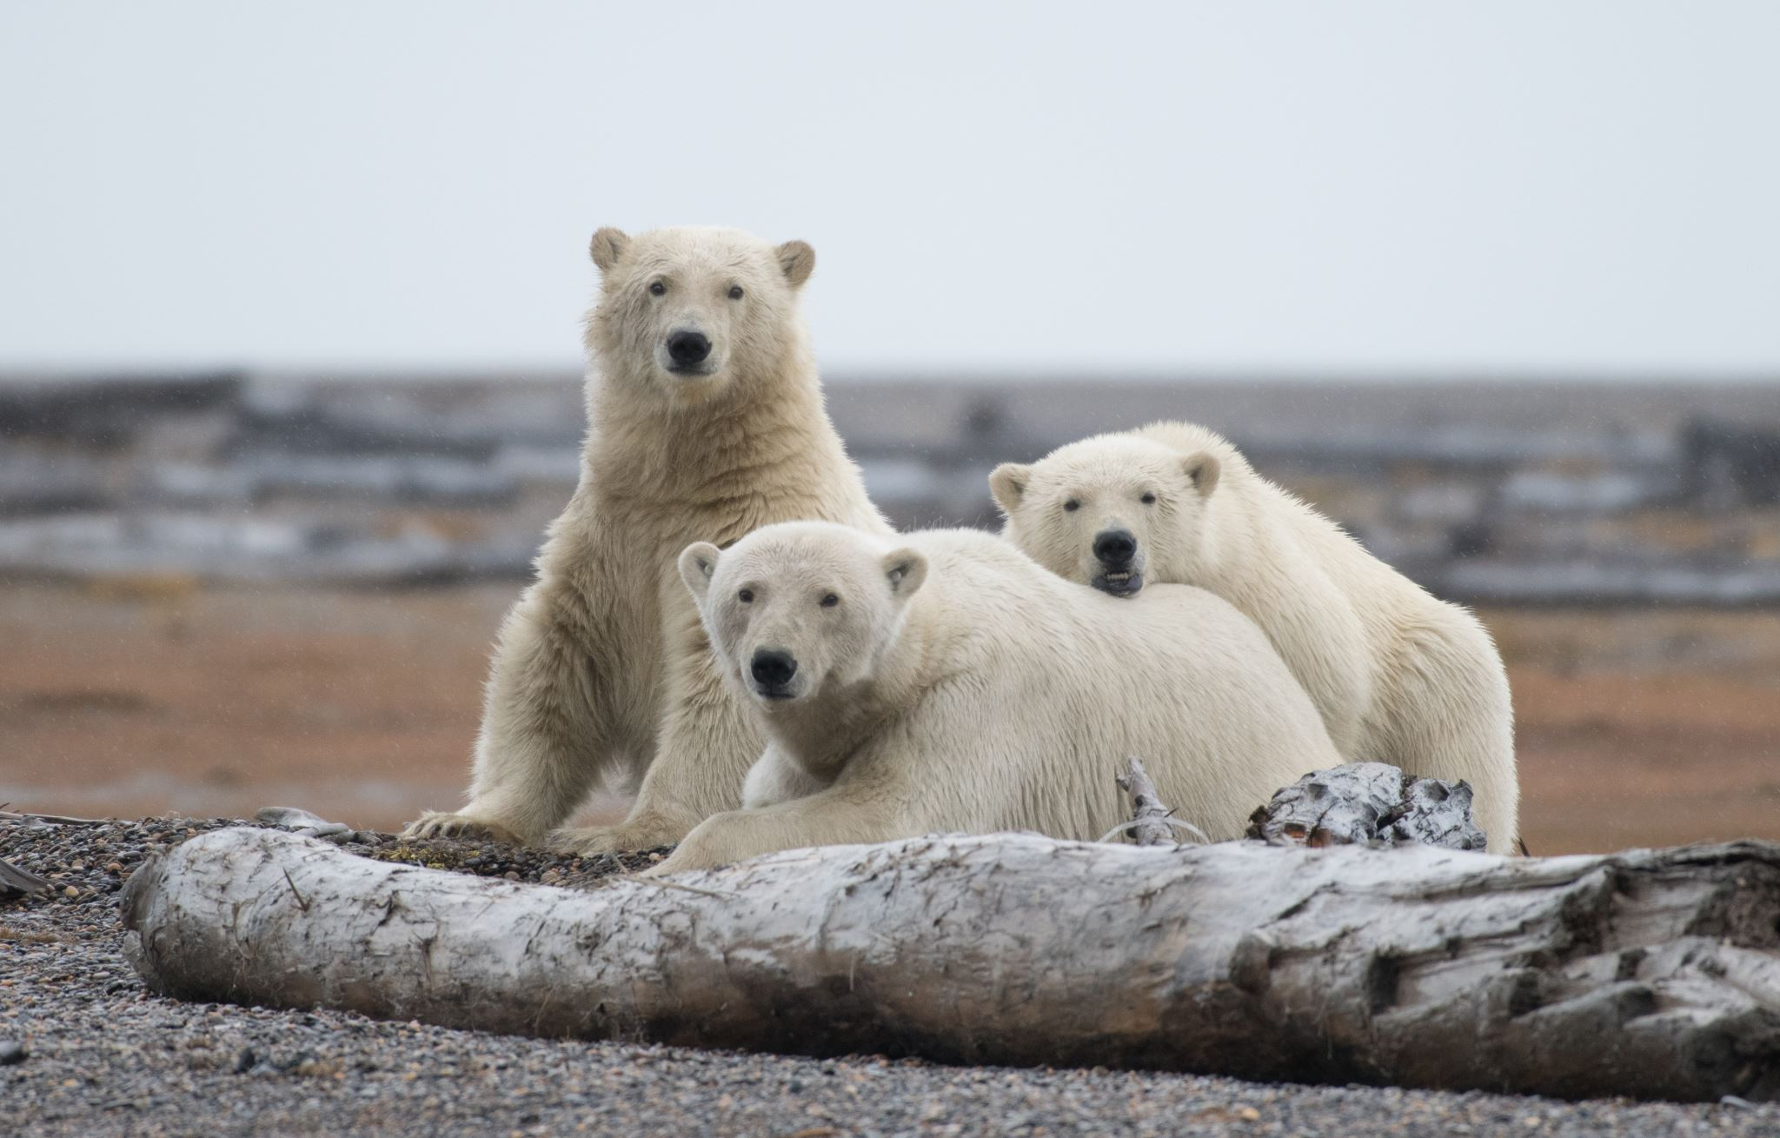
Greenhouse Gases and Climate Change
Destabilization of climate and weather systems
Sea level rise
More extreme weather events
  Heat waves
  Precipitation/flooding
  Drought
Image source: Microsoft Stock Images.
Notes:
Why should we care about greenhouse gas emissions and the warming of the planet? You’ve likely seen images of polar bears stranded on sections of ice or barren land. Melting ice and the resulting sea level rise is one impact. But there has been an overall destabilization of climate and weather patterns and whole systems. We’ll also see more extreme weather events, such as months-long heat waves, flooding, and longer and more dangerous wildfire seasons. As we’ll discuss, these conditions make growing food even more challenging than it already is and can put farmers and farm workers at risk for heat stress, dehydration, and more.

Slide 14
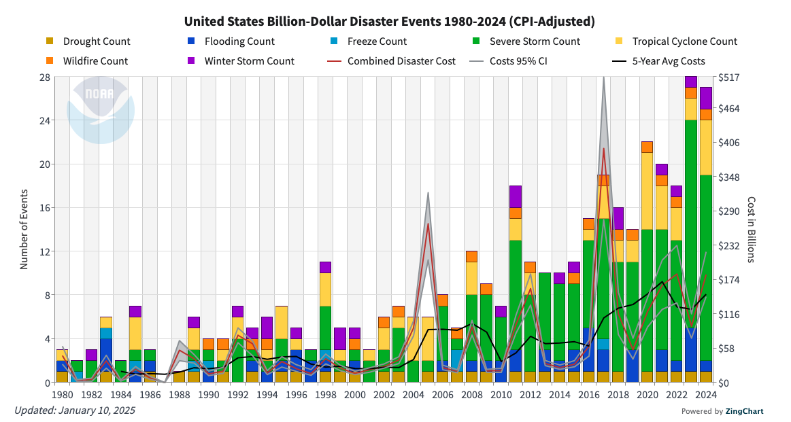
Weather-Related Events Are Costly
Source: NOAA National Centers for Environmental Information. (2025). U.S. billion-dollar weather and climate disasters (2025). https://www.ncei.noaa.gov/access/billions/time-series/US/cost;
Full report is available at https://www.ncei.noaa.gov/access/billions/
Notes:
Extreme weather events are indeed on the rise. This image shows the number of weather and climate related events that have exceeded a billion dollars in cost here in the US, adjusted for inflation, since 1980. You can see the huge rise since the early 2000’s, especially severe storms. Climate events are costly for communities and governments.
Https://www.ncei.noaa.gov/access/billions/time-series/US/cost
OAA National Centers for Environmental Information (NCEI) U.S. Billion-Dollar Weather and Climate Disasters (2025). https://www.ncei.noaa.gov/access/billions/, DOI: 10.25921/stkw-7w73

Slide 15
Section B: Food System Contributions to Climate Change
Notes:
Food is part of a complex system with many interactions. The relationship between food and our environment is not a one-way street. Agriculture is both a contributor to --and affected by --climate change. The changes to the planet’s natural systems that are caused, in part, by how we feed ourselves will in turn, make food production even more challenging. In this section, we’ll look at some key food systems contributions to climate change.

Slide 16
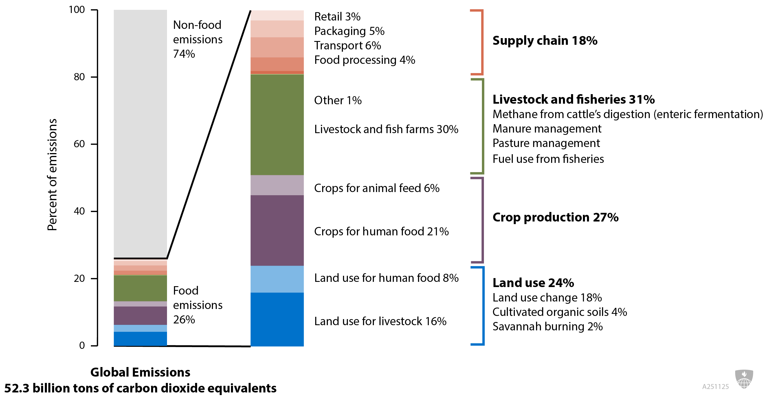
Global Greenhouse Gas Emissions from Food Production
Image source: Adapted by the Johns Hopkins Bloomberg School of Public Health from Ritchie, H. (2019). Food production is responsible for one-quarter of the world’s greenhouse gas emissions. Our World in Data. https://ourworldindata.org/food-ghg-emissions and based on data from Poore, J., & Nemecek, T. (2018). Reducing food’s environmental impacts through producers and consumers. Science, 360(6392), 987–992. https://doi.org/10.1126/science.aaq0216
Notes:
The global food system accounts for approximately one-quarter to one-third of human-caused greenhouse gas (GHG) emissions. Estimates vary due to differences in study methods. For instance, the 26% figure in this image is the low end of the range of estimates mainly because this study did not account for the emissions from food waste.
The bar chart on the right breaks down this 26% contribution from food. Starting at the top, the supply chain including retail, packaging, transport and food processing represents about 18% of all of contributions from food. Livestock and fisheries contribute about 31%. Crop production, including crops for animal feed, comes in at 27% and land use at 24%. And you can see here that land use for livestock is double the land use for human food. If wasted food were included here, the total food systems contributions would be closer to 33% of all emissions.
Question: You may have heard recommendations to “eat local” to reduce the impact of food systems on our planet. Looking at this data, what are your thoughts? How much does transportation contribute, compared to other facets of the food system?
-----
Chart
Ritchie, H. (2019). Food production is responsible for one-quarter of the world’s greenhouse gas emissions. Our World in Data. https://ourworldindata.org/food-ghg-emissions

Slide 17

Global Food System Emissions
What aspects of global livestock production contribute the most to greenhouse gas emissions?
Image source: photo is from Microsoft Stock Images.
Notes:
We just broke down overall food systems-related greenhouse gasses. Those data show that livestock production contributes by far the most of any subset of the production phase of the supply chain.
Question: What aspects of livestock production contribute the most to greenhouse gas emissions?

Slide 18
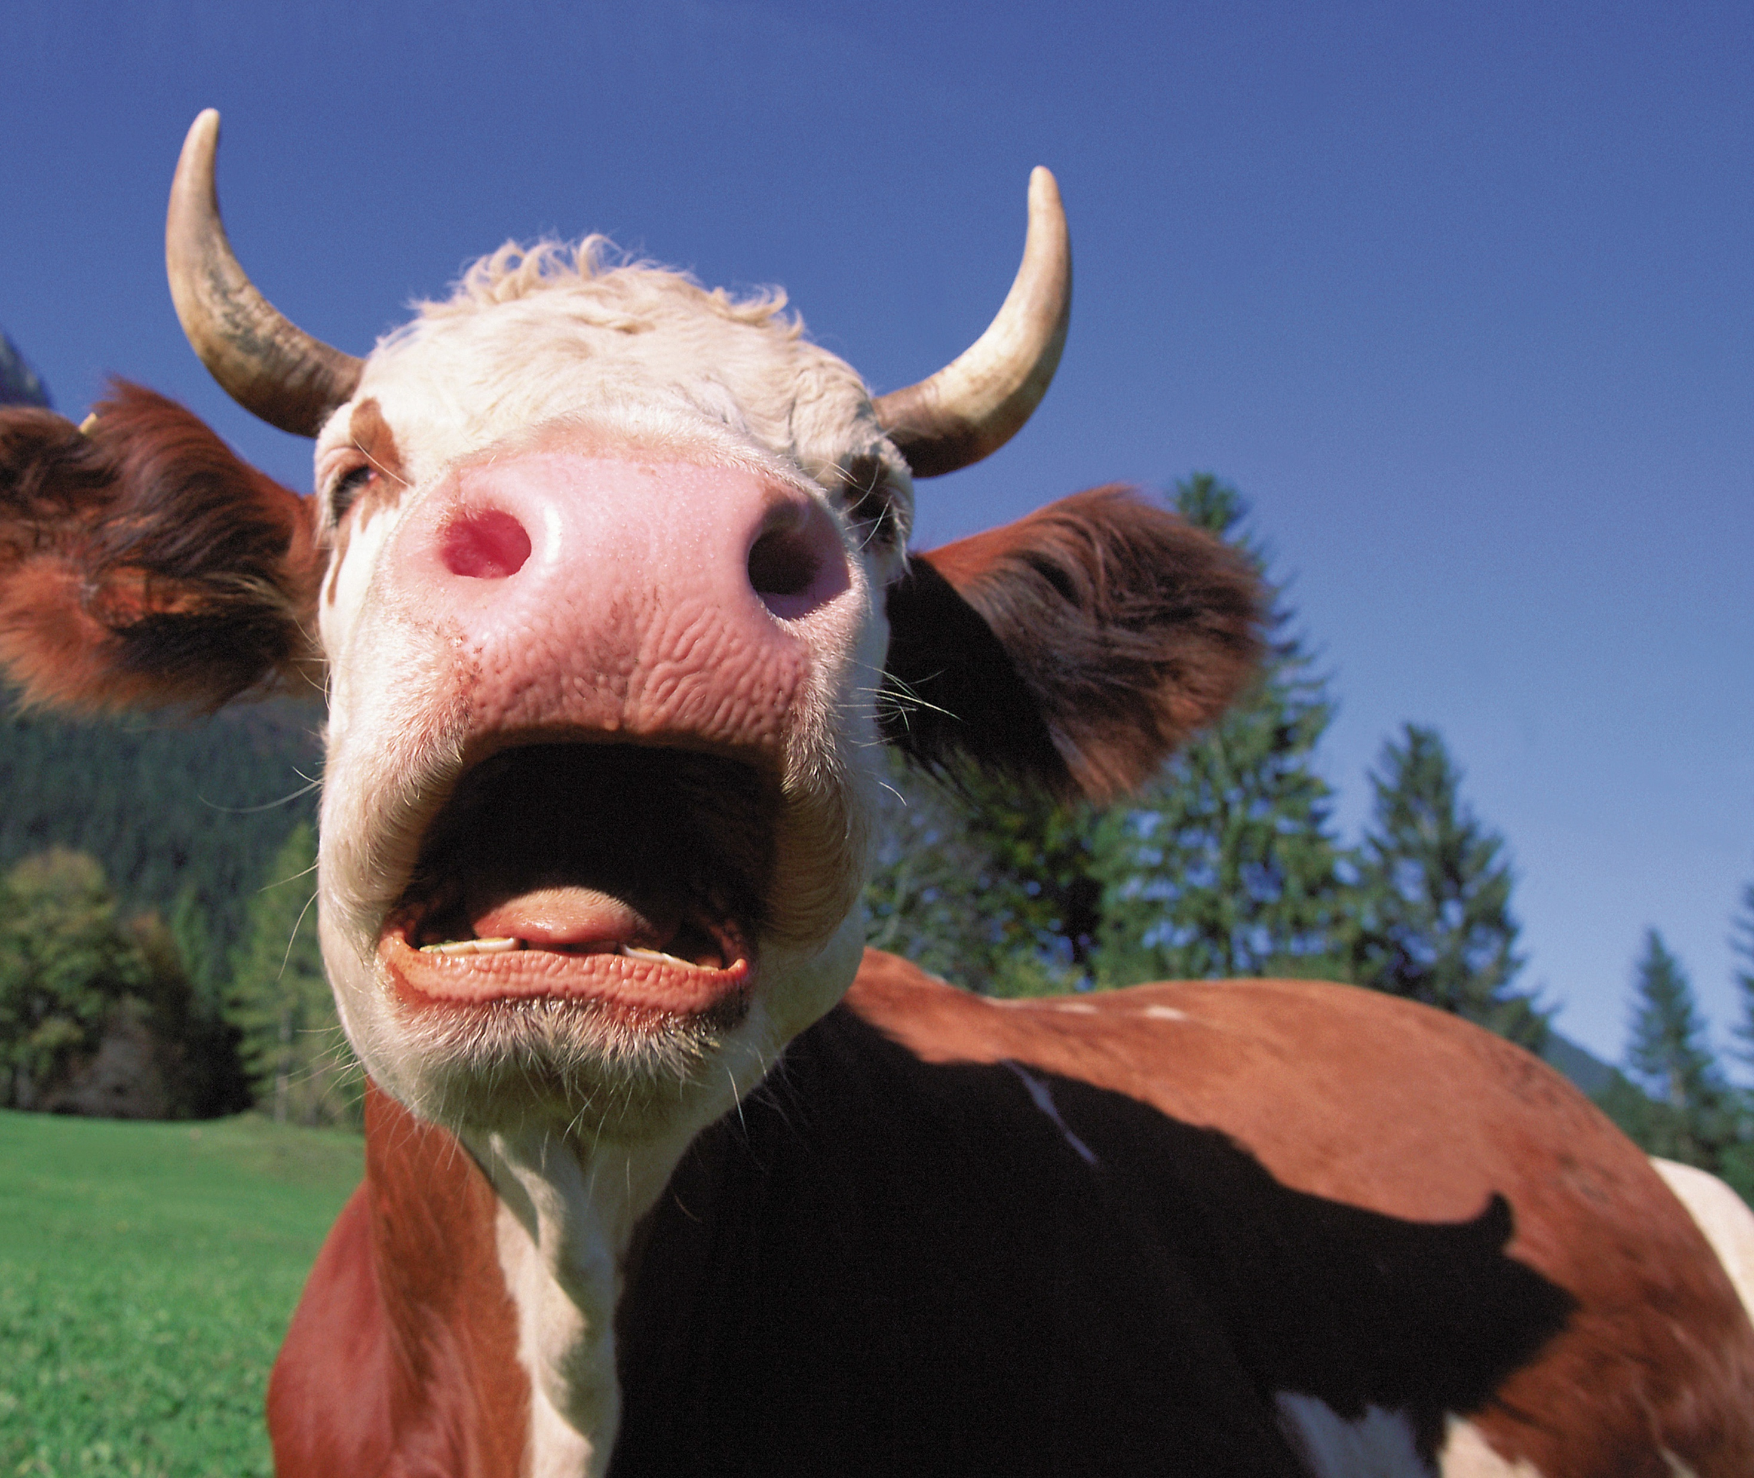
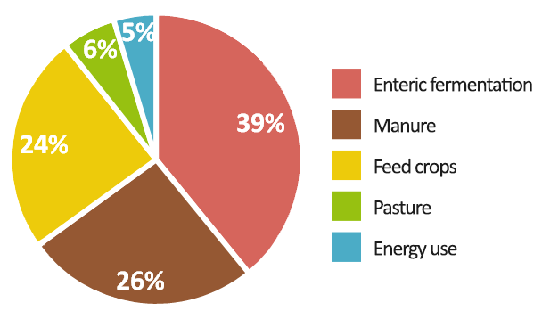
Enteric Fermentation
Image sources: Chart is based on data from Gerber, P. J., Steinfield, H., Henderson, B., Mottet, A., Opio, C., Dijkman, J., Falcucci, A., & Tempio, G. (2013). Tackling climate change through livestock: A global assessment of emissions and mitigation opportunities (No. i3437e). Food and Agriculture Organization of the United Nations. https://www.fao.org/4/i3437e/i3437e.pdf; Photo is from Shutterstock.
Notes:
If you said livestock production, you are correct.
So let's zoom in and see where livestock's greenhouse gas emissions are coming from. This study is a little older, but it’s the most recent data that breaks down emissions attributable to livestock.
The largest share of greenhouse gas emissions from livestock is accounted for by enteric fermentation. This is a digestive process that is unique to ruminant animals with multiple stomachs, such as cattle, sheep, and goats. A byproduct of this digestive process is methane – and it comes out through belching – not so much the backside as many people believe.
And those methane burps comprises an astounding 39% of the greenhouse gas footprint of the global livestock sector.
-----
Chart
Gerber, P. J., Steinfield, H., Henderson, B., Mottet, A., Opio, C., Dijkman, J., Falcucci, A., & Tempio, G. (2013). Tackling climate change through livestock: A global assessment of emissions and mitigation opportunities (No. i3437e). Food and Agriculture Organization of the United Nations. https://www.fao.org/4/i3437e/i3437e.pdf

Slide 19
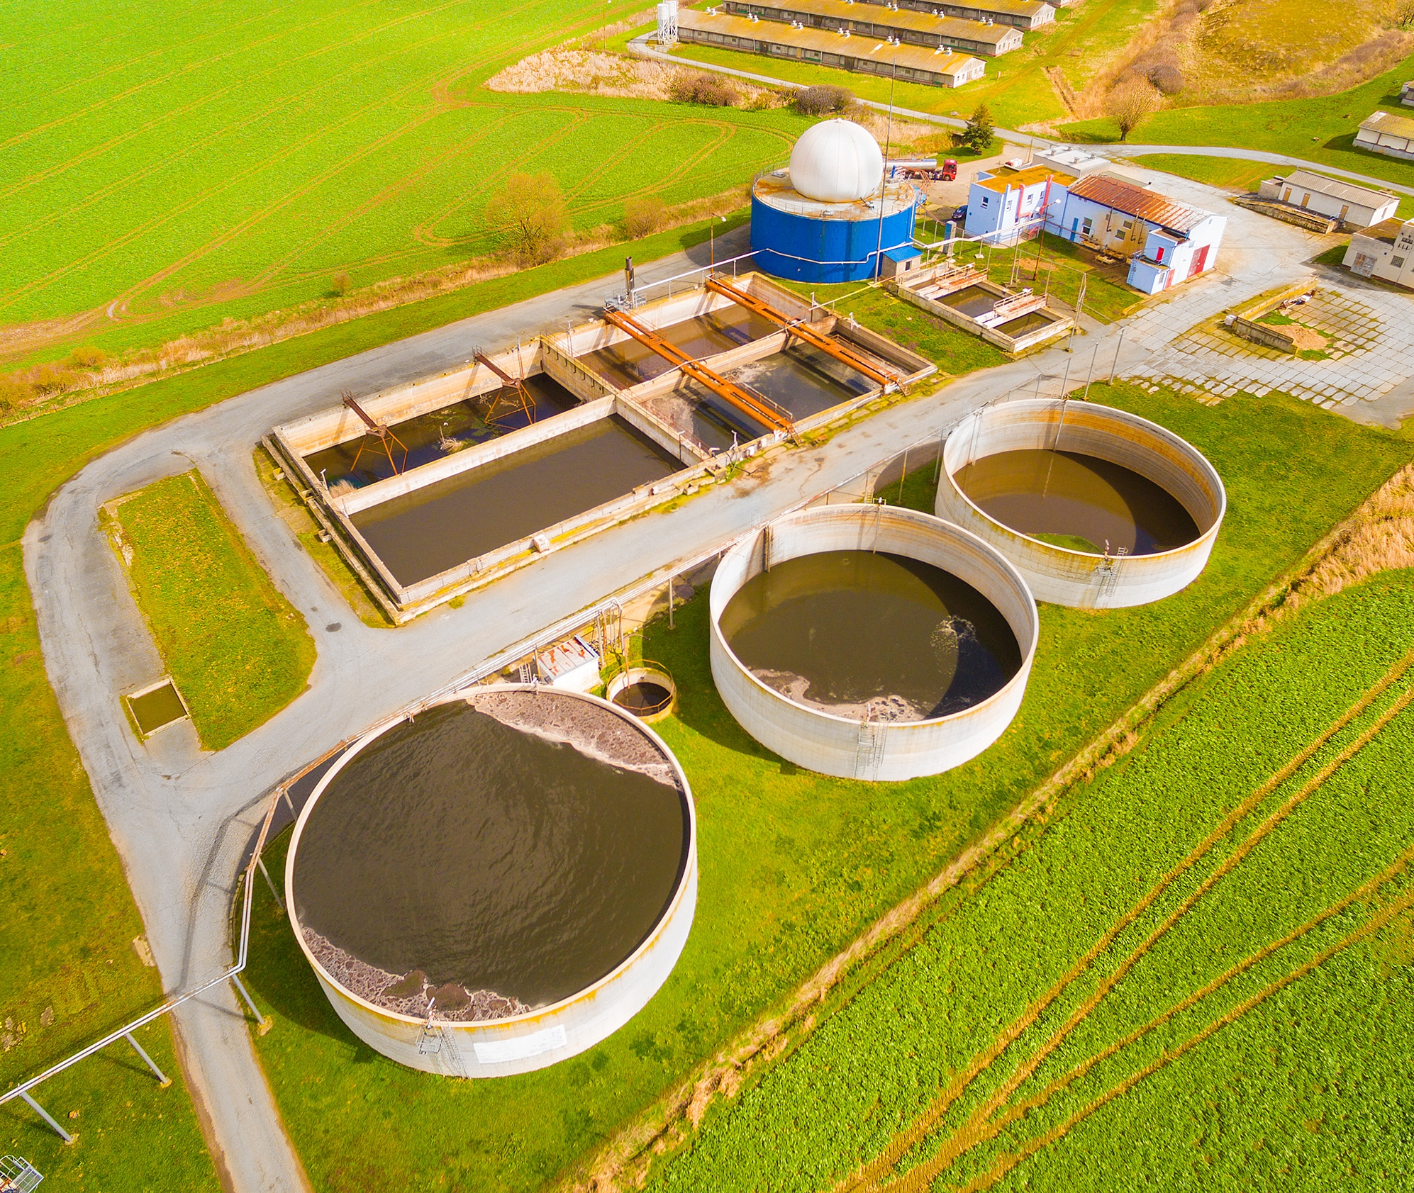
Manure
Image sources: Chart is based on data from Gerber, P. J., Steinfield, H., Henderson, B., Mottet, A., Opio, C., Dijkman, J., Falcucci, A., & Tempio, G. (2013). Tackling climate change through livestock: A global assessment of emissions and mitigation opportunities (No. i3437e). Food and Agriculture Organization of the United Nations. https://www.fao.org/4/i3437e/i3437e.pdf; Photo is from Shutterstock.
Notes:
Just over one quarter of livestock's greenhouse gas emissions are attributable to methane and nitrous oxide from manure. In this picture, we see a manure storage pit, or manure lagoon, as they are called, outside of a hog production facility in North Carolina. When organic matter such as manure decomposes anaerobically, meaning without oxygen, methane is released as a byproduct. This is also why landfills are such a large contributor to greenhouse gas emissions.
-----
Chart
Gerber, P. J., Steinfield, H., Henderson, B., Mottet, A., Opio, C., Dijkman, J., Falcucci, A., & Tempio, G. (2013). Tackling climate change through livestock: A global assessment of emissions and mitigation opportunities (No. i3437e). Food and Agriculture Organization of the United Nations. https://www.fao.org/4/i3437e/i3437e.pdf

Slide 20
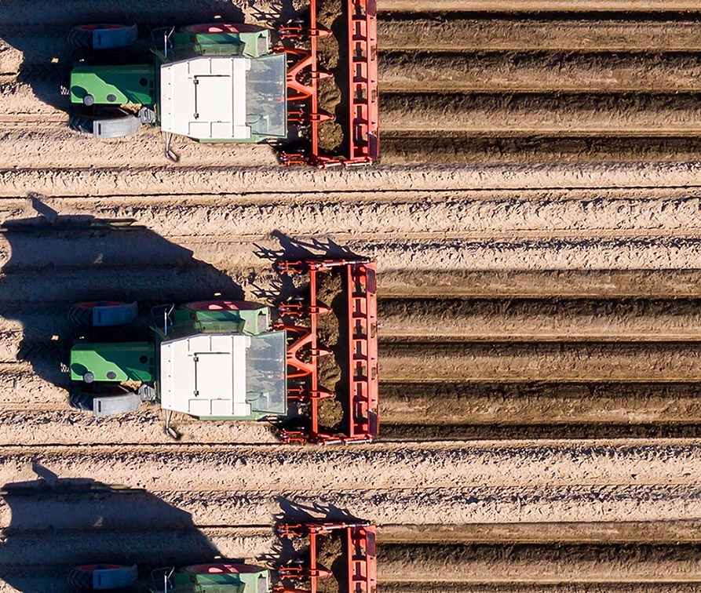
Feed Crop Production
Image sources: Chart is based on data from Gerber, P. J., Steinfield, H., Henderson, B., Mottet, A., Opio, C., Dijkman, J., Falcucci, A., & Tempio, G. (2013). Tackling climate change through livestock: A global assessment of emissions and mitigation opportunities (No. i3437e). Food and Agriculture Organization of the United Nations. https://www.fao.org/4/i3437e/i3437e.pdf; Photo is from Microsoft Stock Images.
Notes:
Another quarter of livestock's greenhouse gas emissions is attributable to growing feed for the animals, such as corn and soy.
-----
Chart
Gerber, P. J., Steinfield, H., Henderson, B., Mottet, A., Opio, C., Dijkman, J., Falcucci, A., & Tempio, G. (2013). Tackling climate change through livestock: A global assessment of emissions and mitigation opportunities (No. i3437e). Food and Agriculture Organization of the United Nations. https://www.fao.org/4/i3437e/i3437e.pdf

Slide 21
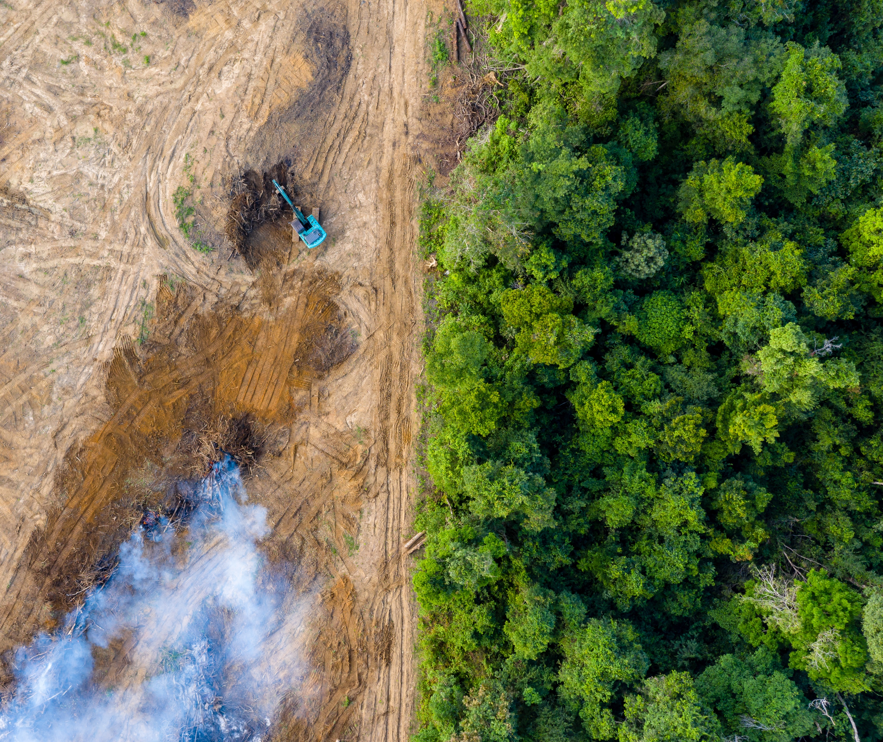
Land Use Change (Deforestation)
Image sources: Chart is based on data from Gerber, P. J., Steinfield, H., Henderson, B., Mottet, A., Opio, C., Dijkman, J., Falcucci, A., & Tempio, G. (2013). Tackling climate change through livestock: A global assessment of emissions and mitigation opportunities (No. i3437e). Food and Agriculture Organization of the United Nations. https://www.fao.org/4/i3437e/i3437e.pdf; Photo is from Shutterstock.
Notes:
Finally, roughly 9% of livestock's greenhouse gas emissions are attributable to land use change or deforestation. These are forests that are cleared predominantly for grazing lands and to a lesser degree, for soy production. Here, we see an aerial photo of the Amazon being burned.
-----
Chart
Gerber, P. J., Steinfield, H., Henderson, B., Mottet, A., Opio, C., Dijkman, J., Falcucci, A., & Tempio, G. (2013). Tackling climate change through livestock: A global assessment of emissions and mitigation opportunities (No. i3437e). Food and Agriculture Organization of the United Nations. https://www.fao.org/4/i3437e/i3437e.pdf

Slide 22
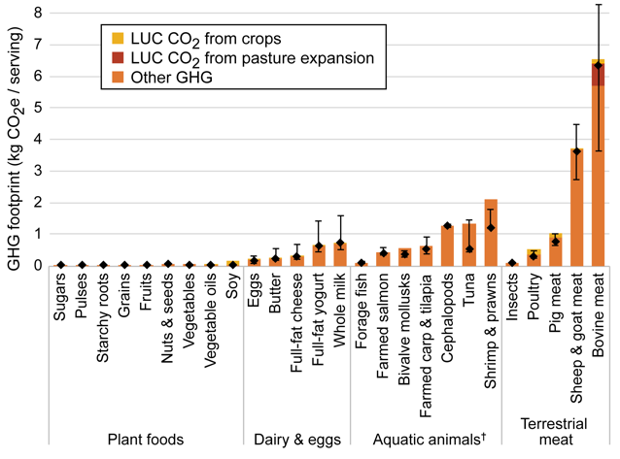
GHG Footprints of Food—1
Per serving GHG footprints
> 3,800 unique observations
> 150 countries
Image source: Kim, B. F., Santo, R. E., Scatterday, A. P., Fry, J. P., Synk, C. M., Cebron, S. R., Mekonnen, M. M., Hoekstra, A. Y., de Pee, S., Bloem, M. W., Neff, R. A., & Nachman, K. E. (2020). Figure 2. Average per serving GHG [Chart]. Country-specific dietary shifts to mitigate climate and water crises. Global Environmental Change, 62. https://doi.org/10.1016/j.gloenvcha.2019.05.010
Notes:
Now let’s look at the GHG footprints of different food groups. This study included 4,000 different data points from hundreds of different studies and data from the Food and Agriculture Organization of the United Nations, representing production scenarios from over 150 different countries.
The y-axis is the kg CO2eq, a standardize measure of GHGe, per serving of the foods listed along the x-axis. The height of each bar reflects the average greenhouse gas intensity of producing each of these foods. And it's an average across, again, many different production scenarios across many different countries. The diamonds show the medians, which are the middle value in a range of numbers. And the bars above and below each diamond reflect the interquartile range, which is the middle 50% of the values – so between 25% and 75%.
There are a couple of important things to note in this figure. One, the greenhouse gas footprints of plant foods on the left are generally many times lower than the animal foods shown over on the right. With meat from bovine animals, such as beef or bison, being by far the most greenhouse gas intensive to produce. By now, this should not be news to any of you listening to this lecture series. This is why so much of the discussion on sustainable diets and climate change tends to focus on meat. But it's worth pointing out that if we compare the footprints of plant foods and that of other dairy, the impact per serving of some of these dairy products is equal to or more than poultry or pork.
-----
Graph
Kim, B. F., Santo, R. E., Scatterday, A. P., Fry, J. P., Synk, C. M., Cebron, S. R., Mekonnen, M. M., Hoekstra, A. Y., de Pee, S., Bloem, M. W., Neff, R. A., & Nachman, K. E. (2020). Country-specific dietary shifts to mitigate climate and water crises. Global Environmental Change, 62. https://doi.org/10.1016/j.gloenvcha.2019.05.010

Slide 23
GHG Footprints of Food—2
Per serving GHG footprints
> 3,800 unique observations
> 150 countries
Image source: Kim, B. F., Santo, R. E., Scatterday, A. P., Fry, J. P., Synk, C. M., Cebron, S. R., Mekonnen, M. M., Hoekstra, A. Y., de Pee, S., Bloem, M. W., Neff, R. A., & Nachman, K. E. (2020). Figure 2. Average per serving GHG [Chart]. Country-specific dietary shifts to mitigate climate and water crises. Global Environmental Change, 62. https://doi.org/10.1016/j.gloenvcha.2019.05.010
Notes:
It's also important to point out that there are several climate-friendly animal foods shown in this figure. Take a look at foraged fish. So those are fish at the bottom of the food chain, such as sardines, mackerel and anchovies, which have a very small greenhouse gas footprint. To the right of that, we see bivalve mollusks, so oysters and clams, also with a relatively low impact.
As we look further right, among terrestrial meat or meat from land animals, insects were extremely low in terms of their greenhouse gas intensity. And here, we're talking about studies of crickets and mealworms. Yum yum, right? For some of us, that might feel a little bit less familiar, depending on what we're accustomed to. But in some parts of the world, insects are a regular part of the menu.
-----
Graph
Kim, B. F., Santo, R. E., Scatterday, A. P., Fry, J. P., Synk, C. M., Cebron, S. R., Mekonnen, M. M., Hoekstra, A. Y., de Pee, S., Bloem, M. W., Neff, R. A., & Nachman, K. E. (2020). Country-specific dietary shifts to mitigate climate and water crises. Global Environmental Change, 62. https://doi.org/10.1016/j.gloenvcha.2019.05.010

Slide 24
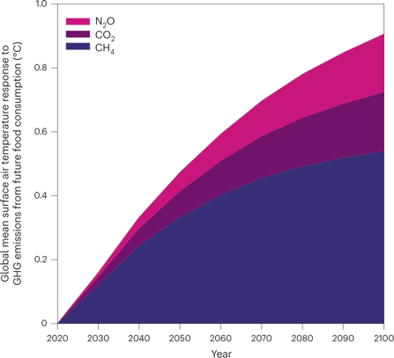
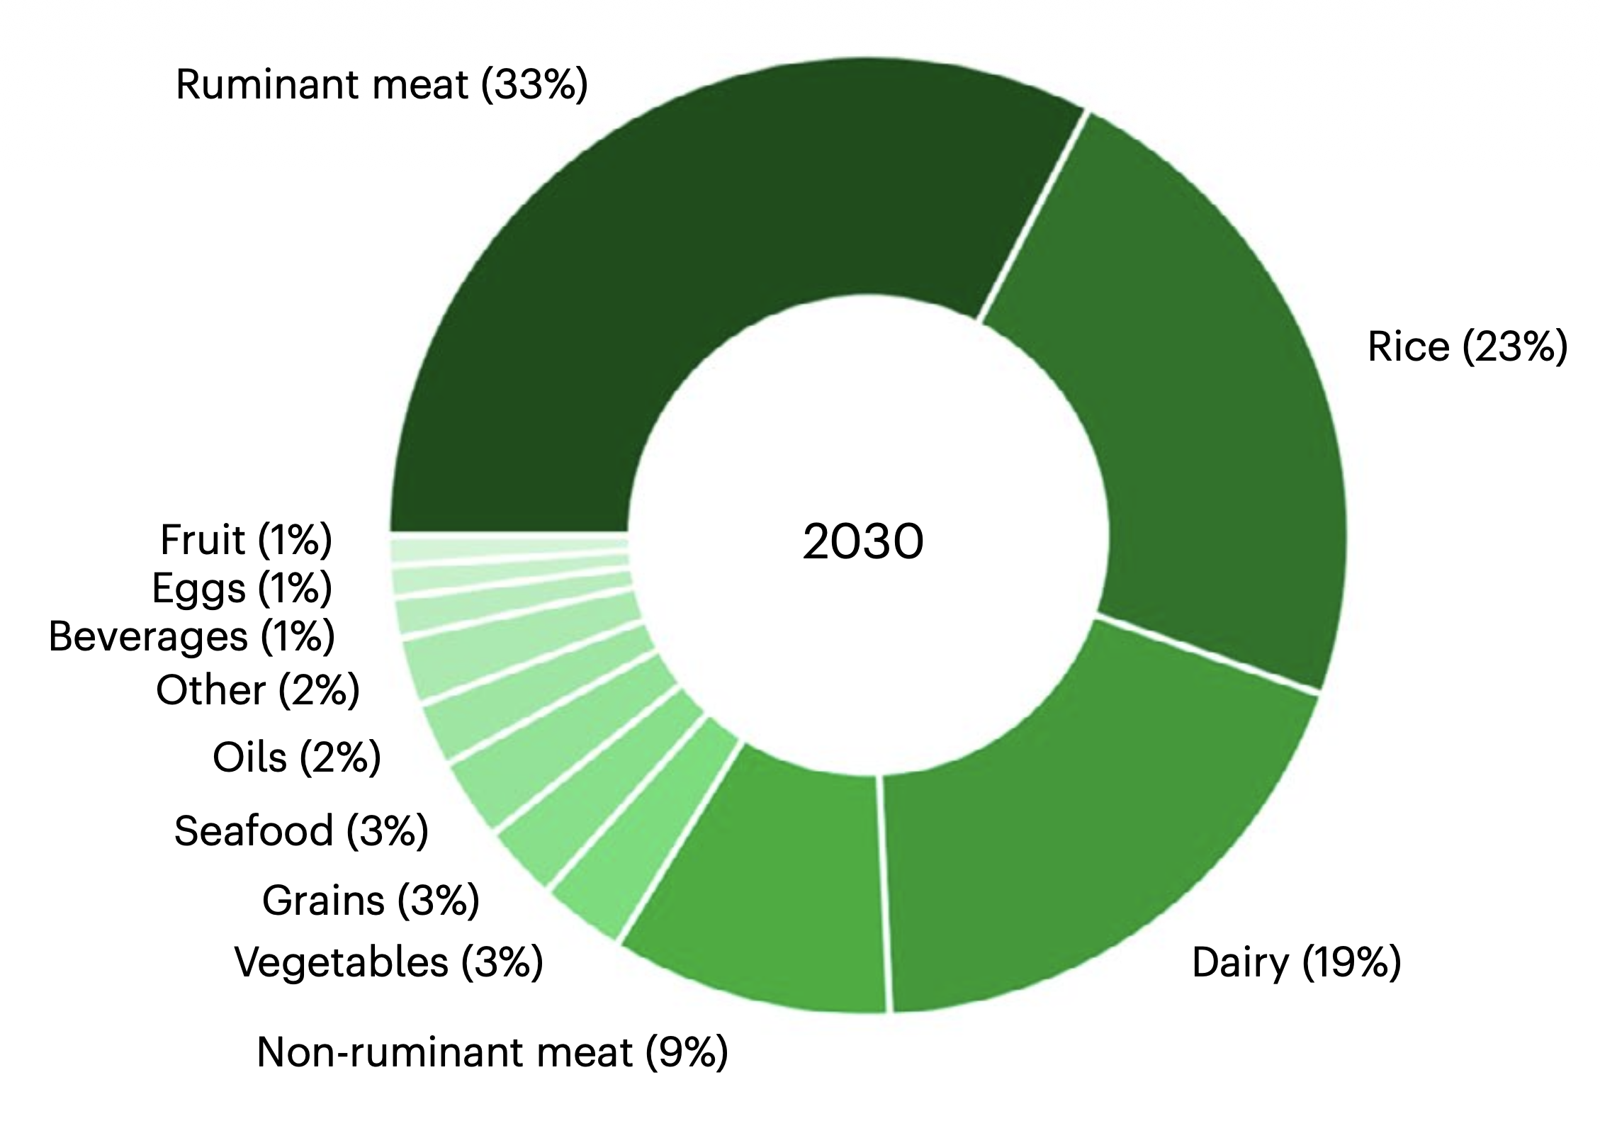
Global Temperature Rise from Food Demand Is Driven by Meat and Dairy
Image sources: Ivanovich, C., Sun, T., Gordon, D., & Ocko, I. (2023). Figure 2. Global mean surface air temperature responses attributed to individual GHG emissions (methane, carbon dioxide and nitrous oxide) from future food consumption under a high-population projection [Chart] and Figure 3. Relative contribution of food groups to global mean surface air [Chart]. Future warming from global food consumption. Nature Climate Change, 13, 297–302. https://doi.org/10.1038/s41558-023-01605-8
Notes:
As pointed out earlier in this module– The Paris Agreement set targets for the avg global temperature rise being “Well below” 2° ; Ideally 1.5° C to avoid much of the devastating impact of climate change.
However, the results of a 2023 study showed that food demand alone could contribute as much as 0.9 degree of warming by end of century – as depicted in the figure on the left.
Looking over to the pie chart on the right, over 60% of that warming is attributable to meat and dairy.
This outsized contributions of animal products to food’s climate impact are more evident when you consider that animal source foods only provide 18% of global calories and 25% of global protein.
NOTE: You may have noticed that rice also takes up a big percentage. That is largely due to the method of growing rice in flooded fields but also the large volume of rice consumed globally as a staple food.
The Key point: we’re already over 1 degree of warming… add another degree from food and we’ve exceeded the target and remember we’re not even considering non-food-related sectors here.
-----
Graphs
Ivanovich, C., Sun, T., Gordon, D., & Ocko, I. (2023). Future warming from global food consumption. Nature Climate Change, 13, 297–302. https://doi.org/10.1038/s41558-023-01605-8

Slide 25
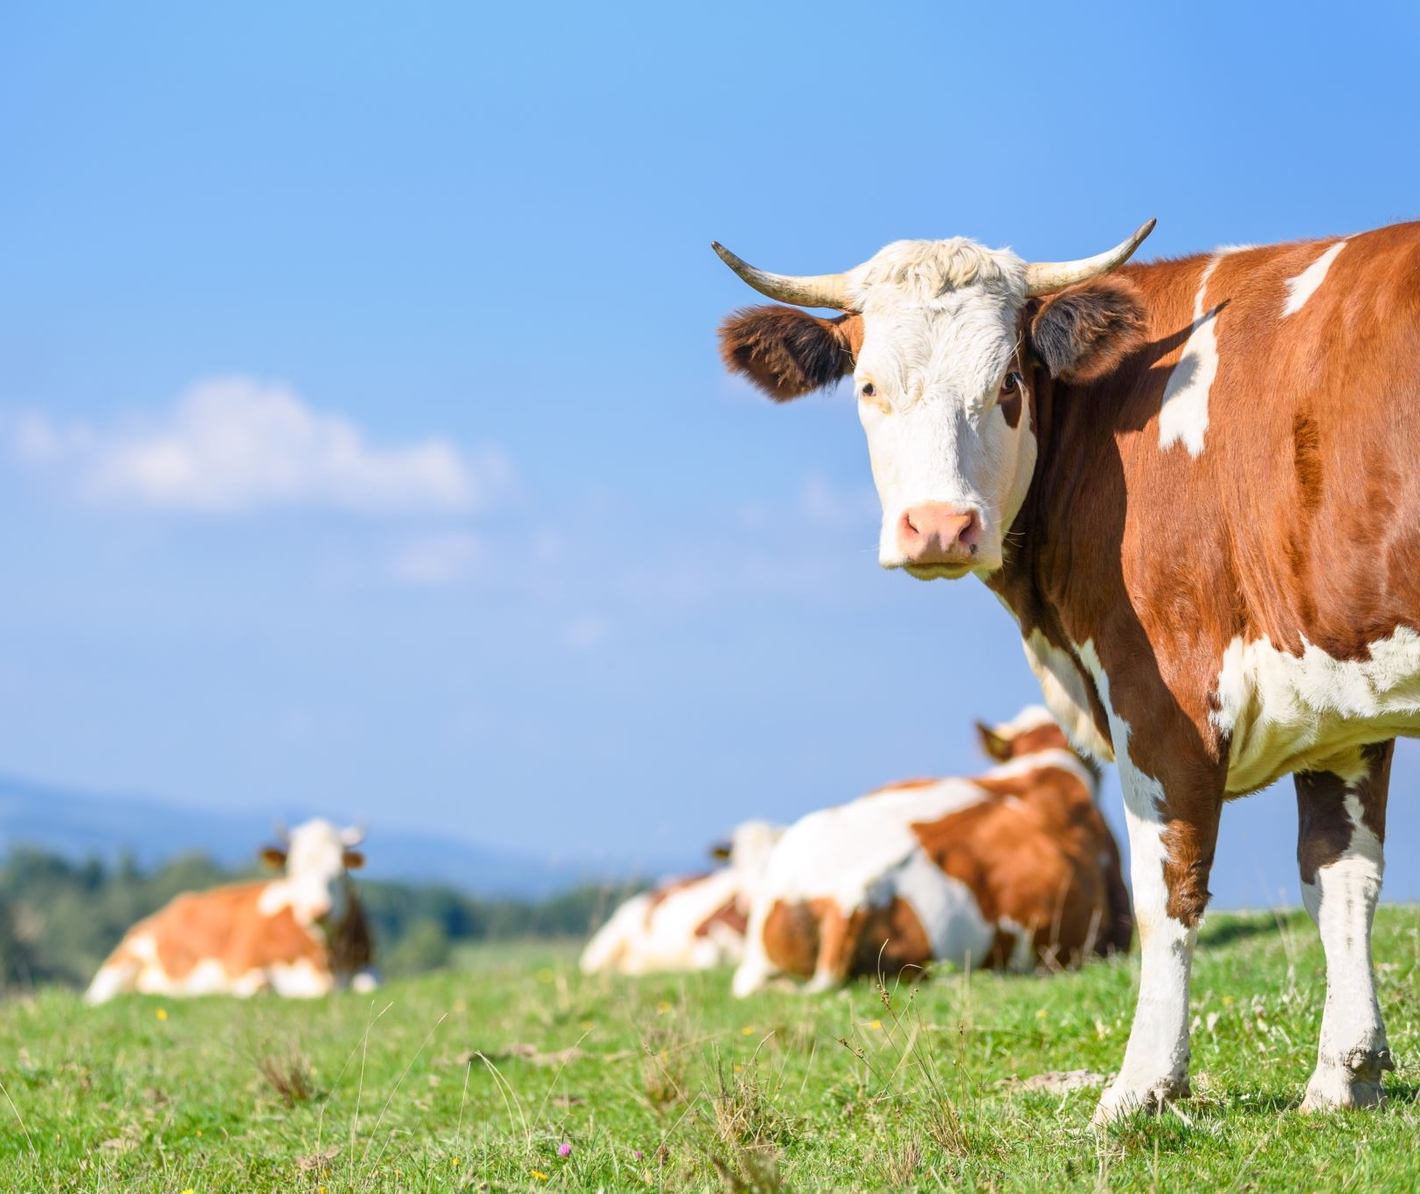

Carbon Sequestration
Can reduce net ${\text{CO}}_{2}$, but enough to offset ${\text{CH}}_{4}$, ${\text{N}}_{2}\text{O}$?
Diminishing returns
Under specific conditions
Also land-use constraints
Image source: Microsoft Stock Images.
Notes:
There has been a lot of interest about the potential of agriculture to actually absorb and sequester carbon from the atmosphere that would otherwise contribute to climate change. But there is considerable debate about the extent to which grazing systems like the one shown in this slide can offset the methane and nitrous oxide that ruminant animals like cows emit.
There are likely diminishing returns. Soil is like a sponge and eventually reaches a point where the soil can no longer continue to store more carbon.
Also, it’s complicated because not all grazing systems are created equal and some sequester more carbon than others. There are many factors related to density of the animals, the soil conditions, and so on.
All in all, you probably look at this photo and could identify several reasons why a system like this might be preferable to a densely packed feedlot. There are many benefits to raising cattle and other animals on pasture like this for animals, biodiversity, soil as well as the people and surrounding communities. But the reality is that there is not enough land to raise beef cattle like this to meet current demand for beef. To raise beef cattle on grazing systems like this, beef consumption in the US and elsewhere would have to decline dramatically. We will revisit this more in the final section.

Slide 26
Section C: Climate Change Impacts on Food Systems
Notes:
The relationship between food and our environment is not a one-way street. Agriculture is both a contributor to --and affected by --climate change.
We’ll now look at a few of the impacts of climate change on our food system.

Slide 27

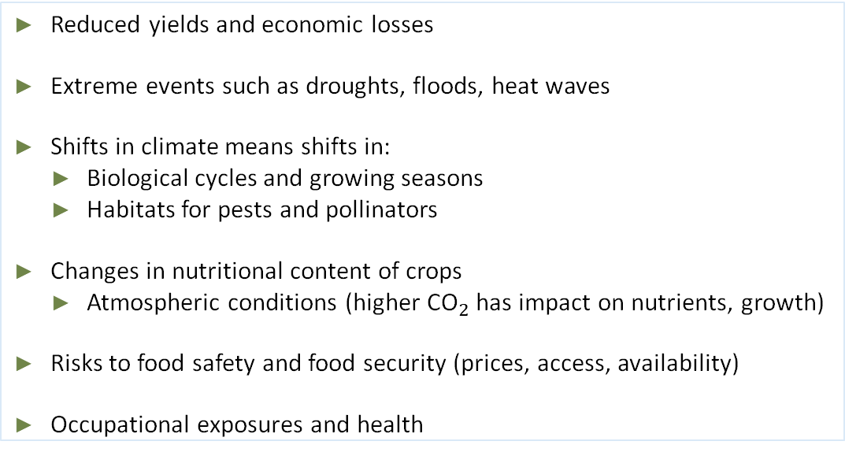
Effects of Climate Change on Food Systems
Reduced yields and economic losses
Extreme events such as droughts, floods, heat waves
Shifts in climate means shifts in:
  Biological cycles and growing seasons
  Habitats for pests and pollinators
Changes in nutritional content of crops
  Atmospheric conditions (higher ${\text{CO}}_{2}$ has impact on nutrients, growth)
Risks to food safety and food security (prices, access, availability)
Occupational exposures and health
Image source: Microsoft Stock Images.
Notes:
Food and climate are two complicated systems that are connected to many other natural systems, so it can be very difficult to predict future impacts. These are some of the primary impacts that we are already seeing and challenges we’ll need to manage in the future.
One major impact is reduced yields – both crops and livestock --resulting in economic losses across the agricultural sector. Farmers in lower-income regions already struggling with food insecurity will likely be hit the hardest.
The frequency and intensity of extreme heat and heavy precipitation events are increasing in most continental regions of the world.
We’re already seeing shifts in growing seasons, as well as shifts in locations where crops thrive, but also pests and pollinators.
High concentrations of CO2 in the atmosphere have been shown to impact the nutritional content of crops – and we’ll talk more about that.
There are broader implications for supply chains, food safety and food security. Increases in the frequency and severity of extreme weather events can interrupt food delivery and resulting spikes in food prices after extreme events are expected to be more frequent in the future. For example, flooding can contribute to spoilage and contamination.
Rising temperatures can alter exposures to some pathogens and toxins. Salmonella, Campylobacter, Vibrio, and mycotoxigenic fungi can all potentially thrive in warmer environments. And because floodwaters can transport sewage, manure or pollutants from roads, farms and lawns, more pathogens and toxins could find their way into our food.
Heat waves and other extreme weather can make outdoor work in agriculture much more difficult. In addition, agricultural workers are at increased risk of exposures from pathogens and toxins.
Let’s take a closer look at some of these impacts on the next few slides.

Slide 28
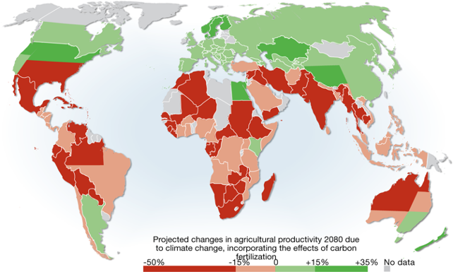
Climate Change and Agricultural Productivity
Image source: Cline, W. R. (2007). Global warming and agriculture: impact estimates by country. Center for Global Development.
Notes:
This map shows projected changes in agricultural productivity in the year 2080 from increased global temperatures and higher levels of atmospheric carbon. Many areas of the world, including the United States and Mexico, much of South America, Africa, South Asia and Australia, are likely to experience a decline in agricultural yields – shown in this map in red and orange. About half of those regions could see declines up to 50%. A few regions – those shown in light and dark green -- will likely see an increase in productivity. These include Russia, China and other parts of east Asia, Canada and some nations in the far southern hemisphere.
-----
Graphic
Cline, W. (2007). Global Warming and Agriculture: Impact Estimates by Country. Center for Global Development. https://www.cgdev.org/publication/9780881324037-global-warming-and-agriculture-impact-estimates-country

Slide 29
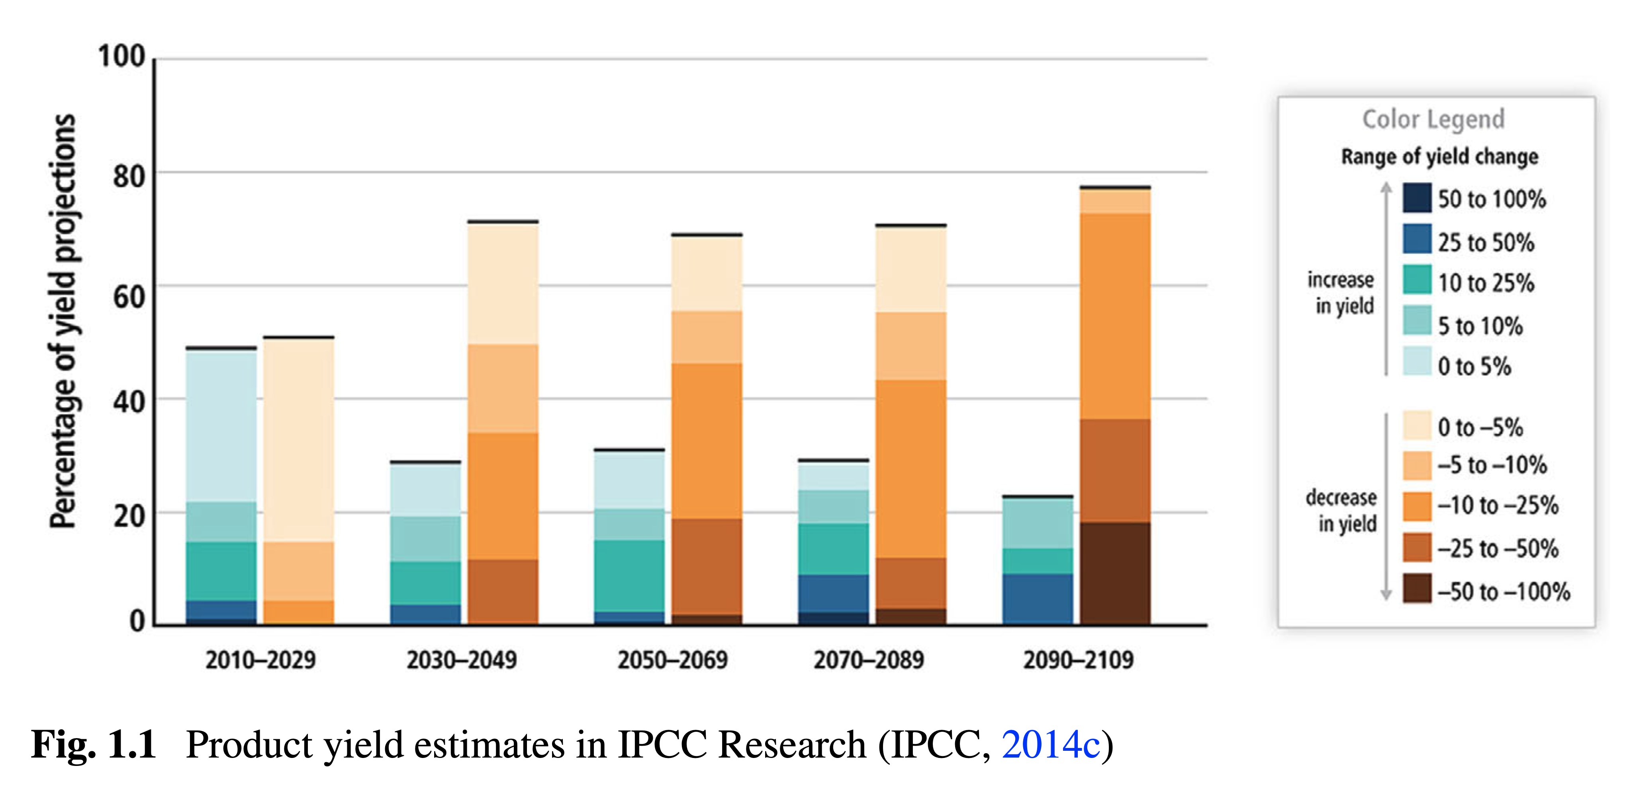
Projected Changes to Crop Yields Due to Climate Change
Image source: Jovović, Z., Velimirović, A., & Yaman, N. (2024). Figure 1.1. Product yield estimates in IPCC Research [Chart]. Climate and crop production crisis. In Ö. Çetin (Ed.), Agriculture and Water Management Under Climate Change (pp. 1–28). Springer, Cham. https://doi.org/10.1007/978-3-031-74307-8_1
Notes:
You see this in the pairs of histograms that project changes in agricultural yields every 20 years over the next century. On the left of each pair in blue and green are the ranges of crop yield production where we will see INCREASED yield over time. For example, tomatoes may in the future be grown in parts of Canada where the growing season has historically been too short to support tomato production.
On the right in the brown colors are the areas of DECREASED production over time. And you see as we project further into the future, more and more of the productive crop lands of the world are falling into those brown areas, getting darker and darker with more and more severe reductions in plant yield from agricultural productivity, the darkest brown being reductions of anywhere from 50% to 100% if we continue on a business-as-usual path with our greenhouse gas emissions. Yield growth for wheat, maize, and other crops has been declining in many countries due to extreme heat, severe weather, and droughts.
-----
Graph
Jovović, Z., Velimirović, A., & Yaman, N. (2024). Climate and Crop Production Crisis. In Ö. Çetin (Ed.), Agriculture and Water Management Under Climate Change (pp. 1–28). Springer, Cham. https://doi.org/10.1007/978-3-031-74307-8_1

Slide 30
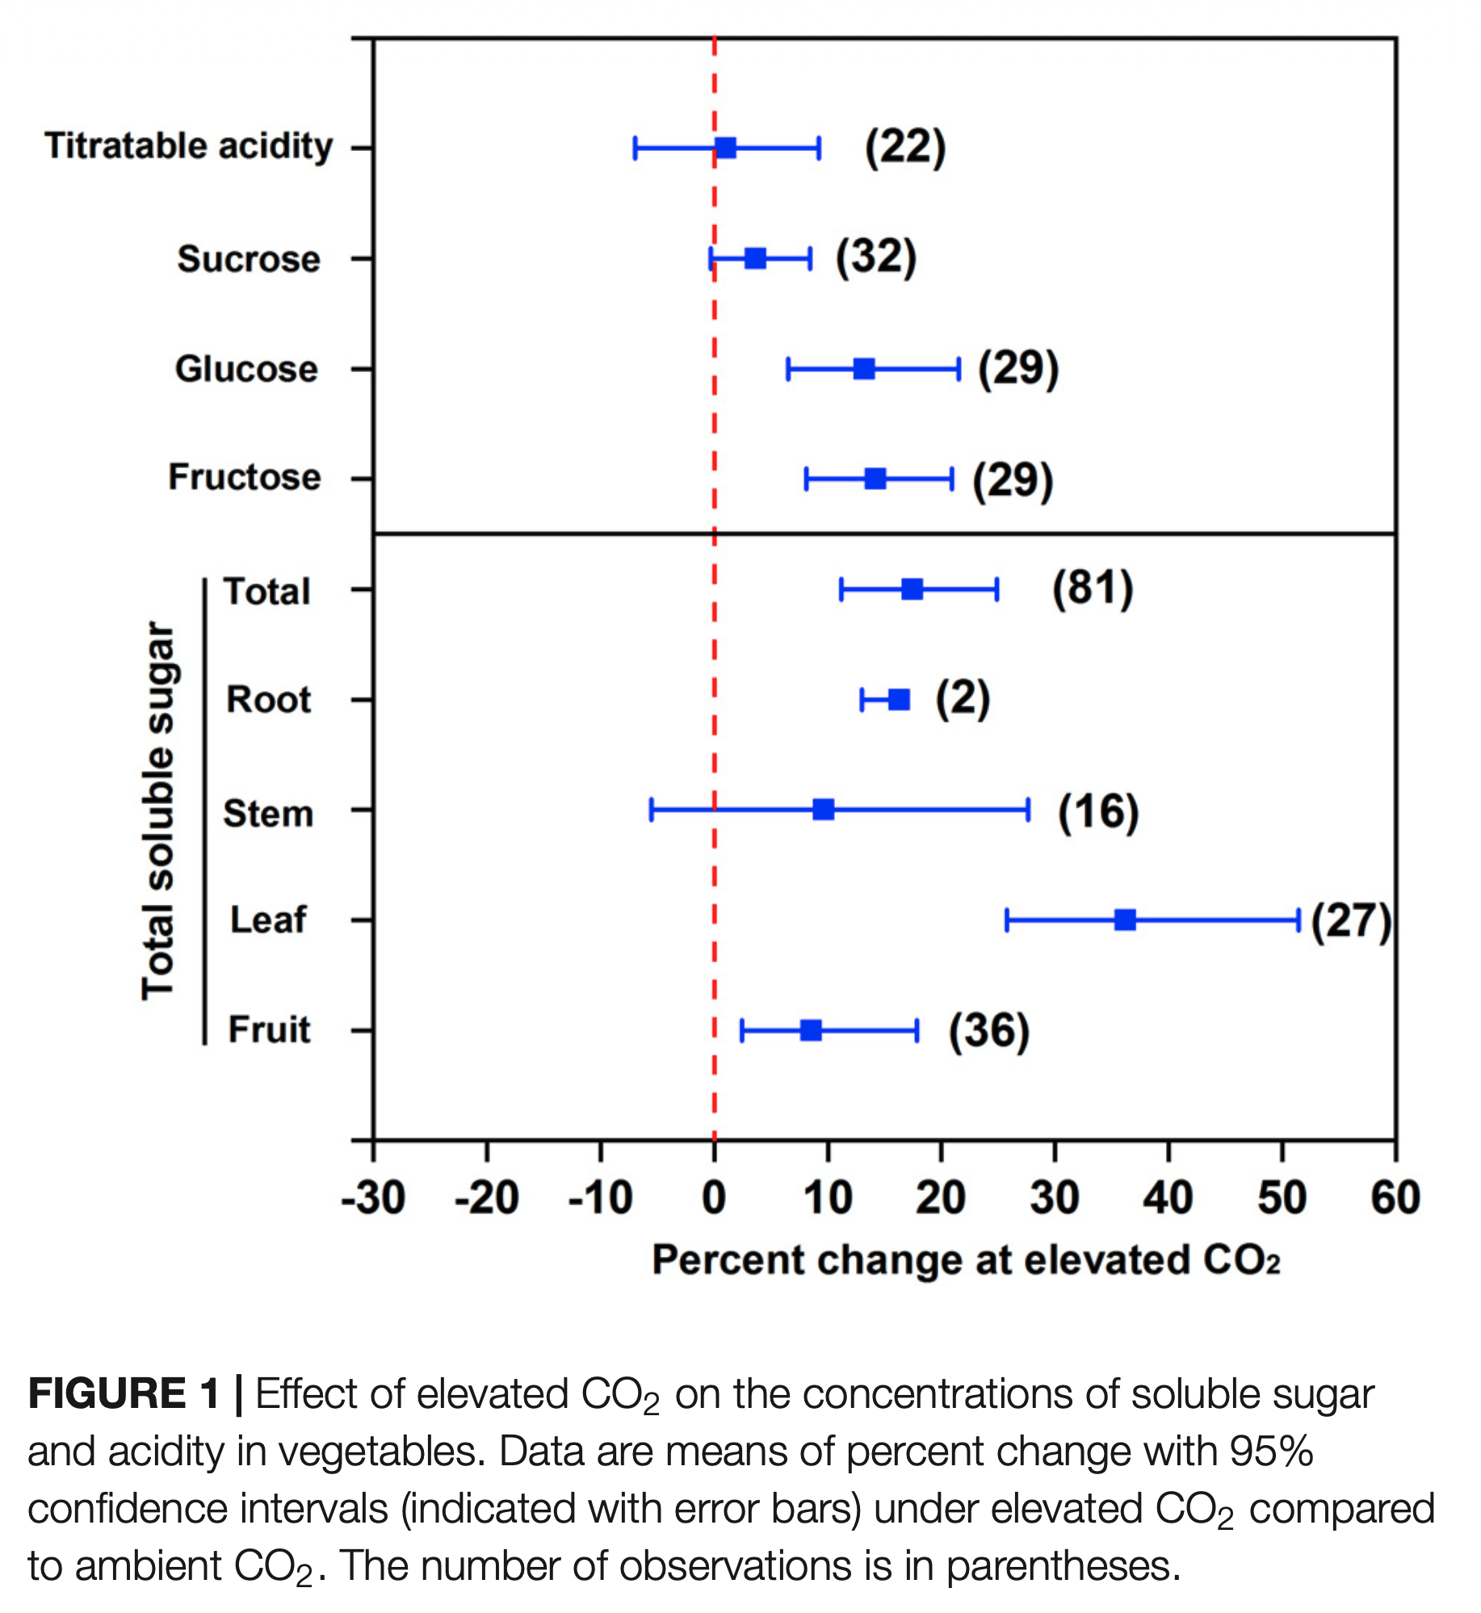
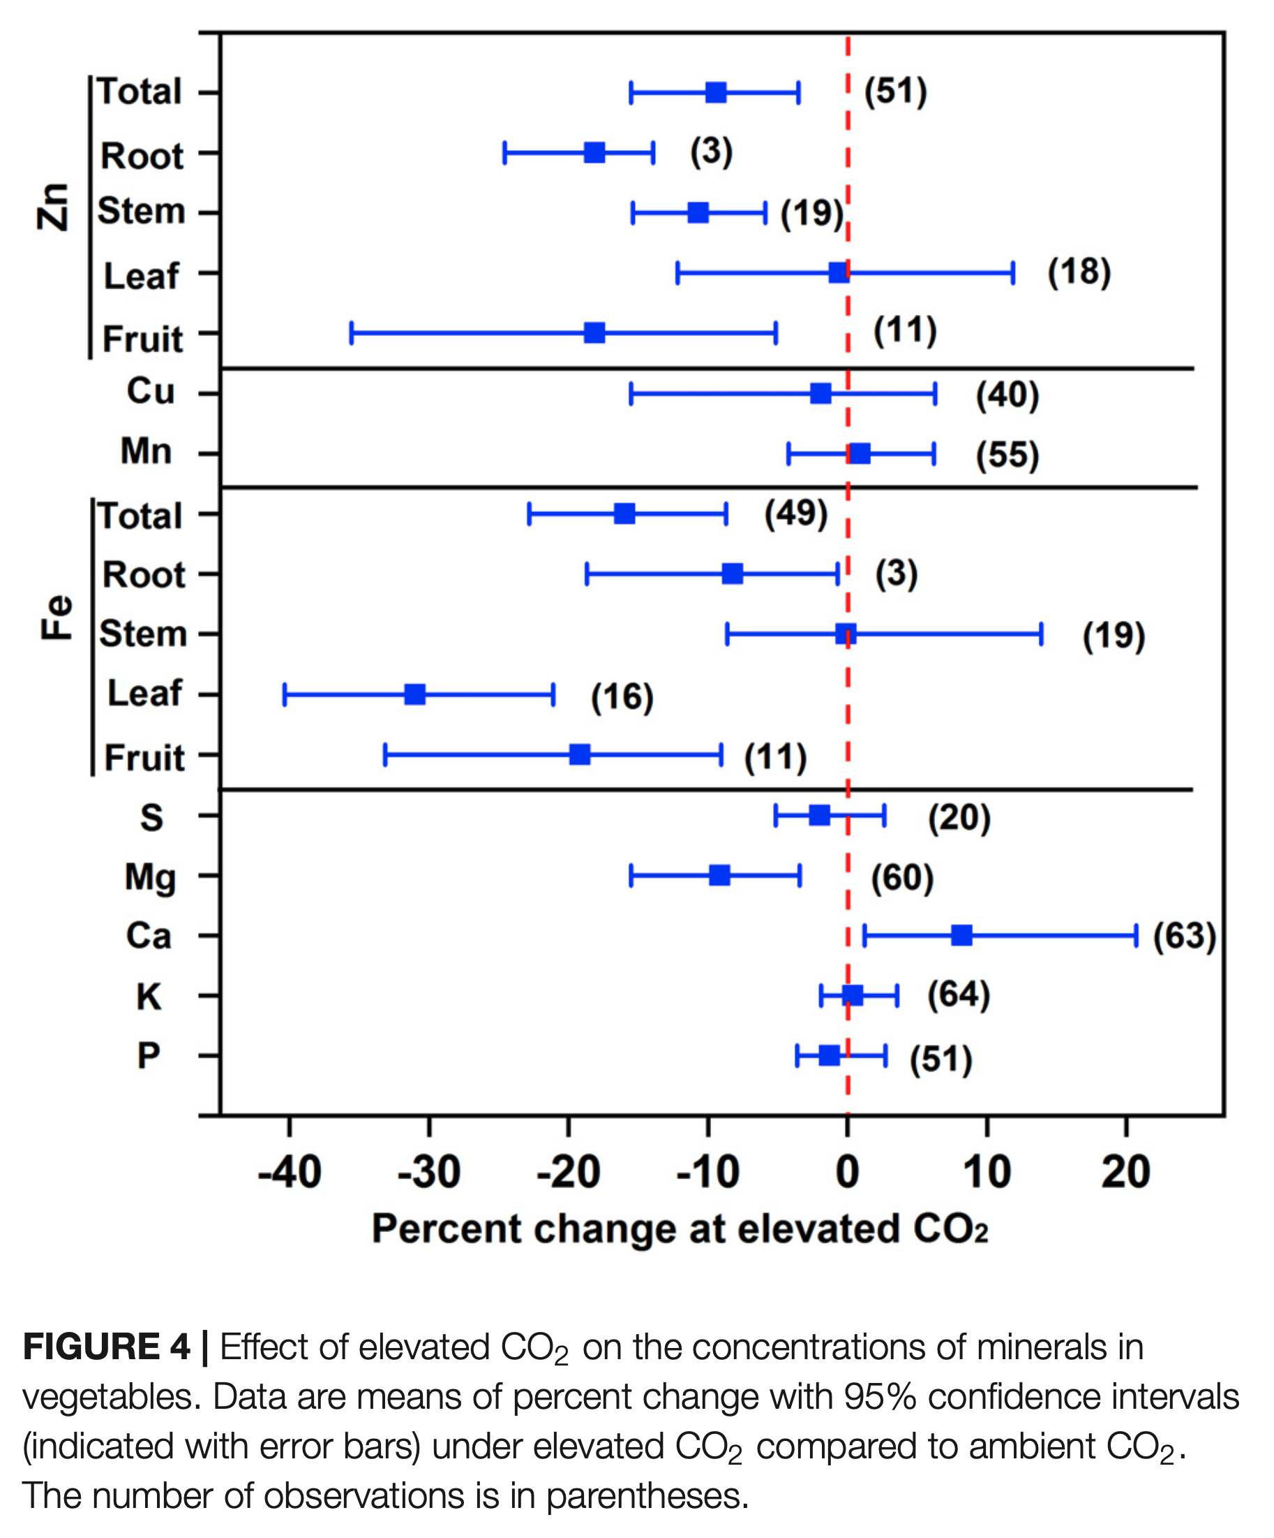

Higher ${\text{CO}}_{2}$ Alters Nutrient Levels in Crops
Carbohydrates
Micronutrients
Image source: Dong, J., Gruda, N., Lam, S. K., Li, X., & Duan, Z. (2018). Figure 1. Effect of elevated ${\text{CO}}_{2}$ on the concentrations of soluble sugar and acidity in vegetables [Chart] and Figure 4. Effect of elevated ${\text{CO}}_{2}$ on the concentrations of minerals in vegetables [Chart]. Effects of elevated CO2 on nutritional quality of vegetables: A review. Frontiers in Plant Science, 9. https://doi.org/10.3389/fpls.2018.00924
Notes:
Climate change can also make our food less nutritious, though the outcomes vary.
A growing body of research has demonstrated that rising levels of CO2 can reduce key nutrients for human health in a variety of crops.
A 2018 review of 57 studies looked at a variety of root, stem, leafy and fruit vegetables. While elevated CO2 levels increased the concentration of carbohydrates (figure on left), calcium and some antioxidants, higher CO2 decreased zinc (by 9%), iron (16%) and magnesium (9%) levels (figure on right), as well as protein (nearly 10%) and nitrates (not pictured)
Another recent study from researchers at Harvard School of Public Health, for example, found that when staple crops like wheat, corn, rice and soy are exposed to CO2 at the levels predicted for 2050, the plants lose as much as 10% of their zinc, 5% of their iron, and 8% of their protein. A 2018 study on rice crops found higher CO2 levels were associated with declines in protein, iron, and zinc, also consistent declines in vitamins B1, B2, B5, and B9 and, conversely, an increase in vitamin E
Deficiency in protein and micronutrients can have a range of health and developmental risks, including stunted growth and lower IQ as well as increased vulnerability to infectious diseases. This is of particular concern in lower- and middle-income populations already struggling with access to healthy food who consume 50-75% of their calories from staples like rice and grains. For rice specifically, the greater potential health risks of these declines are associated with lowest overall GDP per capita for the highest rice-consuming countries, suggesting potential consequences for a global population of approximately 600 million.
-----
Graphs
Dong, J., Gruda, N., Lam, S. K., Li, X., & Duan, Z. (2018). Effects of Elevated CO2 on Nutritional Quality of Vegetables: A Review. Frontiers in Plant Science, 9. https://doi.org/10.3389/fpls.2018.00924

Slide 31
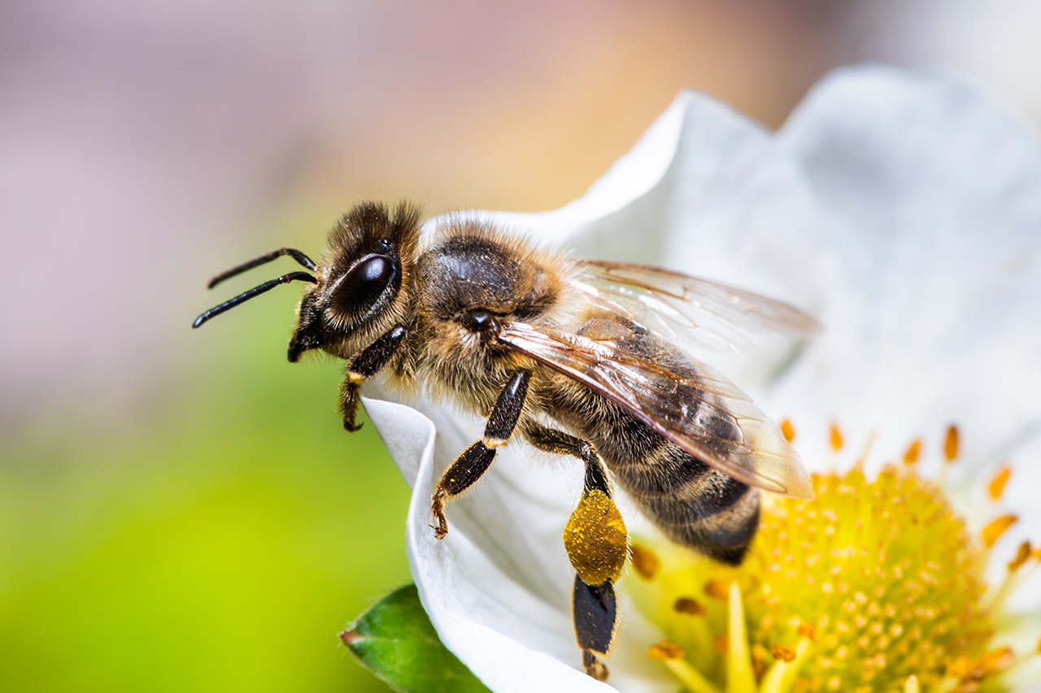
Pests and Pollinators
Pollinator-dependent crops contribute one-third of global crop production
1,500 crops require pollination
Image source: Microsoft Stock Images.

Slide 32
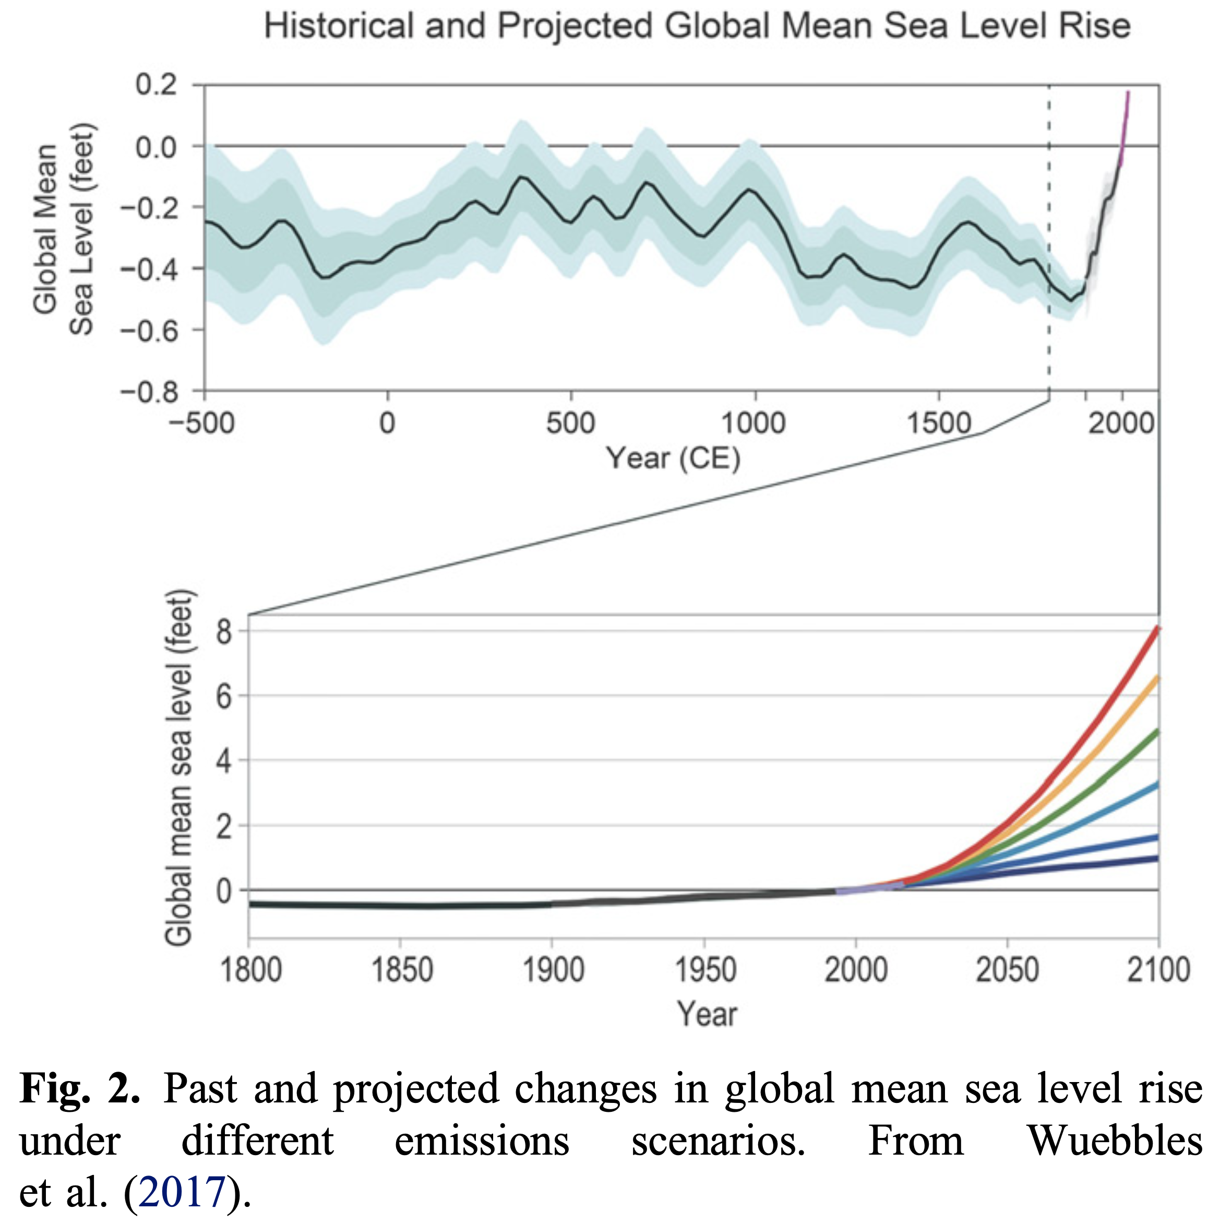
Changes to Oceans and Aquatic Ecosystems
Image source: Culligan, P. J. (2019). Figure 2. Past and projected changes in global mean sea level rise under different emissions scenarios [Chart]. From Wuebbles et al. (2017). Green infrastructure and urban sustainability: A discussion of recent advances and future challenges based on multiyear observations in New York City. Science and Technology for the Built Environment, 25(9), 1113–1120. https://doi.org/10.1080/23744731.2019.1629243
Notes:
Lastly, there will be impacts on oceans and aquatic ecosystems. The top chart shows historical global mean sea level. Over the last century, sea levels have risen about 5.5 inches, which is greater than during any preceding century in at least 2,800 years. The bottom graph shows the projected mean sea level rise over the next 75 years under different scenarios. The most modest scenario, the bottom line in purple, is a sea level rise of an additional foot. Many coastal communities, especially in Florida, Louisiana, and the East Coast of the United States, would experience an increase in flooding.
The world’s oceans have absorbed about 93% of the excess heat caused by greenhouse gas warming since the mid-20th century, making them warmer and altering global and regional climate feedbacks. Meanwhile, warmer water temperatures are likely to cause the habitat ranges of many fish and shellfish species to shift, which could disrupt aquatic ecosystems and the economic security of coastal communities, many of whom rely on fish and seafood for protein and their livelihoods. One of the modules in this series takes a closer look at the sustainability of our seafood sector.
-----
Graph
Culligan, P. J. (2019). Green infrastructure and urban sustainability: A discussion of recent advances and future challenges based on multiyear observations in New York City. Science and Technology for the Built Environment, 25(9), 1113–1120. https://doi.org/10.1080/23744731.2019.1629243

Slide 33
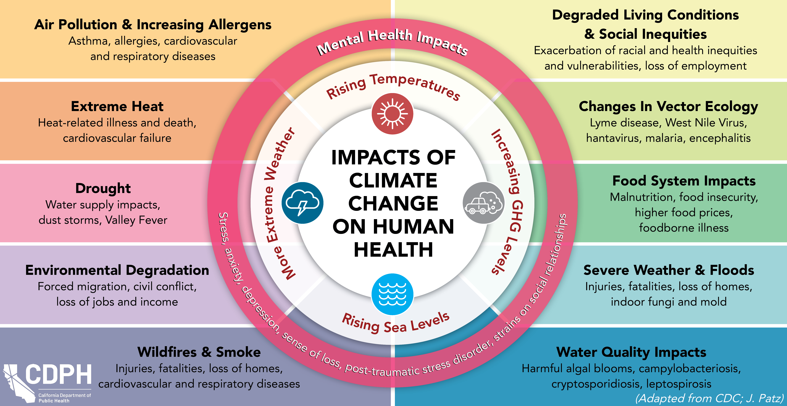
Impacts of Climate Change on Human Health
Image source: California Department of Public Health. (2025). Impacts of Climate Change on Human Health.
https://www.cdph.ca.gov/Programs/OHE/PublishingImages/Climate-Health-Equity/CDPH-Climate-Health-Impacts-Diagram.png
Notes:
Climate change also impacts human health, creating a complex interplay of environmental and health outcomes.
The diagram highlights various pathways through which climate change affects health, including air pollution and increasing allergens, extreme heat, drought, environmental degradation, wildfires and wildfire smoke, which have impacts on living conditions, changes in vector ecology, so where pests that carry diseases like lyme, west nile and malaria can survive and thrive, impacts on food systems which we are talking about throughout this module, severe weather and floods and all of those impacts on physical health, and impacts on water quality and safety. The impacts can be on physical health and mental health. Vulnerable populations—such as low-income communities and those with pre-existing health conditions—are disproportionately affected, exacerbating health inequities. These are all connected, which means that a systems approach is needed so that if you address one factor, you recognize the potential additional impacts on other factors.
-----
Graphic
California Department of Public Health. (2025). Climate Change and Health Equity. CDPH. https://www.cdph.ca.gov/Programs/OHE

Slide 34
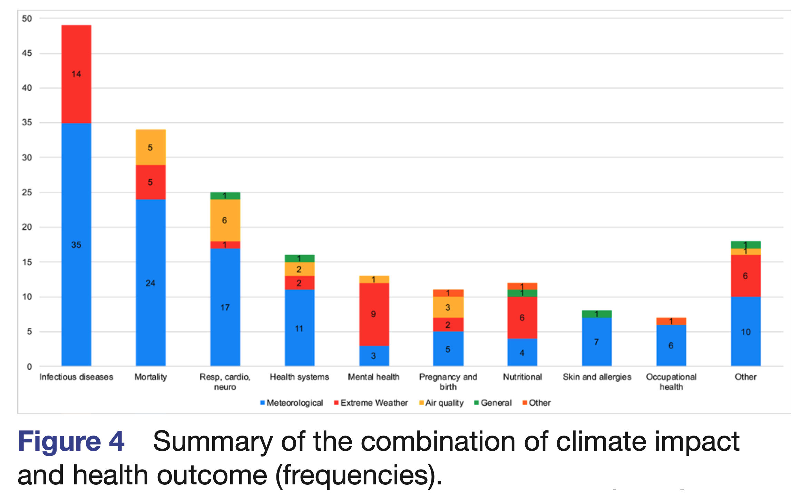
Climate Impacts and Health Outcomes
Top three:
Infectious diseases
Overall mortality
Respiratory, cardiovascular, or neurological outcomes
Image source: Rocque, R. J., Beaudoin, C., Ndjaboue, R., Cameron, L., Poirier-Bergeron, L., Poulin-Rheault, R.-A., Fallon, C., Tricco, A. C., & Witteman, H. O. (2021). Figure 4. Summary of the combination of climate impact and health outcome (frequencies) [Chart]. Health effects of climate change: An overview of systematic reviews. BMJ Open, 11(6). https://doi.org/10.1136/bmjopen-2020-046333
Notes:
Aside from direct impacts of climate, a changing climate influences many different health outcomes through weather events, heat, poor air quality and more – as displayed here in a 2020 synthesis of 94 systematic reviews.
The most common climate related health impacts were infectious diseases, overall mortality and respiratory, cardiovascular or neurological outcomes.
-----
Summary of the combination of climate impact and health outcome (frequencies). The total frequency for one category of health outcome could exceed the number of publications included in this health outcome, since one publication could explore the health impact according to more than one climate factor (eg, one publication could explore both the impact of extreme weather events and temperature on mental health).
Graph
Rocque, R. J., Beaudoin, C., Ndjaboue, R., Cameron, L., Poirier-Bergeron, L., Poulin-Rheault, R.-A., Fallon, C., Tricco, A. C., & Witteman, H. O. (2021). Health effects of climate change: An overview of systematic reviews. BMJ Open, 11(6). https://doi.org/10.1136/bmjopen-2020-046333

Slide 35
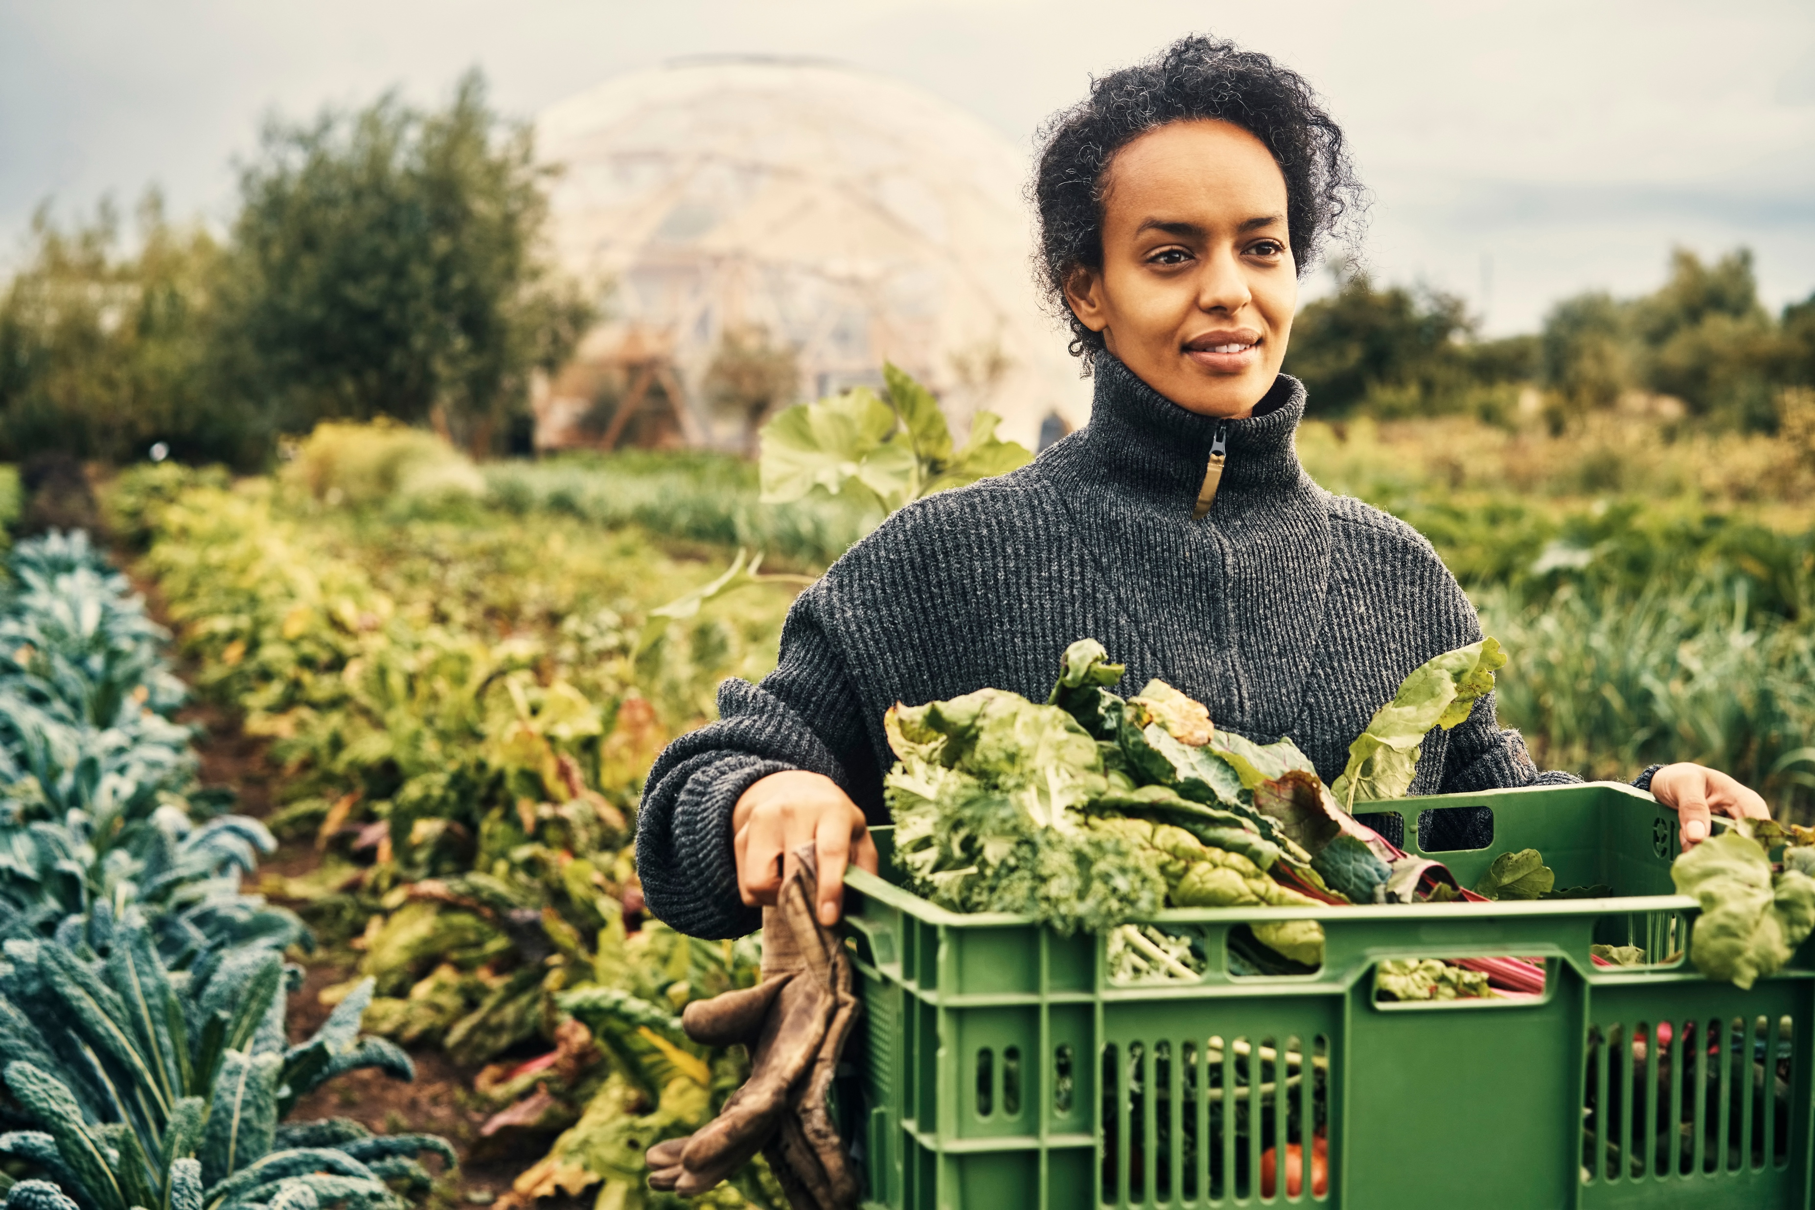
Climate Impacts and People
40% world labor force in food system
Agriculture accounts for 4% world gross domestic product (GDP)
Greater exposure to occupational hazards
Sources: FAO. (2024). Employment indicators 2000–2022 (October 2024 update) (No. FAOSTAT Analytical Brief 92). Food and Agriculture Organization of the United Nation. https://www.fao.org/statistics/highlights-archive/highlights-detail/employment-indicators-2000-2022-(september-2024-update)/en; World Bank. (2024). Agriculture, forestry, and fishing, value added (% of GDP). https://data.worldbank.org/indicator/NV.AGR.TOTL.ZS; Photo is from Microsoft Stock Images.
Notes:
The human impact is even more compelling, especially when considering that 40% world labor force work in agriculture jobs, which accounts for 4% world GDP (CIA Factbook)
Those who work in the food system experience greater exposure to occupational hazards, including chemicals, weather, dangerous equipment.
-----
Data
FAO. (2024). Employment indicators 2000–2022 (October 2024 update) (No. FAOSTAT Analytical Brief 92). Food and Agriculture Organization of the United Nations. https://www.fao.org/statistics/highlights-archive/highlights-detail/employment-indicators-2000-2022-(september-2024-update)/en
World Bank. (2024). World Bank Group. Agriculture, Forestry, and Fishing, Value Added (% of GDP). https://data.worldbank.org/indicator/NV.AGR.TOTL.ZS

Slide 36
Discussion 1: Climate Change and Nutrition
How do you think the changing nutrient content of crops will impact the clients you will work with? Will it differ by type of diet? Location? Community?
Should these changes influence nutrient databases and nutrition labeling?
How can nutritional professionals guide consumers toward nutrient-dense food choices given the inconsistencies in nutrient quality of foods?
What are some additional ways that nutrition professionals can support consumers in this topic?

Slide 37
Section D: Reducing the Climate Footprint of Food Systems
Notes:
Section D will explore strategies to reduce the climate footprint of food systems.
Our climate footprint – sometimes called a carbon footprint – is a term used to describe the amount of greenhouse gases generated directly or indirectly by human activity.

Slide 38
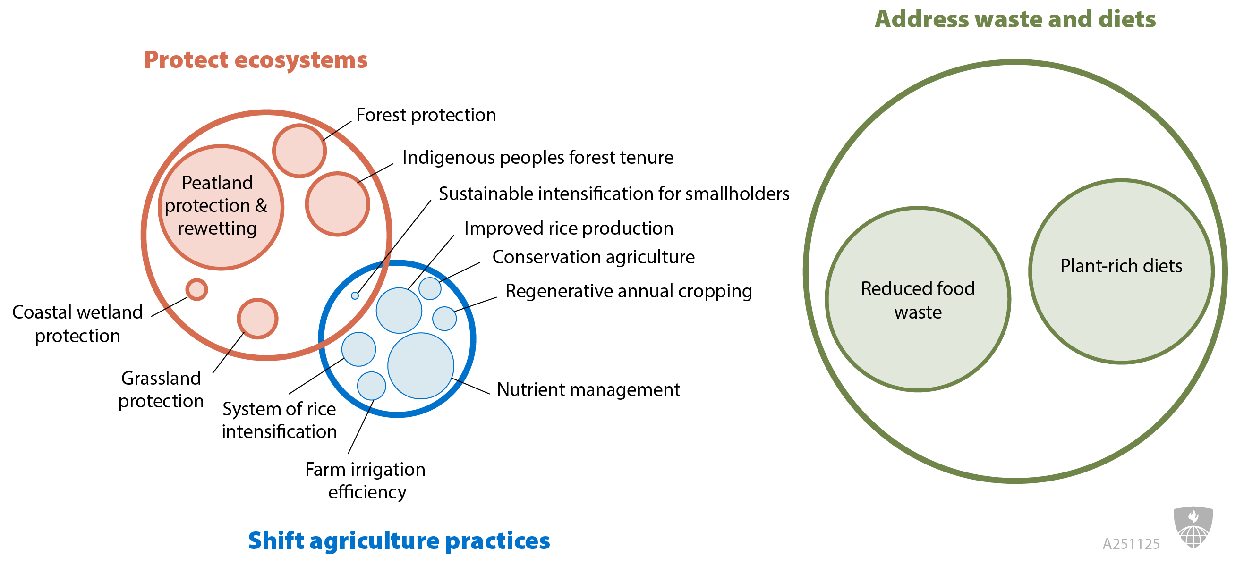
Food, Agriculture, and Land Use
Image source: Adapted by the Johns Hopkins Bloomberg School of Public Health from Mehra, M. (2021). Resilient & sustainable land management practices. Project Drawdown.[Presentation Slides]. https://unfccc.int/sites/default/files/resource/2%20PD_NBS_Mamta%20Mehra_Oct2021.pdf#:~:text=How%20can%20we%20reduce%20the%20pressures%20on,worldwide%20along%20with%20addressing%20the%20issue%20of
Notes:
Climate change is a complex problem and will require a multitude of solutions. We need changes to agriculture, but also the energy sector, manufacturing and transportation. The solutions need to reduce emissions AND sequester the carbon dioxide that is already in the atmosphere.
Analyses by Project Drawdown shown here suggest that we already have the technology and solutions to make meaningful reductions in the amount of greenhouse gases in our atmosphere. It will require changes by individuals, communities, cities, and entire countries. And it will absolutely require changes in our policies – particularly those of countries who emit the most.
Project drawdown shows us here how important certain food systems-related strategies are compared to others. You can see that Reduced Food Waste and Plant-rich Diets are the largest circles, meaning they are some of the most impactful strategies for reducing greenhouse gasses in our atmosphere. Other important strategies address agricultural production and land use.
Although reducing food waste is equally important, in the rest of this module, we will only address plant-rich diets as an action, given our roles as dietitians. We hope to spend more time on wasted food in future modules.
-----
Graphic
Mehra, M. (2021). Food, Agriculture, and Land Use: Resilient and Sustainable Land Management Practices. Project Drawdown. https://unfccc.int/sites/default/files/resource/2%20PD_NBS_Mamta%20Mehra_Oct2021.pdf#:~:text=How%20can%20we%20reduce%20the%20pressures%20on,worldwide%20along%20with%20addressing%20the%20issue%20of

Slide 39
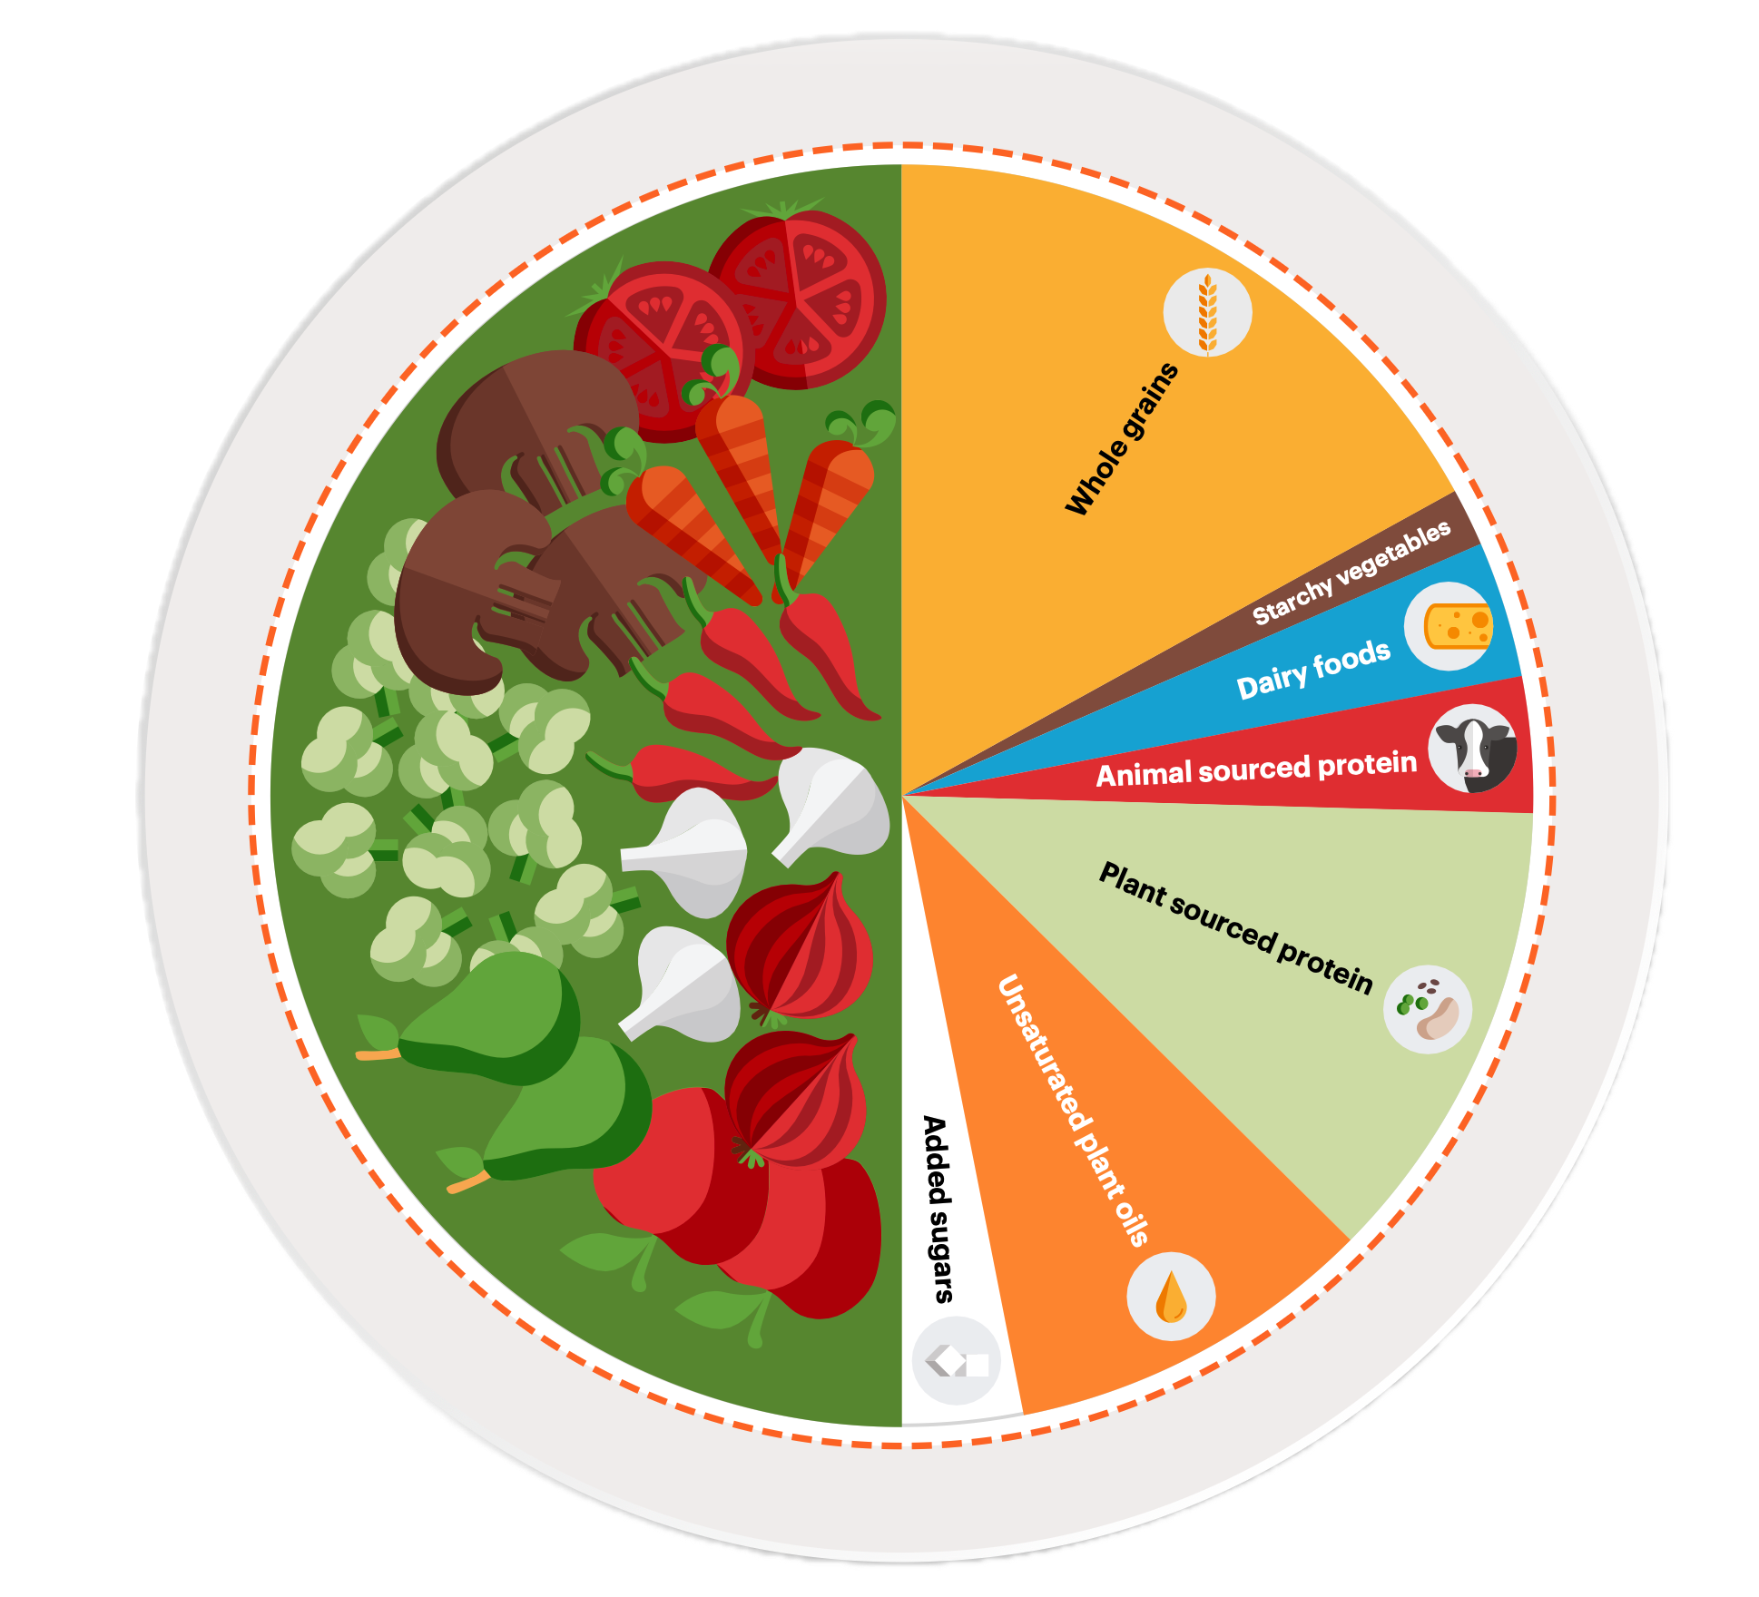
Solutions: Reducing the Food System Contribution to Climate Change through Less Meat, Less Waste
“A diet that includes more plant-based foods and fewer animal source foods is healthy, sustainable, and good for both people and planet. It is not a question of all or nothing, but rather small changes for a large and positive impact.”
—EAT Lancet Planetary Health
Source: The EAT-Lancet Commission on Food, Planet, Health. (n.d.). Figure 3, Planetary Health Plate [Graphic]. The Planetary Health Diet. EAT Forum.
https://eatforum.org/wp-content/uploads/2025/09/EAT-Lancet_Commission_Summary_Report.pdf
Notes:
Sophisticated assessments from scientists around the world, including Project Drawdown and the Eat-Lancet commission on Planetary Health, consistently rank diets lower in meat and less wasted food as among the most effective strategies to make food systems more sustainable, not only in terms of climate, but also overall sustainability.
The EAT-Lancet Commission says in their report: “A diet that includes more plant-based foods and fewer animal source foods is healthy, sustainable, and good for both people and planet. It is not a question of all or nothing, but rather small changes for a large and positive impact.”
This is an image of the planetary health plate that emphasizes plant-based foods and encourages moderations in animal protein consumption.
-----
Quote & Graphic
The EAT-Lancet Commission on Food, Planet, Health. (n.d.). The Planetary Health Diet. EAT Forum. Retrieved July 31, 2025, from https://eatforum.org/eat-lancet-commission/the-planetary-health-diet-and-you/

Slide 40
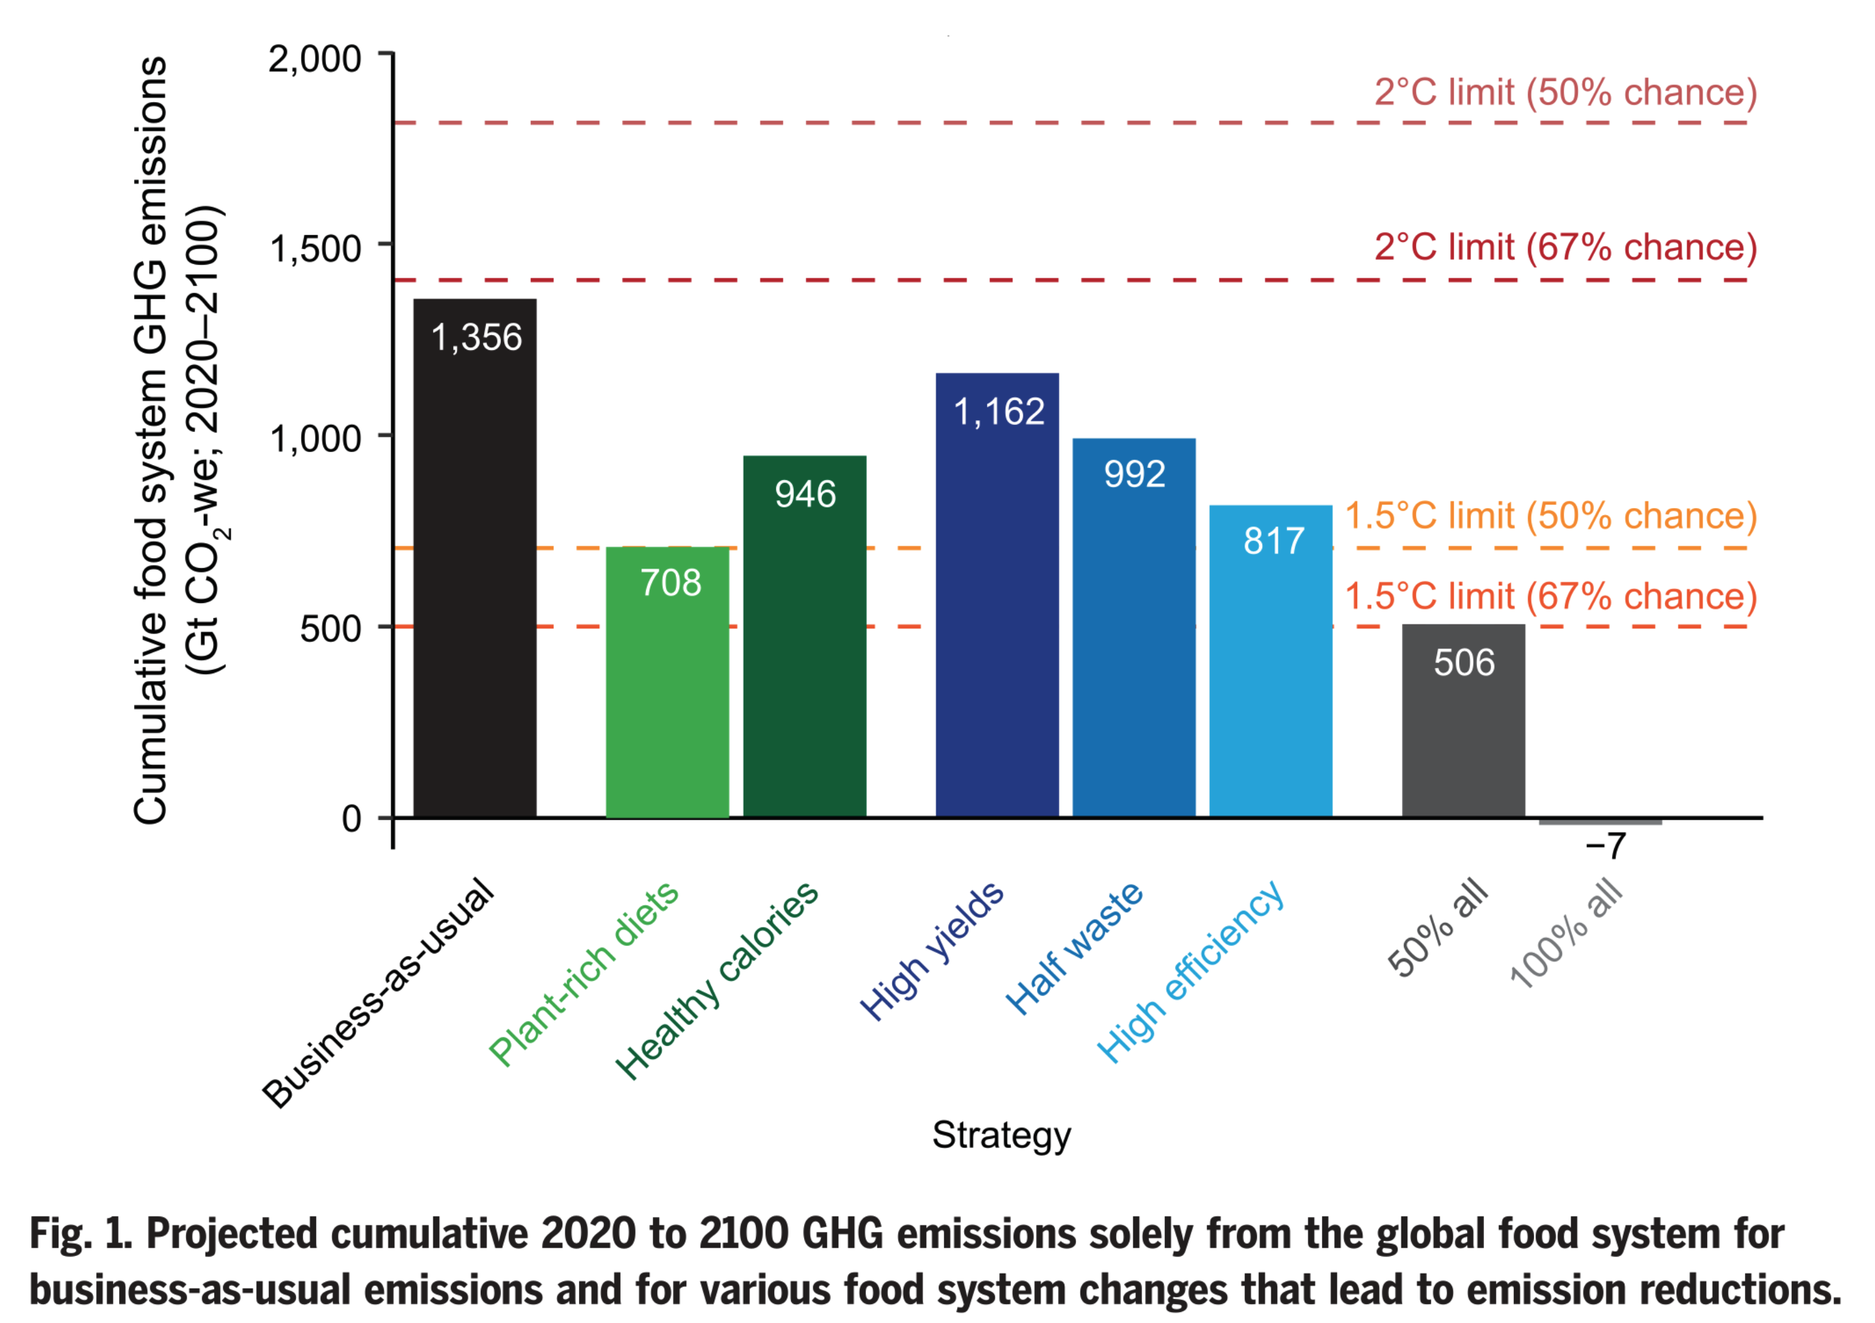
Strategies for a Healthy Climate
Image source: Clark, M. A., Domingo, N. G. G., Colgan, K., Thakrar, S. K., Tilman, D., Lynch, J., Azevedo, I. L., & Hill, J. D. (2020). Figure 1. Projected cumulative 2020 to 2100 GHG emissions solely from the global food system for business-as-usual emissions and for various food system changes that lead to emission reductions [Chart]. Global food system emissions could preclude achieving the 1.5° and 2°C climate change targets. Science, 370(6517), 705–708. https://doi.org/10.1126/science.aba7357
Notes:
What if we do nothing to address food systems contributions to climate? This is called ‘business as usual” and is the first bar on the left in black. Under a business as usual scenario, food systems alone would emit enough greenhouse gas emissions to get us close to a 2 degree rise in temperatures -- that threshold to keep us from the more dire consequences of climate change. This does not include emissions from energy, transportation and manufacturing! You can see why it’s so critically important to reduce the food systems greenhouse gas emissions.
But how? What are the actions that will have the most impact?
The rest of the bars show the GHG savings we would see from different actions. The two green bars show how much we’d reduce emissions if we made changes to our diet. Following a plant-rich diet alone can actually keep us below the 1.5 degrees Celsius threshold.
Improving agricultural production, reducing wasted food and making our entire food system more efficient can help, and we are making improvements in these areas. However, when it comes to diet, we are on the opposite track. Meat consumption is on the rise globally.
Let’s look at the very last bar on the right in dark gray. If we implement half of these solutions, we can cut emissions in half. If we implemented all of them, our food system could actually get below the threshold!
This is why an ‘all-of-the-above’ approach is needed. As nutrition professionals our largest place of influence will be toward shifting diets. We will focus on this for the rest of this module.
-----
Graph
Clark, M. A., Domingo, N. G. G., Colgan, K., Thakrar, S. K., Tilman, D., Lynch, J., Azevedo, I. L., & Hill, J. D. (2020). Global food system emissions could preclude achieving the 1.5° and 2°C climate change targets. Science, 370(6517), 705–708. https://doi.org/10.1126/science.aba7357

Slide 41
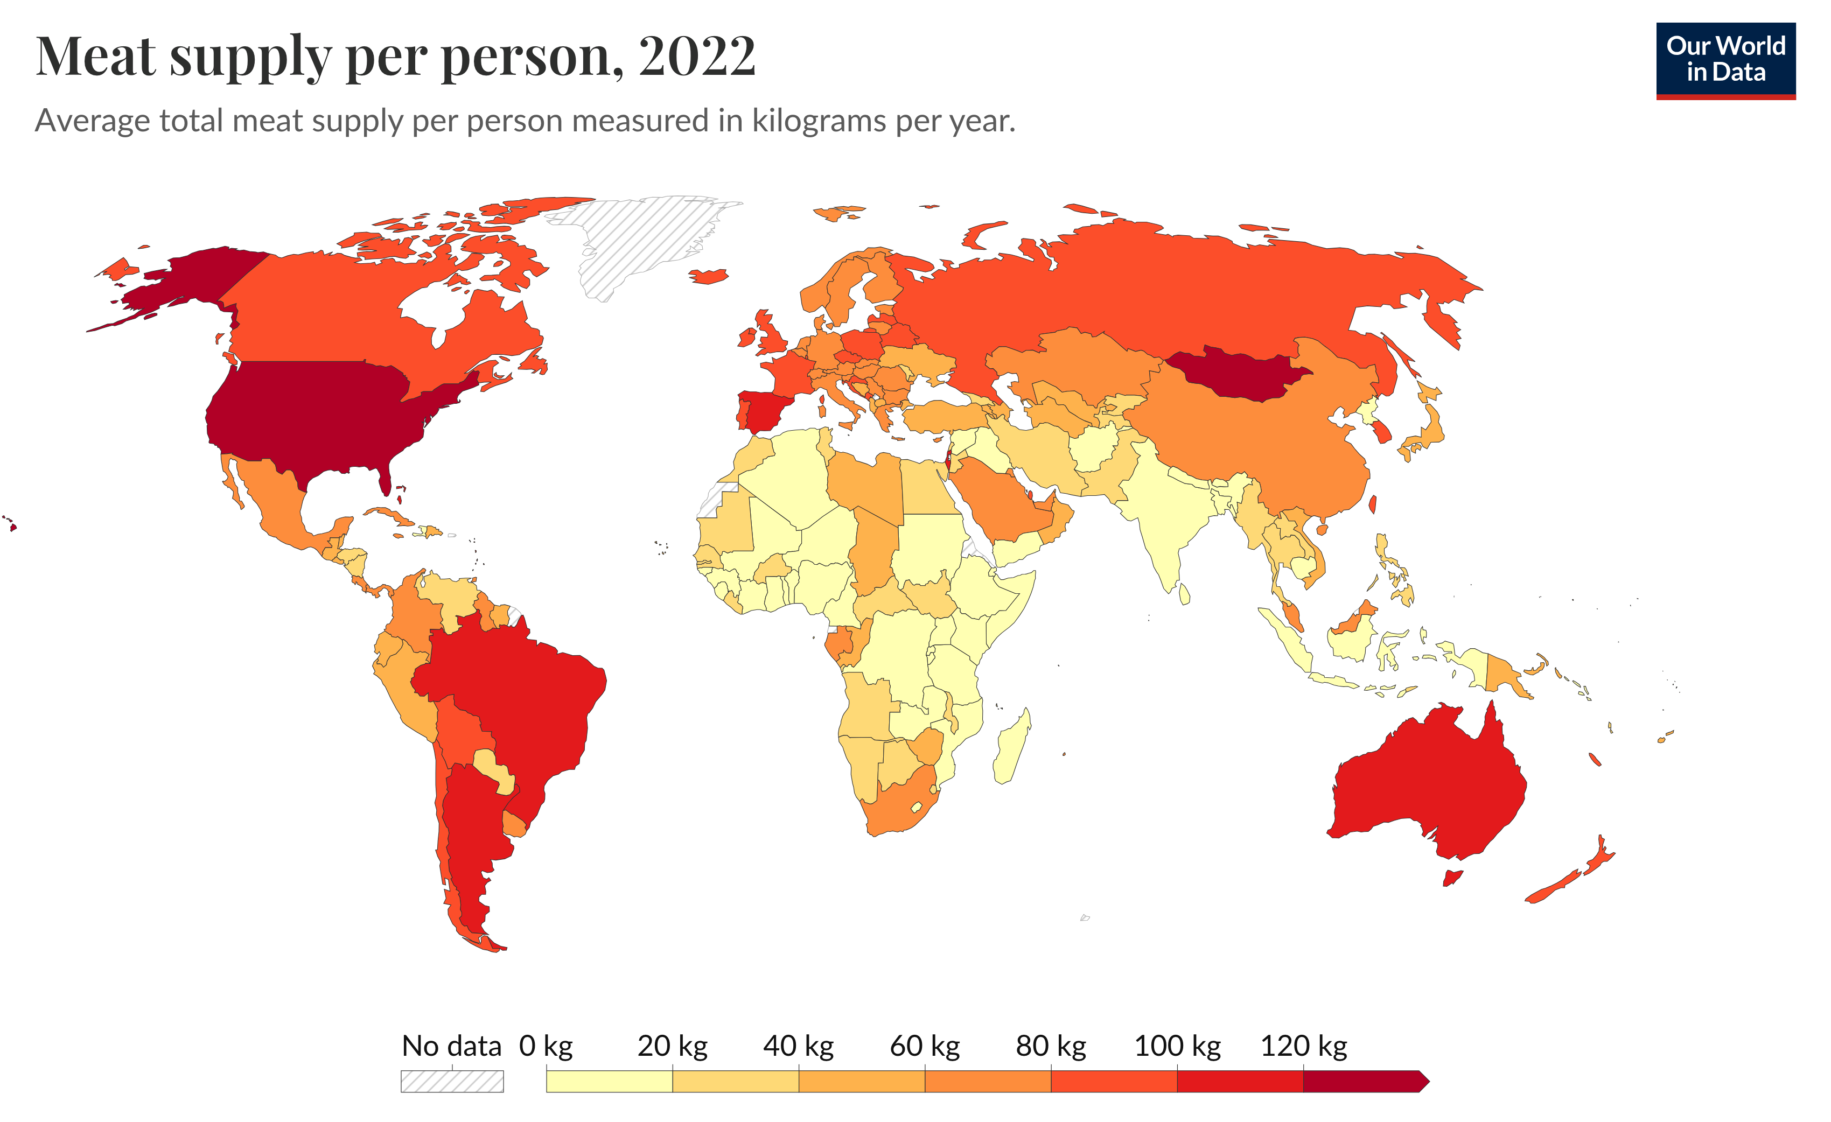
Equity: Per Capita Meat Supply, by Country
Image source: Our World in Data. (2025). Yearly per capita supply of all meat: Meat supply per person. Our World in Data. https://ourworldindata.org/grapher/meat-supply-per-person?time=2022
Notes:
Let’s start with one of the most common questions: Do we ALL need to eat less meat? To answer that question, let’s look more closely at the distribution of meat supply. Though the data doesn’t adjust for what is wasted, it’s a good estimate of consumption. The countries in red and –to a lesser extent orange -- eat far more meat overall than most countries. The countries in red and the darkest shades of orange include the U.S., Mongolia, Australia, Brazil, Argentina and Spain. The countries in yellow, on the other hand, eat very little meat – so many of the countries in Africa, East Asia and the Middle East. These countries also tend to have low food security and higher rates of nutritional deficiencies. For many of these countries, increasing consumption of animal protein would help meet nutritional needs. What this means is that for these countries to meet basic nutritional needs, these countries may need to INCREASE their per capita food systems-related greenhouse gas emissions.
-----
Graphic
Our World in Data. (2025). Yearly per capita supply of all meat: Meat supply per person. Our World in Data. https://ourworldindata.org/grapher/meat-supply-per-person?time=2022

Slide 42
What Can High-Income Countries Do to Make Diets More Sustainable and Aligned With the Planetary Health Diet?—1
Eat less meat
and dairy
(for most)
Consume more
whole grains,
vegetables, legumes,
and nuts
1
2
Notes:
Let’s focus on what high-income countries can do to shift diets to be more sustainable and more in line with the Planetary health diet.

Slide 43
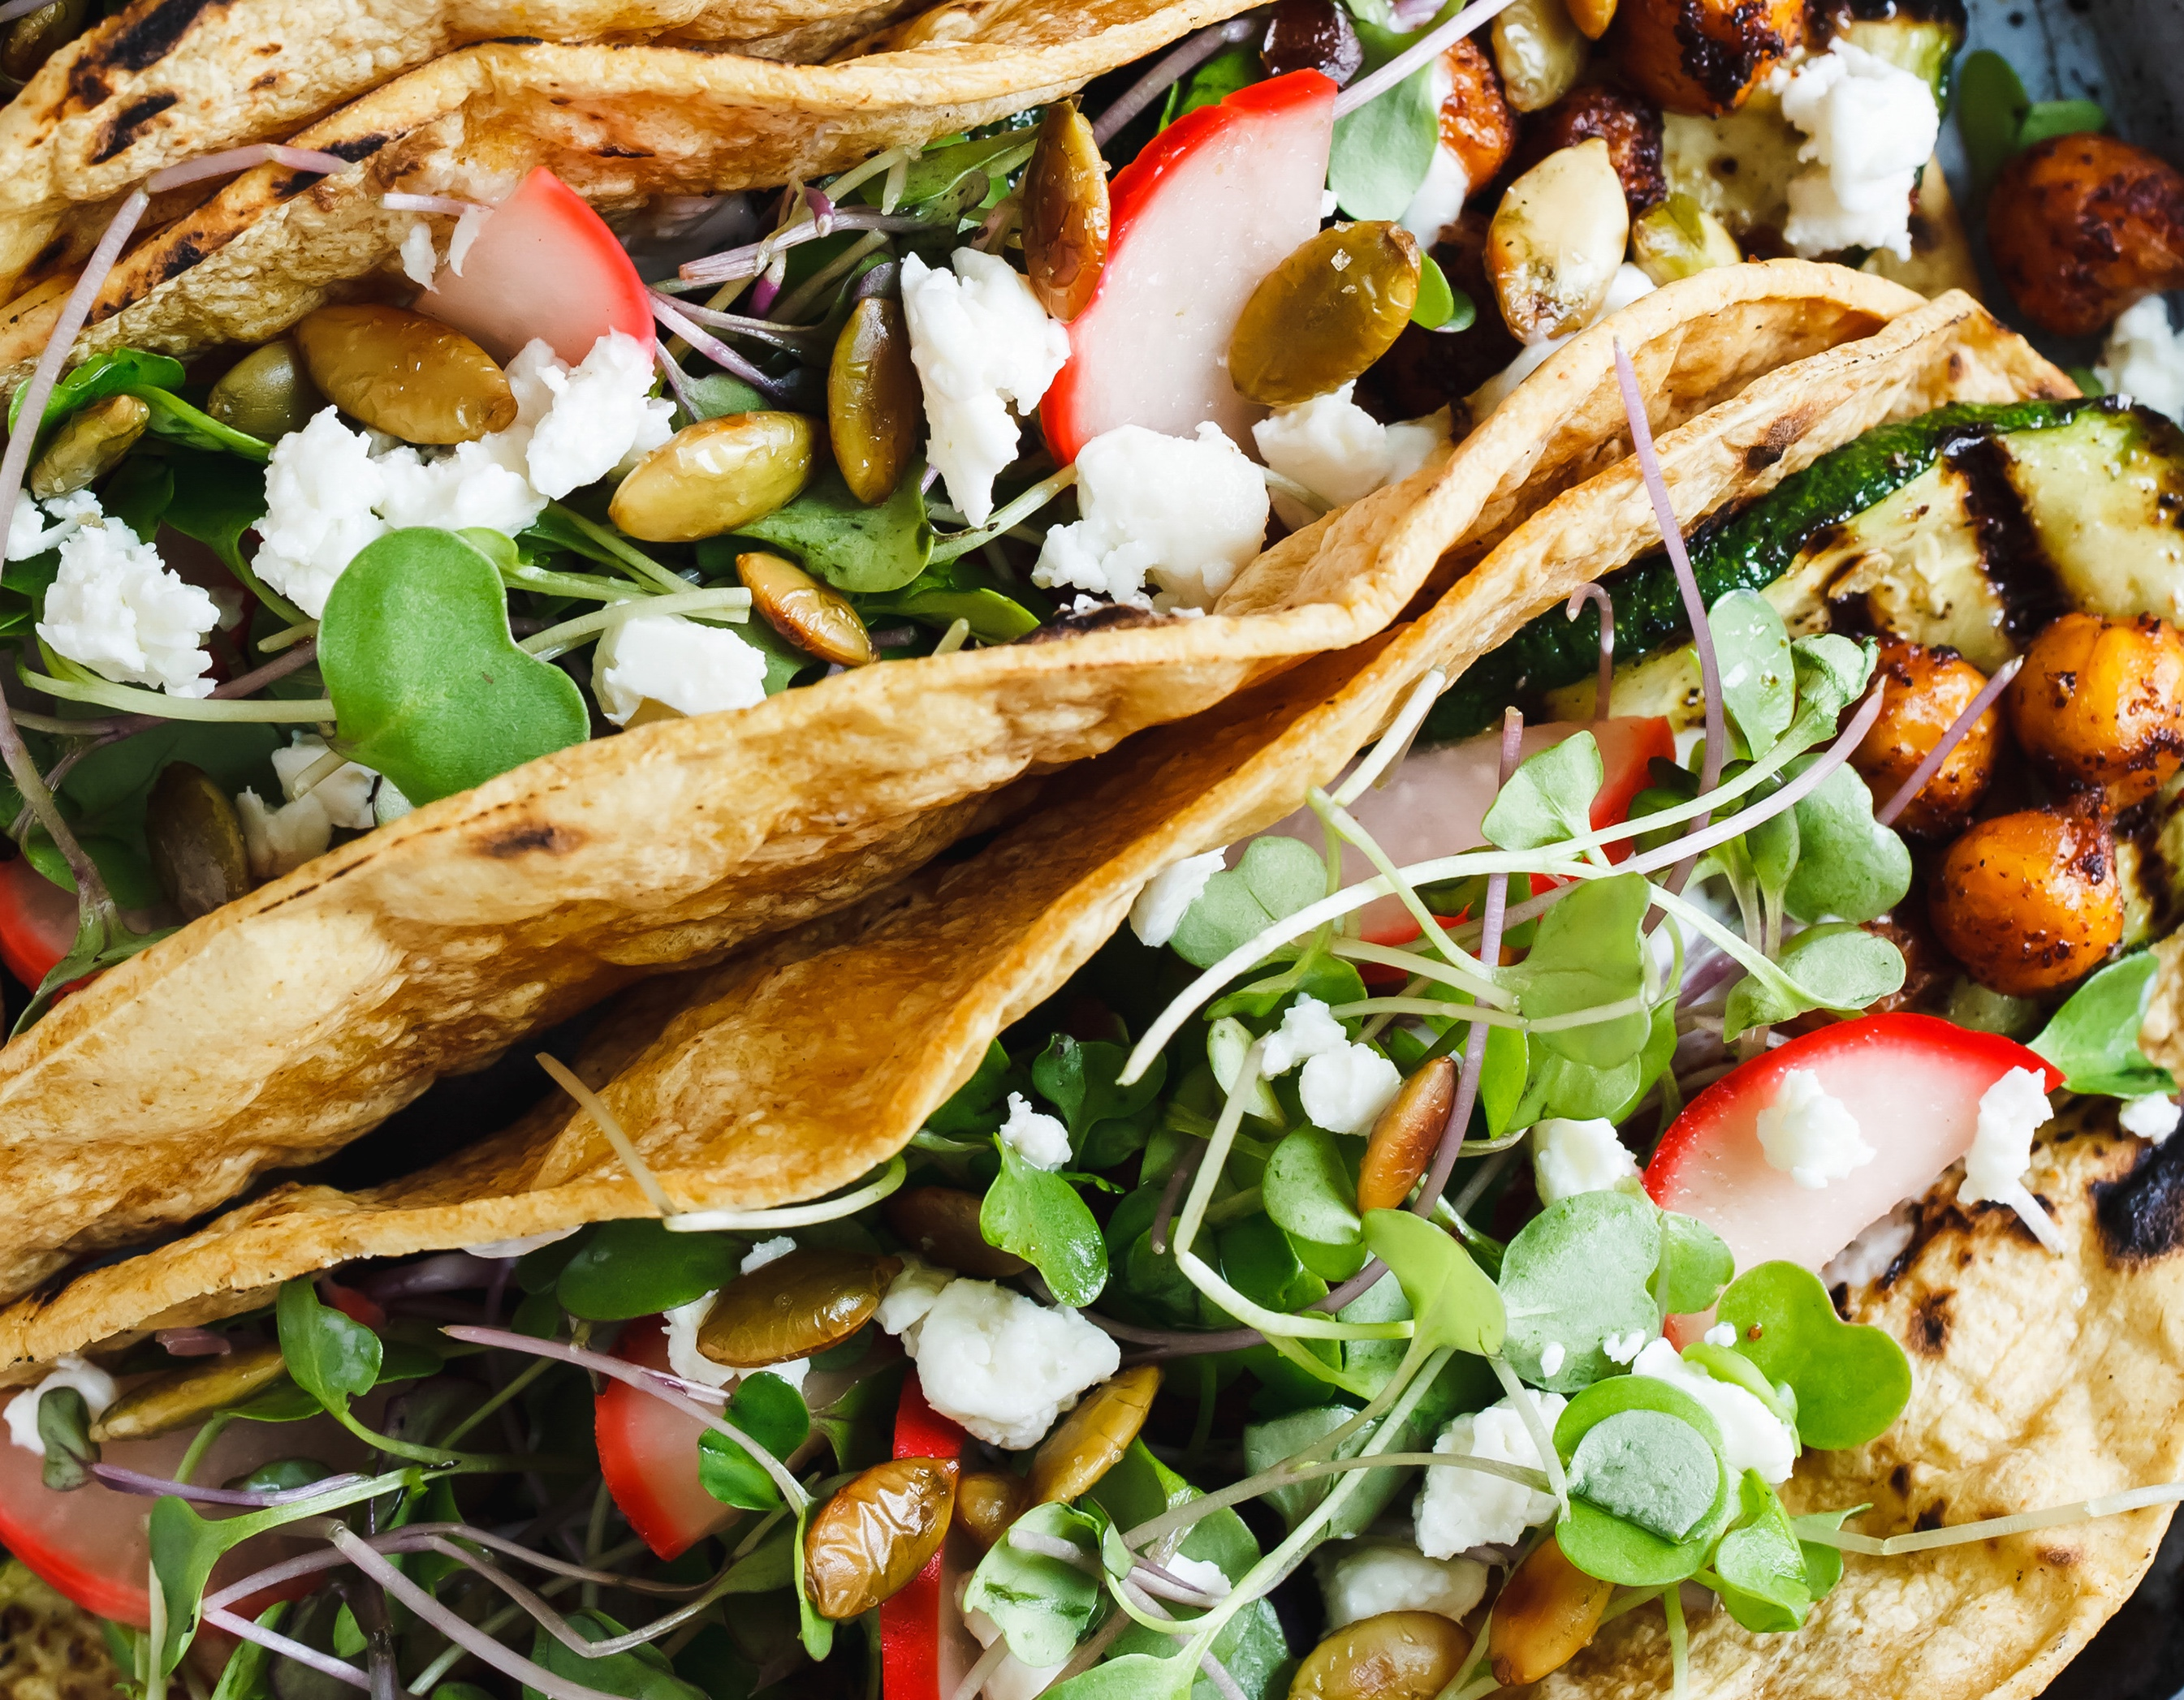
1. Eat Less Meat and Dairy (for Most)
Replace animal proteins with healthy plant proteins
  Beans
  Lentils
  Nuts
Emphasize sustainably and regeneratively produced animal foods
  Including aquatic foods
Moderate portions of dairy
Image stock: Microsoft Stock Images.
Notes:
First and foremost – and likely not surprising given all that we have talked about – is reducing the consumption of animal products, particularly red and processed meat. There are a number of strategies to achieve this. We can start reducing meat by replacing animal protein, especially red and processed meat and dairy, with healthy plant-based protein sources, particularly beans, lentils and nuts. We can also shift toward types of meat that have a lower impact on the environment and health or is raised with regenerative methods. Seafood and poultry have lower greenhouse gas footprints than beef, though they have varying other environmental impacts. But there are many good options, and you don’t have to cut out meat and dairy all together. The Planetary health diet recommends 1 serving of red meat per week, 2 servings of poultry, 2 or more of fish and 1 daily serving of dairy, in addition to daily intake of legumes and nuts.
Seafood or Aquatic food will be covered in another module.

Slide 44
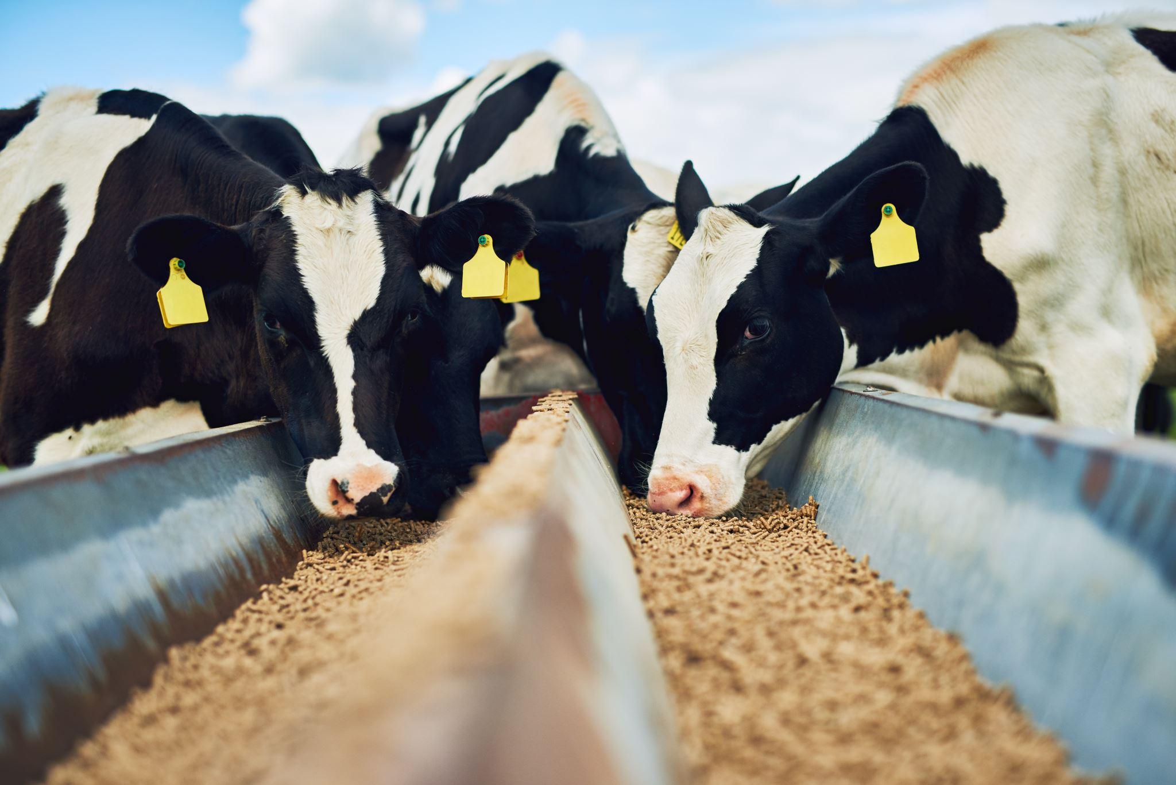
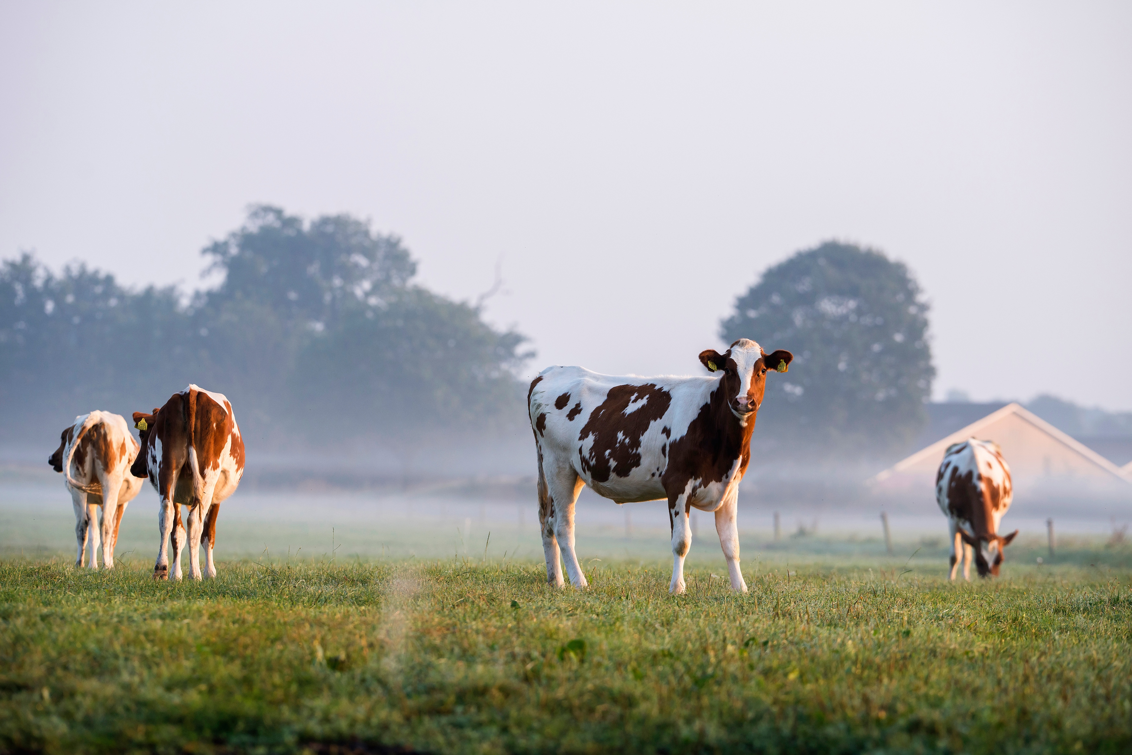
What if We Choose Only Grass-Fed Beef?
Image stock: Microsoft Stock Images.
Notes:
When we start to discuss how to reduce greenhouse gas emissions from the food system, the question often arises, well, what if instead of eating beef produced in industrial feedlots and fed corn-based manufactured feed –which is the image on the left – we switched to beef produced on pasture like the image on the right? You might have heard the argument that grazing animals, what is called grass-finished beef, is better for the environment. This is largely true. In general, raising animals in pasture-based systems is healthier for the animals and the land, and it’s also more humane. Additionally, raising animals without antibiotics reduces the risk of antibiotic and drug resistance in humans. Some studies have found nutritional benefits to grass-fed meat, and there are considerations for the well-being of farmers and farm workers, as well as others across the food system.
Notably, some traditional and Indigenous systems involve raising buffalo (or Bison) on natural prairies with room to roam and respectful, humane harvest methods. They play a key role in regenerative agriculture, as these animals graze on perennial wild grasses, leaving their deep roots intact (which enhances carbon sequestration), controlling weeds without chemicals, and restoring fertility.
However, when it comes specifically to greenhouse gas emissions from cows and the sequestration of carbon (which means storing it in the ground) the factors are complex and the evidence is mixed. That could be an entire lecture of its own.
?

Slide 45
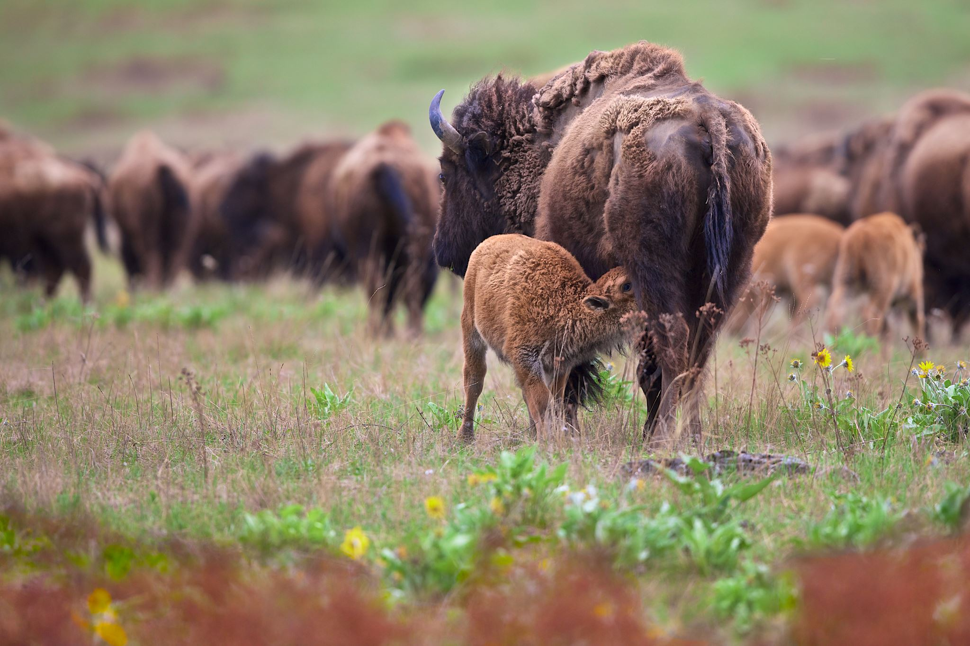
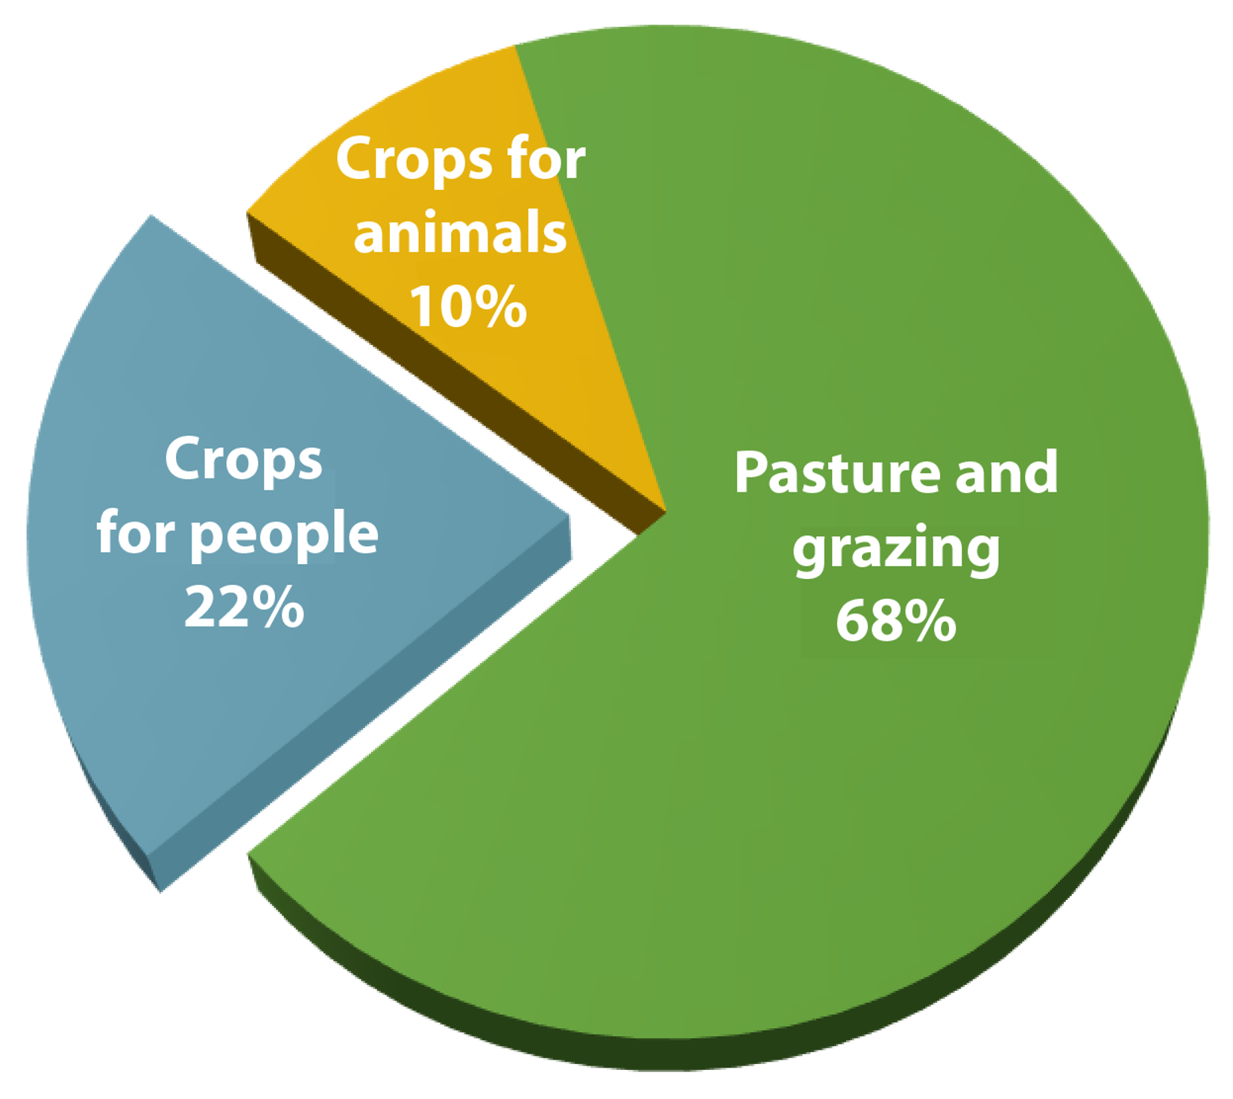
Global Agricultural Land Use
Image sources: Photo is from Microsoft Stock Images; Pie chart was created by the Center for a Livable Future based on data from FAO and Poore, J., & Nemecek, T. (2018). Reducing food’s environmental impacts through producers and consumers. Science, 360(6392), 987–992. https://doi.org/10.1126/science.aaq0216
Notes:
As we noted earlier, in the U.S., we could not continue our current meat intake and simply switch it all over from industrial-raised meat to pasture-raised meat.
If we looked at how global agricultural land is used, the vast majority is for raising food animals. And you can see on the right that about 68% of it comes from pasture and grazing lands. So those grazing systems per unit of output, they do require more land than the intensive system, even after accounting for the land that's used to grow the feed.
However, one important point about land use and livestock systems is that grazing animals can be raised on land that is too hilly or too rocky to grow crops. A key example of this system working for the benefit of people and planet is the case of raising buffalo (or bison) in prairie areas, as mentioned in the previous slide. These buffalo-based agriculture systems are deeply valued by Indigenous people and are an essential part of healing relationships with the land and culture
But while we need to protect these important systems, we simply do not have enough agricultural land to shift all of our current meat consumption over to a grazing system. The bottom line is that our food system needs to operate more efficiently and sustainably on existing land, and that will require reducing meat consumption across most high- and middle- income countries.
-----
Graphic (Adapted)
Poore, J., & Nemecek, T. (2018). Reducing food’s environmental impacts through producers and consumers. Science, 360(6392), 987–992. https://doi.org/10.1126/science.aaq0216

Slide 46
Dairy: The Complexities
Nutrition
Environment
Source of affordable micronutrients
  Calcium, magnesium, phosphorus, iodine, zinc
Associated with growth and cognition for children
Favorable evidence of protection against serious heart disease and all cause mortality
Plant-based milks vary by source
Form matters
Generally, more greenhouse gas emissions (GHGe) per liter and water-intensive than dairy alternatives
Products using large quantities of milk per serving have greater environmental impacts
Most impact from animal feed production and farm activities, including solid waste disposal
Sources: Smedman, A., Månsson, H. L., Drewnowski, A., & Edman, A.-K. M. (2010). Nutrient density of beverages in relation to climate impact. Food & Nutrition Research, 54(5170). https://doi.org/10.3402/fnr.v54i0.5170; Drewnowski, A., Rehm, C. D., Martin, A., Verger, E. O., Voinnesson, M., & Imbert, P. (2015). Energy and nutrient density of foods in relation to their carbon footprint. The American Journal of Clinical Nutrition, 101(1), 184–191. https://doi.org/10.3945/ajcn.114.092486; Johnson, A. J., Stevenson, J., Pettit, J., Jasthi, B., Byhre, T., & Harnack, L. (2025). Assessing the nutrient content of plant-based milk alternative products available in the United States. Journal of the Academy of Nutrition and Dietetics, 125(4), 515–527. https://doi.org/10.1016/j.jand.2024.06.003
Notes:
Let’s talk about dairy. Dairy intake is associated with health benefits and is a significant source of many critical micronutrients, including calcium, magnesium, phosphorus, iodine and zinc. Consumption of dairy can be important source of protein and other nutrients in young children, especially in food insecure populations. Among children in low-income countries, increased milk intake is positively associated with height, weight, and cognitive ability There is evidence of protection against heart disease and all-cause mortality in adults. Not covered here, the form of dairy impacts health differentially, whether fermented, liquid or cheese
But dairy has a significant environmental footprint. While milk production emits more greenhouse gas emissions per liter than non-dairy alternatives such as soy or oat milk, dairy milk generally has greater nutrient density. Most of the environmental impact of dairy comes from animal feed production and farm activities. Dairy alternatives are generally mixed on health and environmental concerns depending on the main ingredient source
A recent study compared the average nutrient profile of several plant-based beverages to dairy milks.
Compared to1% dairy milk, Plant-based milks on average:
Were higher in sugar but also fiber,
Were lower in phosphorous, riboflavin, potassium, and B12.
Protein was lower in all except soy and pea protein beverages
Calcium and Vitamin D depended on fortification.
-----
Note
One observational study of 136,000 adults found that dairy consumption was protective against serious heart disease and all-cause mortality (Dehghan et al, 2018), however, a previous meta-analysis found that total dairy intake was not associated with risk of cardiovascular disease or coronary heart disease (Guo et al, 2017). Dairy products that require large quantities of liquid milk, such as butter, Greek yogurt and hard cheese, have greater environmental impacts than milk alone (Shalant, 2017).
Information
Smedman, A., Månsson, H. L., Drewnowski, A., & Edman, A.-K. M. (2010). Nutrient density of beverages in relation to climate impact. Food & Nutrition Research, 54(5170). https://doi.org/10.3402/fnr.v54i0.5170
Drewnowski, A., Rehm, C. D., Martin, A., Verger, E. O., Voinnesson, M., & Imbert, P. (2015). Energy and nutrient density of foods in relation to their carbon footprint. The American Journal of Clinical Nutrition, 101(1), 184–191. https://doi.org/10.3945/ajcn.114.092486
Johnson, A. J., Stevenson, J., Pettit, J., Jasthi, B., Byhre, T., & Harnack, L. (2025). Assessing the Nutrient Content of Plant-Based Milk Alternative Products Available in the United States. Journal of the Academy of Nutrition and Dietetics, 125(4), 515–527. https://doi.org/10.1016/j.jand.2024.06.003

Slide 47
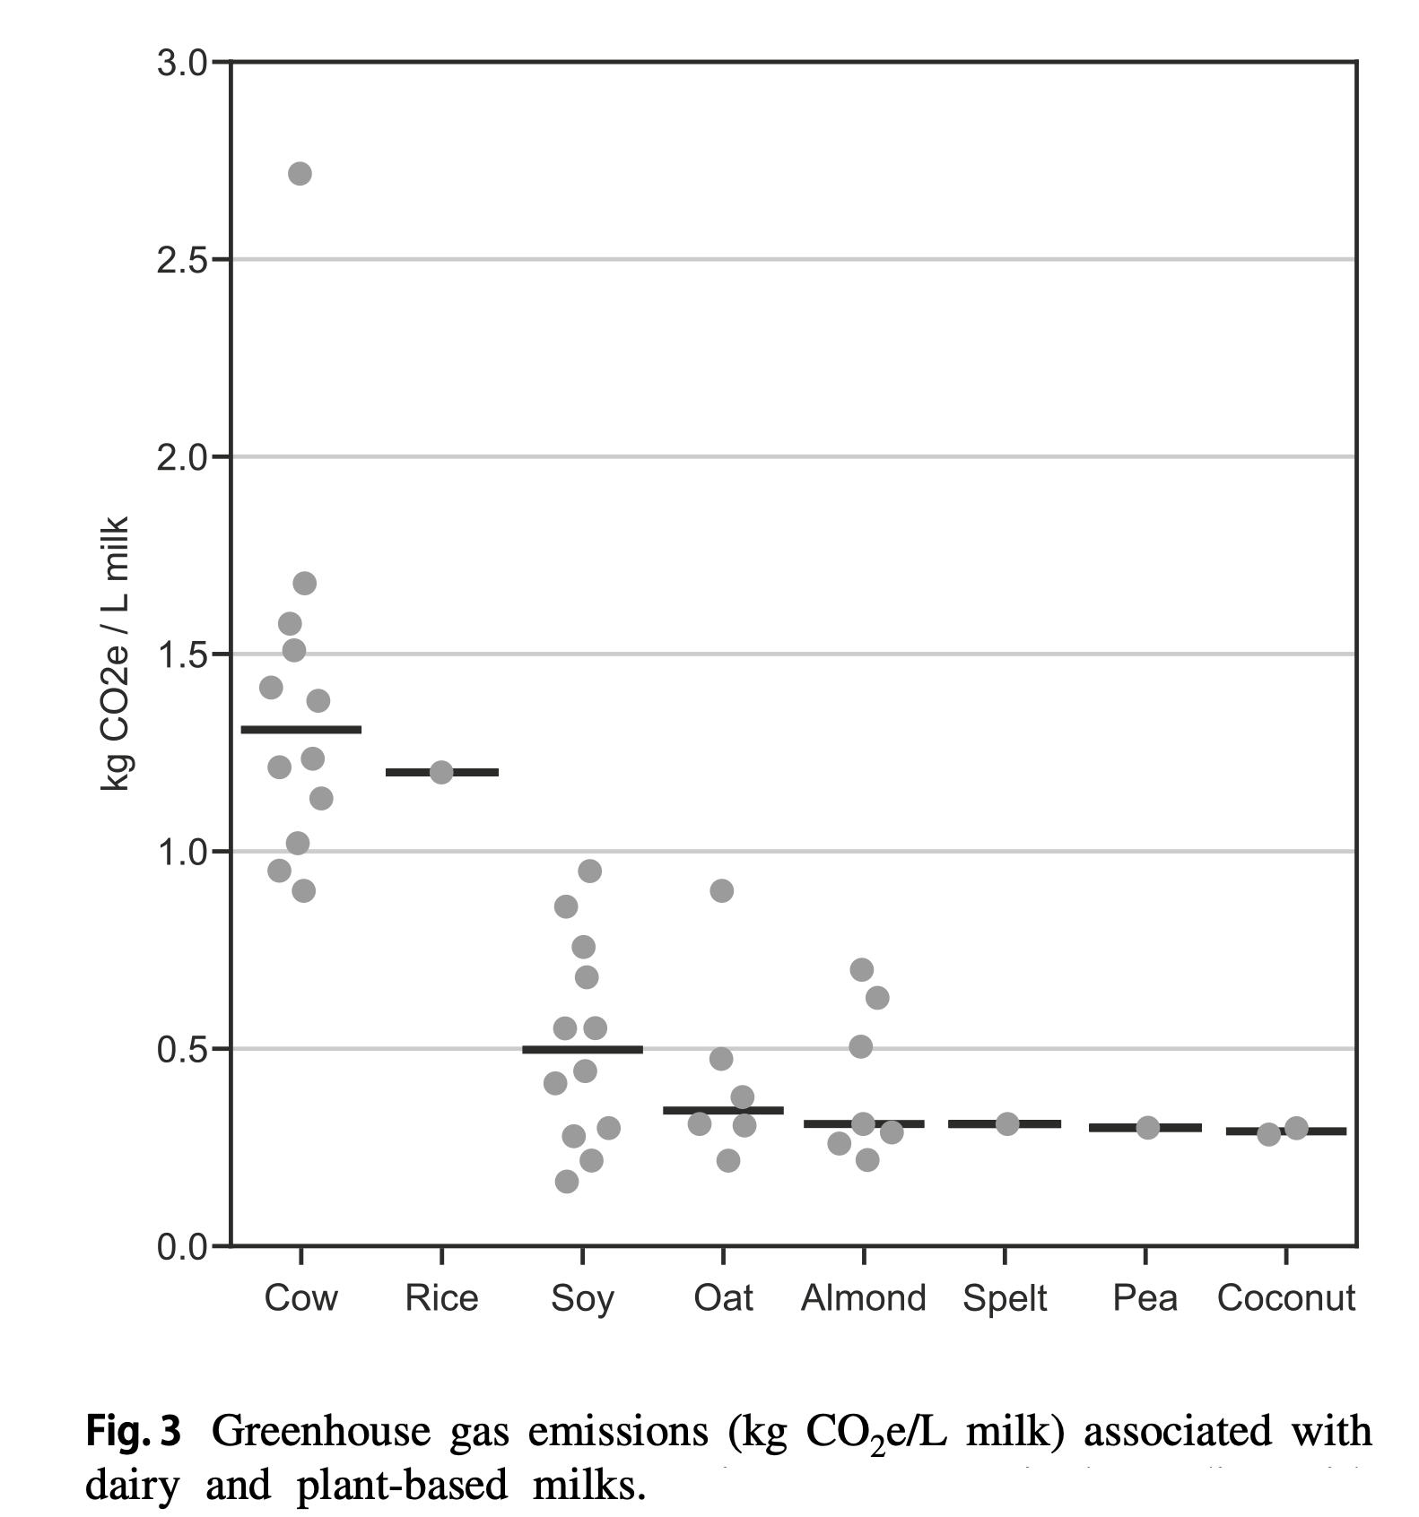
Greenhouse Gas Emissions Associated with Dairy and Plant-Based Milk
Source: Ramsing, R., Santo, R., Kim, B. F., Altema-Johnson, D., Wooden, A., Chang, K. B., Semba, R. D., & Love, D. C. (2023). Figure 3. Greenhouse gas emissions (kg ${\text{CO}}_{2}$e/L milk) associated with dairy and plant-based milks [Chart]. Dairy and plant-based milks: implications for nutrition and planetary health. Current Environmental Health Reports, 10(3), 291–302. https://doi.org/10.1007/s40572-023-00400-z
Notes:
In a 2023 study, researchers synthesized lifecycle assessments of dairy and plant-based milks. The median per-liter greenhouse gas emissions associated with soy, oat, almond, spelt, pea, and coconut milks were 62–78% lower than that associated with cow’s milk which is shown on the left of this image.
Among plant milks, rice was the most greenhouse gas-intensive, although this was based on only one study.
-----
Note
Greenhouse gas emissions (kg CO₂e/L milk) associated with dairy and plant-based milks. Points represent single studies with a horizontal line at the median for each milk type. In cases where a single study reported multiple estimates (e.g., refrigerated and shelf stable; conventional and organic) for a given milk type, we averaged them to avoid over-representing results from those studies
Graph
Ramsing, R., Santo, R., Kim, B. F., Altema-Johnson, D., Wooden, A., Chang, K. B., Semba, R. D., & Love, D. C. (2023). Dairy and Plant-Based Milks: Implications for Nutrition and Planetary Health. Current Environmental Health Reports, 10(3), 291–302. https://doi.org/10.1007/s40572-023-00400-z

Slide 48
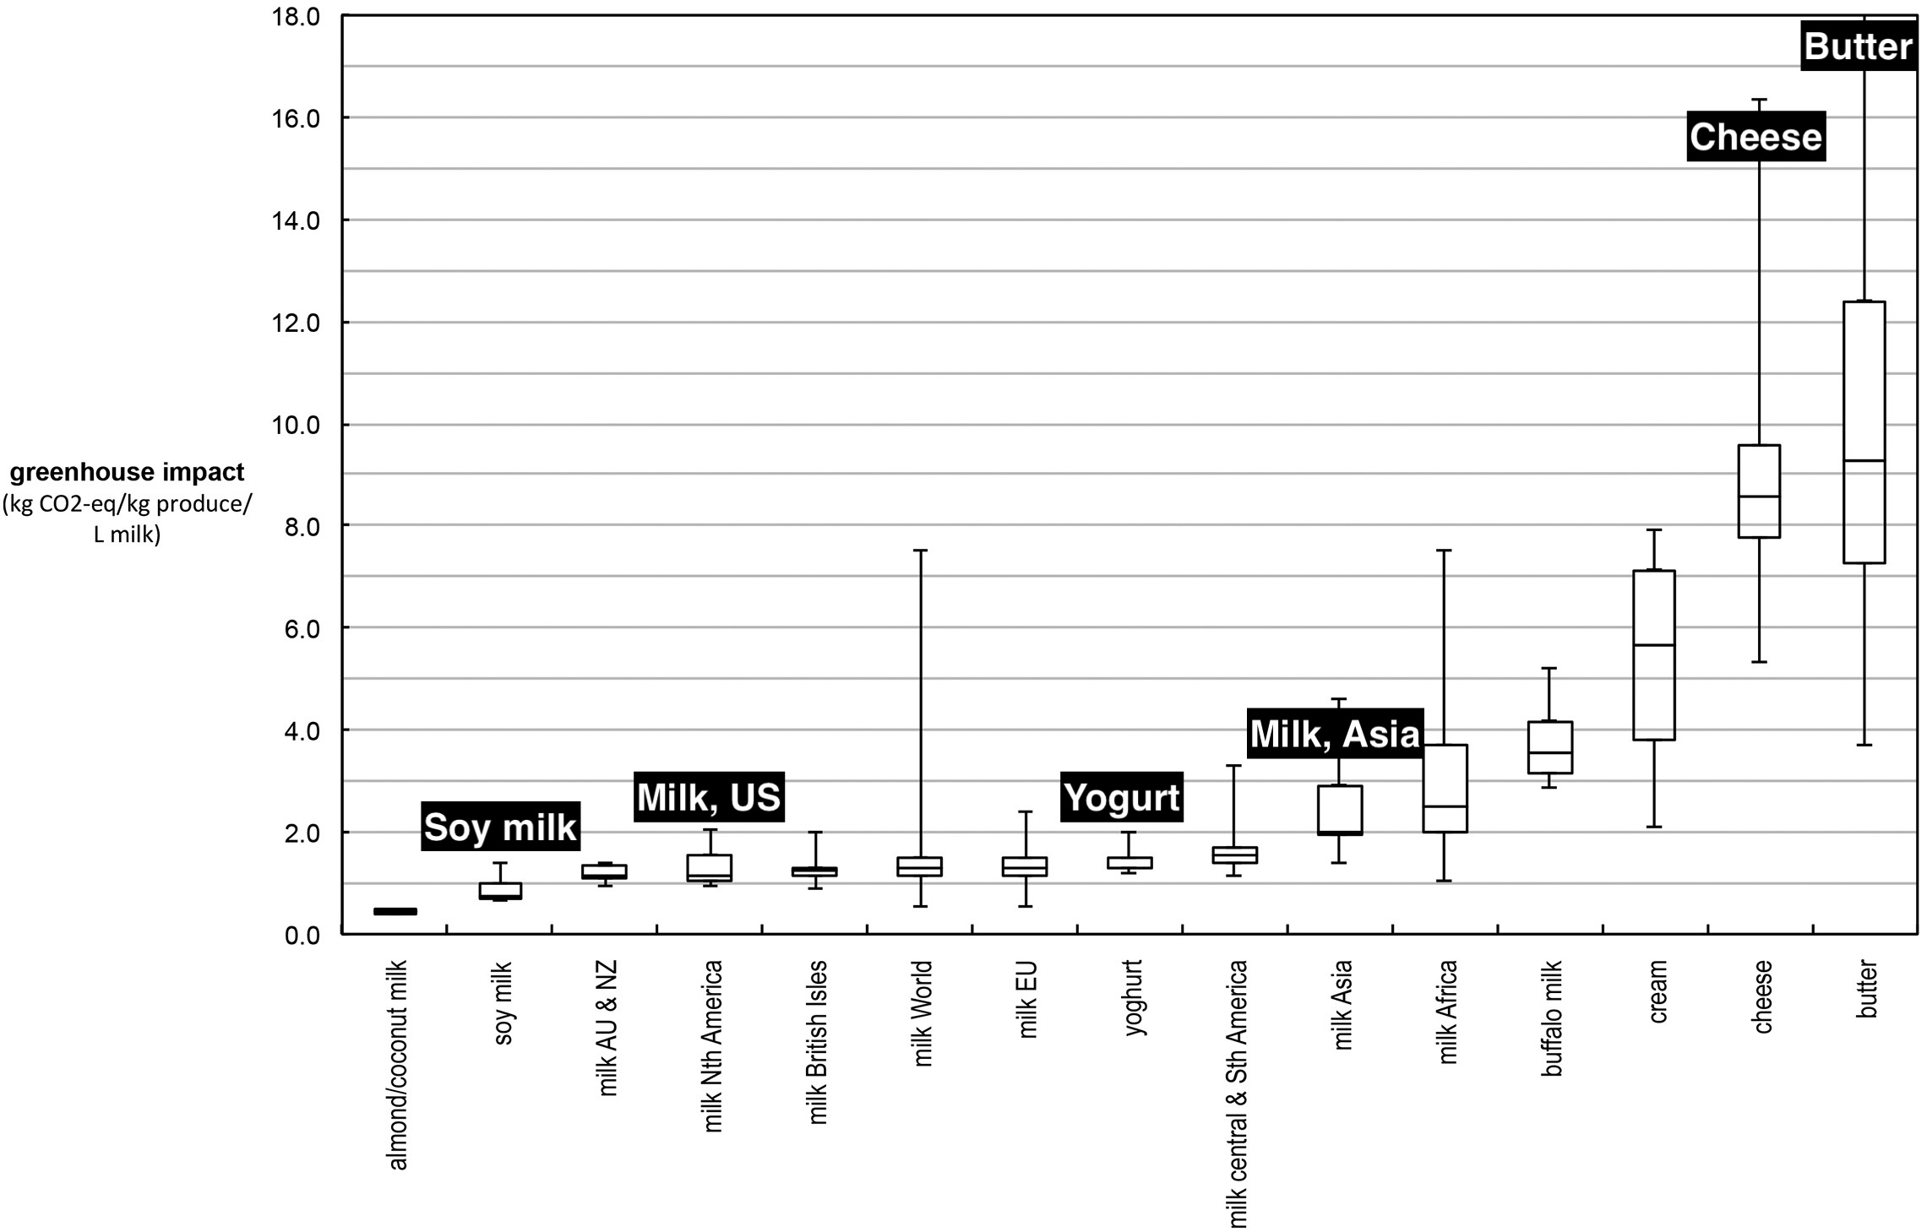
Comparison of Global Warming Potential (GWP) Values for Dairy and Dairy Substitutes
Sources: Shalant, J. (2017). To shrink your carbon footprint, ease up on the dairy. National Resource Defense Council. https://www.nrdc.org/stories/shrink-your-carbon-footprint-ease-dairy; NRDC. (2017). Less beef, less carbon: Americans shrink their diet-related carbon footprint by 10 percent between 2005 and 2014 (Nos. 16-11-B; Issue Paper). National Resource Defense Council. https://www.nrdc.org/sites/default/files/less-beef-less-carbon-ip.pdf; Graph adapted by the Center for a Livable Future from Figure 9. Comparisons of synthesized GWP values for dairy and dairy substitutes [Chart]. Clune, S., Crossin, E., and Verghese, K. (2017). Systematic review of greenhouse gas emissions for different fresh food categories. Journal of Cleaner Production, 140, 2, 766–783. https://doi.org/10.1016/j.jclepro.2016.04.082
Notes:
One more nuance to consider is the type of dairy consumed.
Dairy products that require large quantities of milk, such as butter and hard cheese, have greater environmental impacts than liquid milk alone – as depicted in this whisker plot. However, serving size also matters. For example, we tend to eat smaller portions of cheese and butter by weight than milk.
-----
Graph
Shalant, J. (2017). To Shrink Your Carbon Footprint, Ease Up on the Dairy. NRDC. https://www.nrdc.org/stories/shrink-your-carbon-footprint-ease-dairy
NRDC. (2017). Less Beef, Less Carbon: Americans Shrink Their Diet-Related Carbon Footprint by 10 Percent Between 2005 and 2014 (Nos. 16-11-B; Issue Paper). National Resource Defense Council. https://www.nrdc.org/sites/default/files/less-beef-less-carbon-ip.pdf

Slide 49
What Can High-Income Countries Do to Make Diets More Sustainable and Aligned With the Planetary Health Diet?—2
Eat less meat
and dairy
(for most)
Consume more
whole grains,
vegetables, legumes,
and nuts
1
2
Notes:
The second thing high high-income countries can do to shift diets to be more sustainable is to consume more whole grains, vegetables, legumes and nuts.

Slide 50

2. Consume More Whole Grains, Vegetables, Legumes ,and Nuts
Choose healthy plant proteins
Choose a variety of whole grains and reduce reliance on refined staples
Purchase local produce in season
Focus on diversity and variety
Image source: Shutterstock.
Notes:
While eating less meat is critical, health benefits are only realized when a variety of healthy foods such as whole grains, vegetables, legumes and nuts are consumed instead. Substituting a cheese pizza or a candy bar is not the goal here! Healthy plant-based proteins can adequately replace animal products in most cases when there is variety and sufficient calories. Reducing refined grains in favor of whole grains is also important and in general, purchase local produce in season.

Slide 51
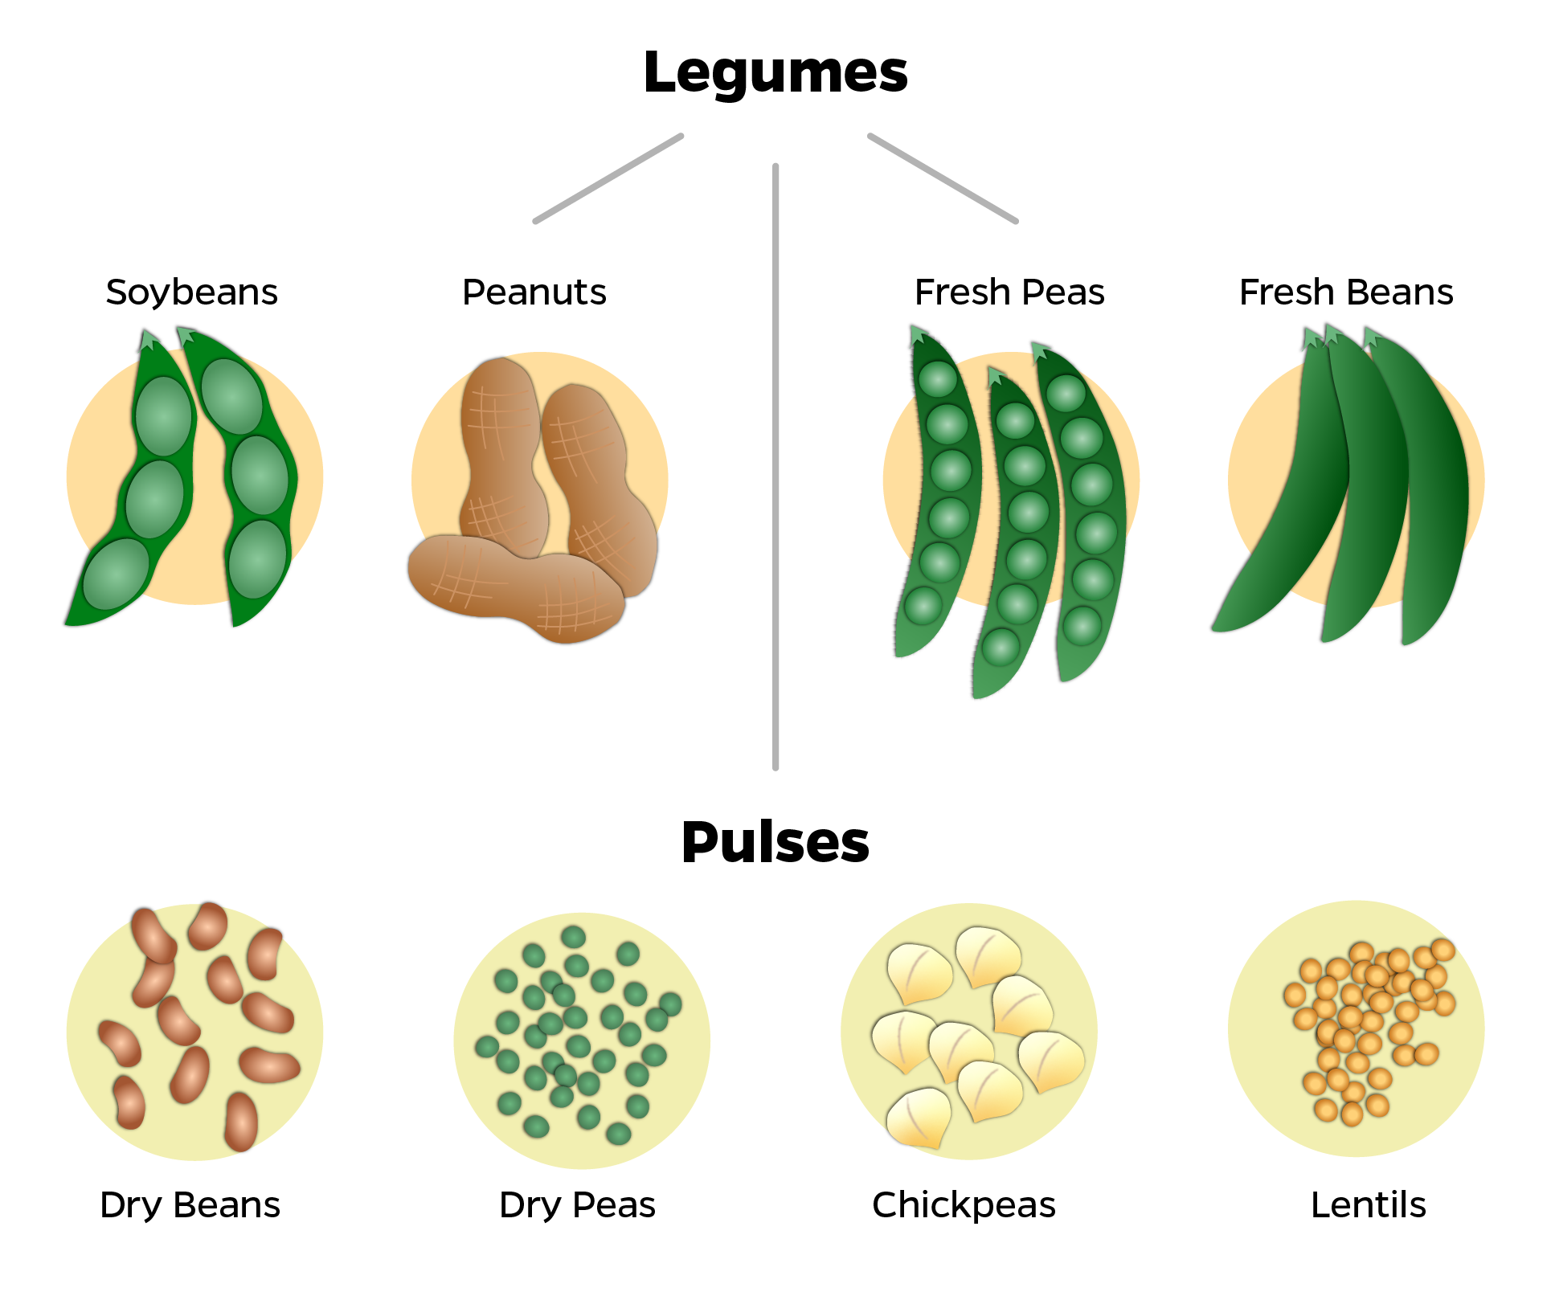
Plant-Based Proteins
Pulses (legumes, beans)
Soy products
Nuts and seeds
“Alt” meats (processed products)
Image source: Johns Hopkins Center for a Livable Future.
Notes:
Not all plant-based proteins are created equally. Legumes (or pulses) in particular offer huge value in terms of both nutrition and environment. We are eating slightly more legumes in the US but still very little compared to other proteins.
Pulses are a subgroup of legumes used mainly as protein sources in the diet. Common pulses include beans, dry peas, chickpeas, and lentils. Legumes that are used as vegetables - peas, green beans - or for oils - soybean, groundnuts - are not considered pulses. Pulses are high in protein, fiber, and many vitamins. They are associated with healthier overall diets, lower BMI’s and lower risk of diabetes and other chronic diseases. They are highly affordable.
They are also favored for their role in nitrogen fixation in the soil. And their greenhouse gas footprint is far, far lower compared to beef.

Slide 52
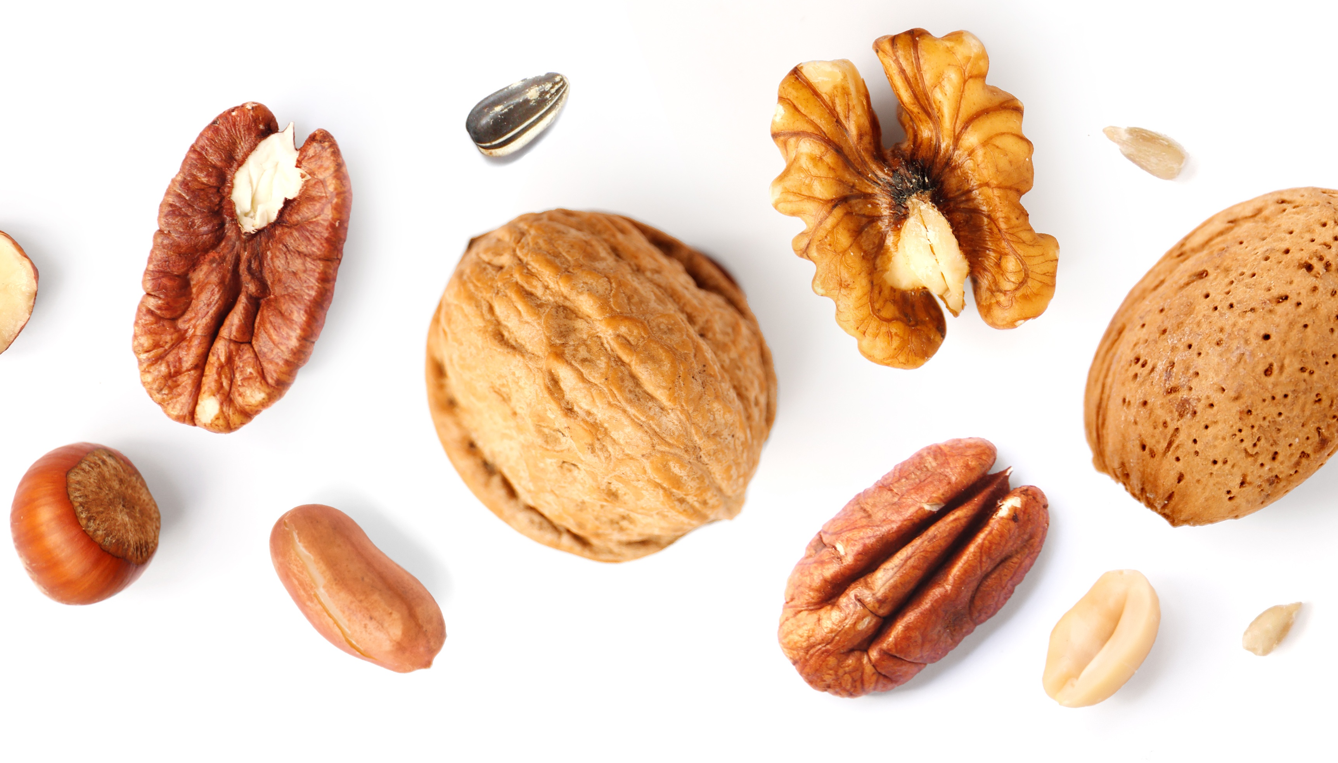
Nuts and Seeds
Environment
Nutrition
Water needs
  Tree versus plant
  Water-scarce areas
Yields
  Trees = higher yields
Soil health
  Peanut = nitrogen fixing
Protein and healthy fats
  Omega-3, alpha-linolenic acid (ALA)
    Flax, walnuts, and chia
  Monounsaturated fatty acids (MUFAs)
  Polyunsaturated fatty acids (PUFAs)
Fiber
Micronutrients
  Vitamin E, calcium, magnesium, and other minerals
Image source: Shutterstock.
Notes:
Often overlooked, nuts and seeds are nutrition powerhouses providing healthy fats, fiber, vitamin E and calcium. They tend to require more water and sometimes chemicals to grow than legumes, but it depends on the nuts and growing conditions – some tree nuts can be grown solely with rain-fed agriculture, while others are grown in water scarce areas, such as California almonds. Peanuts, which are classified as legumes, are grown in the soil. They have similar low GHG footprint to other legumes and also fix nitrogen into the soil. Seeds, including pumpkin and sunflower, are nutritious and have lower environmental footprints compared to tree nuts.

Slide 53
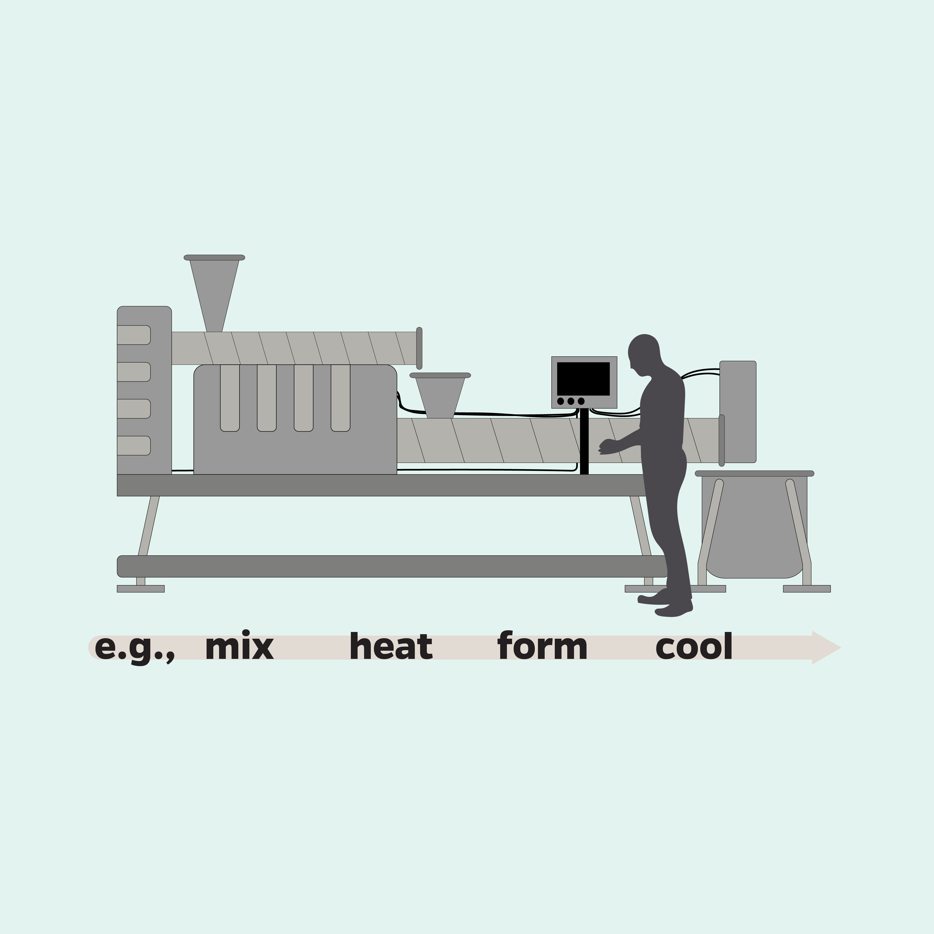
“Alt Meats” and Plant-Based Meat Substitutes
Inputs
Processing
Outputs
Protein ingredients: soy, pea protein, wheat gluten, etc.
Fats and vegetable oils
Structural ingredients
Binding agents
Seasonings, coloring agents
Coarse ground products (sausages and nuggets)
Foods that mimic deli meat and hot dogs
Crumbles that resemble ground meat
Source: Santo, R. E., Kim, B. F., Goldman, S. E., Dutkiewicz, J., Biehl, E. M. B., Bloem, M. W., Neff, R. A., & Nachman, K. E. (2020). Considering plant-based meat substitutes and cell-based meats: A public health and food systems perspective. Frontiers in Sustainable Food Systems, 4. https://doi.org/10.3389/fsufs.2020.00134; Image is from the Johns Hopkins Center for a Livable Future.
Notes:
Alternative meat products, often called “alt-meats” are processed plant-based products designed to look, feel, and taste like meat. Morningstar Farms and Boca Burgers were early brands but there are many more now, including Impossible Foods and Beyond Meat. These products are derived from plant-based ingredients – mostly soy, wheat or pea protein – and are designed to imitate the experience of eating meat – the taste, texture, smell. But alternative meats generally do not include products made from natural foods, such as tofu or burgers made from beans or mushrooms.
The nutritional profile and environmental impacts of alternative meat products vary greatly due to the diversity of ingredients and processing. Ingredients or inputs include the protein ingredients – such as soy, pea protein, wheat gluten, as well as fats and vegetable oils, ingredients that help the product maintain it’s form, other binding agents, and lastly seasonings and coloring agents.
These ingredients then get processed into various forms, such as coarse ground products that resemble foods such as breakfast sausages and chicken nuggets. They can be emulsified and formed into foods that mimic deli meat and hot dogs. Or they can be turned into crumbles that resemble ground meat. But there is indeed quite a bit of processing involved, and the overall environmental impact varies depending on what goes into the product and how those ingredients are produced. The land use, water use, runoff of agricultural fertilizers and pesticides are all different depending on the ingredients used. As with any other food, there are also varying degrees of individual and public health outcomes and impacts on animal welfare.
-----
Graphic
Santo, R. E., Kim, B. F., Goldman, S. E., Dutkiewicz, J., Biehl, E. M. B., Bloem, M. W., Neff, R. A., & Nachman, K. E. (2020). Considering Plant-Based Meat Substitutes and Cell-Based Meats: A Public Health and Food Systems Perspective. Frontiers in Sustainable Food Systems, 4. https://doi.org/10.3389/fsufs.2020.00134

Slide 54
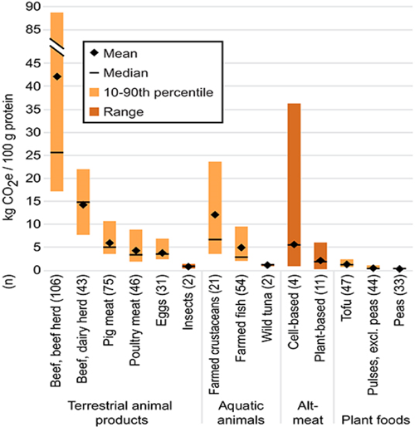
Comparison of Greenhouse Gas Emissions of “Alt” Proteins
Image source: Santo, R. E., Kim, B. F., Goldman, S. E., Dutkiewicz, J., Biehl, E. M. B., Bloem, M. W., Neff, R. A., & Nachman, K. E. (2020). Figure 3. Cradle-to-processing gate GHG footprints (wherever possible) per 100 g protein [Chart]. Considering plant-based meat substitutes and cell-based meats: A public health and food systems perspective. Frontiers in Sustainable Food Systems, 4. https://doi.org/10.3389/fsufs.2020.00134
Notes:
Let’s compare the greenhouse gas emissions of alternative meats to other foods. Studies are limited here, but tofu, pulses and peas have extremely low greenhouse gas emissions overall. Alternative meats tend to me higher, but with a much wider range because of the different ingredients and production methods. However, overall, plant-based products have much lower greenhouse gas footprints compared to beef and dairy. One notable exception is cell-based meat, which is made from animal cells, not plant-based ingredients. But that technology is very new and there is tremendous variation in the greenhouse gas emissions due to the wide range of products and methods used, many of which are proprietary. The 2020 CLF research review on the public health impacts of meat alternatives, provides more background on this topic.
-----
Graphic
Santo, R. E., Kim, B. F., Goldman, S. E., Dutkiewicz, J., Biehl, E. M. B., Bloem, M. W., Neff, R. A., & Nachman, K. E. (2020). Considering Plant-Based Meat Substitutes and Cell-Based Meats: A Public Health and Food Systems Perspective. Frontiers in Sustainable Food Systems, 4. https://doi.org/10.3389/fsufs.2020.00134

Slide 55
Discussion 2: An Optimal Diet Pattern
Given what was covered in the last section, how would you describe an ideal diet pattern?
How would this differ by individual, income, community or location?
  Urban versus rural
  Coastal versus inland
  Etc.
What challenges do you anticipate in providing guidance to consumers and patients?
What might be some barriers to implementation of plant forward menus in food service?

Slide 56
Section E: Connecting With Consumers to Shift Diets
Notes:
In this last section we will focus on helping consumers shift to more climate friendly, sustainable diets.

Slide 57

Food Choice Is Complex! Not Logical nor Linear
Image source: Shutterstock.

Slide 58
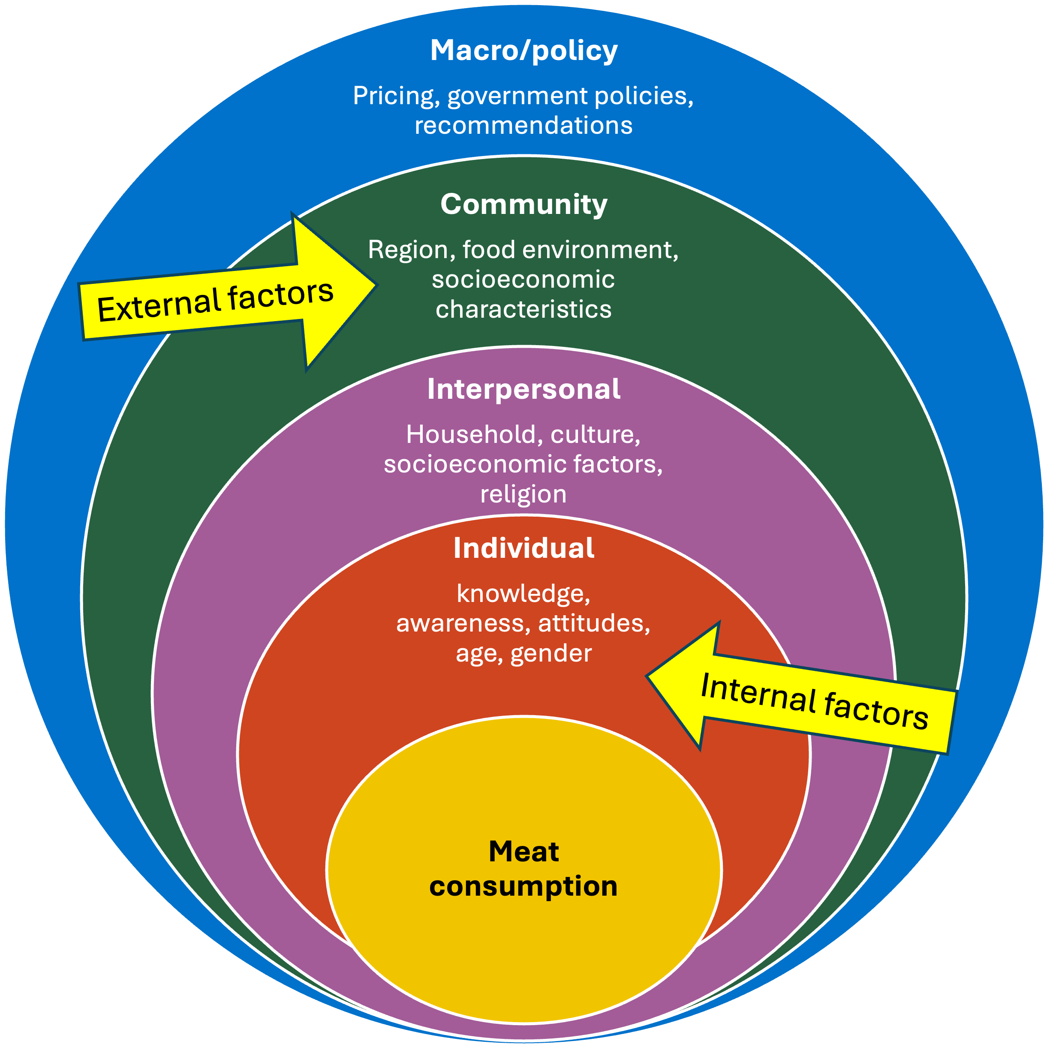
Drivers of
Meat Consumption
Macro/policy: pricing and marketing of meat, government policies and recommendations
Community/institution: Geographic region, urban versus non-urban, food environment, school/workplace environment, socioeconomic characteristics, media, culinary trends, availability and attractiveness of alternative proteins
Interpersonal: Household dietary norms, culture, relationships, friends/family’s dietary practices, socioeconomic factors, religion
Individual: knowledge, awareness, attitudes, values (moral disengagement, openness to change, altruism), age, gender, health, environment, and animal welfare concerns
Image source: Center for a Livable Future.
Notes:
Meat consumption is likely more complicated than other food groups.
Here is one way to conceptualize the many different factors and relationships that influence consumers relationship with meat. The individual level influences are mostly situated within the control of each person. These include knowledge, values and attitudes, age, gender and health status. Interpersonal factors are related to family and social relationships, religion and culture, and socioeconomics. The Community level includes institutional or organizational relationships and characteristics such as neighborhoods, work sites, and schools. Independently of individual level socioeconomic status, socioeconomic characteristics of the environment such as a person’s neighborhood or built environment also strongly influence eating behaviors. The macro/public policy level factors involve local, state, and federal policies.
There are many levels of influence, and therefore multi-level approaches will be needed to shift the role of meat in our diets.
-----
Note
Figure based on CLF compilation of literature

Slide 59
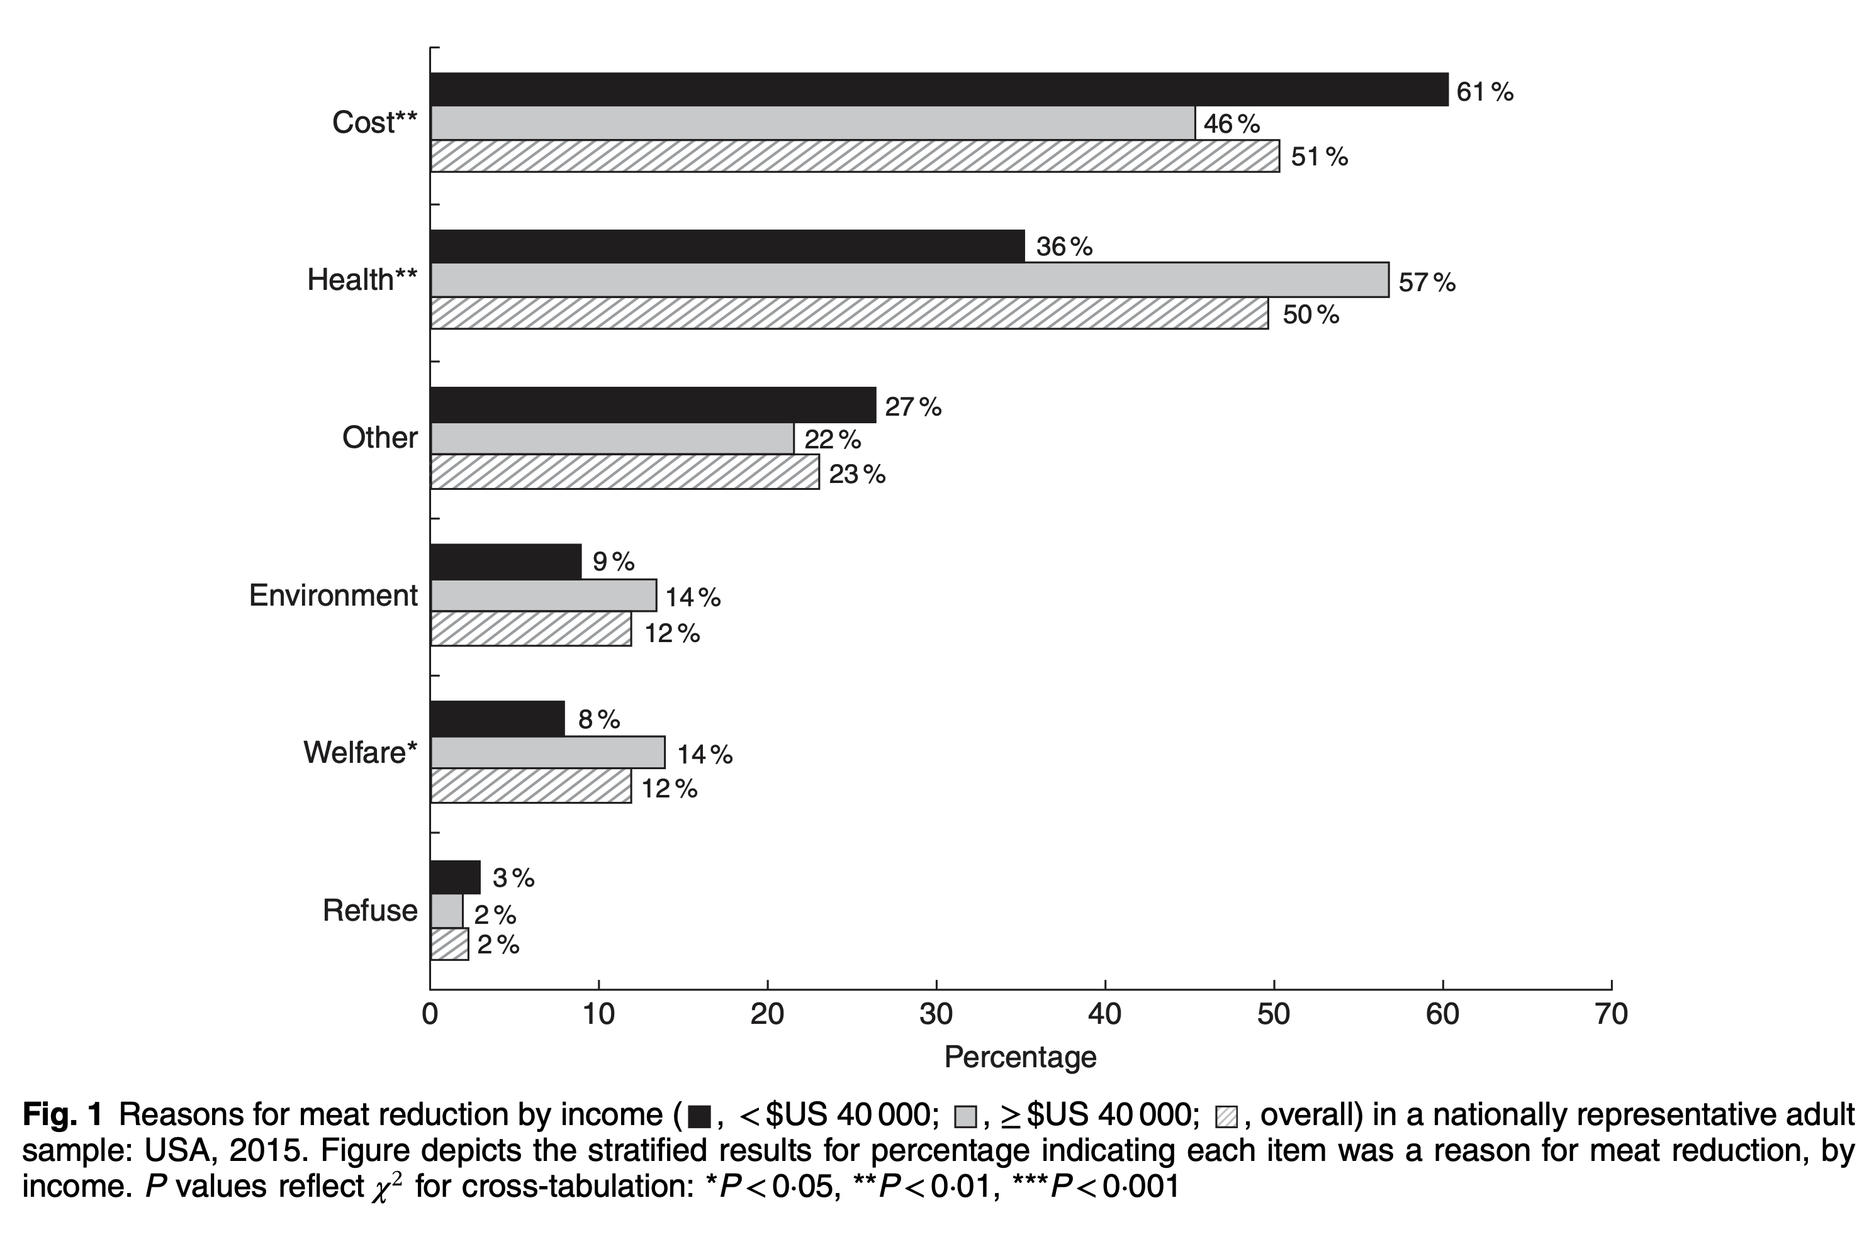
Reasons People Reduce Meat Intake
Image source: Neff, R. A., Edwards, D., Palmer, A., Ramsing, R., Righter, A., & Wolfson, J. (2018). Figure 1. Reasons for meat reduction by income in a nationally representative adult sample [Chart]. Reducing meat consumption in the USA: A nationally representative survey of attitudes and behaviours. Public Health Nutrition, 21(10), 1835–1844. https://doi.org/10.1017/S1368980017004190
Notes:
The Center for a Livable Future fielded a nationally representative survey of 50,000 people in 2015 asking questions about changes in their meat consumption over the past year. Two-thirds of respondents reported reducing meat consumption in the past year. Reductions of red and processed meat were the most common changes reported.
The respondents were stratified by household income. Across both income groups, cost and health were most frequently cited as the reasons for reducing meat consumption. Environmental reasons and animal welfare were not a primary driver for many people although research suggests that people who are driven by concerns about animal welfare tend to completely eliminate meat rather than simply reduce consumption.
-----
Graph
Neff, R. A., Edwards, D., Palmer, A., Ramsing, R., Righter, A., & Wolfson, J. (2018). Reducing meat consumption in the USA: A nationally representative survey of attitudes and behaviours. Public Health Nutrition, 21(10), 1835–1844. https://doi.org/10.1017/S1368980017004190

Slide 60
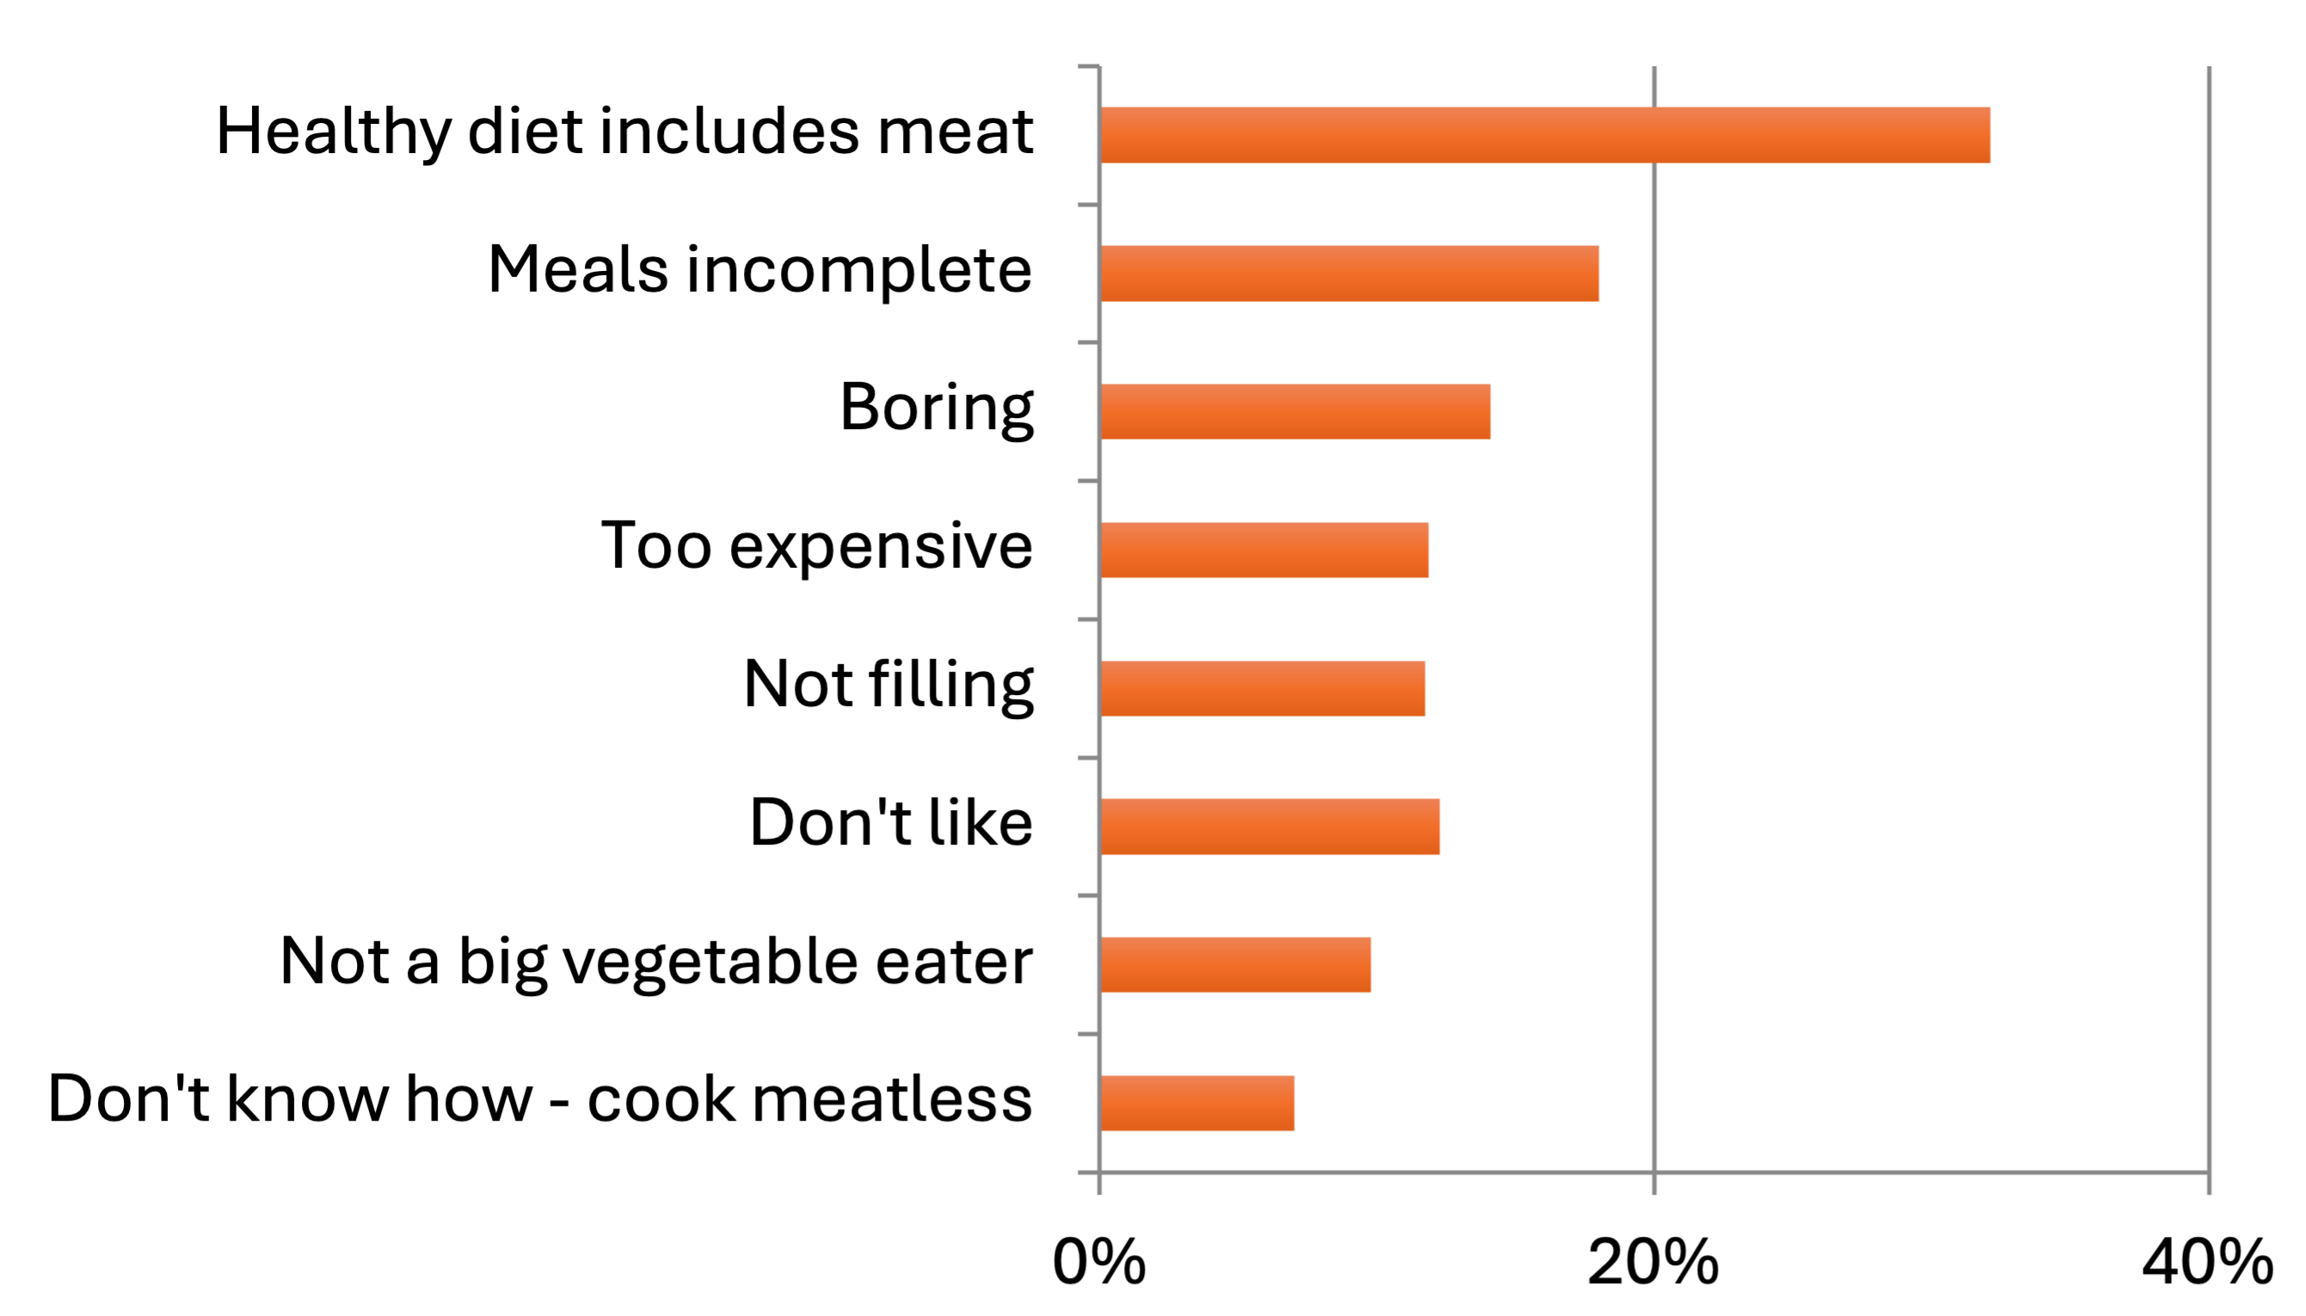
Reasons People Do Not Reduce Meat Intake
Image source: Adapted by the Center for a Livable Future from Neff, R. A., Edwards, D., Palmer, A., Ramsing, R., Righter, A., & Wolfson, J. (2018). Figure 1. Reasons for meat reduction by income in a nationally representative adult sample [Chart]. Reducing meat consumption in the USA: A nationally representative survey of attitudes and behaviours. Public Health Nutrition, 21(10), 1835–1844. https://doi.org/10.1017/S1368980017004190
Notes:
Research and surveys suggest several barriers to reducing meat. Many are on the individual and intrapersonal levels, such as taste preferences, culture, convenience, preference, identity and knowledge. But we know that the food environment and other factors outside of an individual’s control can also heavily influence what consumers have access to and what they choose to eat.
In the CLF survey, of the one-third of survey respondents who had NOT reduced their meat consumption, the primary reasons are the beliefs that a healthy diet includes meat, and that a meal is incomplete or boring without meat. Other reasons are cost, taste preferences, and not knowing how to cook a meatless meal. Which of these are easier to overcome and which are harder? Some depend on knowledge and experience with buying and preparing non-meat meals. And some might be overcome by exposure to good-tasting meatless meals.
This was consistent across all income groups and similar by gender.
-----
Graph
Neff, R. A., Edwards, D., Palmer, A., Ramsing, R., Righter, A., & Wolfson, J. (2018). Reducing meat consumption in the USA: A nationally representative survey of attitudes and behaviours. Public Health Nutrition, 21(10), 1835–1844. https://doi.org/10.1017/S1368980017004190

Slide 61
Approaches to Shifting to Plant-Forward Diets Vary
Eliminate choices (remove meat options)
Fiscal incentives (taxes, discounts)
Change defaults (visibility, menu design)
Provide services (cooking classes)
Provide information (education, promotion)
Image source: Adapted by the Center for a Livable Future from Rust, N. A., Ridding, L., Ward, C., Clark, B., Kehoe, L., Dora, M., Whittingham, M. J., McGowan, P., Chaudhary, A., Reynolds, C. J., Trivedy, C., & West, N. (2020). How to transition to reduced-meat diets that benefit people and the planet. Science of the Total Environment, 718. https://doi.org/10.1016/j.scitotenv.2020.137208
Notes:
When it comes to the HOW to help people shift, many different approaches have been explored with some success and a lot of failure.
From limiting or eliminating choices all together, making substitutions, adjusting prices and using defaults to education and skills training. Some of these reflect interventions (like eliminating choices altogether) are potentially more effective but less feasible and socially acceptable than the others that involve incentives or education..
Effective solutions will likely include a combination of strategies.
-----
Note
Examples of different intervention types to reduce meat overconsumption; darker colours represent potentially more effective but less feasible and socially acceptable options (based on data from Lombardini and Lankoski, 2013 (eliminate choice); Harwatt et al., 2017 (restrict choice); Bødker et al., 2015 (fiscal disincentives); Hansen et al., 2019 (change defaults); Flynn et al., 2013 (provide services); Diepeveen et al., 2013 (provide information)).
Framework
Rust, N. A., Ridding, L., Ward, C., Clark, B., Kehoe, L., Dora, M., Whittingham, M. J., McGowan, P., Chaudhary, A., Reynolds, C. J., Trivedy, C., & West, N. (2020). How to transition to reduced-meat diets that benefit people and the planet. Science of The Total Environment, 718. https://doi.org/10.1016/j.scitotenv.2020.137208

Slide 62


Consumer Connections
Combined approaches are most likely to be accepted and successful when they:
  Raise awareness
  Facilitate access and remove barriers
Source: Wellesley, L., & Froggatt, A. (2023). Changing Climate, Changing Diets: Pathways to Lower Meat Consumption. Chatham House. https://www.chathamhouse.org/2015/11/changing-climate-changing-diets-pathways-lower-meat-consumption; Images are from Shutterstock.
Notes:
As nutrition and health professionals, connecting with consumers by helping them better understand that food impacts more than our own personal health is an important first step along the continuum of dietary behavior change. Multiple studies confirm there is a low level of awareness among most consumers about the connection between diet and climate change. It’s also important to note that meat intake has personal and cultural value, so awareness only is unlikely to propel shifts. Likewise, nudges may lead to short term, but not necessarily long-term change.
Because of this, recommendations for a successful consumer-focused strategy include two elements: (1) approaches to raise awareness and (2) pathways to facilitate change.
-----
Information
Wellesley, L., & Froggatt, A. (2023). Changing Climate, Changing Diets: Pathways to Lower Meat Consumption. Chatham House. https://www.chathamhouse.org/2015/11/changing-climate-changing-diets-pathways-lower-meat-consumption

Slide 63
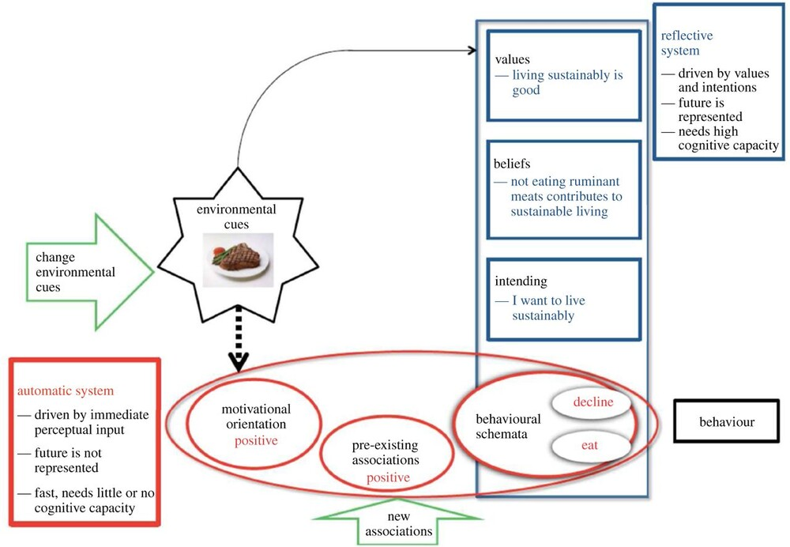
The Power of our Food Environment
Image source: Marteau, T. M. (2017). Figure 1. Automatic and reflective systems guiding behaviour, with potential points for intervention [Chart]. Towards environmentally sustainable human behaviour: Targeting non-conscious and conscious processes for effective and acceptable policies. Philosophical Transactions of the Royal Society A: Mathematical, Physical and Engineering Sciences, 375(2095). https://doi.org/10.1098/rsta.2016.0371
Notes:
This diagram explains how these two pathways work together. Although education efforts tend to focus on building knowledge and values (in the blue boxes, marked as 1), environmental cues are extremely powerful. Our behavior is often under control of the faster, automatic decision-making system (red box , marked as 2), rather than our reflective system. In fact, most decisions are made in an instant and are highly influenced by these environmental cues. Over time and with practice and repetition, intentional choices become more habitual and reflexive. They are driven by experiences and new associations (green arrows, marked as 3) that can be formed through education, motivational outreach and new environmental cues.
-----
Graphic
Marteau, T. M. (2017). Towards environmentally sustainable human behaviour: Targeting non-conscious and conscious processes for effective and acceptable policies. Philosophical Transactions of the Royal Society A: Mathematical, Physical and Engineering Sciences, 375(2095). https://doi.org/10.1098/rsta.2016.0371

Slide 64
One Quick Slide on Policy as a Lever for Change!
Challenges of moving from food trend to dietary transition:
  Consumer intention-behavior gap
  Bottom-up consumer pressure is valuable but limited
Policy actions can support interventions that lead to triggering points
  Impacts the broader external environment where the shift can happen
Types of policy supporting consumer shifts
  Mandates
  Restrictions
  Economic incentives
  Marketing limits
  Information provision
  Environmental defaults
Sources: Gorski, M. T., & Roberto, C. A. (2015). Public health policies to encourage healthy eating habits: Recent perspectives. Journal of Healthcare Leadership, 7, 81–90. https://doi.org/10.2147/JHL.S69188;
Aschemann-Witzel, J., & Janssen, M. (2022). The role of policy actions to accelerate food consumer behaviour change. Agricultural and Food Economics, 10(1), 22. https://doi.org/10.1186/s40100-022-00230-x
Notes:
We’ve spent a lot of time on consumer behaviors and food choices. As nutrition professionals and educators, you will quickly observe what is termed as the consumer intention-behavior gap that is described in the earlier figure from Marteau, et al. When a deeply engrained daily habit or behavior exists, it is difficult to connect the choice at hand to long-term health and environmental consequences. In the case of diets and climate, broad changes are needed to achieve the needed dietary transition. Although bottom-up consumer pressure on food manufacturing and food environments have value, these actions rarely get to the needed societal tipping point.
Good policy can influence the broader external and food choice environment where these needed shifts can happen.
Types of policies that support consumer choices include:
Mandates – to protect against the adverse effects of an unhealthy substance or environment
Restrictions–limit access to an unhealthy substance or environment
Economic incentives– aim to better align price incentives with health outcomes, encouraging higher consumption of healthy products and lower consumption of unhealthy products
Marketing limits - limit advertising and promotion of an unhealthy substance or environment
Information provision - provide the public with important health information, including encouraging healthy behaviors and warning about the dangers of an unhealthy substance or environment
Environmental defaults - preserve the freedom of individuals to expose themselves to an unhealthy substance or environment but makes it easier for them to avoid it.
There are pros and cons of each type, and some are harder to enact than others. Some successful policies that have been used to support sustainable, climate friendly food choices include labeling, pricing incentives, procurement policies and environment defaults. Federal policies such as the Farm Bill can also impact the broader food environment.
All in all, policy and consumer-focused strategies can go hand in hand to accelerate and solidify needed dietary shifts for a sustainable, healthy future.
-----
Information
Gorski, M. T., & Roberto, C. A. (2015). Public health policies to encourage healthy eating habits: Recent perspectives. Journal of Healthcare Leadership, 7, 81–90. https://doi.org/10.2147/JHL.S69188
Aschemann-Witzel, J., & Janssen, M. (2022). The role of policy actions to accelerate food consumer behaviour change. Agricultural and Food Economics, 10(1), 22. https://doi.org/10.1186/s40100-022-00230-x

Slide 65
Gradual Change, Small Steps
8% cut meat out completely
32% cut meat out one day a week
43% eliminate meat from one meal
56% eat smaller portions
66% buy less meat
Image source: Adapted by the Center for a Livable Future from Neff, R. A., Edwards, D., Palmer, A., Ramsing, R., Righter, A., & Wolfson, J. (2018). Reducing meat consumption in the USA: A nationally representative survey of attitudes and behaviours. Public Health Nutrition, 21(10), 1835–1844. https://doi.org/10.1017/S1368980017004190
Notes:
Despite challenges, focusing on incremental changes is an important and effective strategy.
In a 2015 survey of 1,120 respondents, over half reported they ate less red meat, poultry or fish in the past year. Of those, 32% ate less by cutting meat out of their diet one day a week, 4% by eliminating it from at least one meal, 66% by buying less, 56% by eating smaller portions, and only 8% by cutting it out completely. These results support the strong body of evidence that most people make dietary changes gradually, not all at once.
Other research has found that long-term vegetarians shifted gradually and cited multiple reasons for reducing meat consumption – not just health.
This study also pointed out that an emphasis on reduction vs. “pure” diet is more effective in decreasing overall animal product consumption and added that former vegetarians still eat a lot less meat than the U.S. population.
-----
Graphic (Adapted)
Neff, R. A., Edwards, D., Palmer, A., Ramsing, R., Righter, A., & Wolfson, J. (2018). Reducing meat consumption in the USA: A nationally representative survey of attitudes and behaviours. Public Health Nutrition, 21(10), 1835–1844. https://doi.org/10.1017/S1368980017004190

Slide 66
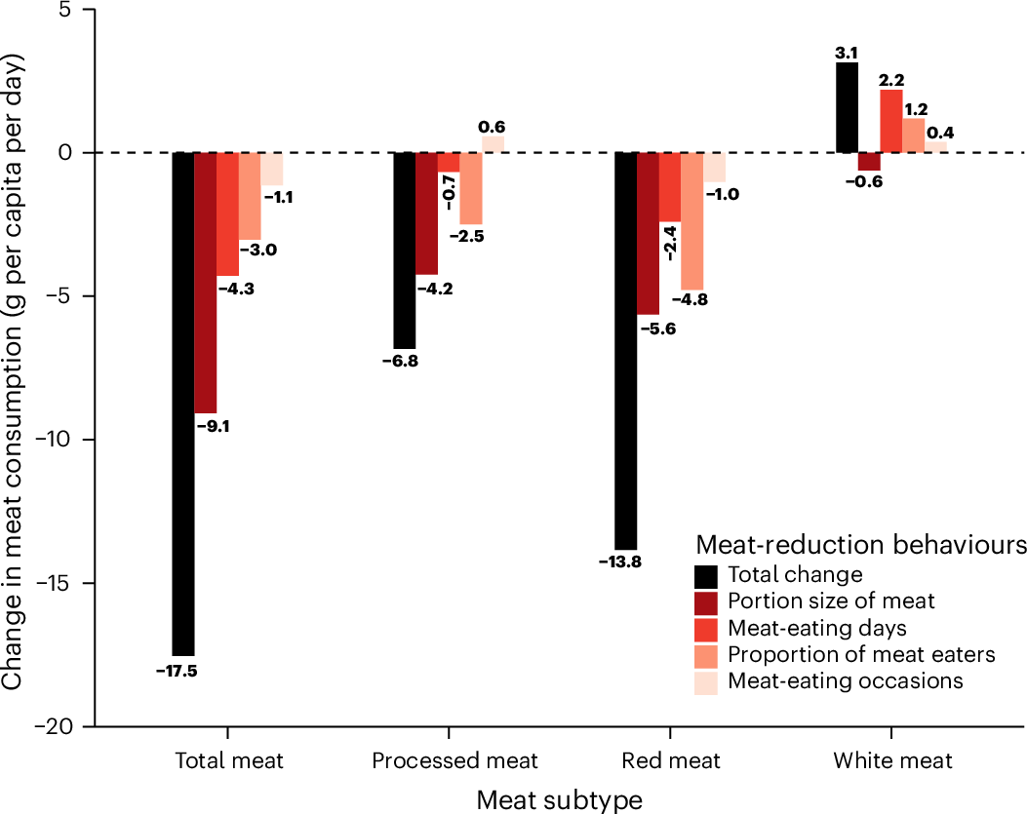
Understanding Consumption Changes
The modest contribution of reducing meat-eating days indicates that we should not overestimate the impact of a weekly ‘Meatless Monday” or “Veggie Thursday.”
Sources: Reinders, M. J., & Dagevos, H. (2024). Meat reduction in small portions. Nature Food, 12(5), 972–973. https://doi.org/10.1038/s43016-024-01084-w; graph is from Vonderschmidt, A., Jaacks, L. M., Alexander, P., Green, R., Bellows, A. L., & Stewart, C. (2024). Figure 2: Decomposition analysis of meat-eating behaviours in the UK NDNS rolling programme years 1–11 [Chart]. Smaller meat portions contribute the most to reducing meat consumption in the United Kingdom. Nature Food, 5(12), 982–987. https://doi.org/10.1038/s43016-024-01070-2
Notes:
In a 2024 United Kingdom analysis, a 17.5 g decrease in per capita total meat consumption was driven by reduced meat portions (52%), followed by fewer meat-eating days (24%), fewer meat consumers (17%) and fewer meat-eating meal occasions (7%).
These findings add to our understanding of the value and contribution of small changes when seeking larger change.
In the decomposition analysis, of the 17.5 g decrease in per capita total meat consumption, portion size contributed nearly 52%, the number of meat-eating days contributed 24.5%, proportion of meat consumers contributed 17% and the number of daily meat-eating occasions contributed 6.5%.
In subgroup analyses, portion size remained the largest contributor among all groups (men: 69.4%, women: 38.5%, adults: 48.1%, children: 66.3%, first income tertile: 54.8%, second income tertile: 73.8%, third income tertile: 45.4%.
The modest contribution of reducing meat-eating days indicates that we should not overestimate the impact of a weekly ‘Meatless Monday’ or ‘Veggie Thursday’.
-----
Graph
Reinders, M. J., & Dagevos, H. (2024). Meat reduction in small portions. Nature Food, 12(5), 972–973. https://doi.org/10.1038/s43016-024-01084-w
Vonderschmidt, A., Jaacks, L. M., Alexander, P., Green, R., Bellows, A. L., & Stewart, C. (2024). Smaller meat portions contribute the most to reducing meat consumption in the United Kingdom. Nature Food, 5(12), 982–987. https://doi.org/10.1038/s43016-024-01070-2

Slide 67
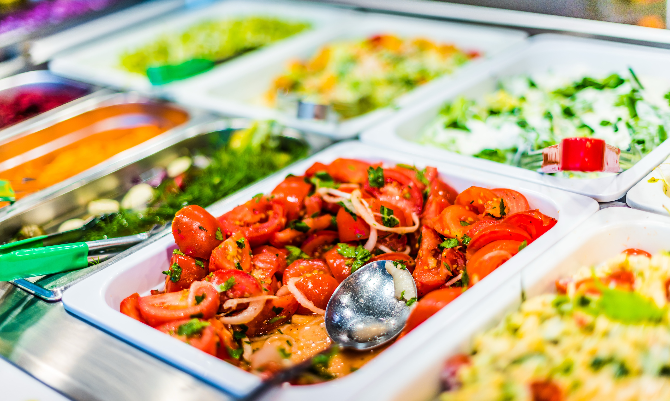


Intervention Examples
Image sources: Meatless Monday, Shutterstock, Greener by Default.
Notes:
In wrapping up, there are many different approaches to working with consumers and modifying food environments to facilitate changes. Meatless Monday encourages small changes.
.
Other programs utilize product placement and hedonic labeling to encourage desired choices. This type of strategy refers to a behavior economics concept called “nudging” or choice architecture. This could be as simple as putting the vegetable first on the food line or having the healthier options at eye level.
Programs like Greener by Default present only plant-based menus but allows consumers to add animal proteins as desired.

Slide 68

Study Overview
The impact of a weekly Meatless Monday email
Those who practiced Meatless Monday were 15 times more likely to avoid meat on more than 1 day/week and 5 times more likely to have more meatless meals at home
The longer people received the MM newsletter the more likely they were to reduce their meat intake overall and skip meat more than 1 day/week
Those who received the e-newsletter > 3 years showed a trend toward increasing meatless meals at home
Source: Shakory, S., Altema-Johnson, D., Hendrickson, Z. M., & Ramsing, R. (2025). Dietary changes among people practicing Meatless Monday: A cross-sectional study. Appetite, 204, 107760. https://doi.org/10.1016/j.appet.2024.107760 ; Image is a screenshot of Eater’s Digest newsletter.
Notes:
In this evaluation study of Meatless Monday’s weekly newsletter recipients, people who reported practicing MM were significantly more likely to decrease meat consumption compared to people who were not practicing MM. In one model, participants practicing MM were 15 times more likely to avoid meat on more than one day per week) and three times more likely to eliminate meat from their diet entirely. They were five times more likely to incorporate more meatless meals at home and three times more likely when eating out.
Likewise, Participants who subscribed to the weekly e-newsletter for longer were significantly more likely to reduce their meat intake.
Participants who received the e-newsletter for more than one year were twice as likely to eliminate meat from their diet entirely compared to those who received it for less than one year/ Additionally, longer duration increased the odds of avoiding meat more than one day per week by three times Moreover, participants who received the e-newsletter for over three years showed a trend towards a higher likelihood of increasing meatless meals at home and when eating out, compared to those who subscribed for less than one year.
-----
Information
Shakory, S., Altema-Johnson, D., Hendrickson, Z. M., & Ramsing, R. (2025). Dietary changes among people practicing Meatless Monday: A cross-sectional study. Appetite, 204, 107760. https://doi.org/10.1016/j.appet.2024.107760

Slide 69
Case Study 1

Slide 70
Key Points: Food Systems and Climate
Our food system is a key driver of climate change
Climate change increasingly puts our food supply at risk
There is consensus among climate, health, and environmental scientists about strategies to reduce the food system’s contributions to climate
Different strategies are needed in different places; responsibility for reducing meat and dairy falls mainly on countries with the highest intake
Low consumer awareness is an opportunity for education

Slide 71

Thank You!
Image source: Microsoft Stock Images.

Slide 72
Practice and Resources Booklet

Slide 73

About This Presentation
© Copyright 2025 Johns Hopkins University.
Attribution-NonCommercial-ShareAlike 4.0 International
Produced by the Center for Teaching and Learning at the Johns Hopkins Bloomberg School of Public Health.
S2512

