Slide 1
Nourishing the Future: Sustainable Food Systems for Nutrition and Dietetic Students
Presented by:
Johns Hopkins Center for a Livable Future
Food + Planet

Slide 2
Food Systems for All
Module 2
Presented by:
Johns Hopkins Center for a Livable Future
Food + Planet

Slide 3
Four Modules
Module 1 Introduction to Sustainable Food Systems
Module 2 Food Systems for All
Module 3 Food and our Climate
Module 4 Aquatic Foods, Nutrition, and Sustainability
Notes:
This lecture series was produced by the Johns Hopkins Center for a Livable Future in partnership with Food plus Planet. The series is composed of four modules. The initial module in the series is an Introduction to Sustainable Food Systems. The second is Food Systems for All.

Slide 4
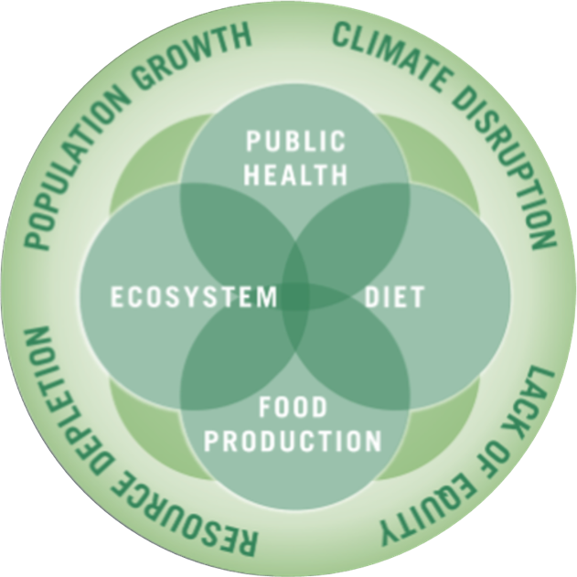
The Johns Hopkins Center for a Livable Future
Interdisciplinary academic center at the Johns Hopkins Bloomberg School of Public Health
Education, research, policy, and practice
Vision: a healthier, sustainable and resilient food system for all
Image source: Johns Hopkins Center for a Livable Future.
Notes:
The Johns Hopkins Center for a Livable Future is an inter-disciplinary academic center at the Johns Hopkins Bloomberg School of Public Health. The Center is engaged in education, research and practice at the intersection of public health, diet, food production and ecosystem health, which are all influenced by and connected to population growth, climate, resource depletion and equity. The Center collaborates with researchers, community groups and advocates at the local, state, national and international level and provides technical assistance to partner organizations. The Center’s vision is a healthier, sustainable and resilient food system for all.
This lecture series is based on the expertise and teaching resources of many faculty and staff at the Center, our collaborators across Johns Hopkins University and our many non-academic partners. We graciously acknowledge their work and thank them for allowing us to share it with you.

Slide 5
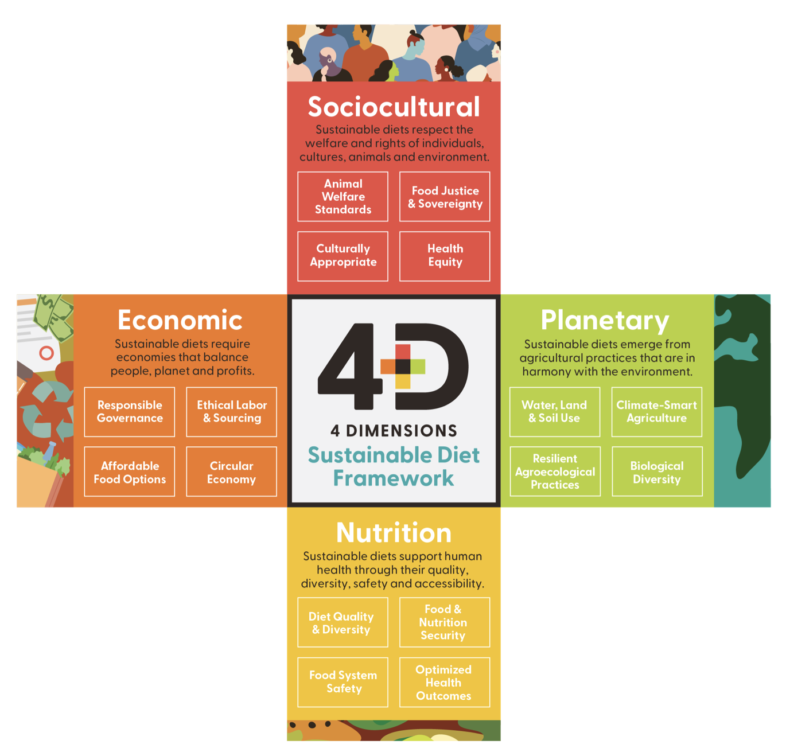
Food + Planet
Vision: a science and practice of nutrition that honors nature as the foundation of health through the four dimensions of sustainability
A collective, visionary 501c3 founded by four registered dietitians with varied experience in the food system
Aim: empower health care professionals to be leaders in sustainable food systems
Image source: Vogliano, C., Geagan, K., Chou, S., Palmer, S. (2021). Figure 1. The 4 dimensions of sustainable diets [Infographic]. Empowering nutrition professionals to advance sustainable food systems [White Paper]. Food and Planet. Retrieved September 14, 2025, from https://7157e75ac0509b6a8f5c-5b19c577d01b9ccfe75d2f9e4b17ab55.ssl.cf1.rackcdn.com/GVISUTJI-PDF-1-675987-4519061561.pdf
Notes:
Food + Planet is a collective, visionary 501c3 founded by four registered dietitians with varied experience in the food system. Our aim is to empower healthcare professionals to be leaders in sustainable food systems. We envision a science and practice of nutrition that honors nature as the foundation of health through the four dimensions of sustainability: Sociocultural, Economic, Planetary and of course, Nutrition.

Slide 6
Learning Objectives
Describe factors that contribute to inequity in the food system
Explain the unique and outsized impact of food system inequities on workers and communities
Discuss how food insecurity interacts with sustainable and healthy food and water systems
Identify actions that dietitians can take to address food system inequities

Slide 7
Section A: Defining Equity in the Context of Nutrition and Health

Slide 8
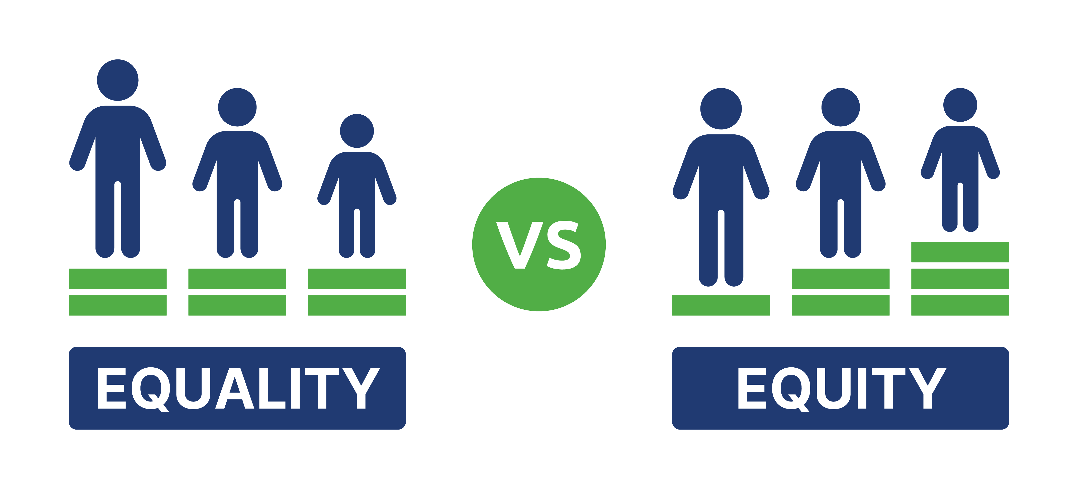
Equality Versus Equity
Image source: The Studio, Shutterstock.
Notes:
Equity and Equality sound alike, but are they the same? What does it mean to be EQUAL, and what does it mean to be EQUITABLE?
Equality means everyone receives the same resources and opportunities. So, in this image on the left, all three people are using the same size box to see over the fence. But can they all see over the fence? So that size box does not work for all three people. The tallest person is using a box, but they didn’t need it to see over the fence anyway!
In the image on the right, the tallest person does not have a box, because they don’t need one to see over the fence. The middle person has a short box and can now see over the fence just fine. The smallest person on the right gets more of a boost and that allows them to be able to see over the fence just like the others. Equity means everyone receives what they need to achieve equal outcomes, recognizing that individuals may have different needs based on their circumstances.
Can you think of all of the ways equality versus equity plays out across health and our food system? We’ll look at some of that in this presentation.
-----
Definition
United Way of the National Capital Area. (2024). Equity Definition: Understanding Key Differences. United Way NCA. https://unitedwaynca.org/blog/equity-vs-equality/

Slide 9
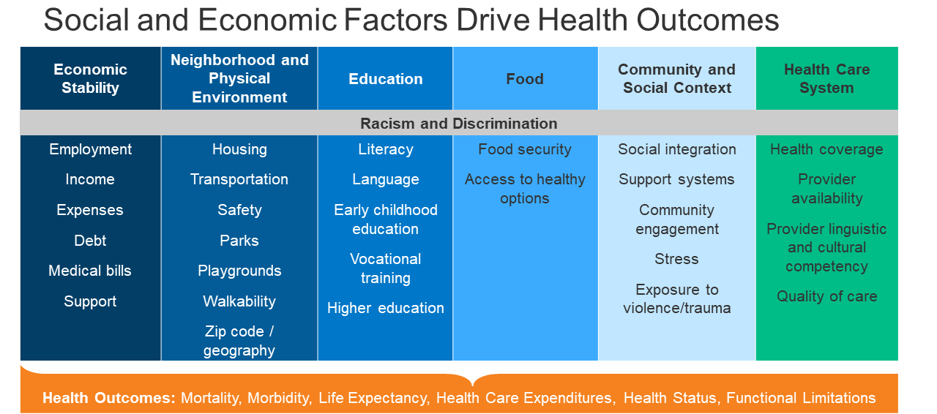
Social Determinants of Health
Image source: Artiga, S. (2020). Figure 2. Social and economic factors drive health outcomes [Chart]. Health disparities are a symptom of broader social and economic Inequities. KFF. https://www.kff.org/policy-watch/health-disparities-symptom-broader-social-economic-inequities/
Notes:
What are the different ways that equity and inequity show up to impact health?
This table frames a concept called the Social Determinants of Health. Social determinants of health are the conditions and circumstances within which people are born and raised, live and work, and age.
One of the primary social determinants of health is Economic Stability – this includes employment, and income, and also our debt and the bills we have to pay. Without a stable job and income, it’s very hard to afford to eat healthy, exercise, and enjoy life. Economic instability takes a huge toll on physical and mental health.
Your neighborhood and physical environment, including housing, transportation, safety and access to parks, playgrounds and areas to promote well-being are also very important.
Education and literacy are also important factors that correlate to many of these other factors, from preschool to college.
Food security is something we’ll talk a lot about in this presentation.
Also important are community and social context, including your support systems and safety nets.
And the health care system, including insurance coverage, access to providers, and the quality of care.
In the gray line near the top cutting across all of these issues is the institutional and historical issues of racism and other forms of discrimination that are the foundation of many of these Social Determinants of Health.
The bottom orange line shows some of the many health outcomes that are tied to the Social Determinants of health: mortality, morbidity, life expectancy, health care expenditures, health status and functional limitations. Can you think of more outcomes that stem from the social determinants of health, that are tied directly to food and nutrition?
-----
Graphic
Artiga, S. (2020). Health Disparities are a Symptom of Broader Social and Economic Inequities. KFF. https://www.kff.org/policy-watch/health-disparities-symptom-broader-social-economic-inequities/

Slide 10
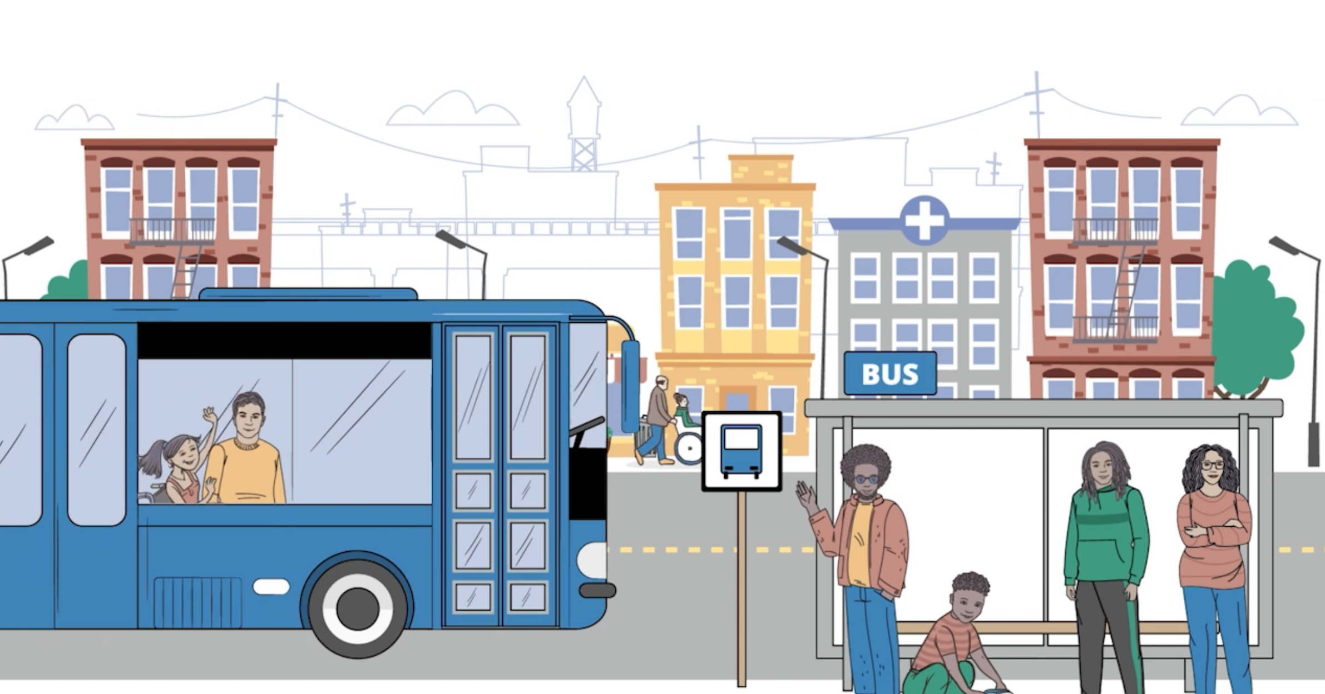
Watch This CDC Video About the Social Determinants of Health
Source: Centers for Disease Control and Prevention. (2024). Health Equity Video Series. CDC. https://www.cdc.gov/healthequity/whatis/videos/Video3-sdoh_LowResolution.mp4
Notes:
View this video from the Centers for Disease Control and Prevention about the Social Determinants of Health.
-----
Video
Centers for Disease Control and Prevention. (2024). Health Equity Video Series. CDC. https://www.cdc.gov/healthequity/whatis/videos/Video3-sdoh_LowResolution.mp4

Slide 11
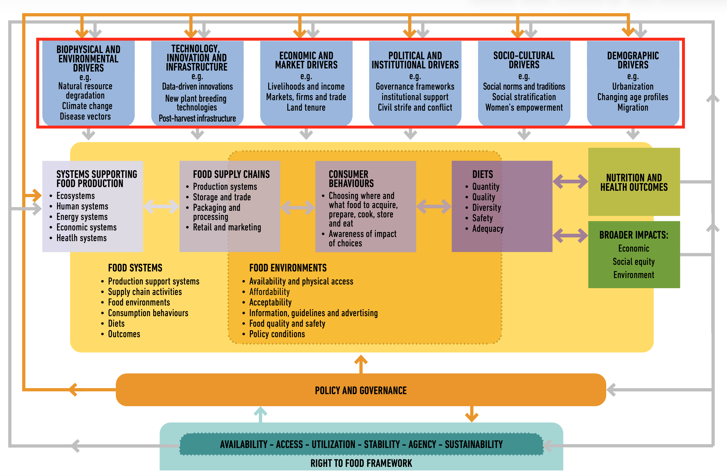
Where Do You See Inequity and the Social Determinants of Health in this Framework?
Image source: HLPE. (2020). Figure 2. Sustainable Food System Framework [Chart]. Food security and nutrition: building a global narrative towards 2030. A report by the High Level Panel. https://openknowledge.fao.org/server/api/core/bitstreams/8357b6eb-8010-4254-814a-1493faaf4a93/content
Notes:
We will revisit this framework from the first introductory module through the lens of equity and the social determinants of health. A main theme in this series is that the food system is not working well for all of us, and there are many negative outcomes and impacts. Inequities across the food system are widespread. Where do you see them showing up in this image?
(Pause this presentation and spend a few minutes thinking about this question).
One example is Food Environments. The drivers connected to consumer food choices are intertwined and embedded in food environments and often complex social and economic factors that are social determinants of health. Employment in food systems jobs may be low-wage, and a high percentage of workers in agriculture are immigrants who may not understand English. What impact might that have if they are working with pesticides or other potentially dangerous chemicals?
That is just one example of how these social and economic factors intertwine with food systems and health. In this module, we’ll highlight a few more examples of how inequities affect farmers, farmworkers and other food system workers. Then we’ll look at the issue of food access and food security, which ironically, is widespread among people who we rely on to grow, process, package, transport and sell us the food we rely on every day.
-----
Graphic
HLPE CFS. (2017). Nutrition and food systems: A report by the High Level Panel of Experts on Food Security and Nutrition of the Committee on World Food Security (HLPE Report 12). High Level Panel of Experts Committee on World Food Security. https://openknowledge.fao.org/server/api/core/bitstreams/4ac1286e-eef3-4f1d-b5bd-d92f5d1ce738/content

Slide 12
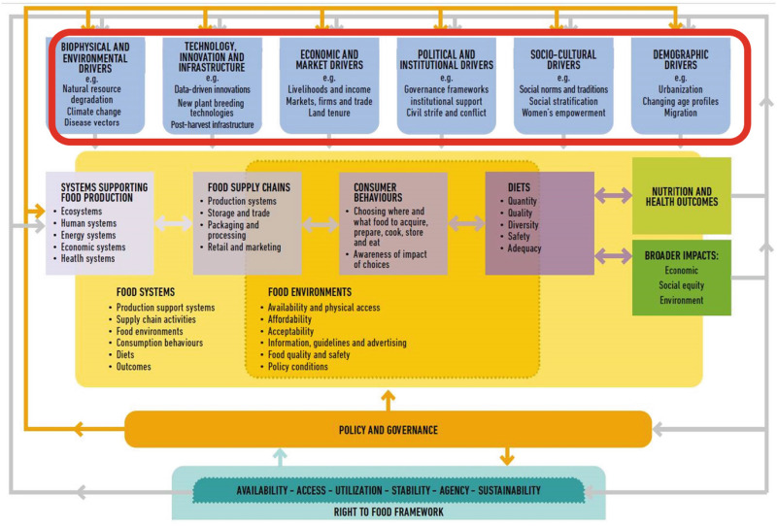
Inequities in the Food System Influence Outcomes
NUTRITION AND HEALTH OUTCOMES
DIETS
Quantity
Quality
Diversity
Safety
Adequacy
BROADER IMPACTS
Economic
Social equity
Environment
Image source: HLPE. (2020). Figure 2. Sustainable Food System Framework [Chart]. Food security and nutrition: building a global narrative towards 2030. A report by the High Level Panel. https://openknowledge.fao.org/server/api/core/bitstreams/8357b6eb-8010-4254-814a-1493faaf4a93/content
Notes:
Let’s drill down to the four outcomes listed in this framework.
Food systems ultimately impact food decisions and diets, which are reflected in different and compelling outcomes with lasting consequences. We will look to the the box on the right—a zoomed in section of the Right to Food framework from the previous slide.
Nutrition and Health
From hunger and undernutrition to overnutrition and diet-related degenerative and chronic diseases.
Economic
Affecting Food affordability, labor conditions, and the distribution of economic opportunities, benefits and burdens across the food system.
.
Social Equity
Inequitable food accessibility, cultural appropriateness, and the inclusion of marginalized voices in decision-making, impacting dietary traditions, social cohesion, and food sovereignty.
Environment
Unsustainable production, distribution, and consumption practices including food waste harm biodiversity, soil, air, water, and the climate, with impacts disproportionately affecting vulnerable communities.
We will revisit these outcomes throughout this module and the ones to follow.
-----
Graphic
HLPE CFS. (2017). Nutrition and food systems: A report by the High Level Panel of Experts on Food Security and Nutrition of the Committee on World Food Security (HLPE Report 12). High Level Panel of Experts Committee on World Food Security. https://openknowledge.fao.org/server/api/core/bitstreams/4ac1286e-eef3-4f1d-b5bd-d92f5d1ce738/content

Slide 13
What Is a Sustainable Food System?
A sustainable food system … delivers food security and nutrition for all in such a way that the economic, social and environmental bases to generate food security and nutrition for future generations are not compromised.
—United Nations, 2015
Source: The Secretary-General’s High-Level Task for on Global Food and Nutrition Security. (2015). All Food Systems are Sustainable (Zero Hunger Challenge Working Groups). FAO, UNCTAD, UNIDO, World Bank, IFAD & UNEP. https://www.un.org/en/issues/food/taskforce/pdf/All%20food%20systems%20are%20sustainable.pdf
Notes:
To summarize this section, the United Nations defines a sustainable food system as a “food system that delivers food security and nutrition for all in such a way that the economic, social and environmental bases to generate food security and nutrition for future generations are not compromised.”
Notice the same four outcomes are highlighted in this definition as in the HLPE framework. These are key themes we will explore in this module, and across this series.
-----
Quote
FAO, UNCTAD, UNIDO, World Bank, IFAD, & UNEP. (2015). All Food Systems are Sustainable (Compendium - Final Repot). The Secretary-General’s High-Level Task Force on Global Food and Security. https://www.un.org/en/issues/food/taskforce/pdf/All%20food%20systems%20are%20sustainable.pdf

Slide 14
Section B: Inequities Across the Food System

Slide 15
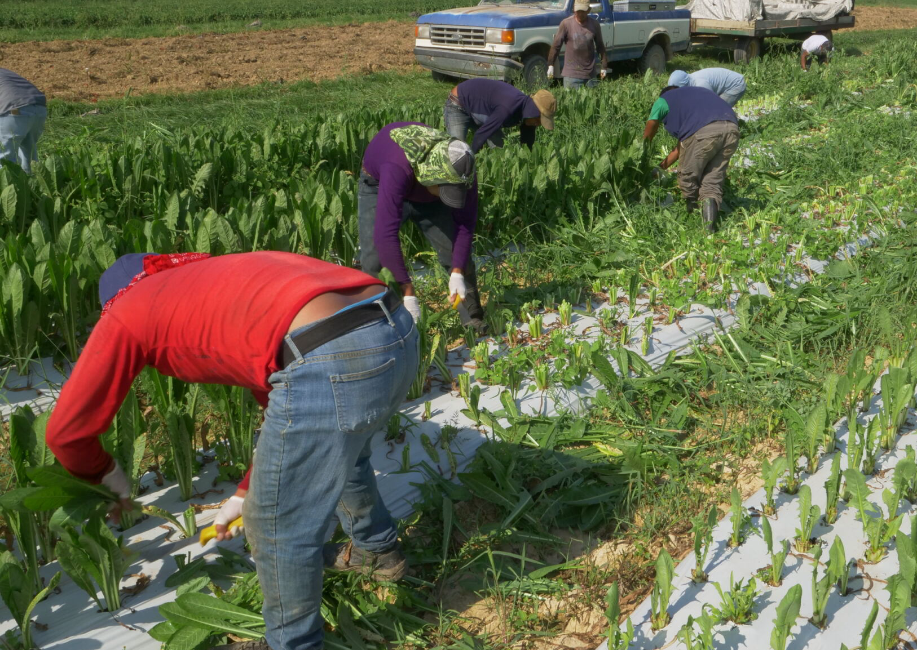
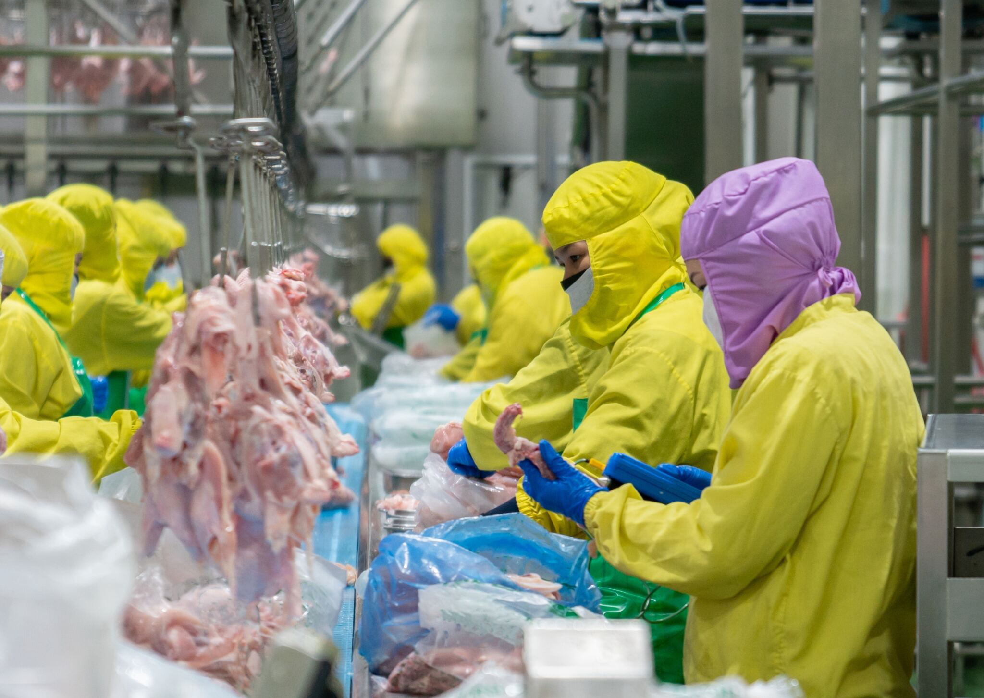

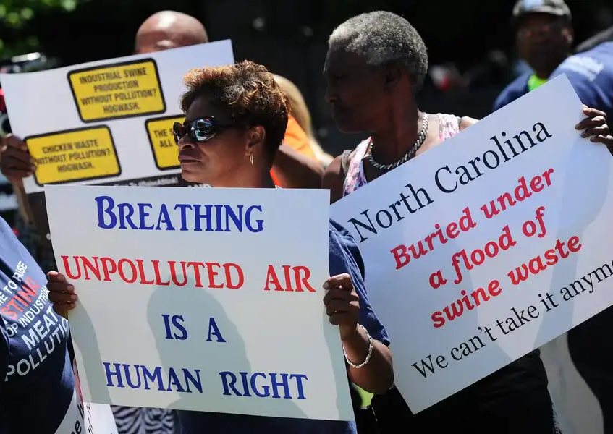
Essential Workers
Production Farmers and farm labor
Processing Food, meat, and poultry
Distribution and service Grocery, restaurants, food service
Communities Rural, urban
Image sources: Clockwise from top left, Mike Milli, Johns Hopkins Center for a Livable Future; zblaster, Shutterstock; Microsoft Stock Images; Waterkeeper Alliance.
Notes:
Let’s begin with our “essential workers” – the people who grow, pick, process, and serve our food. Despite how critically important they are to our health, our well-being, our very survival, they are often the most exploited and suffer the highest rates of food insecurity.
We’ll look at a few sectors within the food systems workforce where equity issues are notable and widespread. This includes production, processing, distribution and food service. We’ll then shift towards how inequities in food systems show up in communities, both rural and urban. Again it’s important to keep in mind that these vulnerable populations are often one and the same. So as we move through the slides in this section, keep in mind the question of where you see issues of equity and the social determinants of health. How are the risks and challenges faced by food systems workers connected to economics stability, neighborhood and physical environments, health care, education and literacy, and access to healthy food.

Slide 16
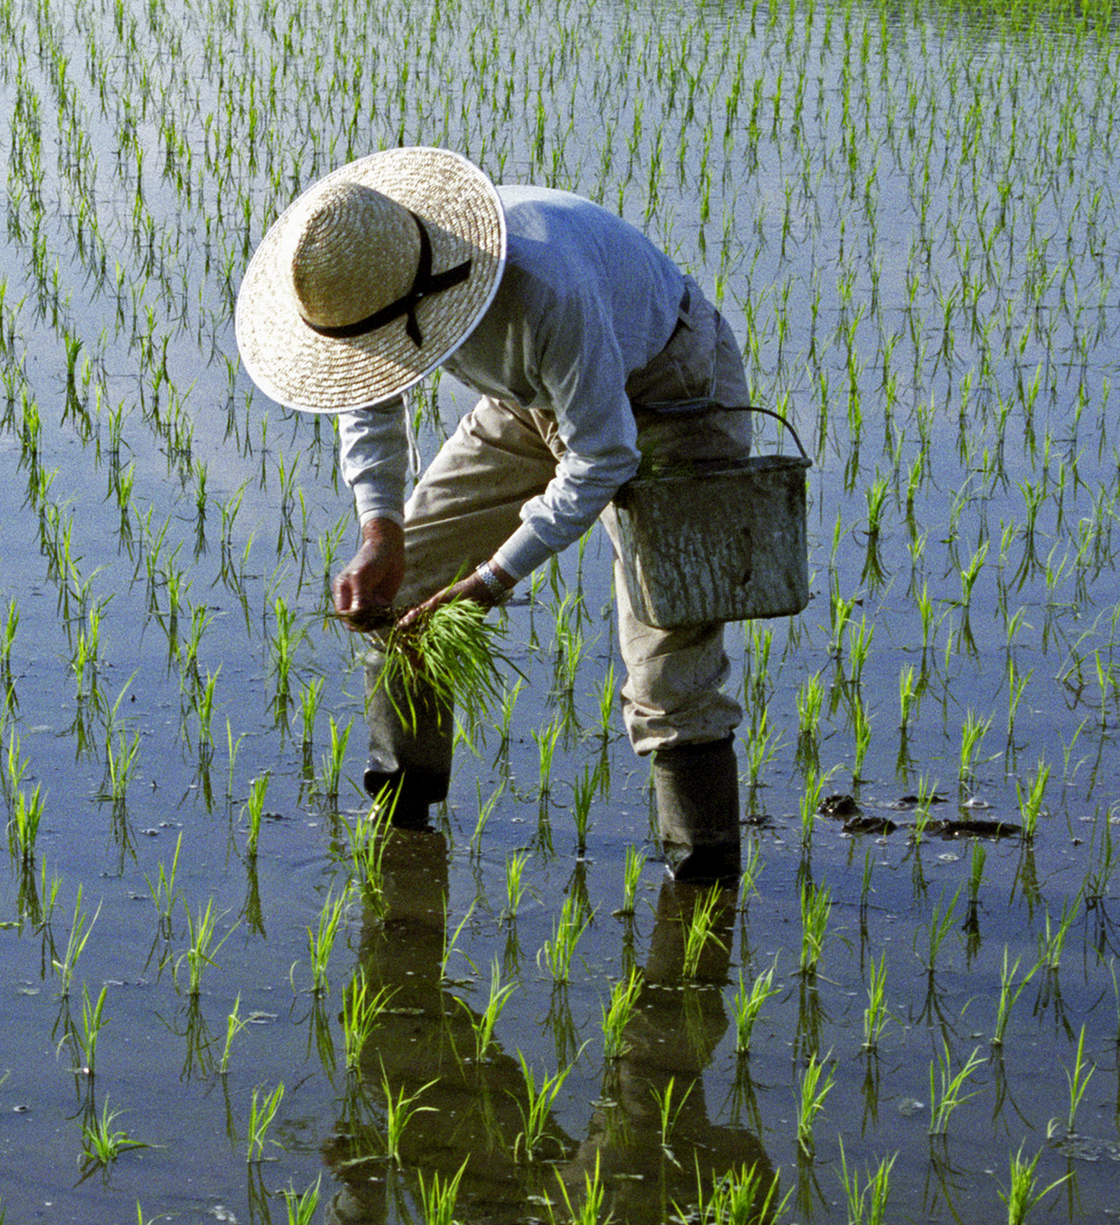
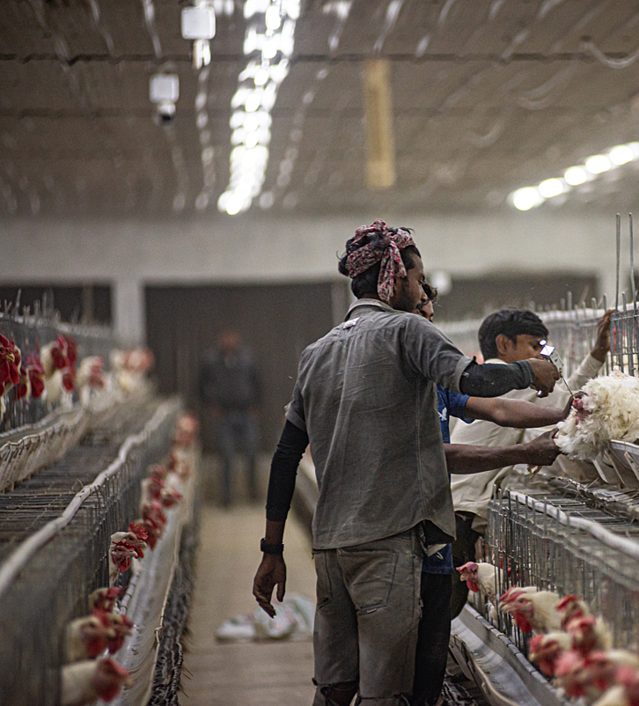
Food Systems Global Workforce
Estimated 1.23 billion people employed in agrifood systems with an additional 2.6 billion in connected households
Over 600 million farms across the globe, though the number is expected to decrease throughout the 21st century
Sources: Davis, B., et al. (2023). Estimating global and country-level employment in agrifood systems. Food and Agriculture Organization of the United Nations. https://openknowledge.fao.org/handle/20.500.14283/cc4337en; Mehrabi, Z. (2023). Likely decline in the number of farms globally by the middle of the century. Nature Sustainability, 6(8), 949–954. https://doi.org/10.1038/s41893-023-01110-y; Photo on left is from Microsoft Stock Images; photo on right is from Shatabdi Chakrabarti, Open Wing Alliance / We Animals.
Notes:
Our food system is a huge part of the global economy and workforce. According to one estimate, over 1.2 billion people are employed in food systems, and another 2.6 billion people live in household with ties to food systems jobs.
There are more than 600 million farms worldwide, though the number is decreasing as farms become larger and more concentrated.
While numbers are inexact and do not begin to capture the unique story of each of these farmers and workers, these figures underscore the critical importance of the many hands that are responsible for the food that you eat every day.
-----
Data
Davis, B., Mane, E., Gurbuzer, L. Y., Caivano, G., Piedrahita, N., Schneider, K., Azhar, N., Benali, M., Chaudhary, N., Rivera, R., Ambikapathi, R., & Winters, P. (2023). Estimating global and country-level employment in agrifood systems. Food and Agriculture Organization of the United Nations. https://openknowledge.fao.org/handle/20.500.14283/cc4337en
Mehrabi, Z. (2023). Likely decline in the number of farms globally by the middle of the century. Nature Sustainability, 6(8), 949–954. https://doi.org/10.1038/s41893-023-01110-y

Slide 17
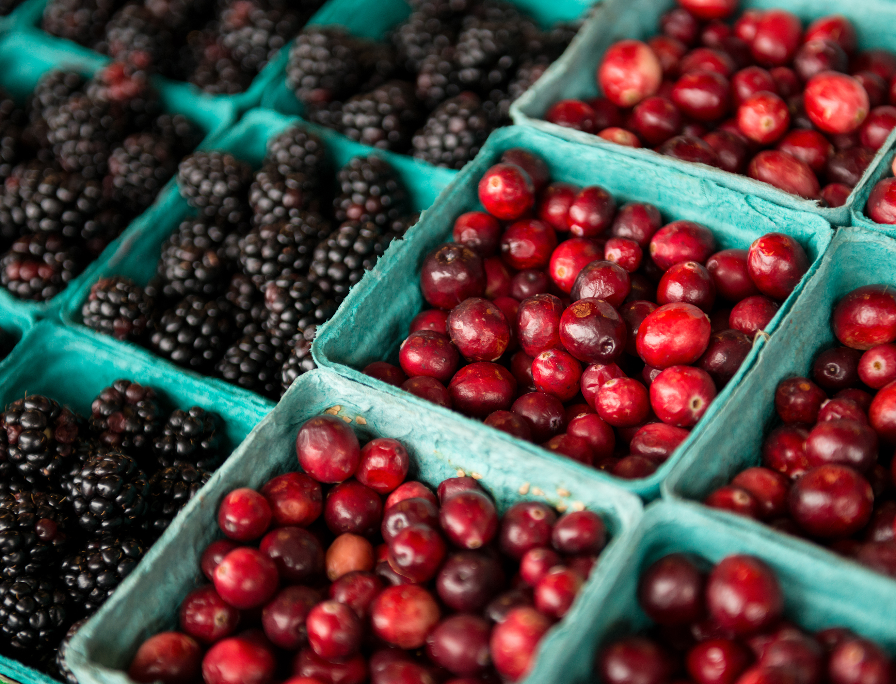

Food Sector Employment
22.1 million people in the US—over 10% of the nation’s workforce—work in the food sector
The largest share (12.7 million) works in the food service industry, followed by food retail (3.3 million) and farmers (2.6 million)
Sources: Hernandez, T., & Gabbard, S. (2018). Findings from the National Agricultural Workers Survey (NAWS) 2015–2016: A demographic and employment profile of United States farmworkers (No. 13). JBS International. https://www.dol.gov/sites/dolgov/files/ETA/publications/ETAOP_2019-01_NAWS_Research_Report_13.pdf; USDA ERS. (2025a). Ag and food sectors and the economy. USDA Economic Research Service. https://www.ers.usda.gov/data-products/ag-and-food-statistics-charting-the-essentials/ag-and-food-sectors-and-the-economy; photos are from Microsoft Stock Images.
Notes:
In the United States, about 22 million people are employed in the food sector, about a tenth of the country’s entire workforce! The largest share works in food service and food retail: about 12.7 million work in the food service industry and about 3.3 million work in food retail. Though farmers still make up a large number - 2.6 million are engaged in farming, it’s far fewer than in the early1900’s when about 40% of the U.S. population was engaged in agriculture..
-----
Data
Hernandez, T., & Gabbard, S. (2018). Findings from the National Agricultural Workers Survey (NAWS) 2015-2016: A Demographic and Employment Profile of United States Farmworkers (No. 13). JBS International. https://www.dol.gov/sites/dolgov/files/ETA/publications/ETAOP_2019-01_NAWS_Research_Report_13.pdf
USDA ERS. (2025a). Ag and Food Sectors and the Economy. USDA Economic Research Service. https://www.ers.usda.gov/data-products/ag-and-food-statistics-charting-the-essentials/ag-and-food-sectors-and-the-economy

Slide 18
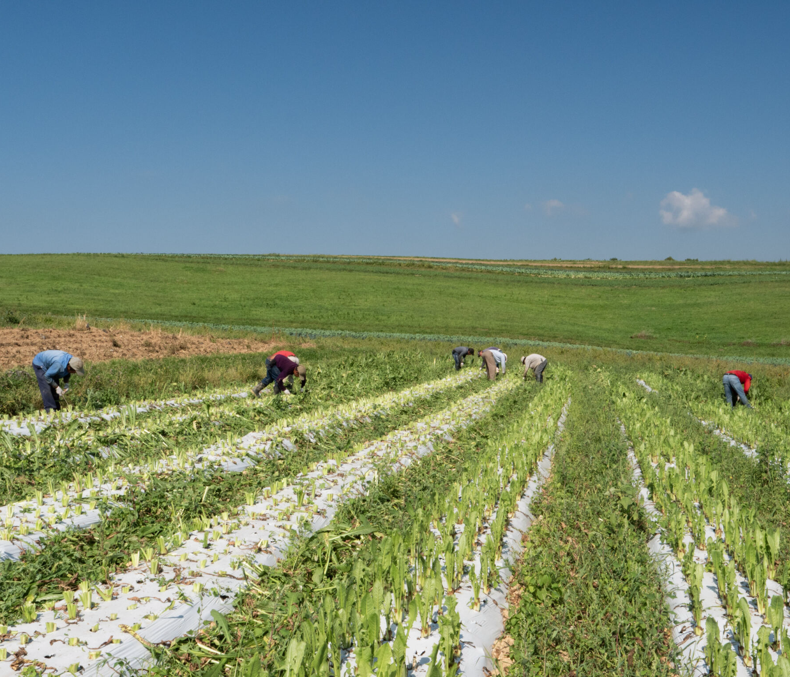
US Agricultural Workers
Between 800,000 and 2.2 million hired farmworkers
Plus “unpaid” and contracted labor
According to the US Department of Labor, immigrants make up two-thirds (68%) of the nation’s crop farmworkers
Long history of discrimination and oppression
Fair Labor Standards Act of 1938 exemptions for some agricultural workers include:
Minimum wage
Overtime
Sources: Fung, W., Prado, K., Gold, A., Padovani, A., Carroll, D., & Finchum-Mason, E. (2023). Findings from the National Agricultural Workers Survey (NAWS) 2021–2022: A demographic and employment profile of United States crop workers (No. 17). JBS International. https://www.dol.gov/sites/dolgov/files/ETA/naws/pdfs/NAWS%20Research%20Report%2017.pdf; Vilsack, T., & Hamer, H. (2024). 2022 Census of Agriculture (No. AC-22-A-51; Geographic Area). USDA National Agricultural Statistics Service. https://www.nass.usda.gov/Publications/AgCensus/2022/Full_Report/Volume_1,_Chapter_1_US/usv1.pdf; USDA ERS. (2025b). Farm Labor. USDA Economic Research Service. https://www.ers.usda.gov/topics/farm-economy/farm-labor#size; Photo from Mike Milli, The Johns Hopkins Center for a Livable Future.
Notes:
Let’s start on the farm. The workforce on farms is difficult to tally for a number of reasons. For one thing, farming – and thus farm work – is generally seasonal and some farm laborers move around to wherever they can find work.
In a given week, it’s estimated that about 800,000 hired farmworkers labor on farms across the U.S. The Census of Agriculture puts the annual tally at around 2.2 million farmworkers. Plus, there are many “unpaid” laborers, mainly family members as well as contract labor hired out through agencies.
Immigrants make up a significant share of the U.S. agricultural workforce, often filling physically demanding, low-wage jobs that few others will perform. They typically work under tough conditions—long hours in extreme weather, limited access to healthcare.
Laws such as the Fair Labor standards act provided exemptions for basic labor laws including minimum wage and overtime pay. This was done at a time when agriculture was mostly a family-run practice and not the large industry that it has become now.
A large portion of these workers are undocumented, which makes them especially vulnerable to exploitation and less likely to report unsafe or unfair practices. Their labor is essential to the food system, keeping farms running and prices relatively low.
-----
Data
Fung, W., Prado, K., Gold, A., Padovani, A., Carroll, D., & Finchum-Mason, E. (2023). Findings from the National Agricultural Workers Survey (NAWS) 2021–2022: A Demographic and Employment Profile of United States Crop Workers (No. 17). JBS International. https://www.dol.gov/sites/dolgov/files/ETA/naws/pdfs/NAWS%20Research%20Report%2017.pdf
Vilsack, T., & Hamer, H. (2024). 2022 Census of Agriculture (No. AC-22-A-51; Geographic Area). USDA National Agricultural Statistics Service. https://www.nass.usda.gov/Publications/AgCensus/2022/Full_Report/Volume_1,_Chapter_1_US/usv1.pdf
USDA ERS. (2025b). Farm Labor. USDA Economic Research Service. https://www.ers.usda.gov/topics/farm-economy/farm-labor#size

Slide 19

Crop Workers and Public Health
Health risks
Chemical exposures, exposure to heat and extreme weather, musculoskeletal injuries
Quality of life
Poverty, poor housing, lack of breaks or time off, lack of access to health care and social support, wage theft, harassment
Societal context
Immigration policy, discrimination, low job security, lack of political power, uncertainty
Sources: de-Assis, M. P., Barcella, R. C., Padilha, J. C., Pohl, H. H., & Krug, S. B. F. (2021). Health problems in agricultural workers occupationally exposed to pesticides. Revista Brasileira de Medicina Do Trabalho, 18(3), 352–363. https://doi.org/10.47626/1679-4435-2020-532; photo is from Mike Milli, The Johns Hopkins Center for a Livable Future.
Notes:
What are some of the public health risks faced by farm workers? Crop farmworkers face many health risks – too many to list on one slide. Some of the major risks include chemical exposures, specifically to pesticides, heat-related illnesses, and musculoskeletal injuries from being bent over for long periods of time and lifting or carrying heavy items or from machinery. Speed is often needed as payment can be based on a per-piece system, so for example, the more apples you can pick in an hour, the more you will get paid. A 2021 literature review identified associations between chemical exposure and cancer, respiratory illnesses and other health issues among agricultural workers.
Crop workers disproportionately face significant quality of life and social problems stemming from their difficult, often hazardous, work environments – this includes poverty and poor housing, limited breaks and time off, limited access to healthcare, inadequate social support systems; there may also be issues like wage theft and harassment. These issues are often exacerbated for undocumented farmworkers due to isolation, language issues and other barriers to accessing resources.
Underlying all of this is the stress and political context of immigration policy, fear of deportation, discrimination, low job security and a general lack of political power to have agency over your own security and uncertainty about the future.
-----
Information
de-Assis, M. P., Barcella, R. C., Padilha, J. C., Pohl, H. H., & Krug, S. B. F. (2021). Health problems in agricultural workers occupationally exposed to pesticides. Revista Brasileira de Medicina Do Trabalho, 18(3), 352–363. https://doi.org/10.47626/1679-4435-2020-532

Slide 20
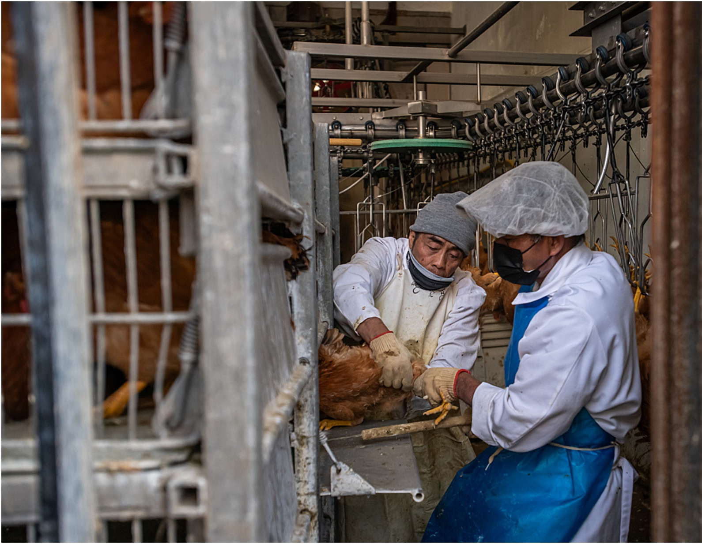
Livestock Workers and Public Health
Exposure to zoonotic diseases and antibiotic-resistant bacteria
Increased susceptibility to Methicillin-resistant Staphylococcus aureus (MRSA), avian influenza
Respiratory illnesses from exposure to chemicals, dust, ammonia, manure, methane
Physical injuries
Mental and psychological health
Image source: Jo-Anne McArthur, We Animals.
Notes:
Working on a livestock farm is very different than farm picking fruits and vegetables but it’s no less challenging and hazardous. Working as a laborer on a livestock farm may involve providing feed and water to the animals, milking them, or more stressful jobs like castrating, branding, de-beaking, catching, and loading animal into cages and trucks for processing.
Livestock workers face significant risks to their physical health, including exposure to zoonotic diseases and antibiotic-resistant bacteria. They have an increased susceptibility to MRSA and bird flu. They are exposed to chemicals, dust, ammonia, manure and methane, resulting in respiratory illnesses. It can also be a physically demanding job.
Livestock workers can also suffer mental health and psychological stress due to significant animal welfare issues they confront on a daily basis.

Slide 21
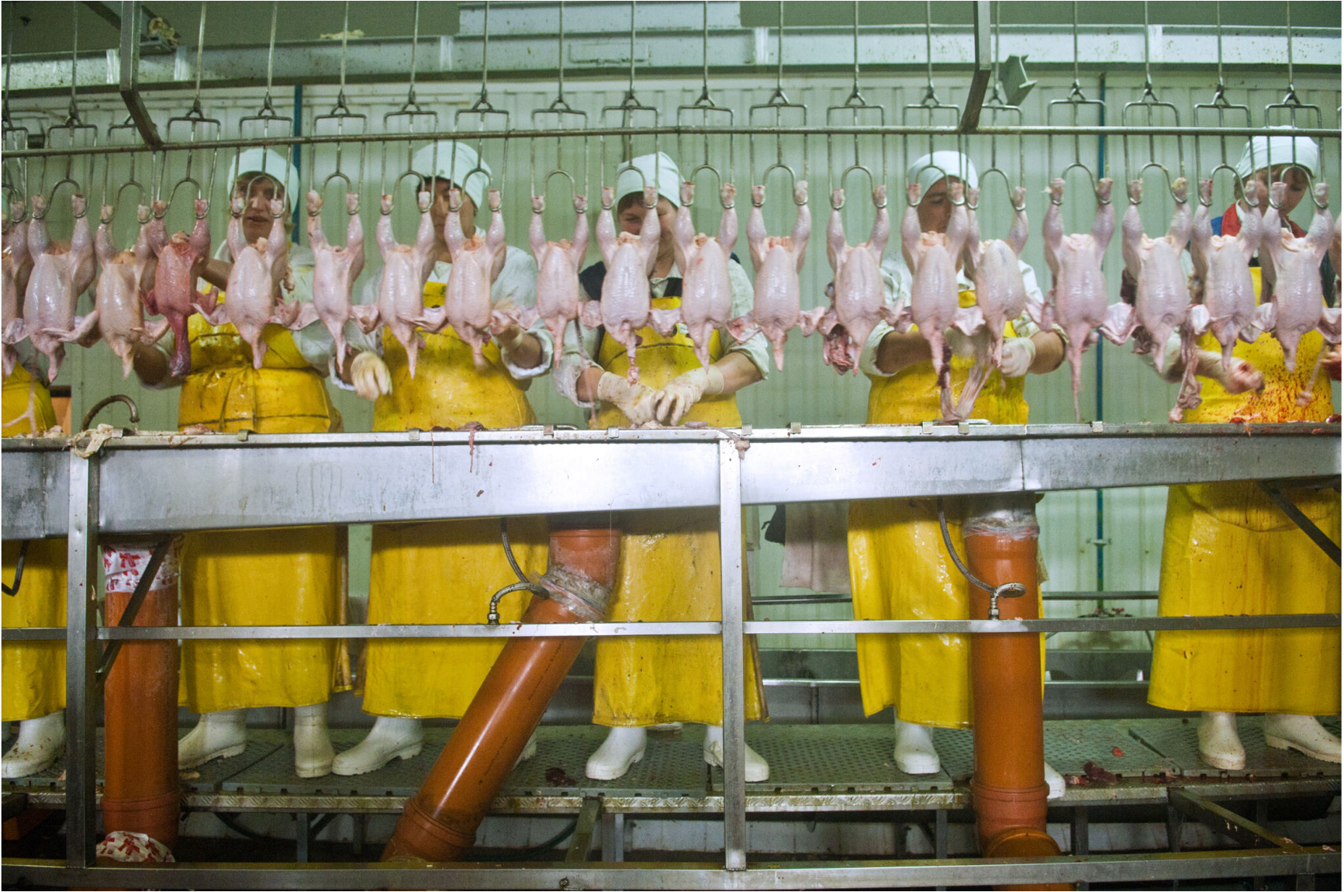
Processing Workers and Public Health
Health risks
High injury rates and disease exposure
Mental and psychological stress
Quality of life
Lack of breaks or time off
Low wages
Societal context
Discrimination
Lack of political power
Image source: Vipavlenkoff, Shutterstock.
Notes:
Life as a slaughterhouse worker in the U.S. is grueling, dangerous, and often hidden from public view. Workers—many of them immigrants—face high injury rates from repetitive motions, sharp tools, and fast-paced production lines.
Poultry processing plants typically operate at 140 birds per minute, though some plants can reach 175 birds per minute. Hogs can be processed at a rate of 1,100 per hour, which equates to about 18 per minute.
The job is physically and psychologically taxing, with constant exposure to trauma, bodily fluids and body parts. Despite being essential to the meat industry, as we saw during the Covid-19 pandemic, these positions are often low-wage, lack union representation, and workers fear speaking out due to immigration status or job insecurity.

Slide 22
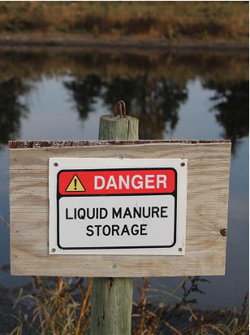
Neighboring Communities and Public Health
Health risks
Respiratory illnesses, drug-resistant infections, chemical exposures
Quality of life
Noise, odors, social disruptions, flies, water contamination
Reduced property values
Societal context
Disproportionate impact on communities of color and those with high poverty rates
Industry concentration
Lack of political power
Image source: Terah vdMeer, Shutterstock.
Notes:
Workers are part of communities, and there are broader risks to the workers living in and near agricultural zones, and particularly those directly adjacent. So let’s briefly take a wider lens and look at the equity issues facing agricultural communities.
Agricultural communities are in close proximity to crops, animals, infrastructure and the waste from the animals. They bear the burden of the heavy use of pesticides and fertilizers and the concentration of a large number of animals in one location.
People living in agricultural communities, especially so-called “fenceline” neighbors, have a higher risk of respiratory illnesses, antibiotic-resistant infections and exposures to chemicals. For example, Iowa has one of the highest cancer rates in the country. Iowa is 85% farmland and most of that is used to grow livestock, especially hogs, and the corn and soy to feed them. One major factor is likely the high concentration of agricultural chemicals and animal waste contaminating wells and other fresh water supplies.
People living near farms, particularly large industrial farms, deal with dust, noise and odors, fly infestations inside and outside their homes, and reduced property values. It can affect their day-to-day life when they cannot spend time outdoors. Some research has found that school children near large hog farms are exposed to dangerous levels of air contamination.
Communities near industrial animal facilities, particularly those with higher percentages of people of color or living below the poverty line, often bear a greater burden of environmental hazards like pesticide exposure, air and water pollution, and unsafe living conditions.
There has been a good deal written about this and described in documentaries if you are interested in exploring this issue more.

Slide 23
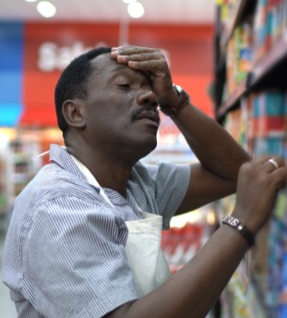
Food Service and Retail Workers and Public Health
Health risks
Physical strain and injuries, exposure to chemicals, disease transmission
Quality of life
Low wages
No sick leave, long hours, unpredictable schedules, pressure to work fast
Public-facing
Societal context
Lack of employee protections and minimum wage laws
Low job security
Image source: Microsoft Stock Images.
Notes:
It takes millions of workers to prepare, serve and deliver meals in restaurants, businesses and schools. These include roles like fast food and counter workers, waiters, and cooks, and the diversity of jobs in grocery and convenience stores.
Food service jobs may not seem as difficult and dangerous as working on a farm or in a slaughterhouse, but they can be physically and mentally taxing and come with many of the financial challenges that are ubiquitous across the food system.
Health risks include physical strain from long hours standing, repetitive motions (like chopping or stocking shelves), and heavy lifting that lead to musculoskeletal injuries. Other injuries include burns, cuts, and falling on slippery floors. There may also be other machinery and forklifts that can be hazardous.
Food service and grocery workers may be exposed to chemicals such as industrial cleaners and sanitizers; and higher risks of infectious diseases. A lack of sick leave policies often discourage staying home.
These jobs are also low wage and come with long hours and unpredictable schedules and pressure to work fast. Additionally, they are often not secure, - many are hourly, dependent on tips and seasonal. Altogether they can take a toll mentally.
Then there’s the challenge of interacting with customers, as many of these are public facing.
Pause here and think about all of the different people in the food service industry you may interact with during a given week – at the grocery store, at the coffee shop, at your school or work cafeteria. Do they have families, are they paying for daycare, are they able to afford healthy food?

Slide 24
What Have We not Covered in This Section? A Lot!
Historical inequities that are the foundation of almost all health and food justice inequity
Continued lack of access to land for farmers of color and new/beginning farmers
Concentration of power leading to a lack of competition across the food sector limits choices for farmers and consumers
Laws and policies that perpetuate these systems
Notes:
In this section, we looked at the inequities faced by selected groups of workers in the food system. And in this next section we are going to look more at food security and inequities in food access. But what didn’t we cover? A whole lot.
First and foremost, it’s important to recognize that so many of the inequities in food systems and health can be traced back to the colonization of the U.S. and the institution of slavery, which began the long history of societal discrimination in this country against people of color.
Access to land has been a large factor in access to wealth in the U.S. However, there has been and continues to be unequal access to land for Black and Indigenous farmers. In fact, the US Department of Agriculture admitted to discrimination against black farmers throughout the 20th century that led to large losses of black-owned farmland.
These days, it’s difficult for almost anyone to access land and become a farmer. Land is valuable and is often too expensive for a younger person to purchase, so it is sold off to a large agribusiness, a developer, or sometimes even to an investor from outside the U.S. The issue of access and ownership of agricultural land is hugely important and not something that is talked about nearly enough.
The concentration and consolidation across the food sector has a huge implication for choices for farmers and consumers. It leads to a concentration of power and wealth in the hands of a few large powerful global companies. While the myriad of brands of food in a grocery store may make a typical consumer think they have many choices, many of these brands are owned by the same company. Choice is an illusion.
And unfortunately, many of our laws and policies simply perpetuate these policies and these society-wide inequities that make it difficult to improve our food systems for farmers, for workers, for communities and for consumers.
Each of these topics would take an entire course to cover in depth. We’ll provide additional resources at the end of this module if you’d like to explore these topics more on your own. But it’s important to note that inequity is built into our food system and while some consumers can create some change, ‘voting with your fork’ only goes so far. We need broader systems and policy changes that go beyond consumer choice, and even beyond food, to impact the economic, healthcare and educational systems that are tied directly and indirectly to health and overall well-being.

Slide 25
Section C: Food Security and Access to Nutritious Food
Notes:
One very important aspect of Sustainable, Healthy Food Systems is Food Security and Food Access. In this section, we’ll take a deeper dive into the consumer end of sustainable food systems and look at the various economic and social dimensions of food access, demand and consumption.
For this section, we will: (1) define and provide scope of food insecurity in the US - who and what are the factors causing it, and (2) consider how food insecurity impacts health and interact with sustainability.

Slide 26
Evolving Definition of Food Security
Food security exists when all people, at all times, have physical, social and economic access to sufficient, safe and nutritious food that meets their dietary needs and food preferences for an active and healthy life.
—Food and Agriculture Organization of the United Nations
… “and food is produced in ways that are environmentally sound and socially just”
Quality
Sustainability
Equity
Sources: FAO. (1996). World Food Summit—Final Report—Part 1. Food and Agriculture Organization of the United Nations. https://www.fao.org/4/w3548e/w3548e00.htm;
CFS. (2014). Global Strategic Framework for Food Security and Nutrition (GSF)—Third version. Committee on World Food Security. https://openknowledge.fao.org/items/9e243f7a-2ed0-4d7d-85c4-3227b76ce79e
Notes:
The concept of food security was first formally defined at the 1996 World Food Summit, where global leaders recognized the need for a clear and universal understanding of what it means to have secure access to food. In the 2001 State of Food Security Report, the definition was further refined to add the word “social” highlighting the importance of social determinants in food security. This definition still stands as the most widely used definition of food security. “Food security exists when all people, at all times, have physical, social, and economic access to sufficient, safe, and nutritious food that meets their dietary needs and food preferences for an active and healthy life."
As awareness of environmental and social justice issues grew, many experts and advocates expanded this definition to include a crucial addition: food must also be produced in environmentally sound and socially just ways. This perspective emphasizes the importance of sustainable agricultural practices, ethical food production, and equitable food distribution, ensuring that future generations can continue to access nourishing food without compromising the health of our planet or the well-being of food producers.
By integrating these elements, the conversation around food security has shifted from merely ensuring food quantity to considering quality, sustainability, and equity—a necessary step in addressing global hunger, climate change, and food system resilience.
-----
Definitions
FAO. (1996). World Food Summit—Final Report—Part 1. Food and Agriculture Organization of the United Nations. https://www.fao.org/4/w3548e/w3548e00.htm
CFS. (2014). Global Strategic Framework for Food Security and Nutrition (GSF)—Third version. Committee on World Food Security. https://openknowledge.fao.org/items/9e243f7a-2ed0-4d7d-85c4-3227b76ce79e
The "Four Pillars of Food Security" – availability, access, utilization, and stability – was developed by the United Nations Food and Agriculture Organization (FAO) at the 1996 World Food Summit.
This describes the different aspects of food security that must be present for someone to be considered food secure.
Food availability addresses the supply side and refers to sufficient quantities of food available on a regular, consistent basis
Food access refers to the economic and physical ability of households to regularly acquire adequate amounts of appropriate and desired food for a nutritious diet.
Food utilization refers to the use that households make of the food to which they have access and each individual’s ability to absorb and metabolize nutrients, which is related to food storage, sanitation, overall nutrition and health. It also refers to the intra-household distribution of food.
Finally, stability refers to the constancy of the availability, access and utilization over time, even with events or shocks that may affect resilience.

Slide 27
Four Dimensions of Food Security
1. Stability: First three dimensions sustained over time
Stability
3. Access: Sufficient resources to obtain appropriate foods for a nutritious diet
Utilization
Access
2. Utilization: Appropriate use based on knowledge of nutrition, care, water, and sanitation
Availability
4. Availability: Sufficient quantities of food available on a consistent basis
Source: World Bank. (n.d.). What is food security? World Bank Group. https://www.worldbank.org/en/topic/agriculture/brief/food-security-update/what-is-food-security
Notes:
The definition of food security is based on four primary dimensions.
The availability of sufficient quantities of food on a consistent basis. Food availability addresses the “supply side” of food security and is determined by food production and trade.
Food access refers to the economic and physical ability for a household to regularly acquire adequate amounts of appropriate and desired food for a nutritious diet. An adequate supply of food at the national or international level does not in itself guarantee household level food security. Factors that affect access include incomes, other household expenditures, food environments, and prices.
Food utilization means that households make of the food that have and includes an individual’s ability to absorb and metabolize nutrients, which is related to food storage, sanitation, overall nutrition and health. This also includes the equitable – or inequitable – distribution of food within households. In some cultures, for example, male children are fed first, and what is left is split among the female children.
Finally, stability refers to the constancy of these three dimensions over time.
-----
Framework
World Bank. (n.d.). What is Food Security? World Bank Group. Retrieved May 23, 2025, from https://www.worldbank.org/en/topic/agriculture/brief/food-security-update/what-is-food-security

Slide 28
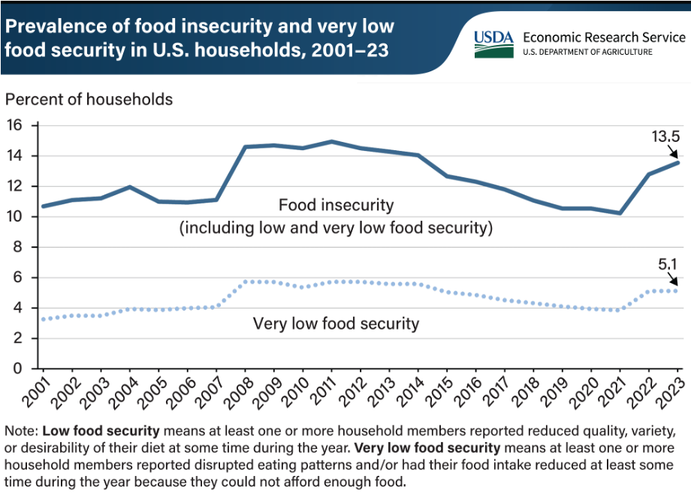
US Food Insecurity Fluctuates Yet Persists
Image source: USDA ERS. (2024). Prevalence of U.S. household food insecurity increased in 2023. USDA Economic Research Service. https://www.ers.usda.gov/data-products/charts-of-note/chart-detail?chartId=109859
Notes:
In this chart, you can see that food insecurity fluctuates slightly but remains a persistent problem. In 2023, 13.5% of US households experienced food insecurity, with 5.1% experiencing very low food security.
As noted on the slide, low food security means at least one or more household members reported reduced quality, variety or desirability of their diet at some time during the year. Very low food security means that at least one or more household members reported disrupted eating patterns, and/or had their food intake reduced at least some time during the year because they could not afford enough food.
-----
Graphic
USDA ERS. (2024). Prevalence of U.S. household food insecurity increased in 2023. USDA Economic Research Service. https://www.ers.usda.gov/data-products/charts-of-note/chart-detail?chartId=109859

Slide 29
Who Does Food Insecurity Impact?
Those most impacted by the food system are:
BIPOC communities
Low-income households
Children
Elderly individuals
Rural communities
College students
Physical and economic access to food is deeply connected to systemic inequities and the social determinants of health
BIPOC: Black, indigenous, people of color.
Source: Feeding America. (2025). Elevating voices: insights report. Feeding America. https://www.feedingamerica.org/hunger-in-america/who-faces-hunger
Notes:
Food insecurity has a disproportionate impact among certain vulnerable groups of people.
Black communities are at higher risk of food insecurity, as are Indigenous and communities of color. Other groups affected by food insecurity include low-income households, as financial struggles can limit access to a variety of high-quality food and the time and resources to prepare food.
Children are particularly vulnerable in the U.S. as food insecurity can affect growth, academic performance, and long-term health, which contributes to the cycle of poverty. As of now, school meals are our best solution to address these potentially lifelong negative impacts of childhood food insecurity.
Elderly individuals are also at risk due to fixed incomes and issues related to limited mobility and isolation.
Rural communities are also at risk, even those engaged in food production. Many rural areas lack grocery stores, limiting access to fresh food.
Believe it or not, college students are also another group that can be food insecure. Many students juggle tuition and food expenses.
We’ll break these down a bit more in the following slides.
But a key point here is that physical and economic access to food is one of the key ways that the social determinants of health manifest in the food system.
-----
Information
Feeding America. (2025). https://www.feedingamerica.org/hunger-in-america/who-faces-hunger

Slide 30
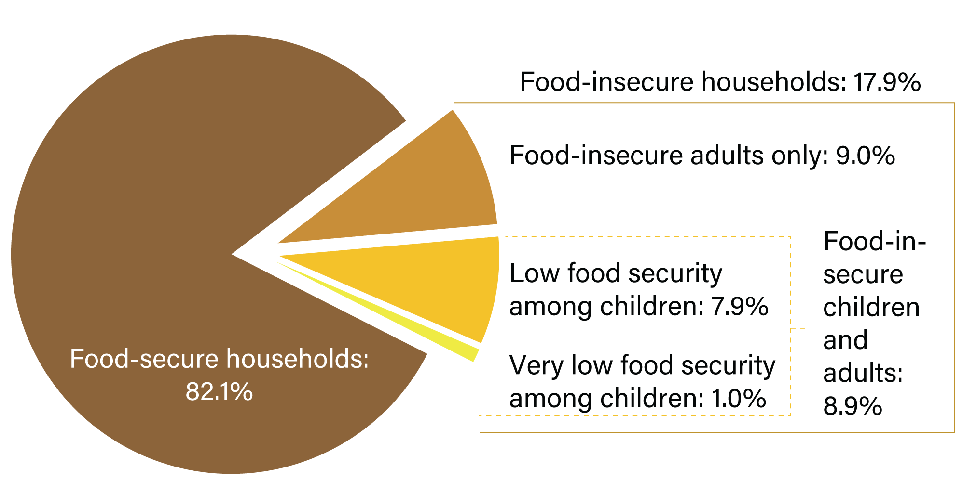
Food Insecurity in Households with Children
US households with children by food security status of adults and children, 2023
Source: Ovenell, M., Azevedo Da Silva, M., & Elgar, F. J. (2022). Shielding children from food insecurity and its association with mental health and well-being in Canadian households. Canadian Journal of Public Health,113(2), 250–259. https://doi.org/10.17269/s41997-021-00597-2; Image source: USDA ERS. (2025c). Food security in the U.S.—Key statistics & graphics. USDA Economic Research Service. https://www.ers.usda.gov/topics/food-nutrition-assistance/food-security-in-the-us/key-statistics-graphics
Notes:
Household food insecurity affected about 18 percent of households with children in 2023 – this is 6.5 million households. In some of these households, only adults were food insecure, while in others children also experienced food insecurity.
According to the USDA Economic Research Service, children are usually protected from substantial reductions in food intake even in households with very low food security thanks in large part to national school lunch programs and other social safety nets. In many households, children are prioritized over adults when it comes to access to food. Nevertheless, in about 1% of households with children (374,000 households), one or more children also reduced their food intake and had disrupted eating patterns at some time during the year.
-----
Graphic
USDA ERS. (2025c). Food Security in the U.S. - Key Statistics & Graphics. USDA Economic Research Service. https://www.ers.usda.gov/topics/food-nutrition-assistance/food-security-in-the-us/key-statistics-graphics
Information
Ovenell, M., Azevedo Da Silva, M., & Elgar, F. J. (2022). Shielding children from food insecurity and its association with mental health and well-being in Canadian households. Canadian Journal of Public Health = Revue Canadienne de Santé Publique, 113(2), 250–259. https://doi.org/10.17269/s41997-021-00597-2

Slide 31
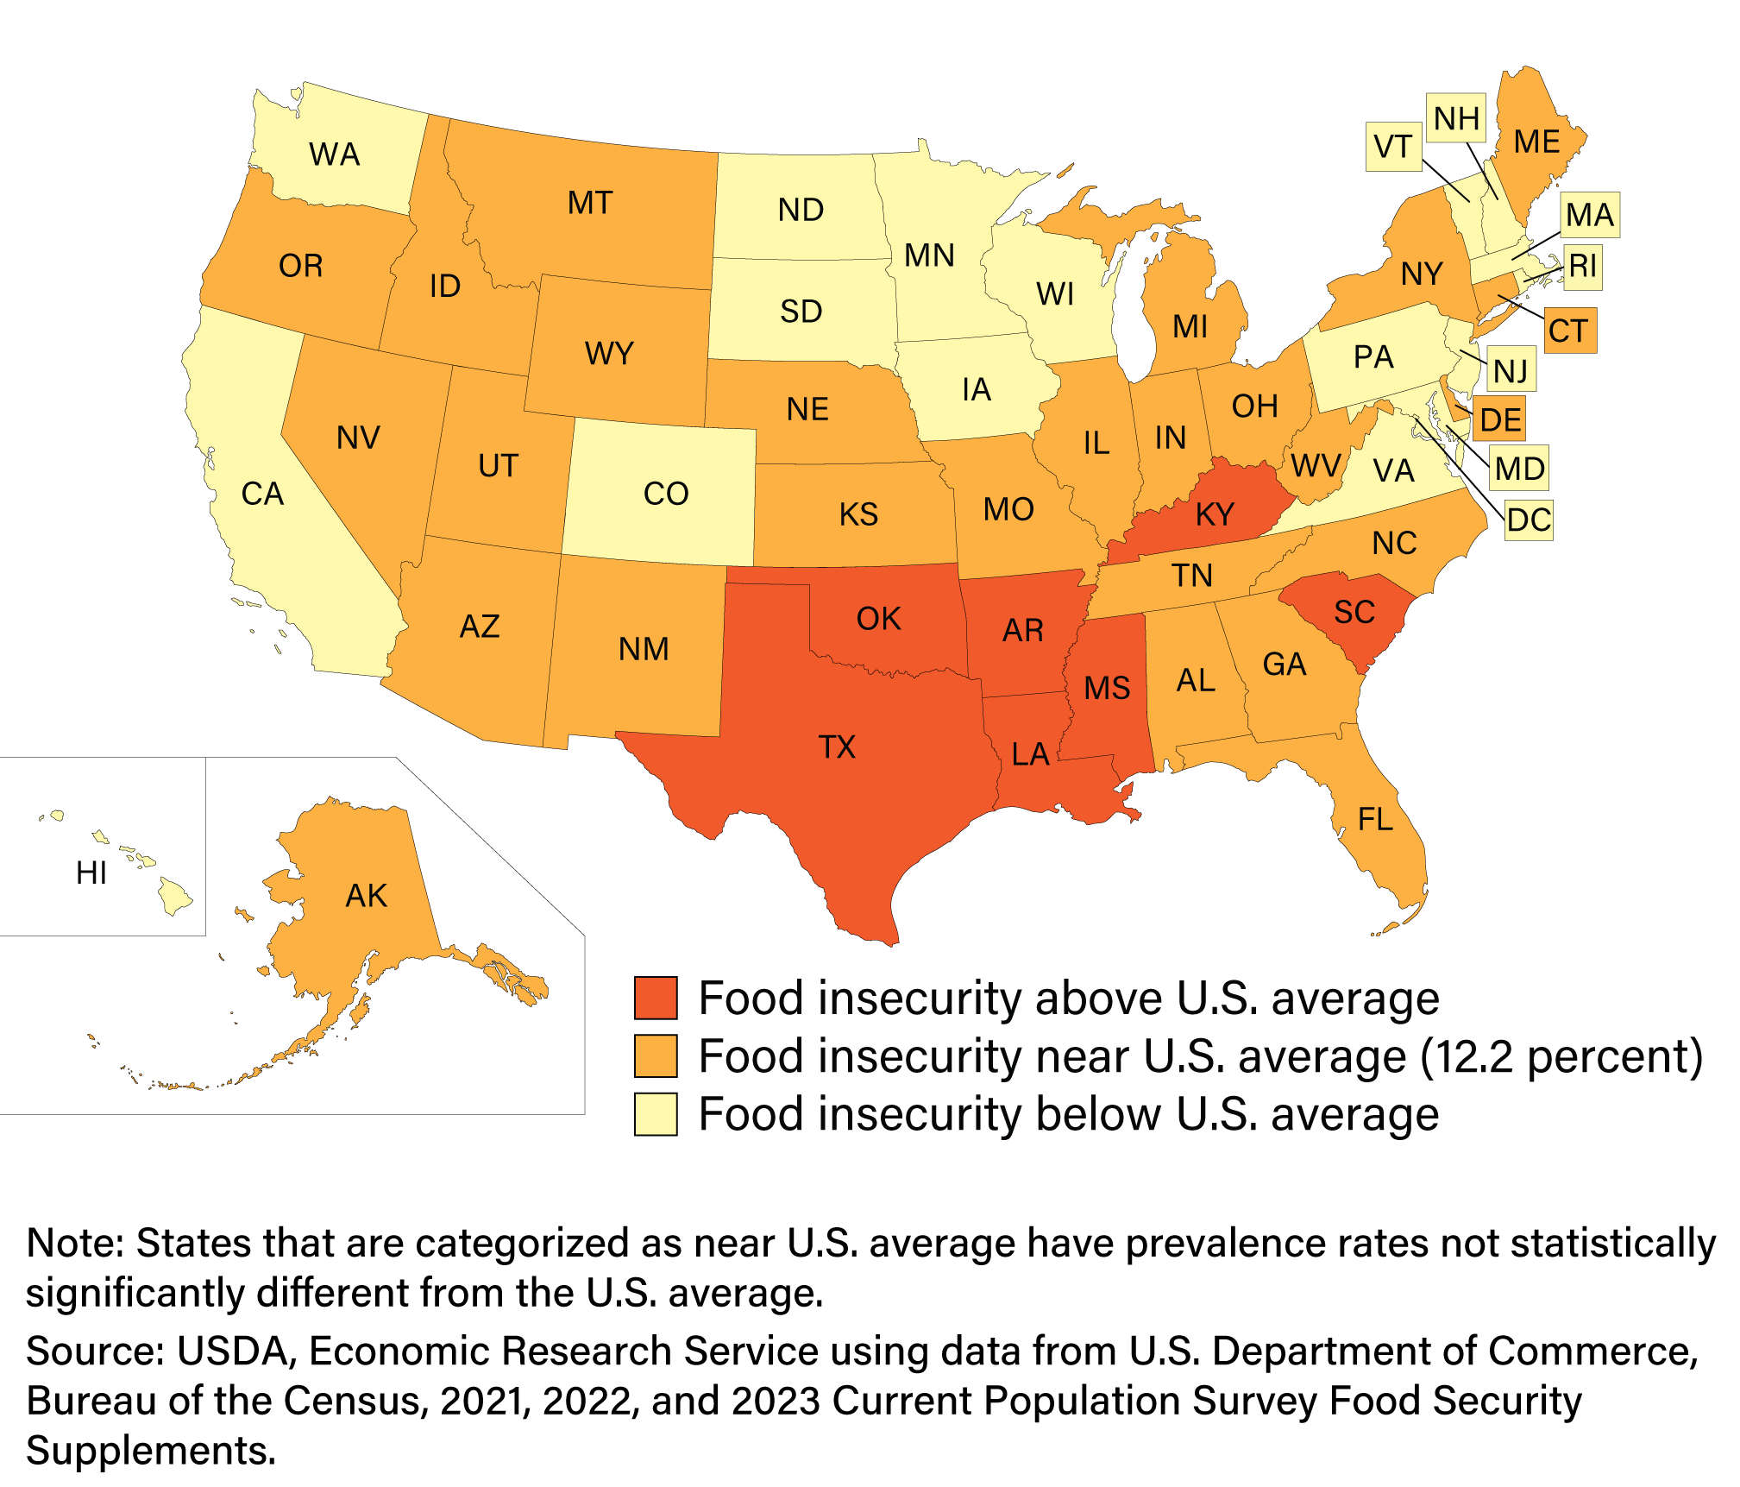
Rates of Food Insecurity by State
Prevalence of food insecurity, average 2021–23
Image source: USDA ERS. (2025c). Food security in the U.S.—Key statistics & graphics. USDA Economic Research Service. https://www.ers.usda.gov/topics/food-nutrition-assistance/food-security-in-the-us/key-statistics-graphics
Notes:
Prevalence rates of food insecurity varied considerably from state to state across the U.S. This chart shows the states that are above or below the US average rates of food insecurity.
Estimated prevalence rates of food insecurity during this 3-year period ranged from 7% in New Hampshire to 19% in Arkansas.
Estimated prevalence rates of very low food security ranged from 3.2% in Iowa, Massachusetts, New Hampshire, New Jersey, and North Dakota up to 7% in South Carolina.
Pause here and ask yourself, or discuss as a class, why is this? What do you think causes food insecurity to be so different from state to state?
-----
Graphic
USDA ERS. (2025c). Food Security in the U.S. - Key Statistics & Graphics. USDA Economic Research Service. https://www.ers.usda.gov/topics/food-nutrition-assistance/food-security-in-the-us/key-statistics-graphics

Slide 32
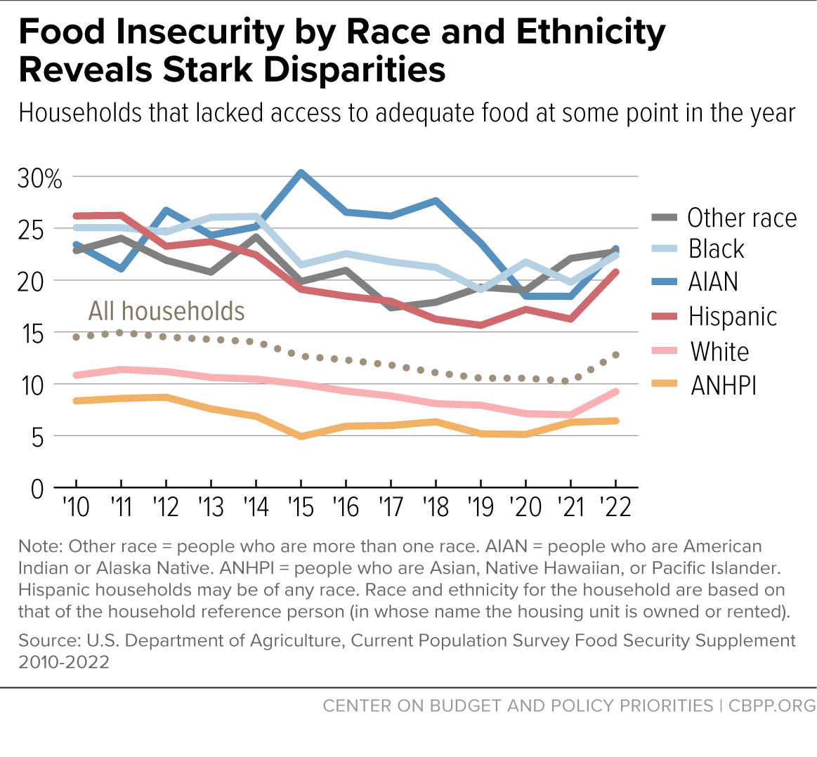
Risk of Food Insecurity by Race/Ethnicity
Image source: Hall, L. (2023). Food Insecurity Increased in 2022, With Severe Impact on Households With Children and Ongoing Racial Inequities. Center on Budget and Policy Priorities. https://www.cbpp.org/blog/food-insecurity-increased-in-2022-with-severe-impact-on-households-with-children-and-ongoing
Notes:
Food security also varies by race and ethnicity. Households that identify as White or Asian, Native Hawaiian and Pacific Islander, labeled here as ANHPI, have lower rates of food insecurity compared to all other groups. Most groups saw rates of food insecurity decline between 2010 and 2020, when the Covid-19 pandemic hit. Food insecurity rates increased across all groups in 2020, though you can see that the rise was higher in groups that had already been experiencing food insecurity before the pandemic.
-----
Graph
Hall, L. (2023). Food Insecurity Increased in 2022, With Severe Impact on Households With Children and Ongoing Racial Inequities. Center on Budget and Policy Priorities. https://www.cbpp.org/blog/food-insecurity-increased-in-2022-with-severe-impact-on-households-with-children-and-ongoing

Slide 33
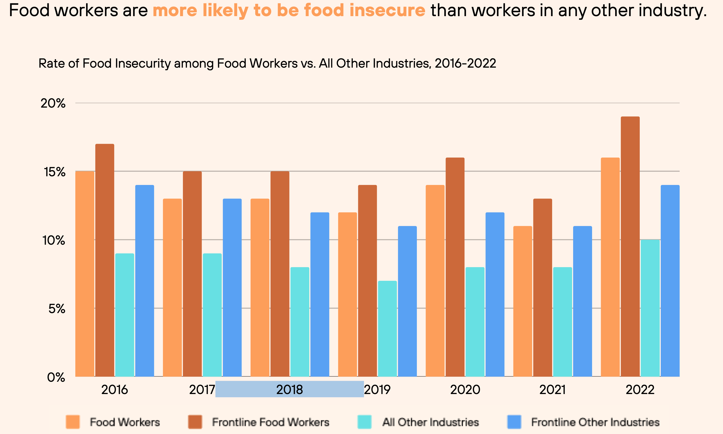
People Who Work in the Food Chain Have 2–3 Times Higher Risk for Low and Very Low Food Security
Food workers use Supplemental Nutrition Assistance Program (SNAP) benefits at double the rate of all other US workers
Source for data and image: Reznickova, A. (2023). How Big Food Corporations Take Advantage of SNAP [Union of Concerned Scientists]. The Equation. https://blog.ucs.org/alice-reznickova/how-big-food-corporations-take-advantage-of-snap/; FCWA. (2025). Food Chain Workers in 2025: Labor & Exploitation in the Food System. Food Chain Workers Alliance. https://foodchainworkers.org/wp-content/uploads/2025/02/Food-Worker-Data-Update-2025-FCWA-3.pdf
Notes:
Food workers are also a group at very high risk for food insecurity, which connects back to the lack of job security and low pay that we discussed in the previous section.
This data from the Food Chain Workers Alliance shows that food workers, and particularly frontline food chain workers have higher rates of food insecurity compared to workers in all other industries and even frontline workers in other industries. Frontline workers are those in public-facing positions who handle much of the day-to-day hands on service and sales of the food, and generally exclude administrative, supervisory and management positions. According to this data, frontline food chain workers have the highest rates of food insecurity every year compared to any other group.
In fact, food workers use SNAP benefits at double the rate of all other US workers. What that means is that the very people who work around food all day or all night are often the least able to buy it. In the next section, we’ll look more closely at food security.
-----
Information
Reznickova, A. (2023). How Big Food Corporations Take Advantage of SNAP [Union of Concerned Scientists]. The Equation. https://blog.ucs.org/alice-reznickova/how-big-food-corporations-take-advantage-of-snap/
Graph
FCWA. (2025). Food Chain Workers in 2025: Labor & Exploitation in the Food System. Food Chain Workers Alliance. https://foodchainworkers.org/wp-content/uploads/2025/02/Food-Worker-Data-Update-2025-FCWA-3.pdf

Slide 34
Factors Driving Food Insecurity in the United States
We have enough food! US agricultural production is enough to feed 136% of its population
Factors
Economic
Poverty, low wages, unemployment, underemployment
High cost of living: housing, transportation, health, education
Social
Neighborhood and community factors, food environments
Environmental
Extreme weather, natural disasters, and impacts of climate change; global pandemics and other supply chain disruptions (COVID-19)
Sources: Conrad, Z., Johnson, L. K., Roemmich, J. N., Juan, W., & Jahns, L. (2018). Nutrient intake disparities in the US: Modeling the effect of food substitutions. Nutrition Journal, 17(1), 53. https://doi.org/10.1186/s12937-018-0360-z; Feeding America. (n.d.). What is Food Insecurity? Retrieved July 30, 2025, from https://www.feedingamerica.org/hunger-in-america/food-insecurity
Notes:
Let’s look more closely at the connections with the Social Determinants of Health and Food Insecurity.
In the U.S., food insecurity is not caused by a lack of food production. Overall, we produce a lot of food. Food insecurity is not caused to a nation-wide lack of food.
In the U.S. – and generally this is true around the world–the primary factors that drive food insecurity are economic, social, and environmental. Do these sound familiar? These are the social determinants of health we have been linking back to throughout this presentation.
Some economic factors include poverty, low wages, unemployment or underemployment. High cost of living, particularly in relation to income, can mean that costs for housing, transportation, medicine, and education reduce food budgets.
Geographic location and neighborhood characteristics where one lives also has a significant impact on access to a variety of nutritious food. Areas with few food purchasing options and poor transportation can make accessing healthy food a challenge.
In addition, and something we haven’t talked about too much yet -- climate change, natural disasters and even global pandemics can disrupt supply chains, impact food availability and affordability.
-----
Information
Conrad, Z., Johnson, L. K., Roemmich, J. N., Juan, W., & Jahns, L. (2018). Nutrient intake disparities in the US: Modeling the effect of food substitutions. Nutrition Journal, 17(1), 53. https://doi.org/10.1186/s12937-018-0360-z
Feeding America. (n.d.). What is Food Insecurity? Feeding America. Retrieved July 30, 2025, from https://www.feedingamerica.org/hunger-in-america/food-insecurity

Slide 35
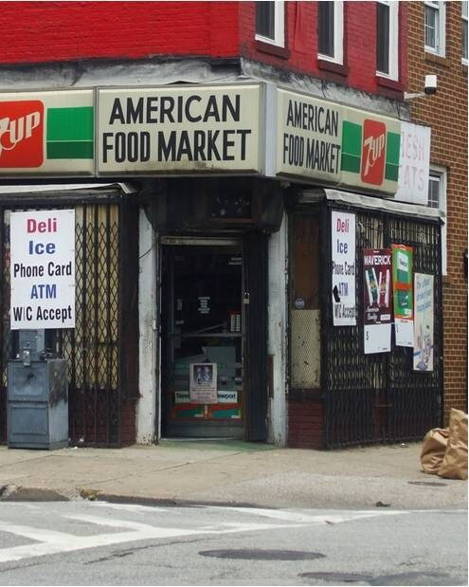
Food Desert Versus Food Apartheid
Food desert
Food apartheid
Focuses on lack of physical access to food
Geographic location and other factors
“Desert” = natural landscape
Coined by food advocate Karen Washington
Focuses on lack of economic access to food
Root causes of food insecurity are not natural but systemic
For many communities, the causes stem from a long history of racial discrimination
Acknowledges the resilience and agency of communities
Image source: Mike Milli, The Johns Hopkins Center for a Livable Future.
Notes:
So how does geography and the physical environment affect our access to food?
You’ve probably heard the term food desert. This has historically been the phrase used to describe an area where a significant portion of the population has limited access to affordable and nutritious food, often due to lack of supermarkets or grocery stores. It’s often framed as a problem of geography or market forces, implying that the issue is simply a lack of resources or investment in a particular area. Like a desert in – say– Arizona—is characterized by scarcity.
The term food apartheid was coined by food advocate Karen Washington to better capture the idea that food deserts aren’t “natural environments” – they are the result of systemic racism and discriminatory policies that have affected the food environments in certain communities. Food justice activists argue that food apartheid more accurately reflects the root causes of food insecurity and the need for systemic change. It also acknowledges the resilience and agency of communities affected by food insecurity.
Later in the module, we’ll discuss the concept of food sovereignty. Food sovereignty is the opposite of food apartheid where the same people who produce, distribute, and consume food also control the mechanisms and policies around food.

Slide 36
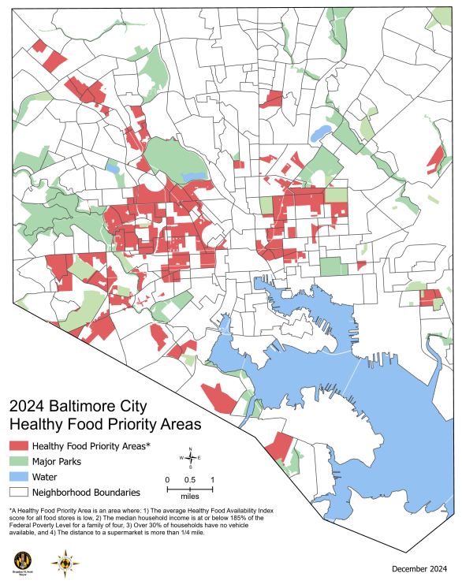
Baltimore City: Healthy Food Priority Areas
Healthy Food Priority Areas reflect access to and distance from healthy food retail outlets and household income
Data (not shown) shows strong correlation between healthy food access, cardiovascular disease, and premature deaths
Neighborhood environments directly influence food choices and health
Source: Misiaszek, C., Buzogany, S., & Freishtat, H. (2018). Baltimore City’s food environment report: 2018 Report. Johns Hopkins Center for a Livable Future. https://clf.jhsph.edu/publications/baltimore-citys-food-environment-report-2018-report; Image source: Baltimore City Department of Planning. (2024). Baltimore City: 2024 Food Environment Brief. https://planning.baltimorecity.gov/baltimore-food-policy-initiative/food-environment
Notes:
In 2018, in response to feedback from resident advisors, community groups, leaders and the local food policy council in Baltimore, Maryland, the term food desert was reframed as Healthy Food Priority Areas to better reflect the barriers residents face in the food system.
Healthy Food Priority neighborhoods are red on this map, showing where certain groups of residents are affected at disproportional rates.
From the 2018 report, 31% of Black residents live in Healthy Food Priority Areas, the highest of any racial or ethnic group. By comparison, only 9% of White residents live in Priority Areas. On average, children are the most likely of any age group to live in Priority Areas, at 28% of all of Baltimore’s children. Seniors also live in Healthy Food Priority Areas at disproportionate rates, with 24% of all of Baltimore’s seniors.
Other mapped data that were part of these studies also showed a strong correlation between healthy food access, cardiovascular disease and life expectancy.
Baltimore is not alone. Other cities have mapped their food environments and found similar results.
-----
Graphic
Misiaszek, C., Buzogany, S., & Freishtat, H. (2018). Baltimore City’s Food Environment Report: 2018 Report. Johns Hopkins Center for a Livable Future. https://clf.jhsph.edu/publications/baltimore-citys-food-environment-report-2018-report
Baltimore City Department of Planning. (2024). Baltimore City: 2024 Food Environment Brief. https://planning.baltimorecity.gov/baltimore-food-policy-initiative/food-environment

Slide 37

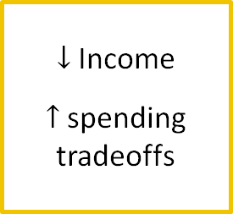
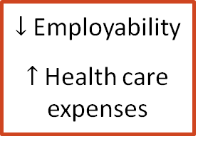
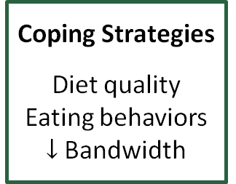
Cycle of Food Insecurity
Food insecurity
$↓$ Income
$↑$ spending tradeoffs
Coping Strategies
Diet quality Eating behaviors $↓$Bandwidth
STRESS
$↓$ Employability
$↑$ Health care expenses
Chronic Disease
Sources: Liu, Y., & Eicher-Miller, H. A. (2021). Food Insecurity and Cardiovascular Disease Risk. Current Atherosclerosis Reports, 23(6), 24. https://doi.org/10.1007/s11883-021-00923-6; Parekh, T., Xue, H., Cheskin, L. J., & Cuellar, A. E. (2022). Food insecurity and housing instability as determinants of cardiovascular health outcomes: A systematic review. Nutrition, Metabolism and Cardiovascular Diseases, 32(7), 1590–1608. https://doi.org/10.1016/j.numecd.2022.03.025; Odoms-Young, A., Brown, A. G. M., Agurs-Collins, T., & Glanz, K. (2024). Food Insecurity, Neighborhood Food Environment, and Health Disparities: State of the Science, Research Gaps and Opportunities. The American Journal of Clinical Nutrition, 119(3), 850–861. https://doi.org/10.1016/j.ajcnut.2023.12.019
Notes:
Food Insecurity is part of a cycle that affects many facets of life that come together to increase physical and mental stress, and ultimately health. Let’s look at how some of this may play out with a client or patient who is experiencing food insecurity.
Food insecurity can lead to coping strategies that affect diet quality and eating behaviors. Food insecurity often results in dependence on inexpensive food that tends to be less nutritious, highly palatable, and energy-dense, which can contribute to weight gain, inflammation, and the development of chronic diseases.
Dealing with chronic diseases and the other poor health outcomes related to food insecurity can lead to issues with employment and school and increased healthcare costs, further limiting income and straining household budgets. This in turn can lead to tradeoffs in paying for healthier food, daycare, medicines, and basic activities to help children and adults enjoy life.
These are just a few examples. Underlying all of these factors is the chronic stress that is known to have many negative impacts on physical and mental health.
Children born into food-insecure families are more likely to experience the same challenges as their parents, perpetuating a cycle of poverty and hunger.
-----
Information
Liu, Y., & Eicher-Miller, H. A. (2021). Food Insecurity and Cardiovascular Disease Risk. Current Atherosclerosis Reports, 23(6), 24. https://doi.org/10.1007/s11883-021-00923-6
Parekh, T., Xue, H., Cheskin, L. J., & Cuellar, A. E. (2022). Food insecurity and housing instability as determinants of cardiovascular health outcomes: A systematic review. Nutrition, Metabolism and Cardiovascular Diseases, 32(7), 1590–1608. https://doi.org/10.1016/j.numecd.2022.03.025
Odoms-Young, A., Brown, A. G. M., Agurs-Collins, T., & Glanz, K. (2024). Food Insecurity, Neighborhood Food Environment, and Health Disparities: State of the Science, Research Gaps and Opportunities. The American Journal of Clinical Nutrition, 119(3), 850–861. https://doi.org/10.1016/j.ajcnut.2023.12.019

Slide 38
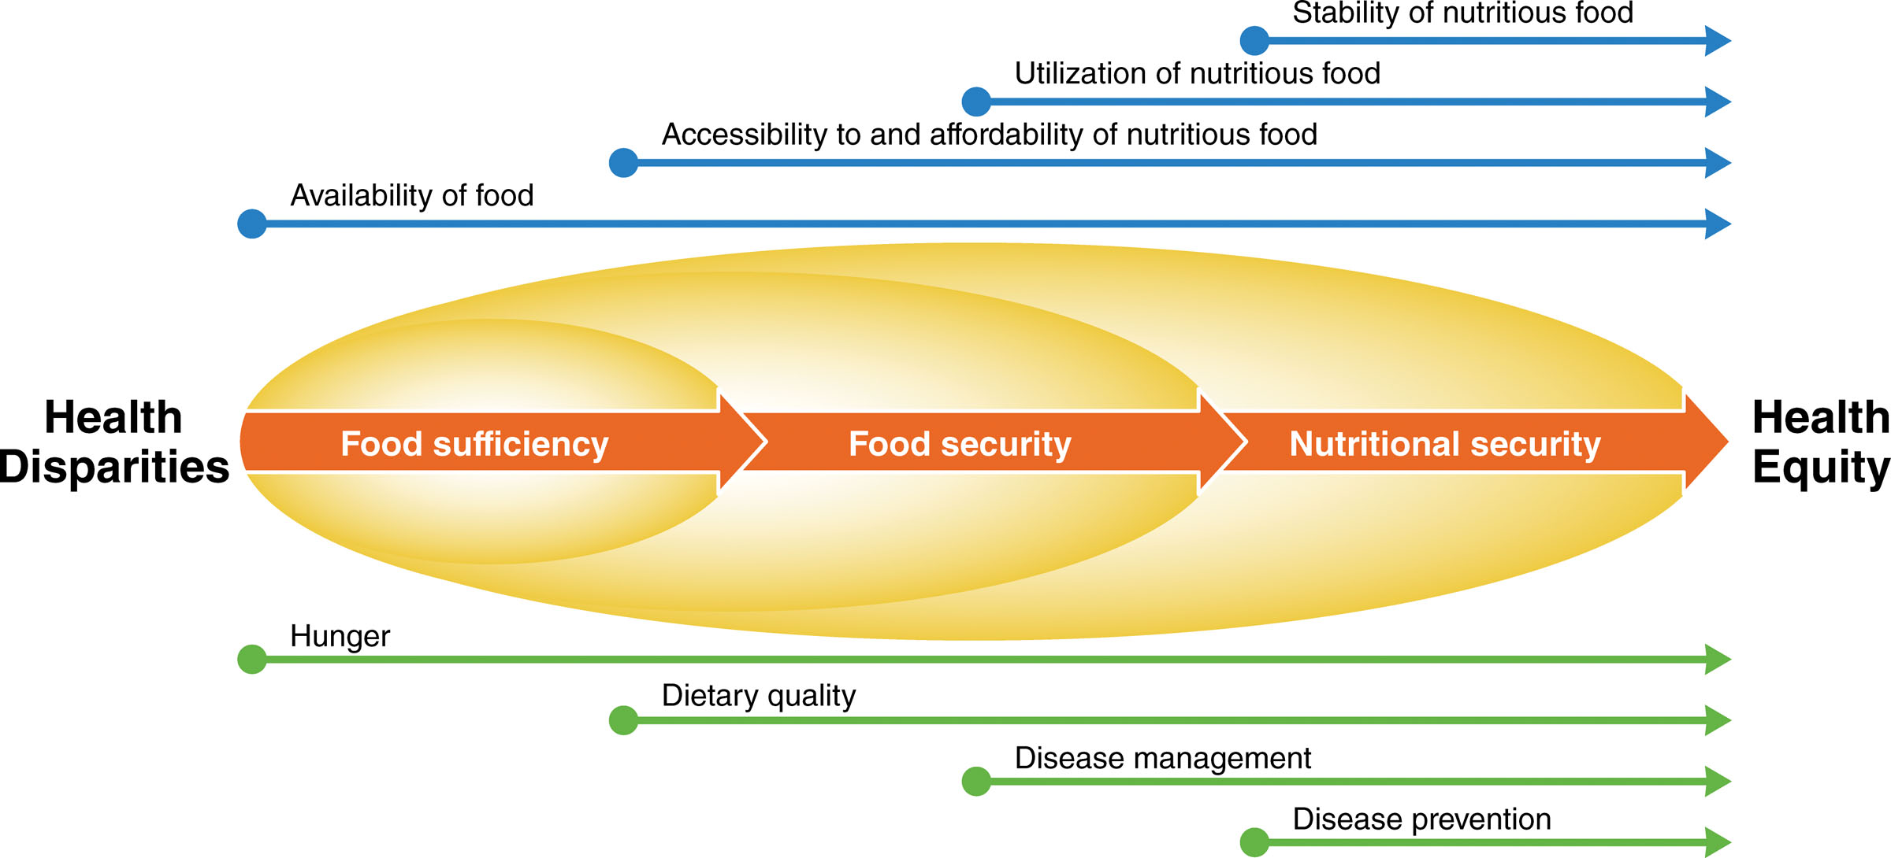
Food Security Influences Nutrition Security and Health Outcomes
Nutrition security influences
Physical health
Mental health
Life expectancy
Maternal health and complications
Child health and development
Sources: Braveman, P. (2014). What are health disparities and health equity? We need to be clear. Public Health Reports®, 129(1_suppl2), 5–8. https://doi.org/10.1177/00333549141291S203; Liu, Y., & Eicher-Miller, H. A. (2021). Food Insecurity and Cardiovascular Disease Risk. Current Atherosclerosis Reports, 23(6), 24. https://doi.org/10.1007/s11883-021-00923-6; Parekh, T., Xue, H., Cheskin, L. J., & Cuellar, A. E. (2022). Food insecurity and housing instability as determinants of cardiovascular health outcomes: A systematic review. Nutrition, Metabolism and Cardiovascular Diseases, 32(7), 1590–1608. https://doi.org/10.1016/j.numecd.2022.03.025; Odoms-Young, A., Brown, A. G. M., Agurs-Collins, T., & Glanz, K. (2024). Food Insecurity, Neighborhood Food Environment, and Health Disparities: State of the Science, Research Gaps and Opportunities. The American Journal of Clinical Nutrition, 119(3), 850–861. https://doi.org/10.1016/j.ajcnut.2023.12.019; Image source: Brandt, E. J., Mozaffarian, D., Leung, C. W., Berkowitz, S. A., & Murthy, V. L. (2023). Figure 1. Moving from food sufficiency to nutrition security in the United States [Chart]. Diet and food and nutrition insecurity and cardiometabolic disease. Circulation Research, 132(12), 1692–1706. https://doi.org/10.1161/CIRCRESAHA.123.322065 (Adapted from Thorndike et al. Illustration credit: Sceyence Studios).
Notes:
This image shows the progression from food sufficiency to food security and nutrition security, a new term for this module.
Similar to food security, the term nutrition security describes the consistent access to a wide range of foods which provide the essential needed nutrients and promote optimal health and well being.
How do food insufficiency and food insecurity influence nutrition security and ultimately, health? Access to nutritious foods — not just food or calories — throughout a person’s life is the foundation of good health. .
And poor nutrition has implications for health across the lifespan. It can affect our physical and mental health and life expectancy. Poor nutrition is a leading cause of heart disease, cardiometabolic disease, cancers and other chronic conditions. The nutritional impacts from food insecurity have negative effects on maternal health during pregnancy. It is associated with an increased risk of depression, gestational diabetes, and other pregnancy complications as well as low birth weight in babies.
In children, it can lead to developmental and learning delays, mental health illnesses like anxiety and depression, and behavioral challenges. Kids who are hungry have a harder time concentrating and learning in school. Over time, this undercuts their chances for academic achievement and economic stability—fueling a cycle that keeps food insecurity persistent in the next generation.
These burdens further contribute to health disparities, disproportionally harming lower-income, less educated, and minority racial and ethnic groups.
Pause here and consider how we can help individuals and communities move from food sufficiency to nutrition security in the work we do.
-----
Graphic
Brandt, E. J., Mozaffarian, D., Leung, C. W., Berkowitz, S. A., & Murthy, V. L. (2023). Diet and Food and Nutrition Insecurity and Cardiometabolic Disease. Circulation Research, 132(12), 1692–1706. https://doi.org/10.1161/CIRCRESAHA.123.322065
Information
Braveman, P. (2014). What are Health Disparities and Health Equity? We Need to Be Clear. Public Health Reports®, 129(1_suppl2), 5–8. https://doi.org/10.1177/00333549141291S203
Liu, Y., & Eicher-Miller, H. A. (2021). Food Insecurity and Cardiovascular Disease Risk. Current Atherosclerosis Reports, 23(6), 24. https://doi.org/10.1007/s11883-021-00923-6
Parekh, T., Xue, H., Cheskin, L. J., & Cuellar, A. E. (2022). Food insecurity and housing instability as determinants of cardiovascular health outcomes: A systematic review. Nutrition, Metabolism and Cardiovascular Diseases, 32(7), 1590–1608. https://doi.org/10.1016/j.numecd.2022.03.025
Odoms-Young, A., Brown, A. G. M., Agurs-Collins, T., & Glanz, K. (2024). Food Insecurity, Neighborhood Food Environment, and Health Disparities: State of the Science, Research Gaps and Opportunities. The American Journal of Clinical Nutrition, 119(3), 850–861. https://doi.org/10.1016/j.ajcnut.2023.12.019

Slide 39
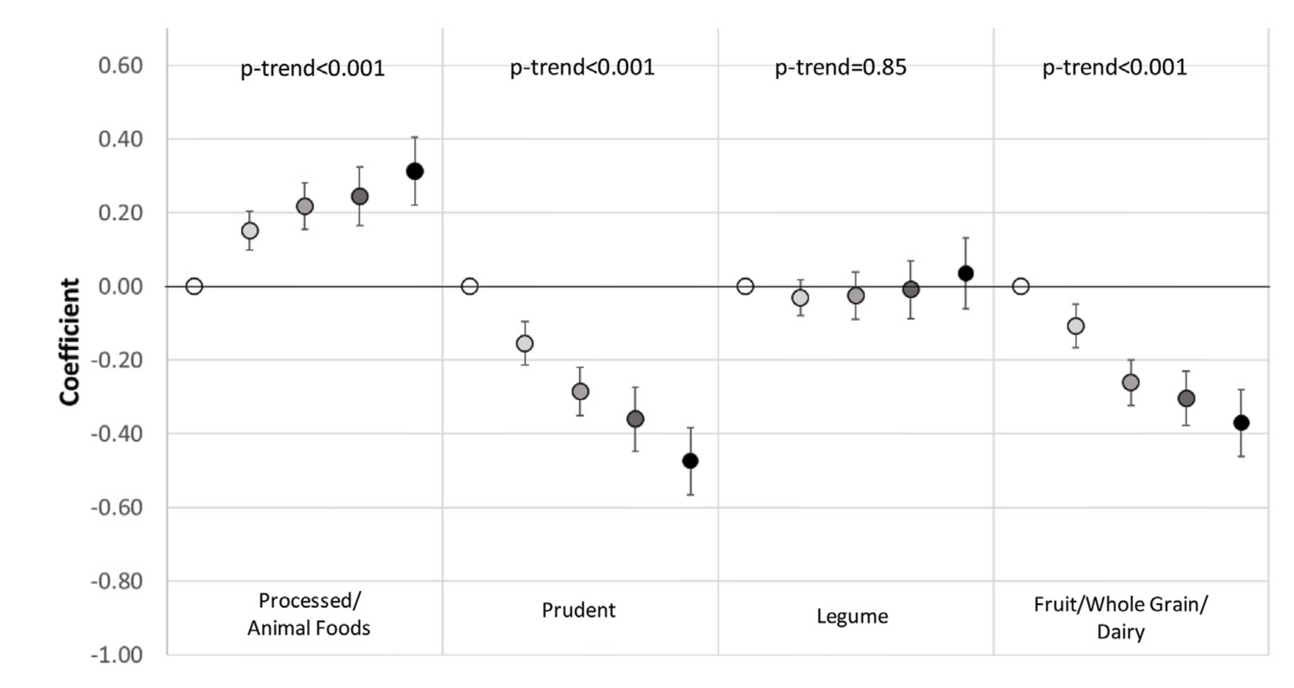
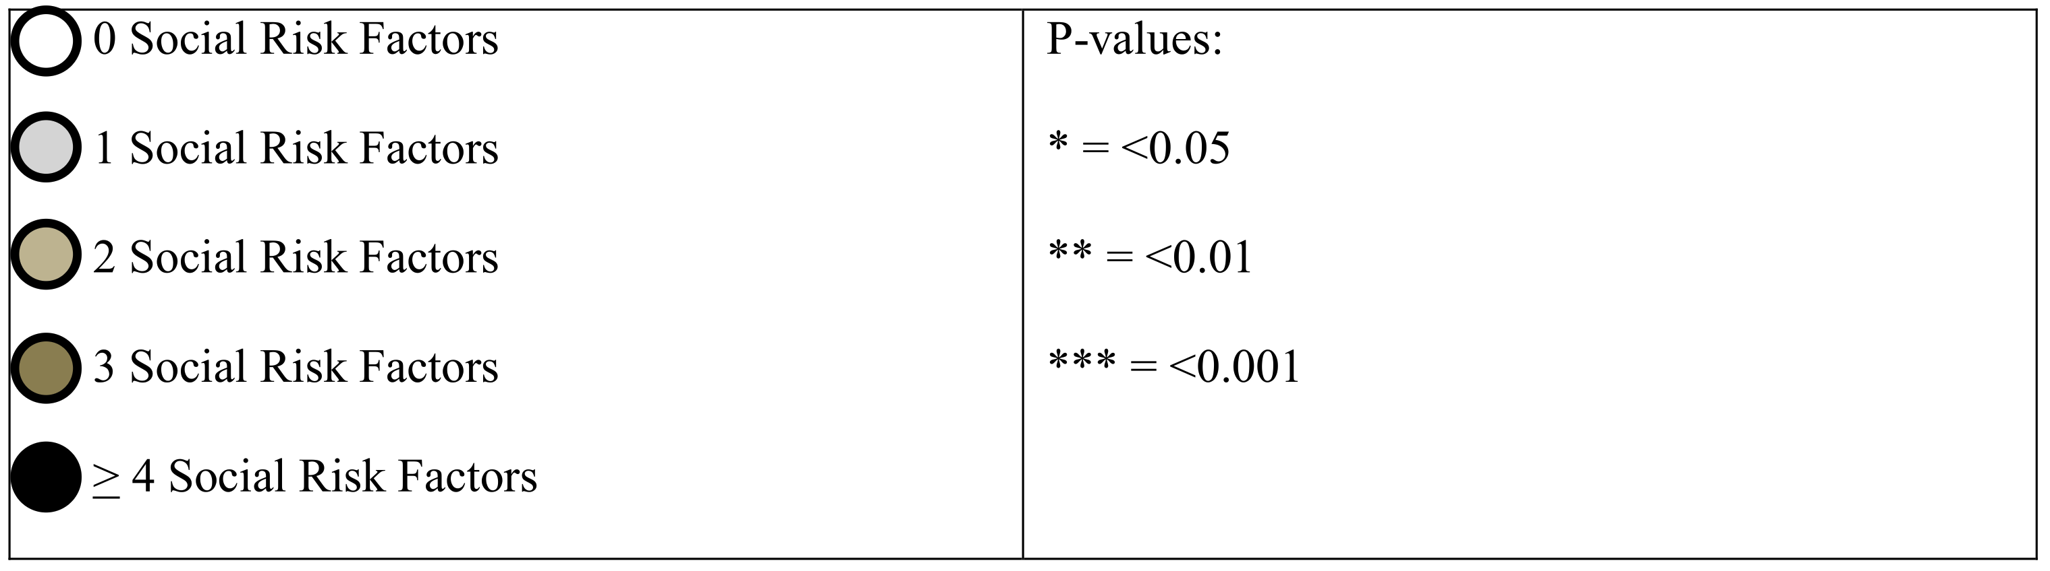
Differences in United States Adult Dietary Patterns by Cardiometabolic Health and Socioeconomic Vulnerability
Image source: Brandt, E. J., Leung, C. W., Chang, T., Ayanian, J. Z., Banerjee, M., Kirch, M., Mozaffarian, D., & Nallamothu, B. K. (2025). Figure 2A. Association of dietary patterns (principal components score) with number of social risk factors for the entire cohort and by race and ethnicity. [Chart]. Differences in United States adult dietary patterns by cardiometabolic health and socioeconomic vulnerability. The Journal of Nutrition, 155(8), 2685–2699. https://doi.org/10.1016/j.tjnut.2025.06.002
Notes:
A 2025 study classified dietary patterns and cardiometabolic risk factors and found that those with higher levels of social risk factors reported less healthy diets and higher rates of diabetes, hypertension, obesity and dyslipidemia. Social risk factors included lower education attainment, single adult households, low food security, under-insured, unemployed, and low access to healthcare.
The processed/animal foods diet pattern was positively associated with diabetes, hypertension and obesity, as well as a higher social risk score, income-eligible SNAP nonparticipation and SNAP participation.
There is a lot more to these findings you can explore in the article. The main takeaway is: A systems perspective is crucial in order to address health and nutrition issues within the broader context of food insecurity and socioeconomic challenges.
-----
Graphic
Brandt, E. J., Leung, C. W., Chang, T., Ayanian, J. Z., Banerjee, M., Kirch, M., Mozaffarian, D., & Nallamothu, B. K. (2025). Differences in United States Adult Dietary Patterns by Cardiometabolic Health and Socioeconomic Vulnerability. The Journal of Nutrition, 155(8), 2685–2699. https://doi.org/10.1016/j.tjnut.2025.06.002

Slide 40
Case Study 1

Slide 41
Section D: How Can RDNs Help Achieve Sustainable, Healthy Food Systems for All?
RDN: Registered Dietitian Nutritionist
Notes:
In this last section, we will share with you how dietitians are uniquely equipped to play a positive role in achieving food systems (and thereby diets) that are not only healthy and more sustainable – but also more equitable, culturally appropriate, and affordable for all.
We will share strategies and examples that will help you translate the concepts from the earlier sections into your practice.

Slide 42

Dietitians Are Key Parts of the Solution
“RDNs frequently encounter the nutritional manifestations of unsustainable practices within the food system”
Dietitians are on the front lines of many of the most crucial problems related to inequity and sustainability in the food system
Inequities in the food system impact food access, hunger, and nutrition-related disease
Dietitians have knowledge and skills to address underlying drivers of inequity
Dietitians are positioned to address these problems at many levels: Individual, household, community, state, regional, national, international
Source: Spiker, M., Reinhardt, S., & Bruening, M. (2020). Academy of Nutrition and Dietetics: Revised 2020 Standards of Professional Performance for Registered Dietitian Nutritionists (Competent, Proficient, and Expert) in Sustainable, Resilient, and Healthy Food and Water Systems. Journal of the Academy of Nutrition and Dietetics, 120(9), 1568-1585.e28. https://doi.org/10.1016/j.jand.2020.05.010; image is from Microsoft Stock Images.
Notes:
The 2020 report of the Academy of Nutrition and Dietetics outlined how Dietitians are directly engaged in the sustainability and equity challenges that are ubiquitous in food systems, which go hand in hand. Dietitians are on the front lines of witnessing and addressing some of the most crucial problems related to inequity in society.
Inequities in the food system impact food access, hunger, and nutrition-related disease.
Dietitians have the knowledge and skills….they are positioned to address these problems at individual, household, community, state, regional, national, and international levels. They can do this through their work in research, advocacy, community, institutions and more
The authors write, “As frontline workers throughout the food system, RDNs frequently encounter the nutritional manifestations of unsustainable practices within the food system. These may present as disparities in diet related disease, healthy food access, health care, and other community resources and services in client populations.” (Spiker 2020)
-----
Quote
Spiker, M., Reinhardt, S., & Bruening, M. (2020). Academy of Nutrition and Dietetics: Revised 2020 Standards of Professional Performance for Registered Dietitian Nutritionists (Competent, Proficient, and Expert) in Sustainable, Resilient, and Healthy Food and Water Systems. Journal of the Academy of Nutrition and Dietetics, 120(9), 1568-1585.e28. https://doi.org/10.1016/j.jand.2020.05.010

Slide 43
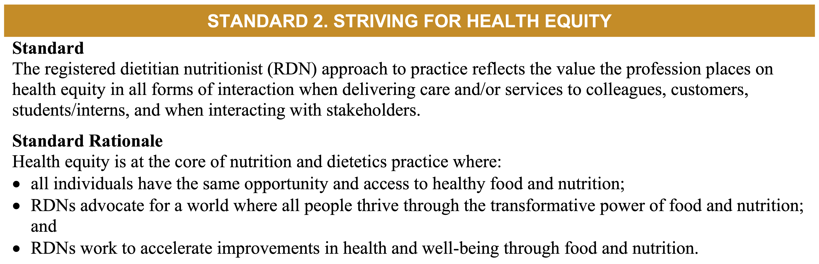
Striving for Health Equity Is Core to Our Work
Page 33 in Revised 2024 Scope and Standards of Practice for the Registered Dietitian Nutritionist report
Source: CDR. (2024). Revised 2024 Scope and Standards of Practice for the Registered Dietitian Nutritionist. Page 33. Commission on Dietetic Registration Scope and Standards of Practice Task Force. https://www.cdrnet.org/vault/2459/web/Scope%20Standards%20of%20Practice%202024%20RDN_FINAL.pdf
Notes:
The 2024 Standards of practice from the Commission on Dietetic Registration for RDN’s state that health equity is core to the work of dietitians in every area of practice and reflects the value the profession places on health equity in all forms of interaction when delivering care and/or services to colleagues, customers, students/interns, and when interacting with stakeholders
The image on this slide is a screenshot from the scope and standards report.
Read the standards on the slide.
-----
Information
CDR. (2024). Revised 2024 Scope and Standards of Practice for the Registered Dietitian Nutritionist (p. 58). Commission on Dietetic Registration Scope and Standards of Practice Task Force. https://www.cdrnet.org/vault/2459/web/Scope%20Standards%20of%20Practice%202024%20RDN_FINAL.pdf

Slide 44
Multilevel Approaches for RDNs to Promote Equity—1
Individual care
Health system
Government nutrition programs
Food environment
Population-level and food policy
Notes:
Dietitians interact with and influence nutrition and health at different scales and levels. These levels include
Individual care
Health systems
Government nutrition programs
Food environments
Population-level policies, including food policies

Slide 45
Multilevel Approaches for RDNs to Promote Equity—2
Hospital/ Clinical
Wellness
Private practice
Education
EQUITY
Community health
Training institutes
Food service
Long-term care
Food industry
Notes:
No matter the type or location of nutrition care dietitians are engaged in - from the hospital to schools to food service and food industry.- equity-based approaches can and should be centered.
Consider these sectors and where you might work as we go through the following practice standards and examples.

Slide 46
Standards of Practice Toward Health Equity
Addresses social determinants of health, nutrition security, food insecurity, and malnutrition
Promotes sustainability practices (for example, food systems, food/ingredient/supply choices)
Maintains awareness of public health and community nutrition/population health
Recognizes global food and nutrition
Source: CDR. (2024). Revised 2024 Scope and Standards of Practice for the Registered Dietitian Nutritionist. Commission on Dietetic Registration Scope and Standards of Practice Task Force. https://www.cdrnet.org/vault/2459/web/Scope%20Standards%20of%20Practice%202024%20RDN_FINAL.pdf
Notes:
The 2024 Standards of practice from the Commission on Dietetic Registration for RDN’s for health equity set forward these four standards:
READ
In the following slides, we will go through each of these four standard and suggest practical ways and examples we can strive for equity in our work and communities. The list will be no where close to exhaustive, but we hope to spark discussion and exploration as you enter your careers as dietitians.
-----
Information
CDR. (2024). Revised 2024 Scope and Standards of Practice for the Registered Dietitian Nutritionist (p. 58). Commission on Dietetic Registration Scope and Standards of Practice Task Force. https://www.cdrnet.org/vault/2459/web/Scope%20Standards%20of%20Practice%202024%20RDN_FINAL.pdf

Slide 47
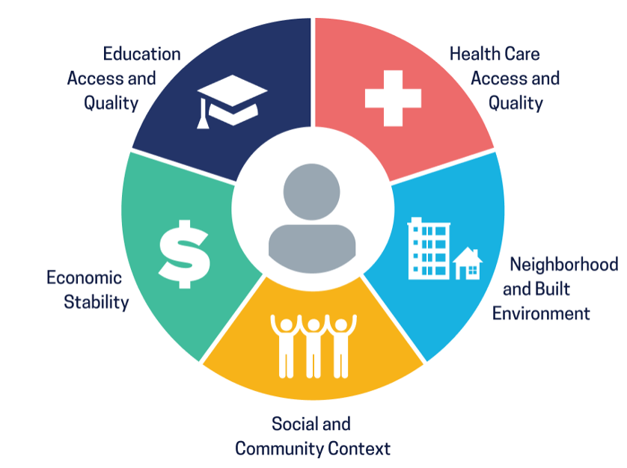
Standard 1: Identify and Address Social Determinants of Health
Explore social determinants of specific nutrition and food issues
Seek community and diverse voices in planning and programs
Practice critical inquiry
Develop tools and materials that reflect social determinants of health
Image source: US DHHS OASH. (n.d.). Healthy People 2030—Social Determinants of Health. OASH Office of Disease Prevention and Health Promotion. Retrieved June 10, 2025, from https://odphp.health.gov/healthypeople/priority-areas/social-determinants-health
Notes:
Addressing Social Determinants of Health which we described earlier in this module can be done by entering patient interactions with a wider perspective and considering questions you can ask or observations you can make to understand more.
First, simply consider how do the social determinants of health – education, health care, neighborhoods, communities and economics, shown on the left, impact the nutrition issue and situation you are encountering?
Finding an appropriate screener or questionnaire to guide you can be very helpful, especially as you start out.
Seeking input from the community and other diverse voices will help expand and broaden your perspective and approach to solutions.
It also important to consider social determinants of health when you select or develop resources, such as brochures or education materials.
Using critical inquiry involves exploration of the personal, social and environmental factors that impact society or a situation, thus challenging standard assumptions. This approach will guide you toward more effective and accepted solutions.
Likewise, any interventions should also consider the impact on food sovereignty and social justice and should move toward reducing ongoing health disparities. We’ll talk about this more in the next slide.
Finally, even when you are unable to change the external factors consider services or recommendations you can make to alleviate or reduce the impact of societal issues on health and nutrition.
-----
Graphic
US DHHS OASH. (n.d.). Healthy People 2030—Social Determinants of Health. OASH Office of Disease Prevention and Health Promotion. Retrieved June 10, 2025, from https://odphp.health.gov/healthypeople/priority-areas/social-determinants-health

Slide 48
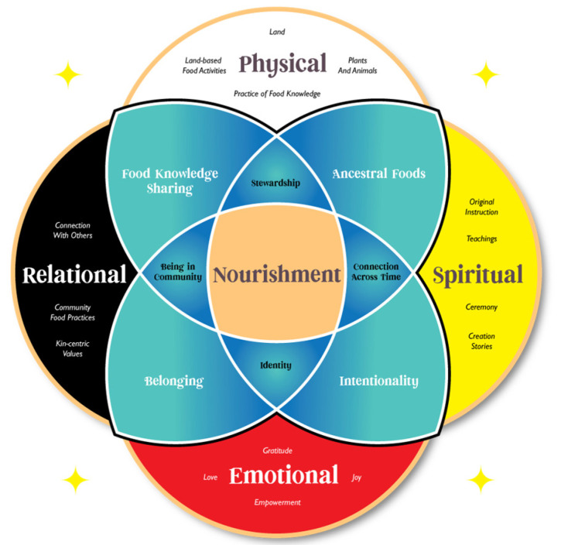
Example: The Indigenous Nourishment Scales
Encompasses multiple dimensions of nourishment
Framework addresses bias in nutrition measurement
Grounds health measurement efforts directly in community perspectives and worldviews
Image source: Maudrie, T. L., Caulfield, L. E., Nguyen, C. J., Walls, M. L., Haroz, E. E., Moore, L. R., Dionne-Thunder, R. G., Vital, J., LaFloe, B., Norris, A., Dionne, V., Pain On Hip, V., Dickerson, J., Hawk Lessard, K., Stately, A. L., Blue Bird Jernigan, V., & O’Keefe, V. M. (2024). Figure 1. Indigenous Nourishment Model [Chart]. In: Community-engaged development of strengths-based nutrition measures: the indigenous nourishment scales. International Journal of Environmental Research and Public Health, 21(11), 1496. https://doi.org/10.3390/ijerph21111496
Notes:
Food and overall nutrition are deeply rooted in many cultures, with food and meals often serving as a vehicle for cultural values, teachings, intergenerational knowledge, and family and community bonding. Understanding the cultural and contextual factors impacting approaches to eating is vital when addressing social determinants of health and using critical inquiry.
The Indigenous Nourishment Scale framework is one example of how you can consider a broader lens on nutrition and health. Developed to be particularly applicable to American Indian and Alaskan Native communities, it consists of four main domains of nourishment: physical, spiritual, emotional, and relational, as well as intersecting components tied to identity, relationships and other cultural factors. It emphasizes the holistic nature of nourishment and the importance of considering multiple dimensions of wellbeing in nutrition research and practice.
This framework helps to address the biases that are common in typical dietary measurement that focus on nutrient intakes or diet patterns and can overlook important cultural and contextual factors.
This model and others like it can help nutrition-centered research and practice efforts to incorporate community perspectives, cultures and worldviews.
-----
Graphic
Maudrie, T. L., Caulfield, L. E., Nguyen, C. J., Walls, M. L., Haroz, E. E., Moore, L. R., Dionne-Thunder, R. G., Vital, J., LaFloe, B., Norris, A., Dionne, V., Pain On Hip, V., Dickerson, J., Hawk Lessard, K., Stately, A. L., Blue Bird Jernigan, V., & O’Keefe, V. M. (2024). Community-Engaged Development of Strengths-Based Nutrition Measures: The Indigenous Nourishment Scales. International Journal of Environmental Research and Public Health, 21(11), 1496. https://doi.org/10.3390/ijerph21111496

Slide 49

It Starts With Us!
Examine your own approaches to be more equity-centered:
Explore your own personal biases, worldviews
When working with clients:
Practice cultural humility
Ask questions to humbly explore the what, why, how
Image source: Microsoft Stock Images.
Notes:
It starts with us.
One of the very first steps in working toward a healthy food system for all is personal reflection. Examine your own approaches, attitudes and beliefs, your own worldviews and cultural context.
Bring more awareness and cultural humility when working with a client. Ask more questions.
There are several resources listed at the end of this module to help you do this. It’s a process.

Slide 50
Discussion 1: Food Justice and Sovereignty
How might nutrition interventions impact these broader food equity matters?
Food justice
Food sovereignty
A holistic and structural view of the food system that sees healthy food as a human right and addresses structural barriers to that right …
(FoodPrint)
The right of peoples to healthy and culturally appropriate food produced through ecologically sound and sustainable methods and their right to define their own food and agriculture system
(Declaration of Nyéléni)
Sources: FoodPrint. (2024). FoodPrint Issue: Food Justice. https://foodprint.org/issues/food-justice/; USFSA. (2025). Food Sovereignty. U.S. Food Sovereignty Alliance. https://usfoodsovereigntyalliance.org/what-is-food-sovereignty/
Notes:
Before we move onto the next standard, let’s pause and consider how we might address food justice and food sovereignty in interventions that aim to promote good nutrition and lessen health disparities?
Consider these two definitions and discuss ways in which RDN’s can impact these areas in both positive and negative ways.
“Food justice is a holistic and structural view of the food system that sees healthy food as a human right and addresses structural barriers to that right . . . . Food justice efforts (which are generally led by indigenous peoples and people of color) work not only for access to healthy food, but for an end to the structural inequities that lead to unequal health outcomes.”
“Food sovereignty is the right of peoples to healthy and culturally appropriate food produced through ecologically sound and sustainable methods, and their right to define their own food and agriculture systems. It puts the aspirations and needs of those who produce, distribute and consume food at the heart of food systems and policies rather than the demands of markets and corporations.”
Core components include
1.Focuses on the right to food for everyone
2.Values food producers and providers
3.Localizes food systems and links producers and consumers
4.Puts control locally, with farmers and consumers
5.Strengthens and shares local knowledge and skills
6.Works with nature to build resilience
In other words, Food Sovereignty is a food system in which the people who produce, distribute, and consume food also control the mechanisms and policies of food production and distribution.
For a deeper dive into food sovereignty in action, La Via Campesina founded and is a leader in the food sovereignty movement. It’s worth exploring their work and we have a link to their website in the resources.
-----
Definitions
FoodPrint. (2024). FoodPrint Issue: Food Justice. FoodPrint. https://foodprint.org/issues/food-justice/
USFSA. (2025). Food Sovereignty. U.S. Food Sovereignty Alliance. https://usfoodsovereigntyalliance.org/what-is-food-sovereignty/

Slide 51
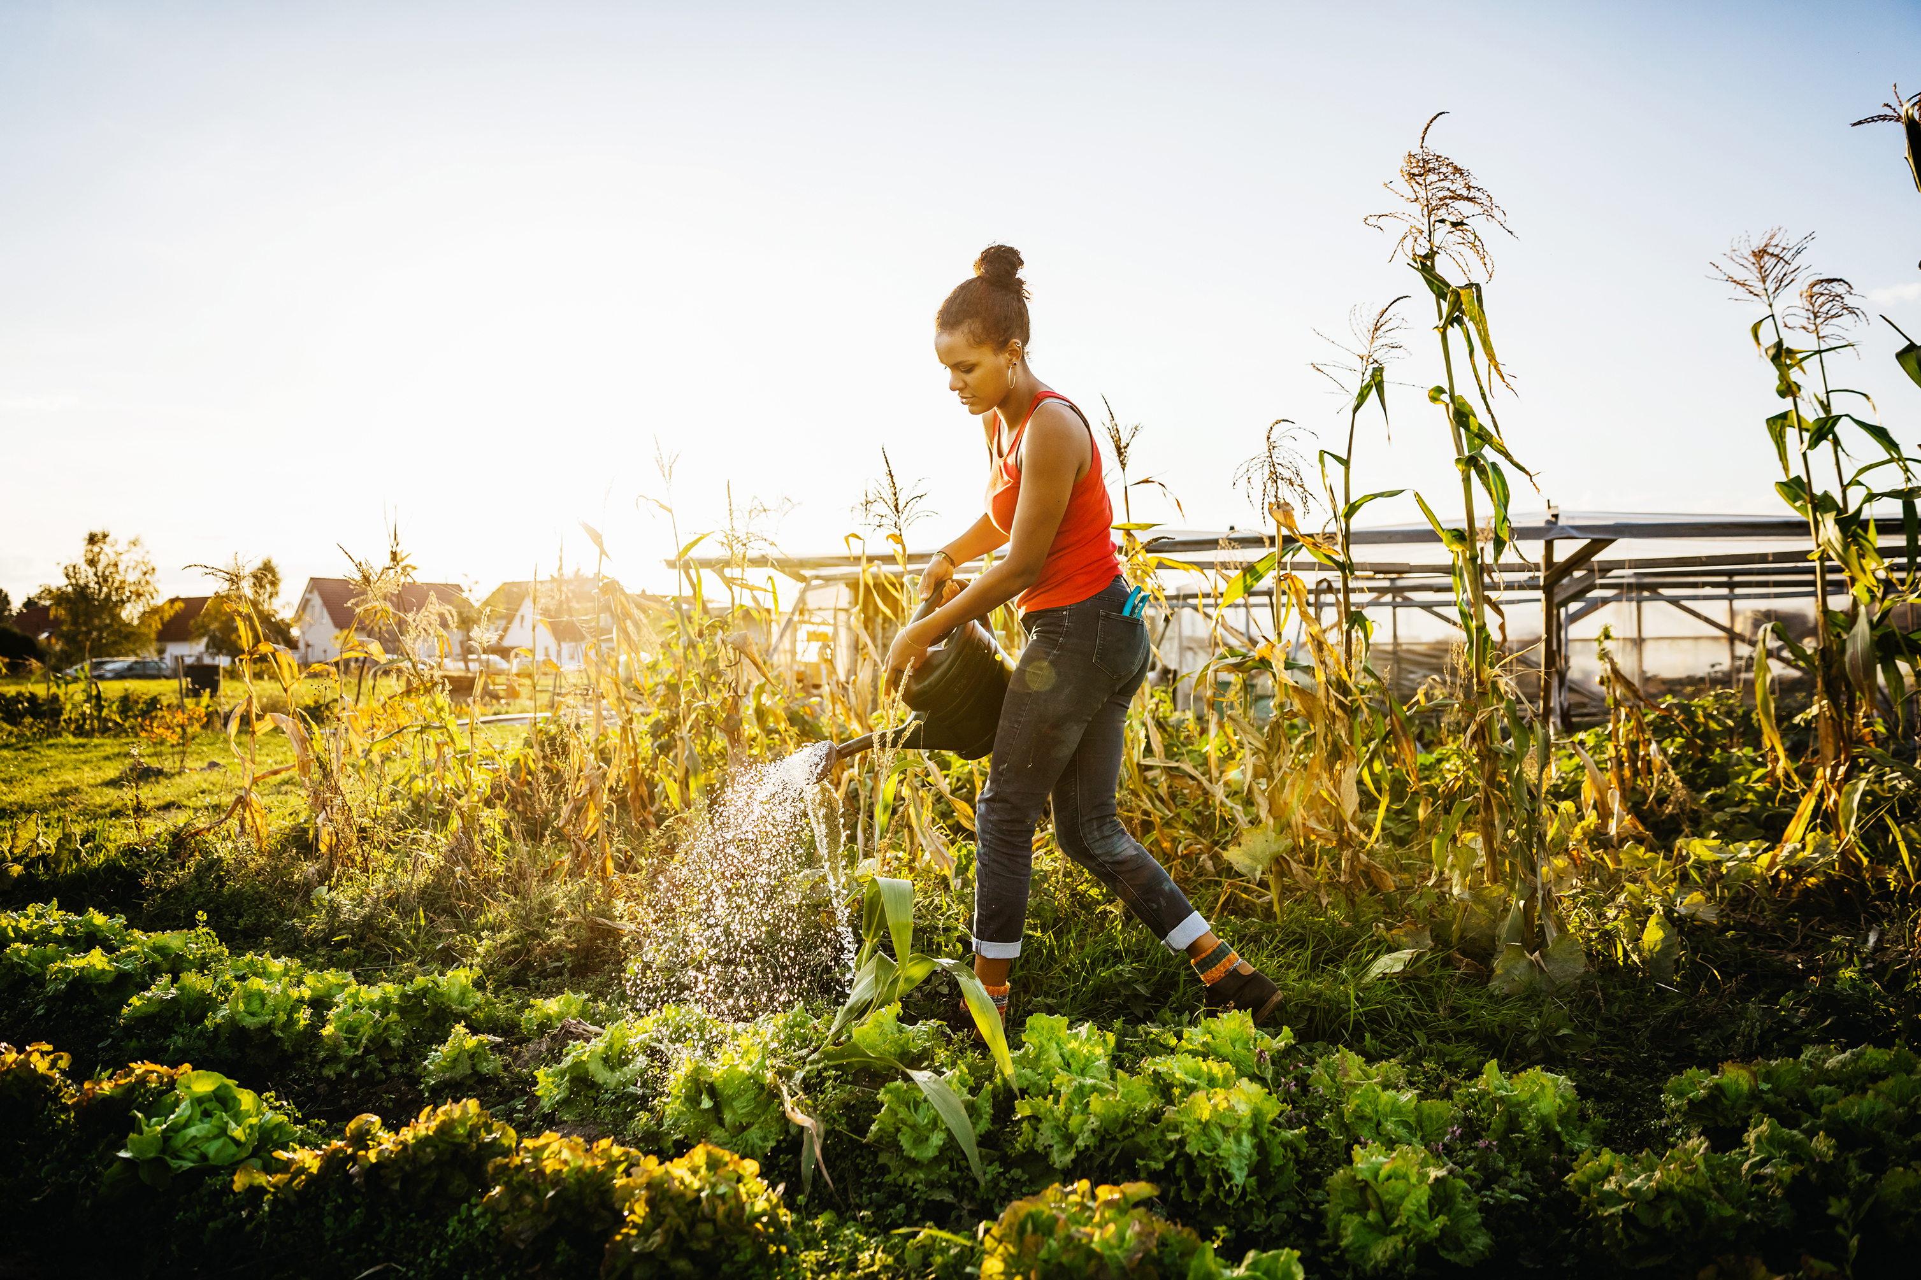

Standard 2: Promote Sustainable Practices and Healthy Food for All
Encourage plant-centric food choices
Guide practices to reduce wasted food and packaging
Support local food systems in your community
Community and school gardens
Community-supported agriculture (CSA) programs and local food outlets
Farm-to-school programs
Center food system workers (often left out of the conversation) in planning, practice, and political advocacy
Image source: Microsoft Stock Images.
Notes:
The second area is promoting access to sustainable, healthy food for all – considering those who produce food to those who consume it.
Shifting what people eat to center more sustainable plant-based foods supports a more sustainable food system overall. Sustainability also means reducing wasted food and packaging.
Support local food systems. Smaller, community-based farmers, grocers and restaurants often strive for more sustainable practices and tend to be more committed to a thriving community. Explore opportunities to support community and school gardens, community supported agriculture and local food outlets and promote farm-to-school programs.
Finally, there are many opportunities to engage food system workers in actions and solutions. They have hands on experience in the food system but are often left out of the conversation.

Slide 52

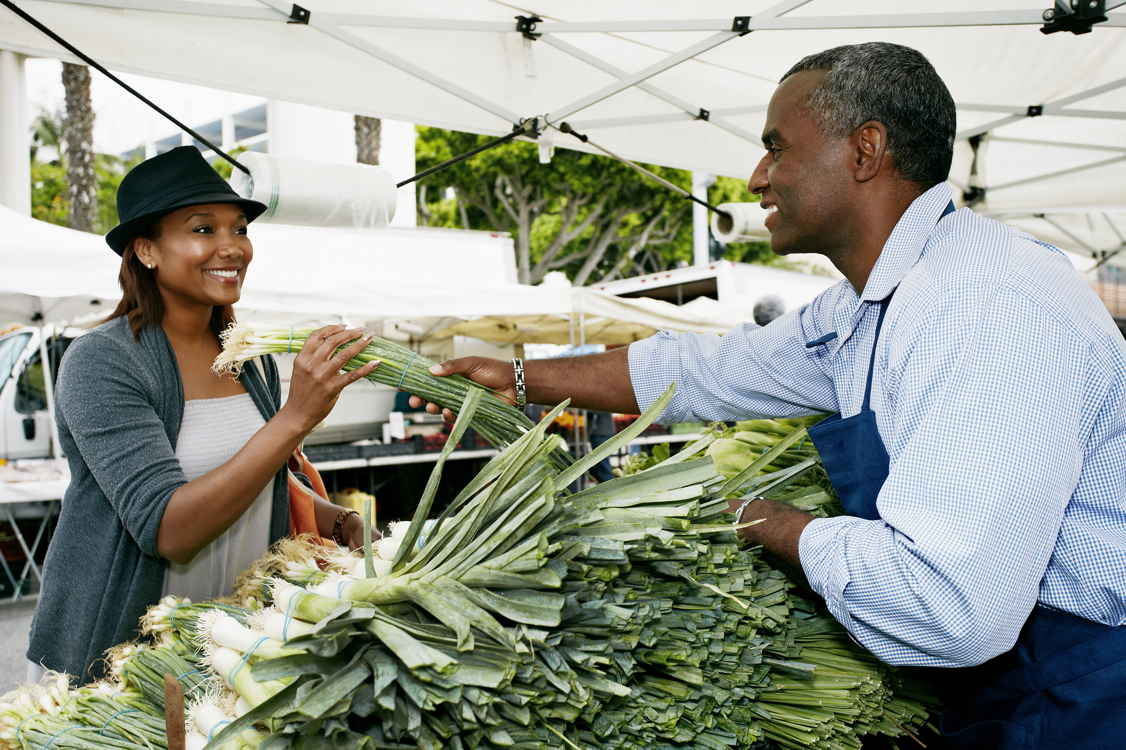
Healthier Food Environments for All
Explore food environments, food access, and affordability in your area
Promote programs and businesses that support:
Healthy options in small local stores
Reduced costs of healthy foods
Fruit and vegetable programs and Supplemental Nutrition Assistance Program (SNAP) incentives
Affordable, Healthy, Tasty, Sustainable
Image source: Microsoft Stock Images.
Notes:
Healthy, sustainable food choices are only possible with supportive food environments. Food programs and interventions should be well thought through to ensure food is affordable, health, sustainable and tasty.
Some examples of interventions include nutrition incentive programs to facilitate healthy food purchases: produce prescriptions, medically tailored meals, grocery food packages and delivery services, on-site pantries, and creating stronger linkages between health care, food assistance programs, and the charitable food system.
One of the largest national nutrition investments is the Gus Schumacher Nutrition Incentive Program (GusNIP), a USDA-funded program with the goal to support health and reduce food insecurity by promoting the purchase and consumption of fruits and vegetables among low-income consumers.
SNAP healthy incentive programs encourage people participating in SNAP to purchase healthy foods by providing a coupon, discount, gift card, bonus food item or extra funds.
Finally, there may be local stores and outlets in your community that promote or incentivize healthy options.

Slide 53
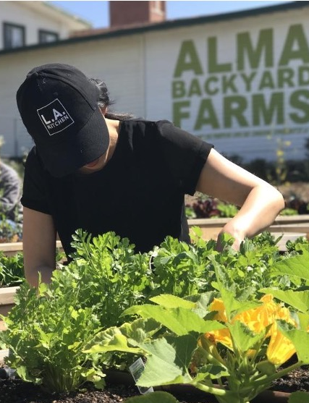
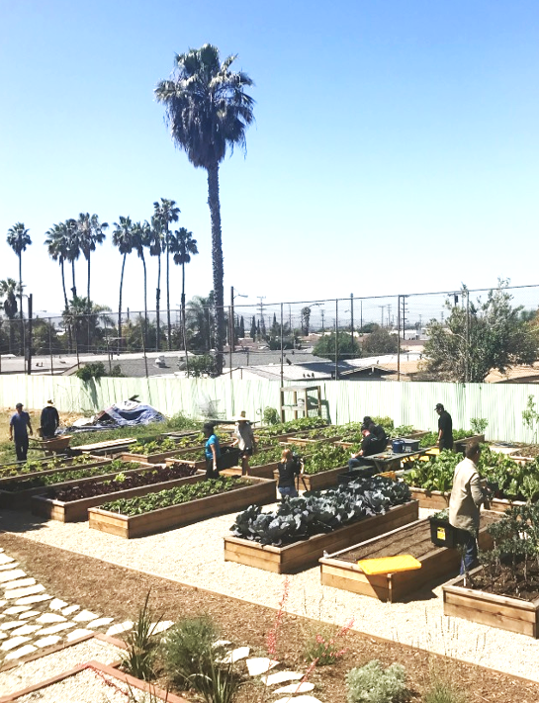
Example: ALMA Backyard Farms
ALMA creates opportunities for the previously incarcerated to become agents of health, safety, and community
Rooted in restorative justice and environmental stewardship, ALMA was started in 2013 to reclaim lives, repurpose land, and reimagine community
Source: ALMA Backyard Farms. (n.d.). Feed the Soil, Feed the Soul. Retrieved July 31, 2025, from https://almabackyardfarms.com; Photos are from Sherene Chou, Food+Planet.
Notes:
One example is Alma Backyard Farms in the city of Los Angeles.
Alma Backyard Farms was inspired by the voices and ideas shared by juvenile offenders and prisoners eager to transform their lives and communities by "giving back" to the communities they "took from" and were taken away from. For most people experiencing incarceration, there are few opportunities to see and interact with nature and few opportunities to provide nurture to others. Yet few are given the opportunities to learn skills and make that possible.
ALMA has listened to the formerly incarcerated and been inspired by their willingness to reorient their lives as caretakers of community. Recognizing that Los Angeles is a place where no life or space is wasted, ALMA creates multiple opportunities for women and men who were incarcerated to give back to the health and safety of communities by growing food in and for these communities.
Rooted in restorative justice and environmental stewardship, ALMA started in 2013 to implement this project of reclaiming lives, repurposing land and reimagining community. ALMA proposes real solutions to the challenges of California's overcrowded prisons and food injustice in low-income neighborhoods. Recognizing that no lives or land is to be wasted, ALMA creates opportunities for the previously incarcerated to become agents of health, safety and community.
How can RDNs be involved? As an RDN, you can learn about similar programs in your area and make the connections for your patients or institution. You can also provide education and demos to help participants utilize the food grown and make delicious, healthy meals. An RDN can also provide technical assistance to the program to apply a nutrition focused lens.
Can you think of other ways to be involved?
-----
Information
ALMA Backyard Farms. (n.d.). Feed the Soil, Feed the Soul. ALMA Backyard Farms. Retrieved July 31, 2025, from https://almabackyardfarms.com

Slide 54
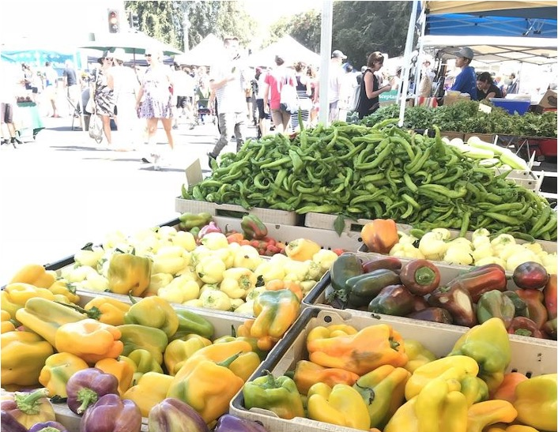
Example: Farm-to-School Programs
USDA estimates that schools spent nearly $800 million on local food
Buying power of farm-to-school could result in an additional $350 million for family farmers— a full economic impact of $1 billion
Each dollar invested in farm-to-school programs stimulates an additional $0.60–$2.16 of local economic activity
Sources: USDA. (n.d.). Farm to School Census. Retrieved June 10, 2025, from https://farmtoschoolcensus.fns.usda.gov/; National Farm to School Network. (2020). The Benefits of Farm to School. https://cdn.prod.website-files.com/5c469df2395cd53c3d913b2d/611027419232d281ad2f51ff_BenefitsFactSheet.pdf; photo is from Sherene Chou, Food+Planet.
Notes:
Another example is Farm to school programs, which support local farmers and economies, while ensuring students have access to nutritious vegetables and fruit.
“Farm to School” programs bring locally produced foods into school cafeterias; complemented by hands-on learning activities for students such as farm visits, school gardening and the integration of food-related education into the standards-based classroom curriculum. Far​m to school includes of all types of producers and food businesses including farmers and waterman as well as food processors, manufacturers, and distributor.
Dietitians can advocate for more of these programs and help build linkages with students and farms in their own organizations.
READ
-----
Data
USDA Farm to School Census. (n.d.). Farm to School Census. USDA Farm to School Census. Retrieved June 10, 2025, from https://farmtoschoolcensus.fns.usda.gov/
National Farm to School Network. (2020). The Benefits of Farm to School. National Farm to School Network. https://cdn.prod.website-files.com/5c469df2395cd53c3d913b2d/611027419232d281ad2f51ff_BenefitsFactSheet.pdf

Slide 55
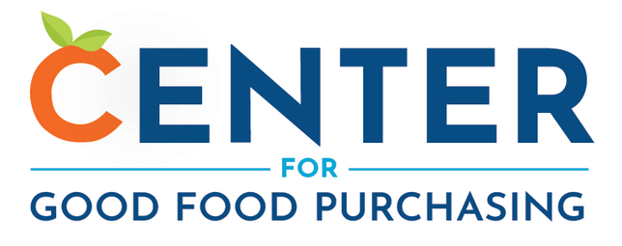
Example: The Good Food Purchasing Program
Uses the power of procurement to create a transparent and equitable food system that prioritizes the health and well-being of people, animals, and the environment
Provides a framework that encourages large institutions to direct their buying power toward six core values
Equity, accountability, transparency
Local economies
Environmental sustainability
Valued workforce
Animal welfare
Community health and nutrition
Source: Bronsing-Lazalde, C. (2025). The Good Food Purchasing Values. Center for Good Food Purchasing. https://goodfoodpurchasing.org/good-food-values/
Notes:
As an RDN, you can explore whether your municipality or institution aligns with the Good Food Purchasing program, which uses the power of procurement to create a transparent and equitable food system that prioritizes the health and well-being of people, animals, and the environment.
The GFPP provides a framework and guidelines that encourages large institutions to direct their buying power toward five core values: local economies, environmental sustainability, a valued workforce, good nutrition and animal welfare, and the overarching principles of equity, accountability, and transparency.
-----
Information
Bronsing-Lazalde, C. (2025). The Good Food Purchasing Values. Center for Good Food Purchasing. https://goodfoodpurchasing.org/good-food-values/

Slide 56

Standard 3: Maintain (and Build) Awareness of Public Health, Community Nutrition, and Population Health
Advocate for population-level programs and policies
Collaborate with stakeholders and community leaders
Train fellow health and food professionals to recognize social determinants, food insecurity, and food system inequities
Sources: Mozaffarian, D. (2023). Measuring And Addressing Nutrition Security To Achieve Health And Health Equity (Health Policy Brief | Culture of Health). Health Affairs. https://www.healthaffairs.org/do/10.1377/hpb20230216.926558/full/; Photo is from Microsoft Stock Images.
Notes:
Raising awareness about how public health and nutrition intersect with equity is essential across diverse audiences and disciplines. Addressing these complex challenges requires coordinated, multilevel, and multisectoral strategies. Taking a systems-based approach can help inform both effective actions and sustainable solutions.
Population-level policies and programs can significantly enhance nutrition security by shaping broader social, economic, and environmental conditions. Examples include implementing strong nutrition standards for food procurement in settings such as workplaces, schools, and early childhood centers; introducing labeling requirements and nutritional guidelines in restaurants and retail stores to inform consumers and encourage healthier menus. These policies can also involve offering tax credits and incentives to increase access to healthy foods, fostering innovation in local and regional food systems, and using taxes on sugary drinks or ultra-processed foods to both discourage consumption and fund nutrition programs for underserved populations. While such strategies should prioritize reaching vulnerable and at-risk groups to help reduce health disparities, broad-based, population-wide initiatives remain essential, as poor diet quality and nutrition insecurity extend beyond low-income or food-insecure households.
For dietitians and nutrition professionals, collaboration with community leaders and stakeholders and across sectors is crucial. Within healthcare settings, dietitians play a vital role in educating other health professionals about nutrition and health equity, while also supporting patients and communities in understanding and addressing these issues.
-----
Information
Mozaffarian, D. (2023). Measuring And Addressing Nutrition Security To Achieve Health And Health Equity (Health Policy Brief | Culture of Health). Health Affairs. https://www.healthaffairs.org/do/10.1377/hpb20230216.926558/full/

Slide 57
Advocate for Equity-Focused Food Policies
Federal food policy
Women, Infants, and Children (WIC)
SNAP
Child and Adult Care Food Program (CACFP )
Nutrition programs (state and federal)
Farmers market nutrition program
School nutrition programs
SNAP education
Municipal food policy and programs
Local food policy councils
Good Food cities (C40)
Institution
Local
State
Federal
Source: Odoms-Young, A., Brown, A. G. M., Agurs-Collins, T., & Glanz, K. (2024). Food insecurity, neighborhood food environment, and health disparities: state of the science, research gaps and opportunities. The American Journal of Clinical Nutrition, 119(3), 850–861. https://doi.org/10.1016/j.ajcnut.2023.12.019
Notes:
Policy is a hugely important lever of change. This is generally where we try to affect broad structural, society-wide changes – the root causes – the influences and external drivers. But good policy can also target the food industry, and food environments in ways that shape consumer demand. Food policy describes the set of laws and regulations that inform how, why, and when food is produced, transported, distributed, consumed and disposed of.
Even if we are not policy makers, RDN’s have an important role advocating for policies that support an equitable, healthy and sustainable food system. Consider different levels of policy and where you might have the greatest influence.
Nutrition programs such as SNAP and WIC are funded at the federal level, but many federal laws and regulations are directly applicable to local food systems.
There are also several federally created programs administered at the state level, such as The Farmers’ Market Nutrition Programs and the School Nutrition Programs.
However, most regulation takes place at the state or local level, or a combination thereof.
------
Information
Odoms-Young, A., Brown, A. G. M., Agurs-Collins, T., & Glanz, K. (2024). Food Insecurity, Neighborhood Food Environment, and Health Disparities: State of the Science, Research Gaps and Opportunities. The American Journal of Clinical Nutrition, 119(3), 850–861. https://doi.org/10.1016/j.ajcnut.2023.12.019

Slide 58
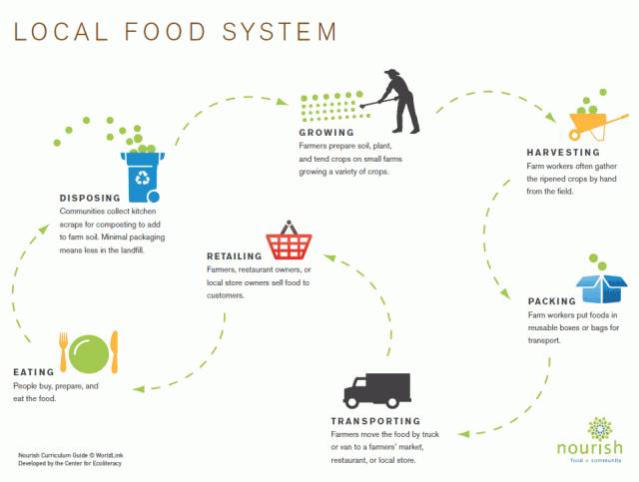
Local Food Policy in Action
Source: Nourish. (n.d.). Food System Tools. Nourish. Retrieved May 27, 2025, from https://www.nourishlife.org/teach/food-system-tools/
Notes:
Often the best (and most impactful) place to start is the local level.
As we learned last slide, food policy describes the set of laws and regulations that inform how, why, and when food is produced, transported, distributed, consumed and disposed of. Policy improves the environment in which programs operate, incentivize/rewards good behavior, penalizes negative behavior
Local food policy works across the local food system from growing, to buying to preparing and eating and even disposing. We often have a lot more influence and impact at the local level.
Local food policy councils represent multiple stakeholders and that are either sanctioned by a government body or exist independently of government, and address food-related issues and needs within a city, county, state, tribal, multi-county or other designated region.”
They can take various forms and depend largely upon the needs of the community they intend to serve. Many FPCs address concerns about hunger, accessibility of food to urban residents, availability of local food, marketing of local food, farmland preservation, food security, and nutrition. FPCs are comprised of individuals who represent a cross-section of interests relating to the food system. This can include farmers, consumer groups, retailers, restaurants, faith groups, anti-hunger organizations, academia, food processors, and state governmental entities.
RDN’s can impact policy at many different points of the local food system. Can you think of some?
-----
Graphic
Nourish. (n.d.). Food System Tools. Nourish. Retrieved May 27, 2025, from https://www.nourishlife.org/teach/food-system-tools/

Slide 59
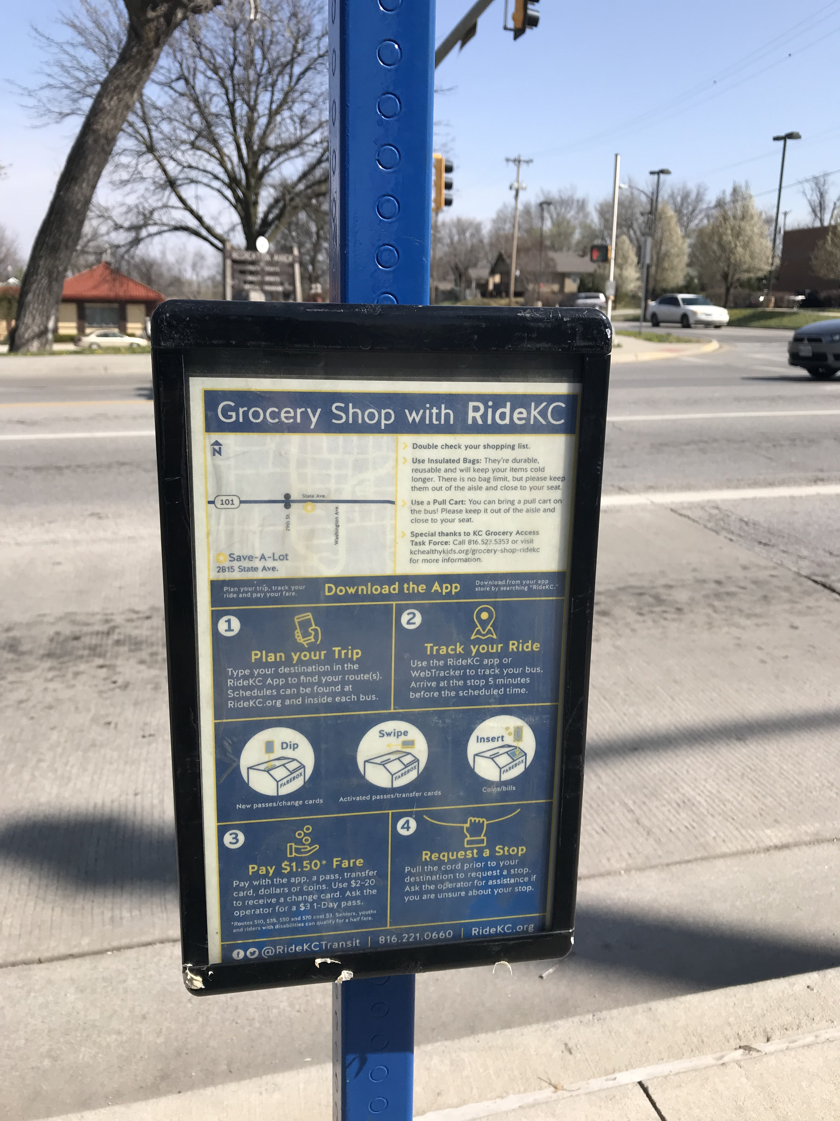
Example: The Greater Kansas City Food Policy Coalition—1
Convened a Grocery Access Task Force of about 30 experts representing government, public health, retail, civic, and community and economic development organizations
Explored barriers to grocery store development in underserved neighborhoods
Evaluated six bus stops near grocery stores
Image source: Center for a Livable Future. (December 7, 2018). Photo series: Fare Food Shopping.
Notes:
Local policy can influence many changes across the food system. Here is one example of food policy at the municipal level.
The Greater Kansas City Food Policy Coalition worked to ensure better access to healthy food. To start, they convened a Grocery Access Task Force of ~30 experts representing government, public health, retail, civic, and community and economic development orgs, including registered dietitians. The taskforce explored barriers to grocery store development in underserved neighborhoods.
They also evaluated 6 bus stops near grocery stores, which turned out to be one of the key improvements identified.

Slide 60
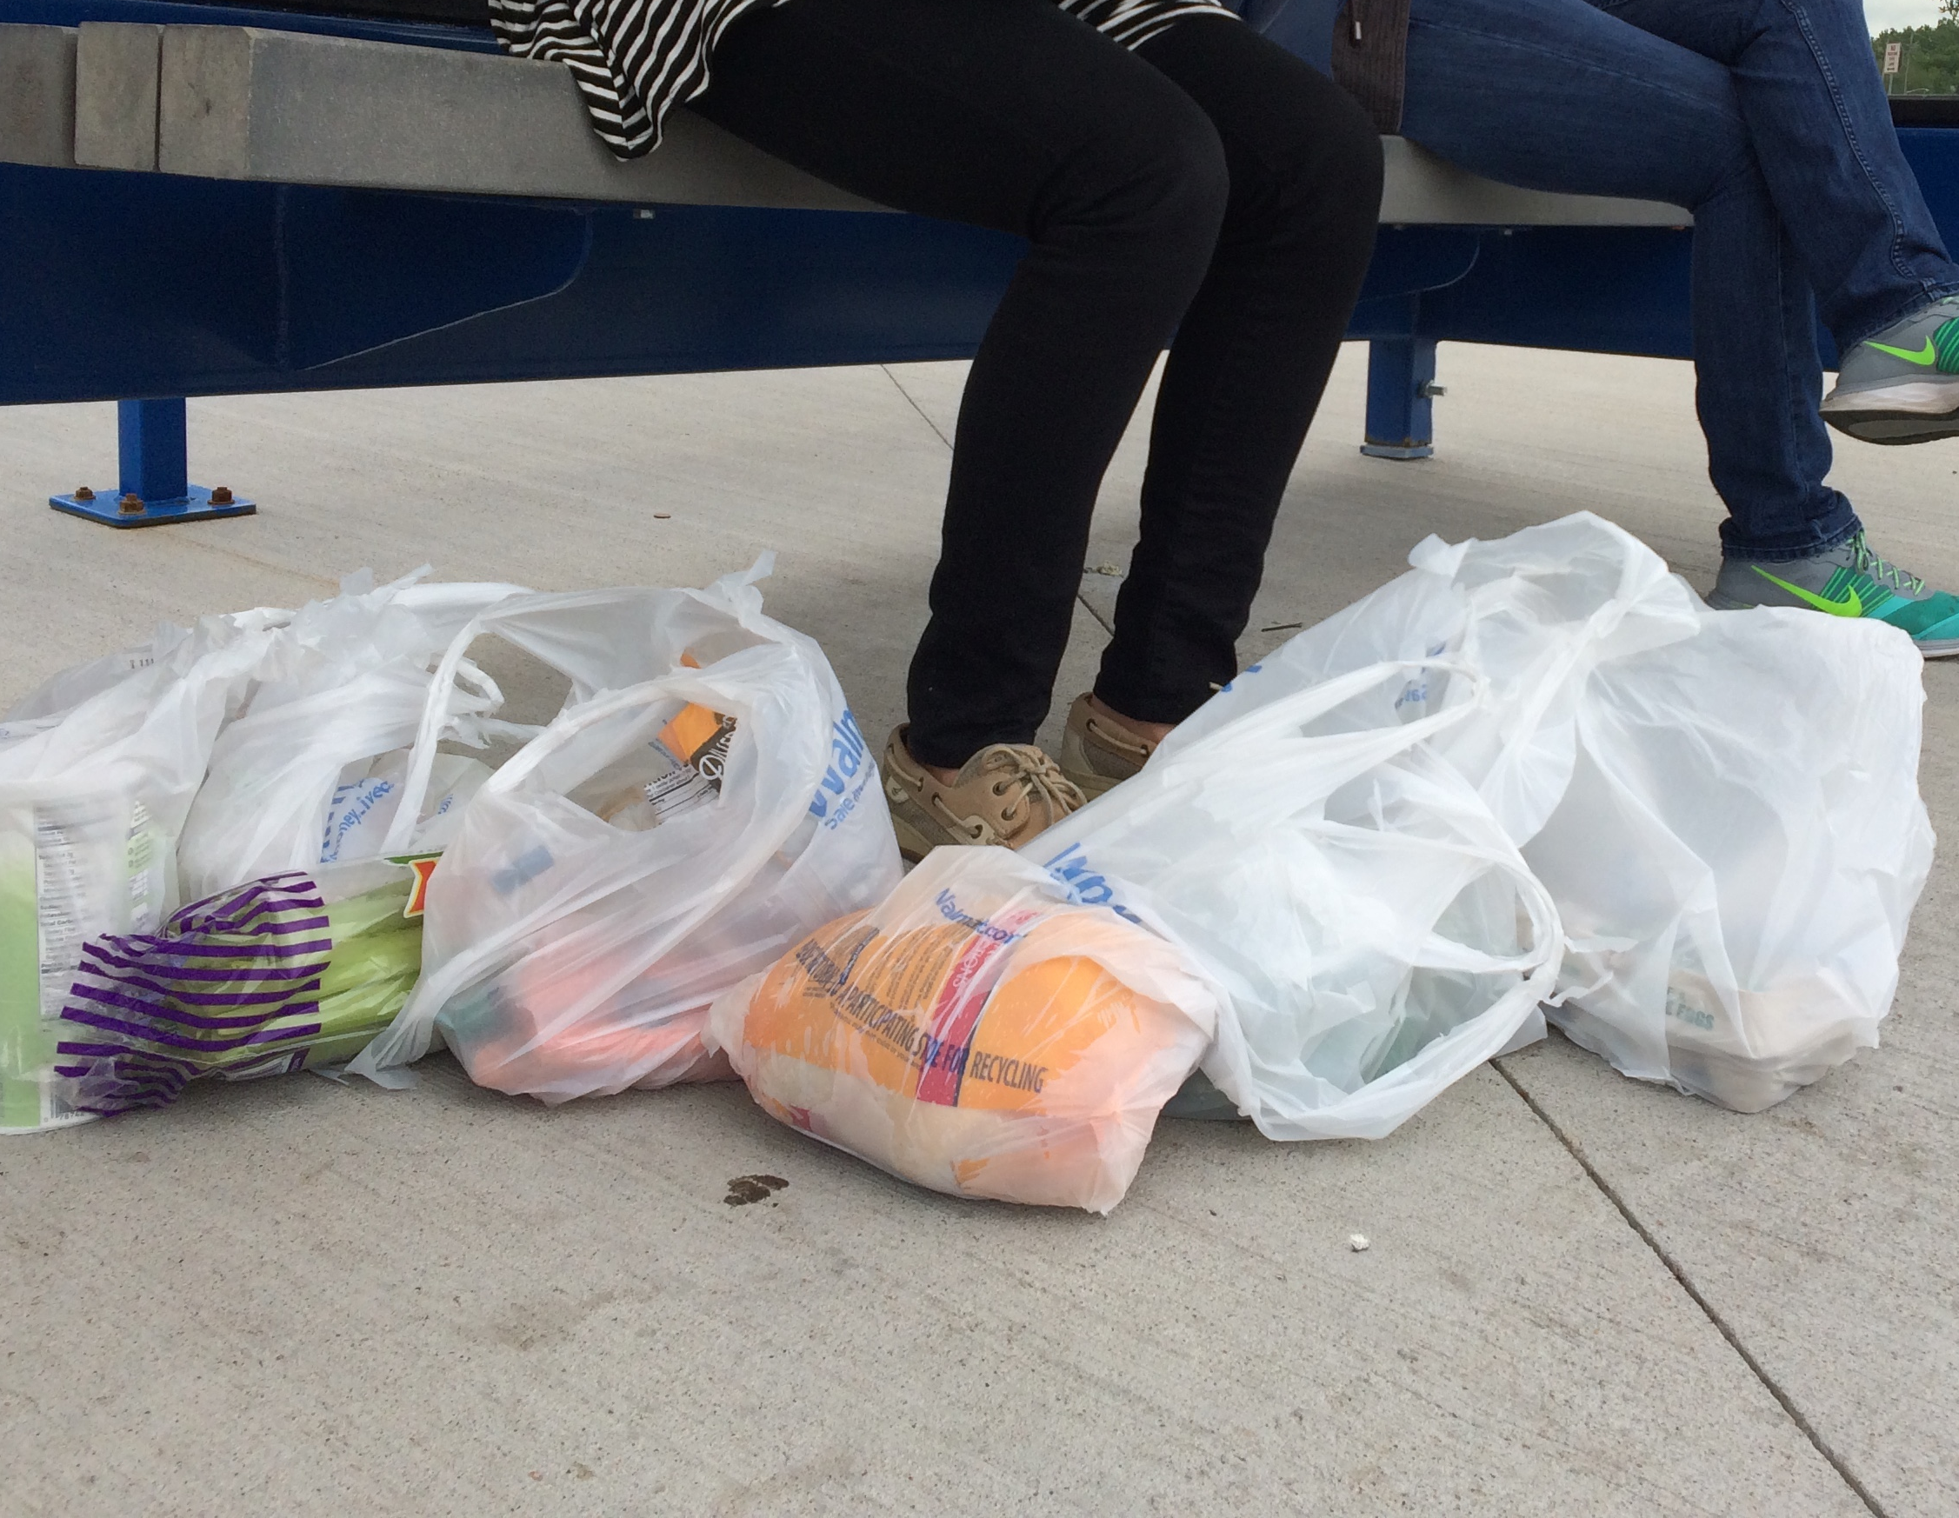
Example: The Greater Kansas City Food Policy Coalition—2
The recommendations were submitted to city manager’s office in early 2018
Recommendations resulted in new:
Bond funding
Complete streets ordinance
Trip planning tools and bus stop signage
Dietetic interns also created healthy recipes with ingredients that are:
Affordable
Easy to carry: Lightweight, fit in single bag, won’t spoil on way home
Image source: Heather Gibbons. (n.d.) Greater Kansas City Food Policy Coalition.
Notes:
Their recommendations were submitted to city manager’s office in early 2018.
Recommendations resulted in:
new bond funding for infrastructure assets
new complete streets ordinance
new trip planning tools and bus stop signage
The task force also worked with the Transportation Authority to recommend repairs and improvements to help residents in underserved/low-vehicle-ownership areas grocery shop by city bus. Their recommendations included ADA accessibility, crosswalks and safe sidewalks.
Additionally, Dietetics interns also created healthy recipes that use affordable, easy-to-carry (lightweight, can fit in single bag, won’t spoil on way home) ingredients:
-----
Note: Bond financing is a type of long-term borrowing that state and local governments frequently use to raise money, primarily for long-lived infrastructure assets. They obtain this money by selling bonds to investors.

Slide 61
Example: C40 Good Food Cities Declaration
C40 Cities
Good Food Cities Declaration – by 2030, cities commit to:
Representing 700+ million citizens and one quarter of the global economy, mayors committed to delivering on the most ambitious goals of the Paris Agreement at the local level
Barcelona, Copenhagen, Guadalajara, Lima, London, Los Angeles, Milan, Oslo, Paris, Quezon City, Seoul, Stockholm, Tokyo, and Toronto
Align food procurement policies to the Planetary Health Diet
Support an overall increase of healthy plant-based food
Reduce food loss and waste by 50% from 2015 figures
Work with citizens, businesses, public institutions, and other organizations to develop a joint strategy into the city’s climate action
Sources: C40 Cities. (2019). A sustainable diet by 2030 is key to solving the climate emergency. C40 Cities. https://www.c40.org/news/a-sustainable-diet-by-2030-is-key-to-solving-the-climate-emergency/;
C40 Cities. (2023). C40 Good Food Cities Accelerator: How cities are achieving the planetary health diet for all. C40 Cities. https://www.c40knowledgehub.org/s/article/The-C40-Good-Food-Cities-Declaration-Planned-actions-to-deliver-commitments
Notes:
The C40 Good Food Cities works on a larger scale to leverage policy toward sustainable, healthy food for all.
Food is amongst the biggest sources of consumption-based emissions from cities. A report estimated that food related actions could cut greenhouse gas emissions from the food we eat by more than 60%, prevent 170 thousand deaths and $600 billion per year. These 16 signatory cities serve 500 million meals per year – in schools, hospitals, and other public buildings, and are improving availability and affordability of nutritious and sustainable food for their 64 million citizens. (June 2019)
-----
Information
C40 Cities. (2019). A sustainable diet by 2030 is key to solving the climate emergency. C40 Cities. https://www.c40.org/news/a-sustainable-diet-by-2030-is-key-to-solving-the-climate-emergency/
C40 Cities. (2023). C40 Good Food Cities Accelerator: How cities are achieving the planetary health diet for all. C40 Cities. https://www.c40knowledgehub.org/s/article/The-C40-Good-Food-Cities-Declaration-Planned-actions-to-deliver-commitments

Slide 62
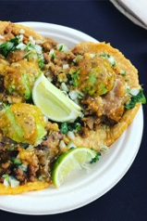

Standard 4: Recognize Global Nutrition
A lack of research on diverse populations makes it difficult to make nutrition and health recommendations that are culturally appropriate and affordable
Communities need to see their cultures and foods represented to make sustainable changes
Cultural does not always mean traditional
Community voice matters
Sources: Vogliano, C., Geagan, K., Chou, S., & Palmer, S. (2021). Empowering Nutrition Professionals to Advance Sustainable Food Systems: 8 Essential Strategies to Accelerate Change. Food + Planet. https://foodandplanet.org/downloads/; both photos are from Sherene Chou, Food+Planet.
Notes:
Although nutrition is global and diverse, much of our research is biased toward the dominant culture and often overlooks options and customs that can be incorporated into healthy, sustainable diets. Additionally, diverse voices are often lacking within nutrition and health care fields. It is important to practice cultural humility and seek out diverse colleagues to recommend culturally appropriate practices for those you work with .
However, cultural does not always mean traditional. Cultures change and evolve over time and geographies. For this reason, it is important to align our recommendations and guidance with foods that are known, accepted, and preferred. Additionally, they should include foods that your clients are confident purchasing and preparing.
You can learn a lot by asking questions with your patients and the communities you work in.
Ask about food preferences.
How does the food you recommend or provide align with their preferences or ability to access and prepare?
Who purchases and prepares food?
Are there preferred cultural foods that are as healthy or healthier than typically recommended?
What can you change or modify in your practice?
Finally, when giving advice or guidance, can you help clients modify or adapt foods they like and can access to better align to nutrition and sustainability needs?
-----
Note
This is a great example
https://www.foodbankrockies.org/about/programs/culturally-responsive-food-initiative/
Information
Vogliano, C., Geagan, K., Chou, S., & Palmer, S. (2021). Empowering Nutrition Professionals to Advance Sustainable Food Systems: 8 Essential Strategies to Accelerate Change. Food + Planet. https://foodandplanet.org/downloads/

Slide 63
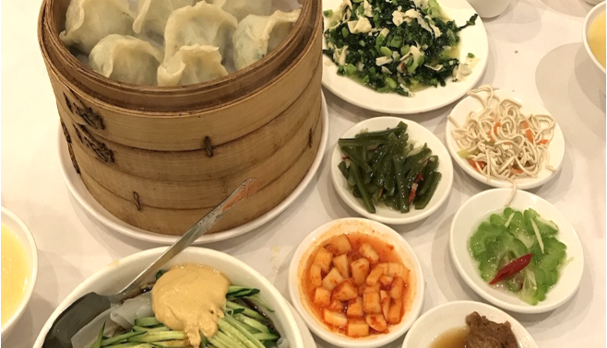
Culturally Appropriate Diets
Cultural responsivity: related to culture-specific foods, culturally responsive distribution methods, and/or culture-specific education around food
Cultural relevancy: related to personal taste preference, knowledge on how to prepare the food, dietary restrictions, or religious restrictions
Image source: Sherene Chou, Food+Planet.
Notes:
Consider these definitions when developing strategies and program.
Cultural responsivity: culture-specific foods, culturally-responsive distribution methods, and/or culture specific education around food
Cultural relevancy: related to personal taste preference, knowledge on how to prepare the food, dietary restrictions, or religious restrictions

Slide 64

Evaluating Nutrition Education
Content: current, accurate, consistent, relevant
Behavior focus
Cultural sensitivity
Written word: simple, positive, active voice
Organization/readability: logical order, clear layout
Source: Academy of Nutrition and Dietetics Foundation. (n.d.). Developing and Assessing Nutrition Education Handouts. Eat Right Foundation. Retrieved August 17, 2025, from https://www.eatrightfoundation.org/resources/daneh
Image source: Microsoft Stock Images.
Notes:
When aiming for culturally appropriate diets, it’s a good idea to evaluate the nutrition education materials and approaches you use to best align to your audience. The Academy of Nutrition and Dietetics has developed a checklist to use when evaluating and preparing effective handouts.
The checklist incorporates 21 constructs identified as quality indicators to be included in nutrition education handouts, based on a literature review. The constructs are categorized into five main topic areas: content; behavior focus; cultural sensitivity; written word; and organization/readability.
-----
Information
Academy of Nutrition and Dietetics Foundation. (n.d.). Developing and Assessing Nutrition Education Handouts. Eat Right Foundation. Retrieved August 17, 2025, from https://www.eatrightfoundation.org/resources/daneh

Slide 65
Discussion 2: Social Determinants of Health
Share some questions you could ask to assess the influence of social determinants of health and nutrition
What does it mean to separate individual and social issues?
How might your default approach need to be modified to ensure an equity focus?

Slide 66
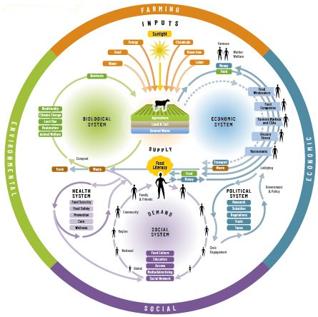
Pulling it Together
Apply a systems perspective
Seek multilevel approaches and collaboration
Use your unique position
Image source: Nourish. (n.d.). Food system tools. Retrieved May 27, 2025, from https://www.nourishlife.org/teach/food-system-tools/ and https://www.nourishlife.org/pdf/Nourish_Food_System_Map_18x24.pdf
Notes:
We’ve gone over a lot of material in this module, which may feel overwhelming. We’ll try to summarize here with key actions; however, it’s important to remember this is a journey, and you will learn and grow along the entire way!
Seek to apply a systems perspective in every area of your work.
Inequities within the food system are complex, rampant, and deeply entrenched and include differential treatment of people based on race, class, and gender.
Using a systems approach is crucial when addressing multiple causes and complexities and coming up with effective solutions
2. Seek multi-level approaches and collaboration.
Working with other organizations that share similar values and goals and across disciplines enables you to strengthen your impact and work toward effective solutions.
3. Use your unique position
Dietitians can identify, address, and develop solutions that counter-balance inequities through their work within the food system and with their clients.
Conversations about food system inequities are crucial to increase awareness among dietitians, to define root causes, to prevent them, and to effectively address them within dietetics.
Celebrate cultural traditions, practice cultural humility and seek out diverse colleagues to provide culturally appropriate practices to include all that you serve
-----
Graphic
Nourish. (n.d.). Food System Tools. Nourish. Retrieved May 27, 2025, from https://www.nourishlife.org/teach/food-system-tools/

Slide 67
Case Study 2

Slide 68
Case Study 3

Slide 69
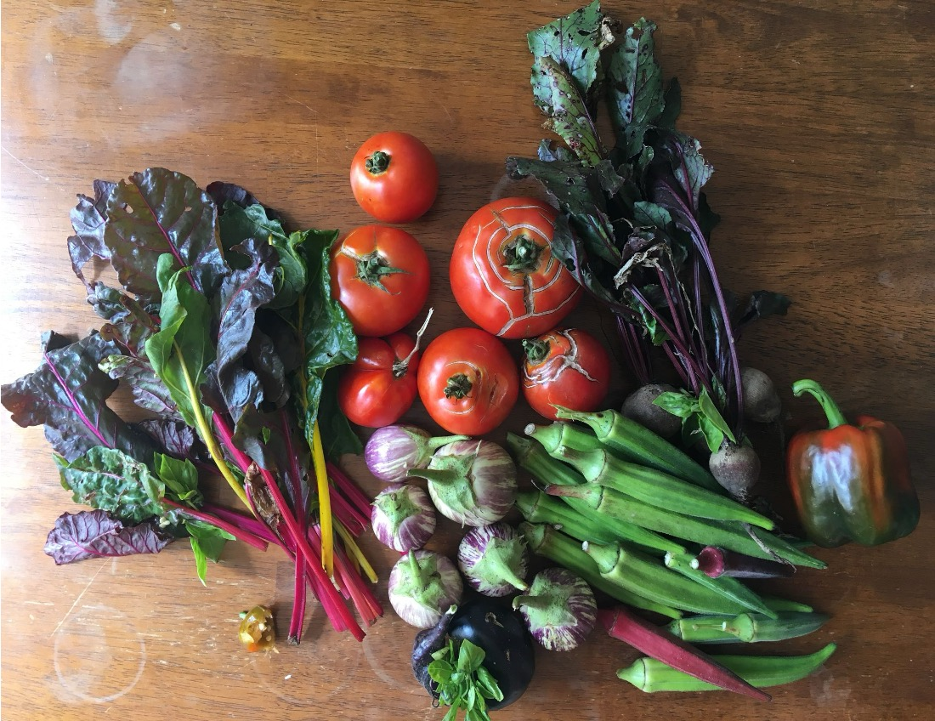
Thank You!

Slide 70
Practice and Resources Booklet

Slide 71

About This Presentation
© Copyright 2025 Johns Hopkins University.
Attribution-NonCommercial-ShareAlike 4.0 International
Produced by the Center for Teaching and Learning at the Johns Hopkins Bloomberg School of Public Health.
S2512

