Slide 1
Nourishing the Future: Sustainable Food Systems for Nutrition and Dietetic Students
Presented by:
Johns Hopkins Center for a Livable Future
Food + Planet

Slide 2
Introduction to Sustainable Food Systems
Module 1
Presented by:
Johns Hopkins Center for a Livable Future
Food + Planet
Notes:
Welcome to this module an Introduction to Sustainable Food Systems. This is the first in a series of learning modules designed for RDN students. These modules were produced by the Johns Hopkins Center for a Livable Future with Food and Planet/

Slide 3
Four Modules
Module 1
Introduction to Sustainable Food Systems
Module 2
Food Systems
for All
Module 3
Food and
our Climate
Module 4
Aquatic Foods, Nutrition, and Sustainability
Notes:
The series will be composed of three modules. This initial module in the series is an Introduction to Sustainable Food Systems. In the following modules we’ll address, Food systems for all, Food and climate, and Aquatic food systems

Slide 4
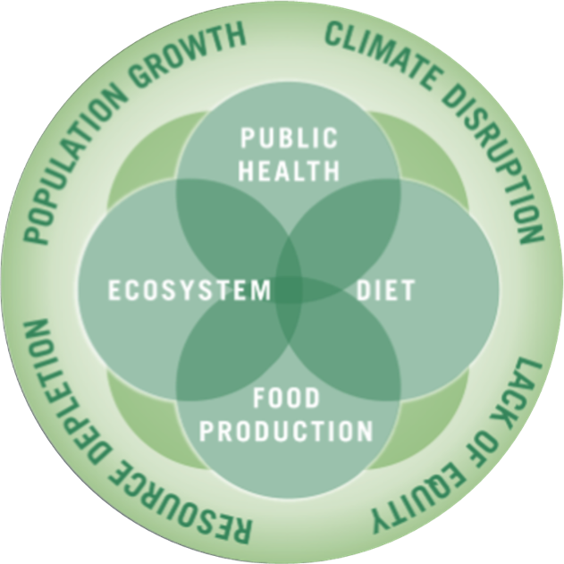
The Johns Hopkins Center for a Livable Future
Interdisciplinary academic center at the Johns Hopkins Bloomberg School of Public Health
Education, research, policy, and practice
Vision: a healthier, sustainable and resilient food system for all
Image source:
Notes:
The Johns Hopkins Center for a Livable Future is an inter-disciplinary academic center at the Johns Hopkins Bloomberg School of Public Health. The Center is engaged in education, research and practice at the intersection of public health, diet, food production and ecosystem health, which are all influenced by and connected to population growth, climate, resource depletion and equity. The Center collaborates with researchers, community groups and advocates at the local, state, national and international level and provides technical assistance to partner organizations. The Center’s vision is a healthier, sustainable and resilient food system for all.
This lecture series is based on the expertise and teaching resources of many faculty and staff at the Center, our collaborators across Johns Hopkins University and our many non-academic partners including Food and Planet. We graciously acknowledge their work and thank them for allowing us to share it with you.

Slide 5
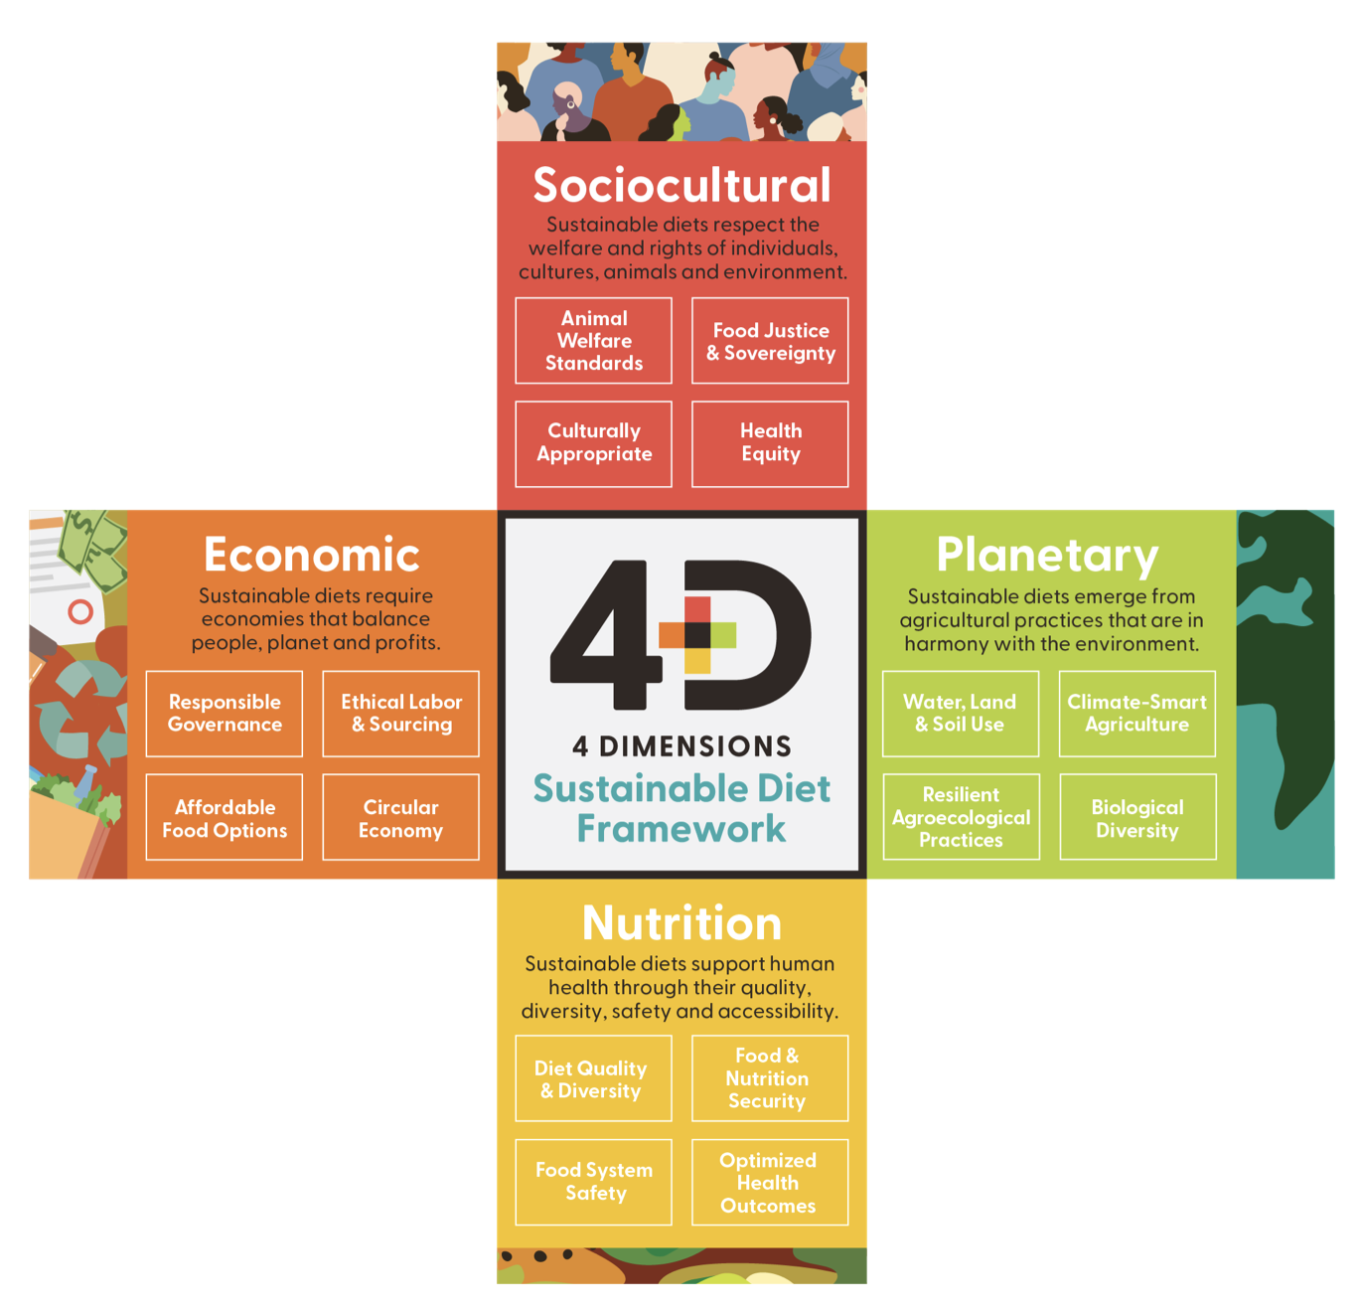
Food + Planet
Vision: a science and practice of nutrition that honors nature as the foundation of health through the four dimensions of sustainability
A collective, visionary 501c3 founded by four registered dietitians with varied experience in the food system
Aim: empower health care professionals to be leaders in sustainable food systems
Image source: Vogliano, C., Geagan, K., Chou, S., Palmer, S. (2021). Empowering nutrition professionals to advance sustainable food systems [White Paper]. Food and Planet. Figure 1. The 4 dimensions of sustainable diets. [Infographic]. Retrieved September 14, 2025, from https://7157e75ac0509b6a8f5c-5b19c577d01b9ccfe75d2f9e4b17ab55.ssl.cf1.rackcdn.com/GVISUTJI-PDF-1-675987-4519061561.pdf
Notes:
Food + Planet is a collective, visionary 501c3 founded by four registered dietitians with varied experience in the food system. Our aim is to empower healthcare professionals to be leaders in sustainable food systems. We envision a science and practice of nutrition that honors nature as the foundation of health through the four dimensions of sustainability: Sociocultural, Economic, Planetary and of course, Nutrition.

Slide 6
Learning Objectives
Describe food systems and their impact on human and planetary health
Discuss the various dimensions of sustainable food systems
Explain three strategies to make our food systems more sustainable
State the role of RDNs as leaders in food system change and how it aligns with the RDN Scope of Practice
Notes:
After completing this learning module, you should be able to:
Describe food systems and their impact on human and planetary health
Define the various dimensions of sustainable food systems
Describe three strategies to make our food systems more sustainable
Describe the role of RDNs as leaders in food system change

Slide 7
Section A: What Are Food Systems?

Slide 8
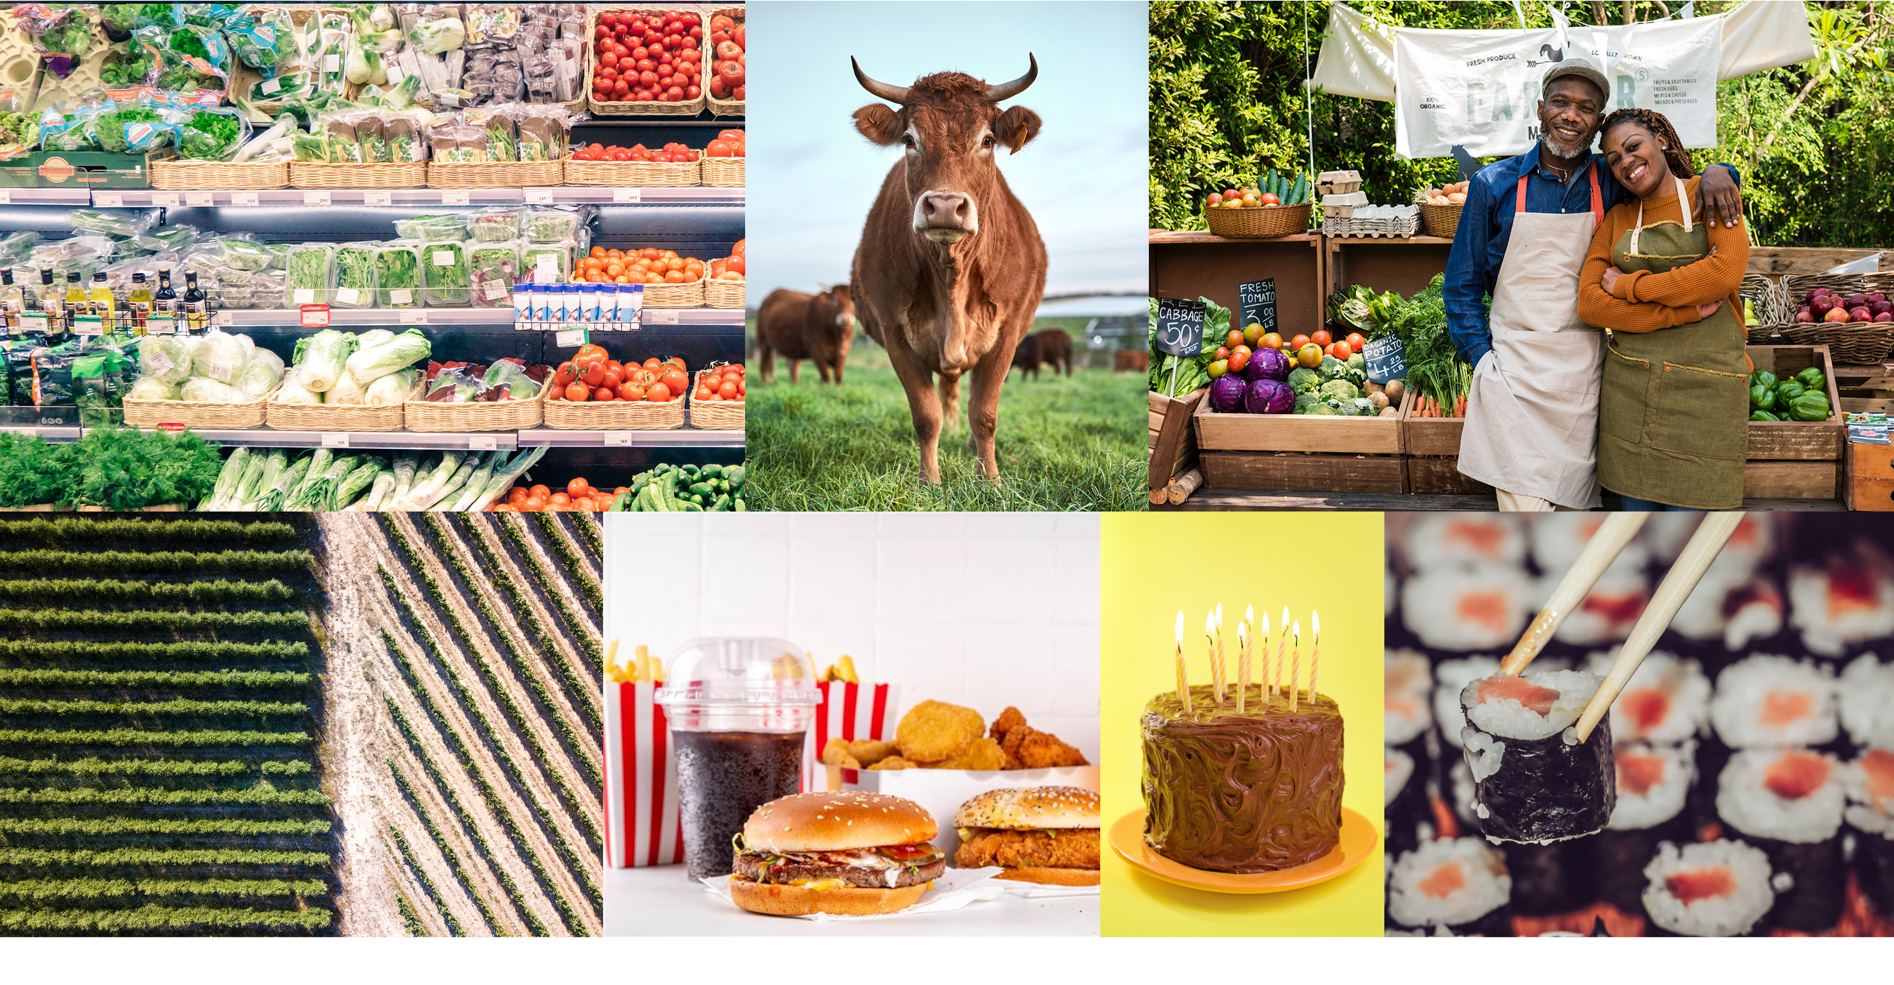
What Is the Food System?
Image sources: Collage created by the Center for a Livable Future from available Microsoft Office stock images and purchased Shutterstock images.
Notes:
Let’s get started.
What do you think of when you think about food systems?
This? This? This?
You are correct – all of these are part of the food system.

Slide 9
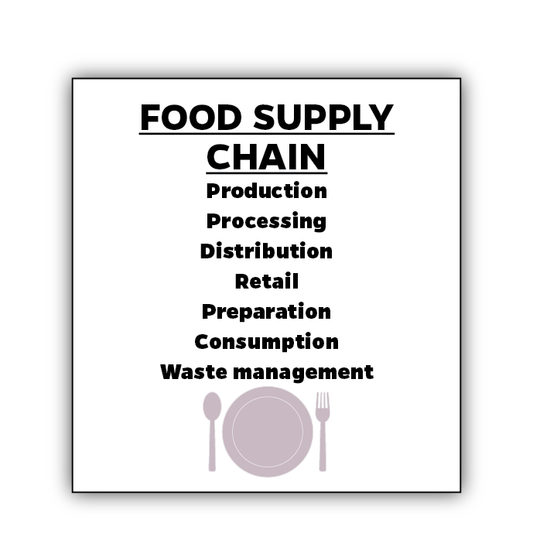
Food Systems—1
Image source: Johns Hopkins Center for a Livable Future (2023).
Notes:
When we think of food systems, what we often picture is a food supply chain. The food supply chain includes production, processing, distribution, retail, preparation, consumption and waste management

Slide 10
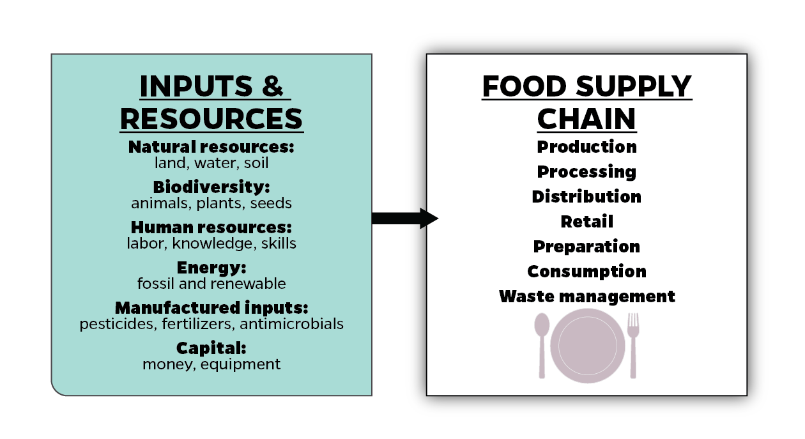
Food Systems—2
Image source: Johns Hopkins Center for a Livable Future (2023).
Notes:
But these supply chain activities don’t happen on their own, it takes many Inputs and Resources going into the food system. Some of these Inputs and Resources are natural resources and biodiversity – land, water, soil, animals, plants and seeds. Without these, we would not have food. These are the absolute essential resources for humanity to eat, breathe, and exist. Ironically, as we’ll see, these very resources are under threat BECAUSE of food systems, undermining our ability to feed ourselves now and in the future.
We also need human resources such as labor, knowledge and skills.
And we need energy, which can come in the form of renewable energy like sunlight, or fossil fuels.
Most food systems also have come to rely on manufactured inputs such as pesticides, fertilizers and antibiotics. And of course, money and equipment are essential.
These are some of the many inputs and resources that go into feeding billions of people worldwide.

Slide 11
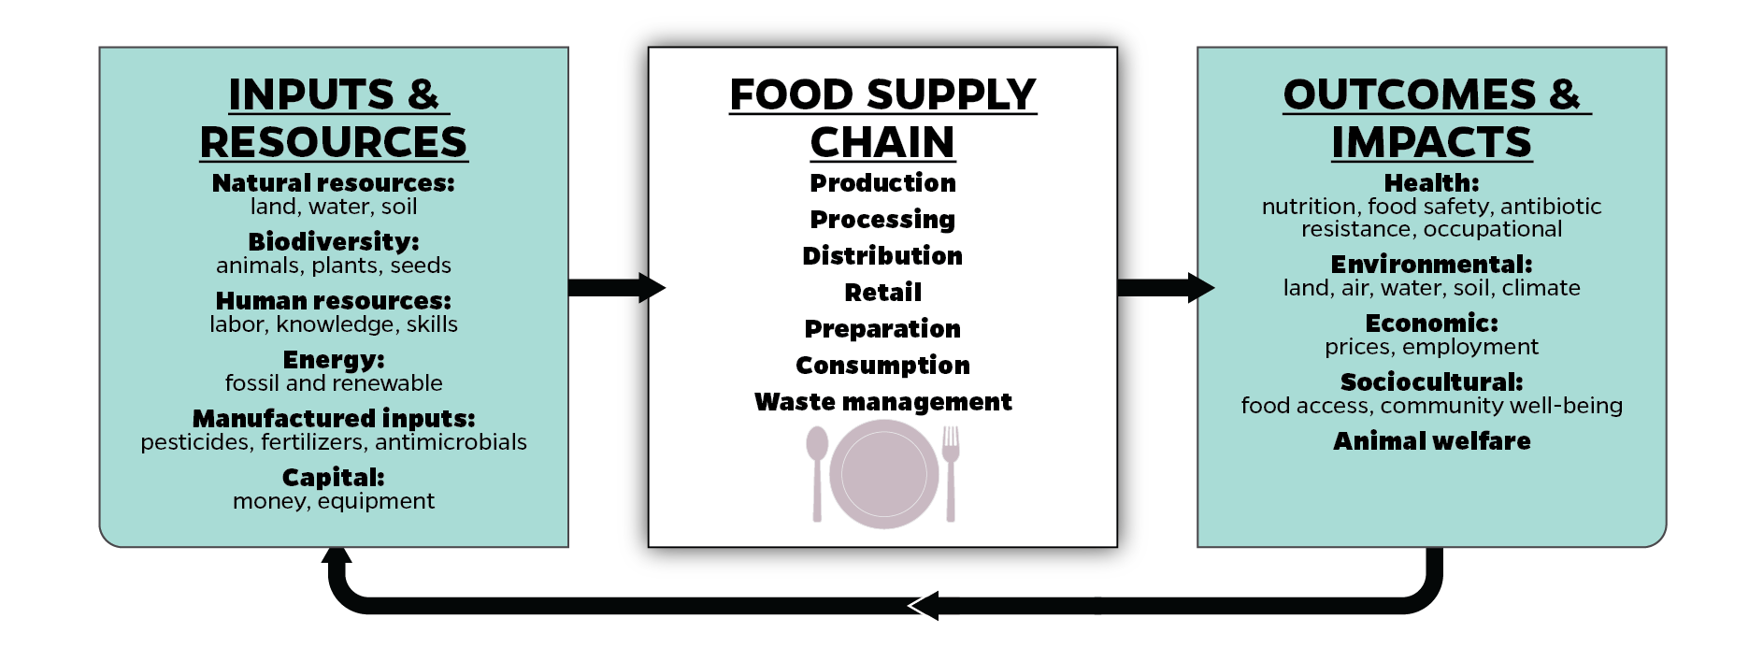
Food Systems—3
Image source: Johns Hopkins Center for a Livable Future (2023).
Notes:
Our food system also results in many outcomes and impacts.
What’s the primary outcome of the food supply chain? [PAUSE] It’s food.
Beyond food, our food systems produce and result in many other outcomes and impacts, both positive and negative.
Health impacts and outcomes include nutrition, food safety and quality, antibiotic resistance, and occupational health outcomes; as well as Environmental impacts on land, air, water, soil and our climate, which we will talk more about.
Economic and Sociocultural impacts on people and communities including the direct and indirect costs of food, who has access to that food, and impacts related to employment. The food system is one of the largest sectors of the U.S. economy, but many of these jobs are low-paying and dangerous, so you have people who work around food all day but can’t afford to feed their families.
And, of course, the welfare of the 80 billion animals each year who provide us with meat, dairy and eggs.

Slide 12
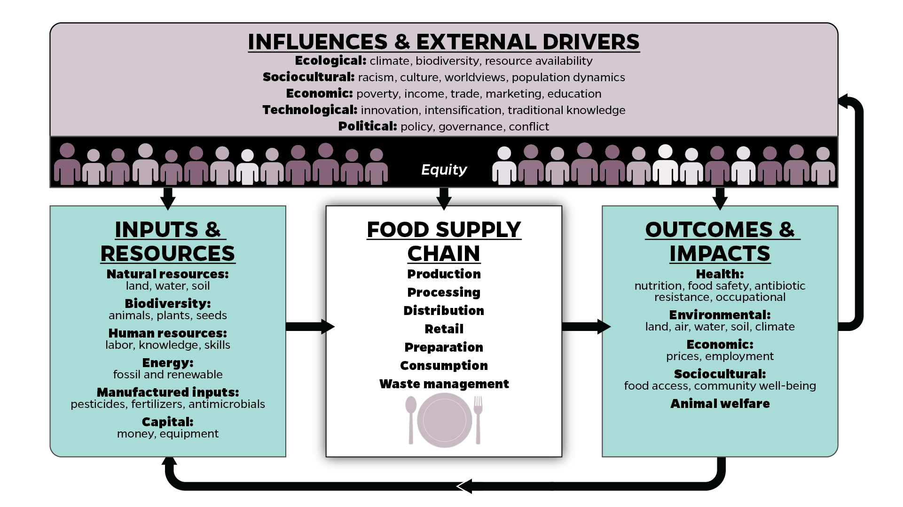
Food Systems—4
Image source: Johns Hopkins Center for a Livable Future (2023).
Notes:
Many outcomes and impacts of our food system are positive and promote good health and well-being. However, we also see many negative impacts: hunger, malnutrition and obesity, chronic diseases, low wages and dangerous working conditions, and animal abuse.
And that brings us to the final section of this framework – the Influences and External Drivers. The outcomes and impacts we get from our food system are largely determined by these Influences and External Drivers in the top box. These are just a few of the many factors that influence and shape how well our food systems function and the results we get. We’ve categorized some of them here as ecological, sociocultural, economic, technological and political. Again, these are just a few examples. You can probably think of more influences and external drivers that are not listed here. These are the upstream factors. In public health we talk a lot about prevention by focusing on upstream causes and determinants of health. In food systems, much of the work happens directly with the outcomes – such as food environments and dietary choices. But it’s important to be aware of how important these drivers are in influencing food environments and food access.
In the dark line under Influences and External Drivers is the word Equity with arrows pointing down towards the other boxes. There are VAST inequities pervasive throughout our food system – there are inequities in access to inputs and resources and inequities in the outcomes. Equity and inequity is fundamental to any discussion about the historical context of food and agriculture, of power and privilege, and of what we can do to transform food systems so we’re ALL experiencing positive outcomes from our food system, whether as farmers, workers or consumers.
This is a very simple representation of food systems. There are many different conceptual frameworks out there that tell different stories about different aspects of food systems and how complex they are. The arrows in this image indicate only the prevailing directions of activity or influence as food moves across the supply chain. But it’s these relationships in a food system that make it so dynamic and complicated.

Slide 13
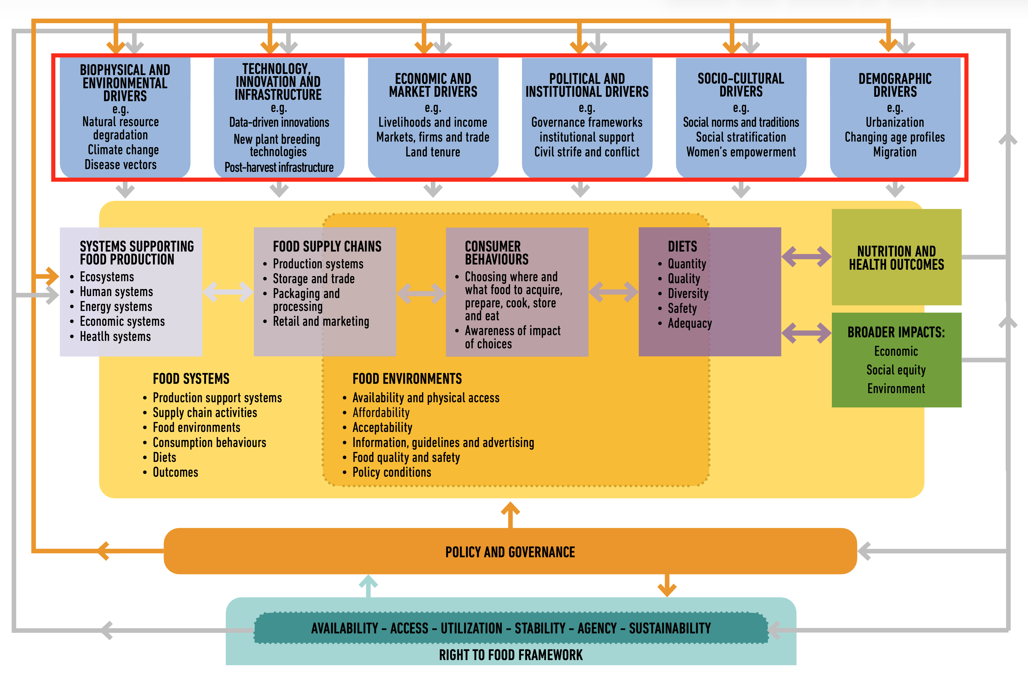
Sustainable Food System Framework
Image source: HLPE. (2020). Food security and nutrition: building a global narrative towards 2030. A report by the High Level Panel. Figure 2, Sustainable Food System Framework. [Chart]. https://openknowledge.fao.org/server/api/core/bitstreams/8357b6eb-8010-4254-814a-1493faaf4a93/content
Notes:
This more recent framework by the High-Level Panel of Experts on Food Security and Nutrition is quite similar but much more detailed. We show it here because it does a great job of breaking out aspects of the food system that are food environments, consumer behaviors, and other factors related to what people ultimately eat. These are also areas where RDNs often work.​
​
The framework shows four clear outcome areas that can guide registered dietitians as we practice. They include health & nutrition outcomes, as well as economic, social equity and environmental impacts. We will revisit these throughout these modules.​
​
But the overall messages is the same: The food system is more than a supply chain; it involves many influences and relationships. To change nutrition and health outcomes and impacts on planetary health, we need to think about changing these upstream factors. There is no single silver bullet solution. ​
​
----
Infographic
HLPE CFS. (2017). Nutrition and food systems: A report by the High Level Panel of Experts on Food Security and Nutrition of the Committee on World Food Security (HLPE Report 12). High Level Panel of Experts Committee on World Food Security. https://openknowledge.fao.org/server/api/core/bitstreams/4ac1286e-eef3-4f1d-b5bd-d92f5d1ce738/content

Slide 14
Systems Thinking
Systems thinking is a discipline for seeing wholes. It is a framework for seeing interrelationships rather than things, for seeing ‘patterns of change’ rather than static ‘snapshots.’
—Peter Senge
Source: Senge, P. The Fifth Discipline: The Art & Practice of The Learning Organization.
Notes:
And this brings us to the concept of Systems Thinking. What is Systems thinking? Often referred to as the father of systems thinking, Peter Senge defines it as “a discipline for seeing wholes. It is a framework for seeing interrelationships rather than things, for seeing patterns of change rather than static snapshots.
A system is more than the sum of its collective parts. For example, our body is more than just our various body parts, there are so many interactions and relationships that influence how the different parts function.

Slide 15
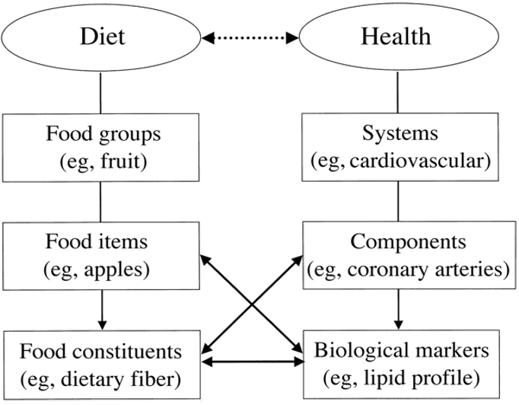
Examples of Reductionism in Nutrition Research
Image source: Hoffmann, I. (2003). Transcending reductionism in nutrition research. Figure 1. [Chart].
The American Journal of Clinical Nutrition, 78(3), 514S–516S. https://doi.org/10.1093/ajcn/78.3.514S
Notes:
Systems approaches differ from reductionist approaches, which breaks large complex systems down into smaller parts. This image represents a classic reductionist approach to nutrition research, where diets and what we eat, is broken down into food groups, then to individual foods, and even further to food constituents, such as micro and macro nutrients. And then health is broken down to individual systems, then components, and finally, individual biological markers.
The arrows point to the relationships that are often the focus of nutrition research. Fiber and colon cancer, or saturated fat intake and HDL and LDL, are some examples. And not just research -- this approach is often the focus of interventions, too -- for example, increasing fiber intake to reduce the risk of colorectal cancer.
Reductionist approaches are important in that they help us understand parts of systems and some of the interactions that are happening within a larger system. This is how research is generally conducted. Reductionist research is essential! However, you cannot understand or adequately address problems in a big messy complex system just by understanding or targeting one part or one interaction because the system is MORE than the sum of its parts. So, systems thinking is also essential.
-----
Graphic
Hoffmann, I. (2003). Transcending reductionism in nutrition research. The American Journal of Clinical Nutrition, 78(3), 514S-516S. https://doi.org/10.1093/ajcn/78.3.514S

Slide 16
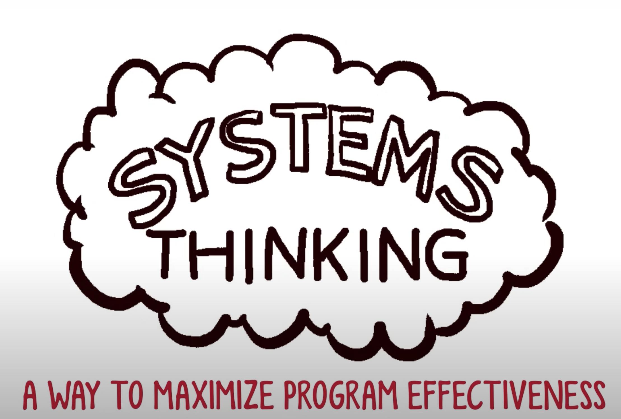
Watch This Five-Minute Video from …
Systems thinking applied to an obesity program
Systems Thinking: A Way to Maximize Program Effectiveness
Notes:
Watch this 5-minute video about Systems Thinking applied to an obesity program.
-----
Video
James Swanson (2014) https://www.youtube.com/watch?v=GPW0j2Bo_eY&t=2s

Slide 17
Discussion: Reductionism v. Systems Thinking
What are the benefits of reductionist thinking in nutrition research and practice?
What connections and relationships might be missed in reductionist thinking?
How could a systems approach fill these gaps and contribute to improved perspectives and solutions?
Have you ever experienced a situation where systems thinking may have led to a better outcome?
Notes:
Let’s pause again with these discussion questions

Slide 18
Section B: Why Do Food Systems Matter?
Notes:
Why Do Food Systems Matter? Take a few minutes to think about this question. What do you think? Why do food systems matter?

Slide 19
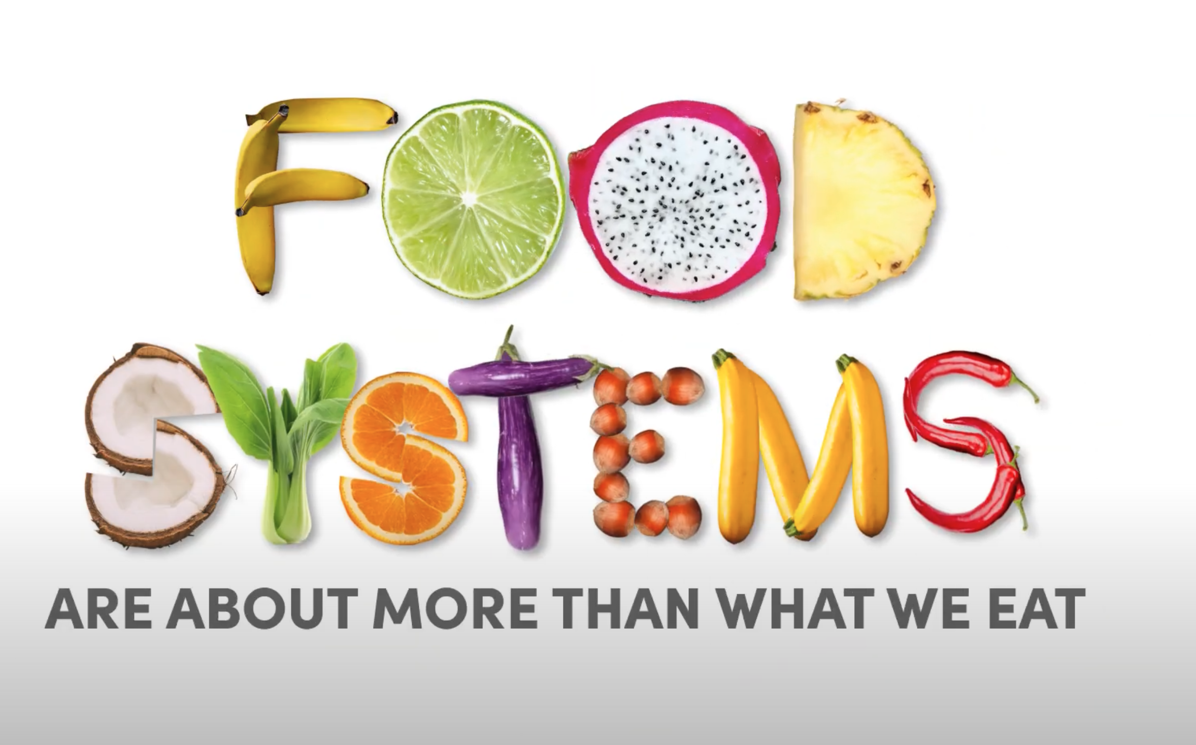
Watch This Video from the World Health Organization
More About Food Systems
Food Systems: Our food, our health, our future
Notes:
There is so much more to food systems. Here is another short video from the World Health Organization.
-----
Video
WHO (2021) https://www.youtube.com/watch?v=6Y499vq7tDg

Slide 20
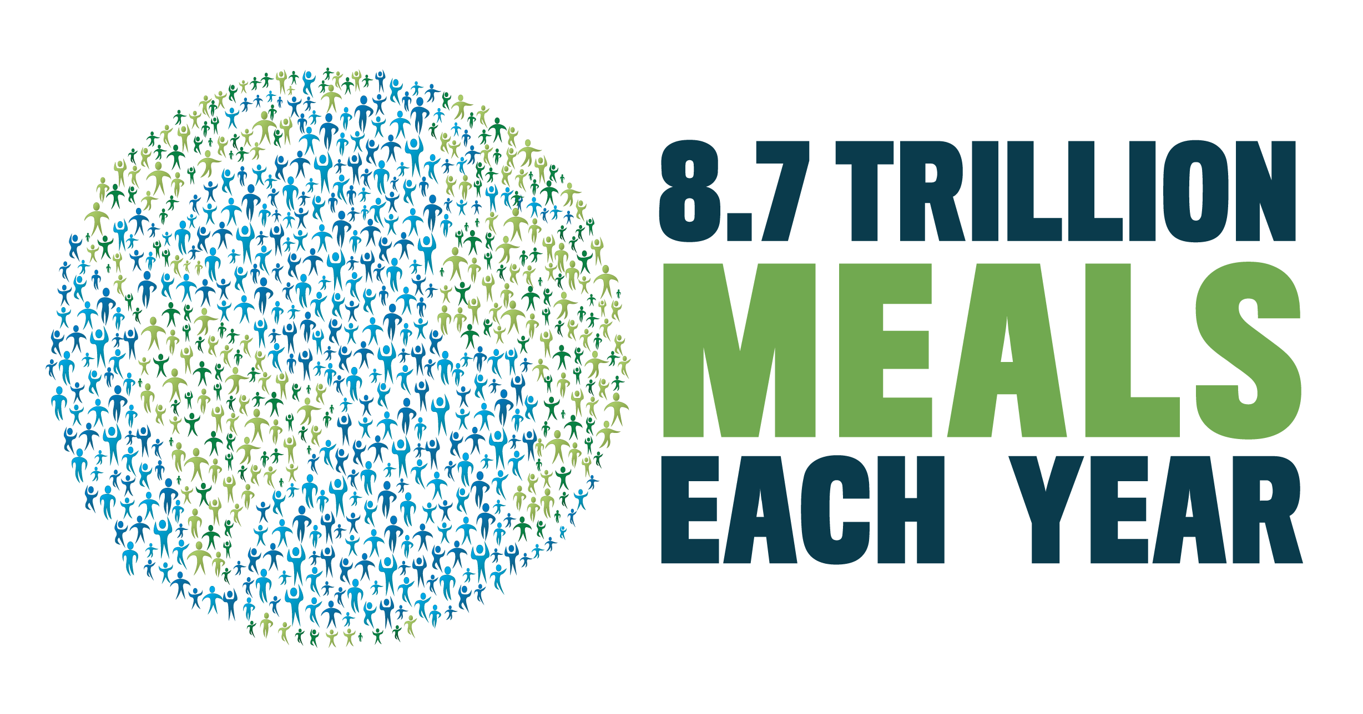
8.7 Trillion Meals Each Year
Image source: Johns Hopkins Center for a Livable Future.
Notes:
The impact of feeding the human population is enormous. If every human being ate breakfast, lunch and dinner every day, we would consume 8.7 trillion meals each year. This doesn’t include feeding livestock and pets.
Note this calculation assumes that every person eats 3 meals/day, which is NOT the case globally. However, it demonstrates that what we eat and how that food is produced, processed and distributed has significant impacts on our personal health and the planet, including the air we breathe and water we drink. What we eat today also determines the ability of future generations to feed themselves.

Slide 21
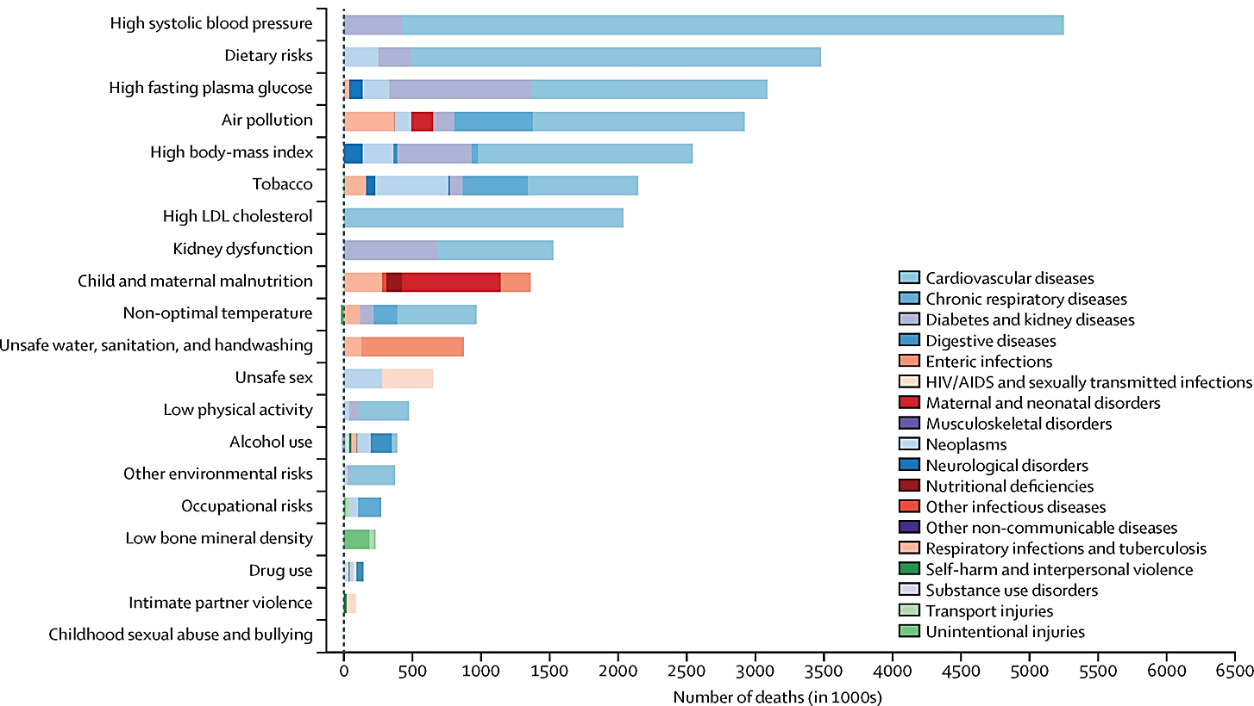
Suboptimal Diets Are a Top Risk Factor of Mortality
Global number of deaths attributable to level 2 risk factors, by cause
(females, 2019)
Image source: GBD 2019 Risk Factors Collaborators (2020). Global burden of 87 risk factors in 204 countries and territories, 1990–2019: a systematic analysis for the Global Burden of Disease Study 2019. Figure 3, Global number of deaths and percentage of DALYs attributable to Level 2 risk factors, by cause and sex, 2019. [Chart]. Lancet (London, England), 396(10258), 1223–1249. https://doi.org/10.1016/S0140-6736(20)30752-2
Notes:
One of the primary outcomes of food is our health. When we look at the global number of deaths attributable to different risk factors, we see that suboptimal diets and diet-related non-communicable diseases are top risk factors for mortality. So, what we're seeing with the global burden of disease is that these suboptimal diets are now significant contributors to disease and mortality and will continue to be so over the next decade and likely longer.
Note: this chart reflects data for females in 2019, a similar chart for males can be found in the 2020 Lancet article.
-----
Graph
Murray, C. J. L., Aravkin, A. Y., Zheng, P., Abbafati, C., Abbas, K. M., Abbasi-Kangevari, M., Abd-Allah, F., Abdelalim, A., Abdollahi, M., Abdollahpour, I., Abegaz, K. H., Abolhassani, H., Aboyans, V., Abreu, L. G., Abrigo, M. R. M., Abualhasan, A., Abu-Raddad, L. J., Abushouk, A. I., Adabi, M., … Lim, S. S. (2020). Global burden of 87 risk factors in 204 countries and territories, 1990–2019: A systematic analysis for the Global Burden of Disease Study 2019. The Lancet, 396(10258), 1223–1249. https://doi.org/10.1016/S0140-6736(20)30752-2

Slide 22
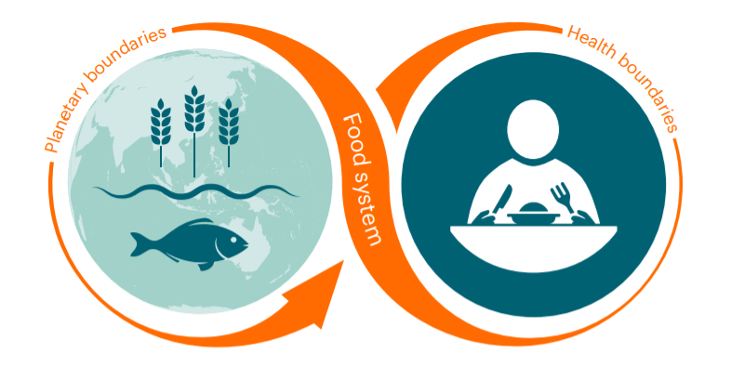
Planetary Health
The health of human civilization and the state of natural systems on which it depends
Source: EAT-Lancet Commission. (2025). Food, planet, health: A sustainable and healthy dietary pattern for all. Figure 1. [Graphic]. EAT. https://eatforum.org/wp-content/uploads/2025/09/EAT-Lancet_Commission_Summary_Report.pdf
Notes:
Beyond chronic diseases and impacts on human health, it’s important to also consider the impact our food systems have on planetary health. Planetary Health is a term coined to describe “the health of human civilization and the state of the natural systems on which it depends”. Much broader than traditional environmental health, planetary health considers how our increasing exploitation of earth’s resources impacts the dynamic and complicated natural systems around us, and the consequences for human health and sustainability. An important goal of the planetary health approach is equity and the recognition that economic and social systems are the foundation of nutrition and good health. We’ll refer to planetary health throughout this series of modules.
-----
Definition & Graphic
Whitmee, S., Haines, A., Beyrer, C., Boltz, F., Capon, A. G., Dias, B. F. de S., Ezeh, A., Frumkin, H., Gong, P., Head, P., Horton, R., Mace, G. M., Marten, R., Myers, S. S., Nishtar, S., Osofsky, S. A., Pattanayak, S. K., Pongsiri, M. J., Romanelli, C., … Yach, D. (2015). Safeguarding human health in the Anthropocene epoch: Report of The Rockefeller Foundation–Lancet Commission on planetary health. The Lancet, 386(10007), 1973–2028. https://doi.org/10.1016/S0140-6736(15)60901-1

Slide 23
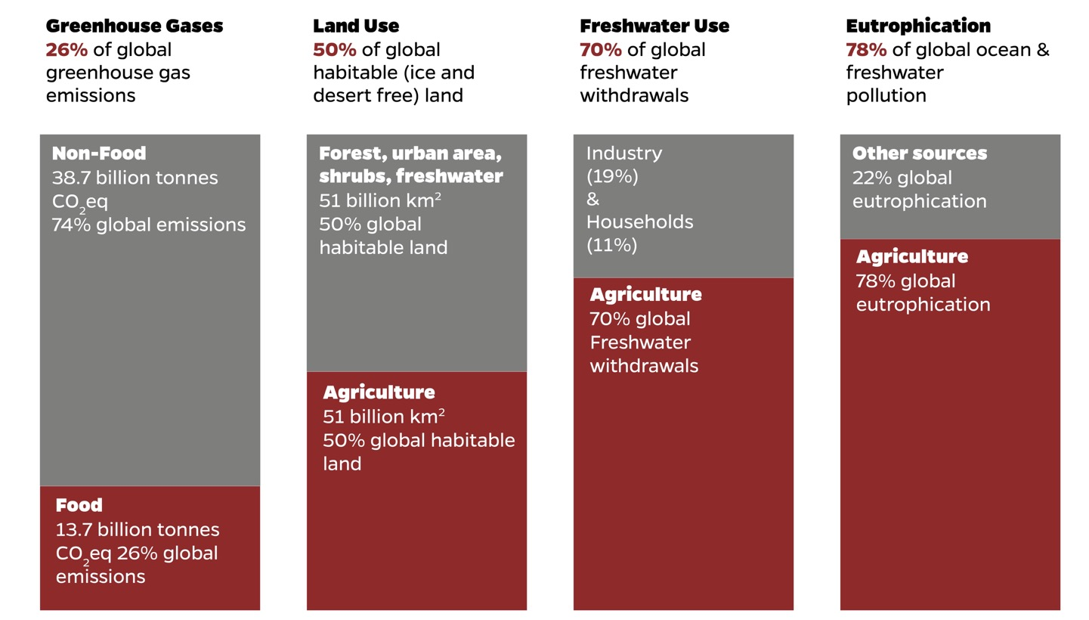
Agriculture Has an Outsized Impact on Planetary Health
Image source: Adapted by the Center for a Livable Future from Ritchie, H., Rosado, P., & Roser, M. (2022). Environmental impacts of food production. Our World in Data. https://ourworldindata.org/environmental-impacts-of-food
Notes:
To get us started with systems thinking, let’s look at some of the impacts of food systems on planetary health.
We’ll start with agriculture. Why? Because of all the steps along the food supply chain, the global production of food has an outsized impact on planetary health. More than the transportation sector as a whole, more than heating, cooling or lighting our homes and offices, what we eat and how that food is produced is one of the greatest determinants of our planet’s health now and in the future. Food production alone (not including food waste and post-farm gate) is responsible for 26% of greenhouse gases. Globally, over half of all habitable land and 70% of freshwater withdrawals are used for agriculture. And agriculture is responsible for 78% of eutrophication, which occurs when water is contaminated by too many nutrients such as nitrogen and phosphorus. And as we’ll see, agriculture has been implicated as a main driver of biodiversity loss as well.
-----
Graph
Ritchie, H., Rosado, P., & Roser, M. (2022). Environmental Impacts of Food Production. Our World in Data. https://ourworldindata.org/environmental-impacts-of-food

Slide 24
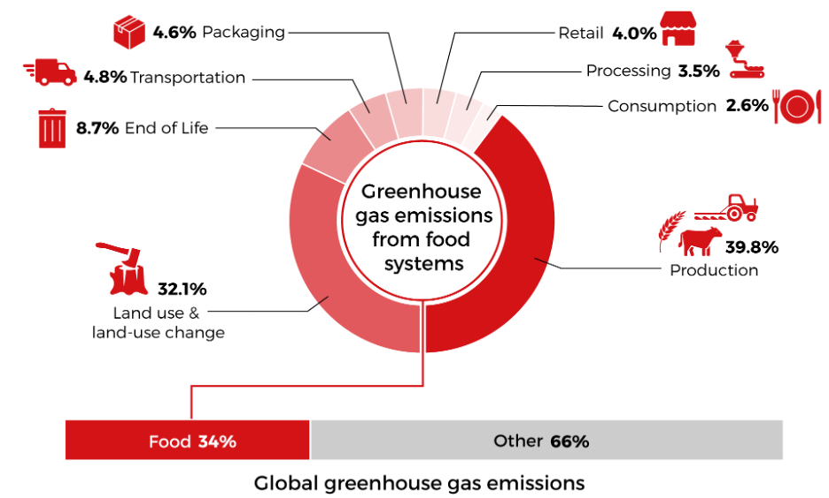
Food System Greenhouse Gas Emissions
Image source: Halloran, A. (2021). COP26 failed to tackle the biggest GHG emitter: the food system. Food Planet Prize. https://foodplanetprize.org/news/cop26-fails-to-systemically-tackle-the-biggest-ghg-emitter-the-food-system/
Notes:
Let’s dive a little deeper into food systems greenhouse gas emissions (GHGE), which play a role in global climate change. Most studies agree that the OVERALL food system contribution of GHGE is about one-third, indicated in the bar chart at the bottom of the slide. A few notable studies estimate a lower contribution, but they did not include certain aspects of food production and disposal. Important to note here is that in the last slide, we saw that agriculture alone accounted for 26% of total greenhouse gas emissions globally. Here we see that out of all of the food systems sources of greenhouse gas emissions, the majority come from production and land-use and land use change – generally that means the clearing of forests for agriculture. In other words, what we eat and how it is produced is more important for climate change than, for example, how far it is transported and how much it is processed.
These estimates are based on global data. In industrialized countries like the U.S., food systems contribute around 24% of total emissions, because emissions are much higher in other sectors. In lower-and middle-income countries, it’s closer to 39%. We will explore food and climate in much greater depth in another module in this lecture series.
-----
Graphic
Halloran, A. (2021). COP26 failed to tackle the biggest GHG emitter: The food system. Food Planet Prize. https://foodplanetprize.org/news/cop26-fails-to-systemically-tackle-the-biggest-ghg-emitter-the-food-system/

Slide 25
Global Land Use for Food Production—1
Image source: Ritchie, H., and Roser, M. (2019). Half of the world’s habitable land is used for agriculture. OurWorldinData.org. Accessed September 19, 2025, from https://ourworldindata.org/global-land-for-agriculture
Notes:
Now let’s look closer at land use for food production. Out of all of Earth’s surface, only approximately 29% is land – the rest is our vast oceans. Out of that 29% of land surface, 76% is habitable. The rest is barren or glaciers.
This habitable land is where humans live and thrive – this is the land that provides us food, shelter, and housing. It’s where we exist.
So, how much of this habitable land do you think is used for housing, buildings, and roads, and how much do you think is for food production? (pause)
-----
Graph
Ritchie, H., & Roser, M. (2019). Half of the world’s habitable land is used for agriculture. Our World in Data. https://ourworldindata.org/global-land-for-agriculture

Slide 26
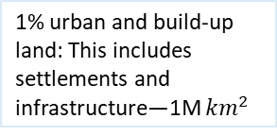
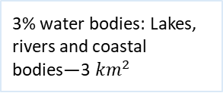
Global Land Use for Food Production—2
3% water bodies: Lakes, rivers and coastal bodies—3 ${km}^{2}$
1% urban and build-up land: This includes settlements and infrastructure—1M ${km}^{2}$
Image source: Ritchie, H., and Roser, M. (2019). Half of the world’s habitable land is used for agriculture. OurWorldinData.org. Accessed September 19, 2025, from https://ourworldindata.org/global-land-for-agriculture
Notes:
Almost half of all habitable land is used for agriculture. The rest is forest, shrub or fresh water or urban and built environments, which takes up just 1% of all habitable land.
How much of the land used for agriculture is dedicated to the production of animal protein?
-----
Graph
Ritchie, H., & Roser, M. (2019). Half of the world’s habitable land is used for agriculture. Our World in Data. https://ourworldindata.org/global-land-for-agriculture

Slide 27
Global Land Use for Food Production—3
Image source: Ritchie, H., and Roser, M. (2019). Half of the world’s habitable land is used for agriculture. OurWorldinData.org. Accessed September 19, 2025, from https://ourworldindata.org/global-land-for-agriculture
Notes:
Out of the 45% of land used for agriculture, almost three-quarters is used to produce meat and dairy. In other words, about 7.5% of ALL of earth’s surface is devoted to two food groups -- meat and dairy. That’s far more than is taken up by cities and residential communities. Livestock are able to graze on land that can’t be used to grow crops – such as land that is too hilly or too rocky for many other uses. However, good quality land is being cleared for livestock production and the grains to feed the livestock.
As the last two bars indicate, animal protein contributes fewer calories and less protein to our global food supply when compared to plant-based crops. One huge challenge is how to meet the growing demand for animal protein and improve access to high-quality protein to those who need it without putting further pressure on forests and other critical ecosystems.
-----
Graph
Ritchie, H., & Roser, M. (2019). Half of the world’s habitable land is used for agriculture. Our World in Data. https://ourworldindata.org/global-land-for-agriculture

Slide 28
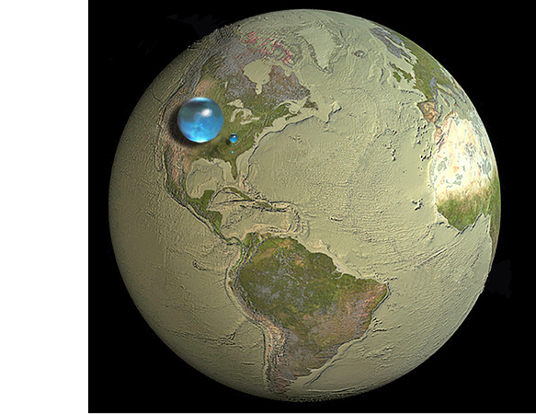
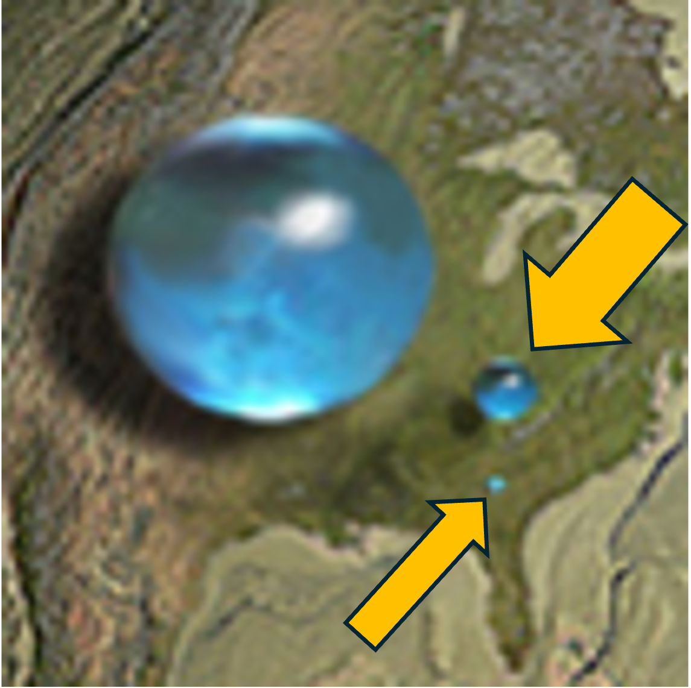
Freshwater Use
Only 0.5% of all water on Earth is freshwater available for drinking and other uses
About 70% of all freshwater we withdraw is for agriculture
Sources: U.S. Geological Survey's (USGS) Water Science School. (2019). How Much Water is There on Earth? Accessed September 19, 2025, from https://www.usgs.gov/water-science-school/science/how-much-water-there-earth; Falkenmark, M., & Rockström, J. (2013). Balancing water for humans and nature: The new approach in ecohydrology. EarthScan. https://doi.org/10.4324/9781849770521
Image source: Jack Cook, Woods Hole Oceanographic Institution. (2013). A Drop in the Ocean. Accessed September 19, 2024, from
https://www.whoi.edu/ocean-learning-hub/multimedia/a-drop-in-the-ocean/ v
Notes:
Water use is also an important issue for planetary health. This picture with 3 spherical water droplets demonstrates how much water we have available to us on earth.
The large sphere over North America represents all the water on earth, including in oceans, rivers, the atmosphere, and living organisms.
Only 2.5% of Earth’s water is freshwater this is the middle-sized dot. Of that, 60 percent is frozen in ice caps, glaciers, and snow.
The remaining liquid fraction is represented by the smaller sphere over Kentucky. Nearly all - about 99 percent- liquid freshwater is below ground.
The remaining amount in lakes and rivers, represented by the smallest dot over Georgia, is responsible for most human water needs.
Only 0.5% of all water on Earth is freshwater available for drinking and other uses. Of all the water that we withdraw about 70% is for agriculture.
Note: If we account for water that evaporates or leaves with the product and doesn’t return to the same watershed, agriculture accounts for about 85% of our global water consumption or footprint.
The point here is that water use for agriculture has tripled between 1940 and 2010. Experts project that water demand will increase in manufacturing, energy production and domestic uses, competing with food production. Yet our freshwater resources are decreasing and there are many places around the world that are seeing underground aquifers drying up.
-----
Data
Water Science School. (2019). How Much Water is There on Earth? USGS. https://www.usgs.gov/special-topics/water-science-school/science/how-much-water-there-earth
Falkenmark, M., & Rockström, J. (2013). Balancing water for humans and nature: The new approach in ecohydrology. EarthScan. https://doi.org/10.4324/9781849770521
Graphic
Cook, J. (2013). A Drop in the Ocean. Woods Hole Oceanographic Institution. https://www.whoi.edu/multimedia/a-drop-in-the-ocean/

Slide 29
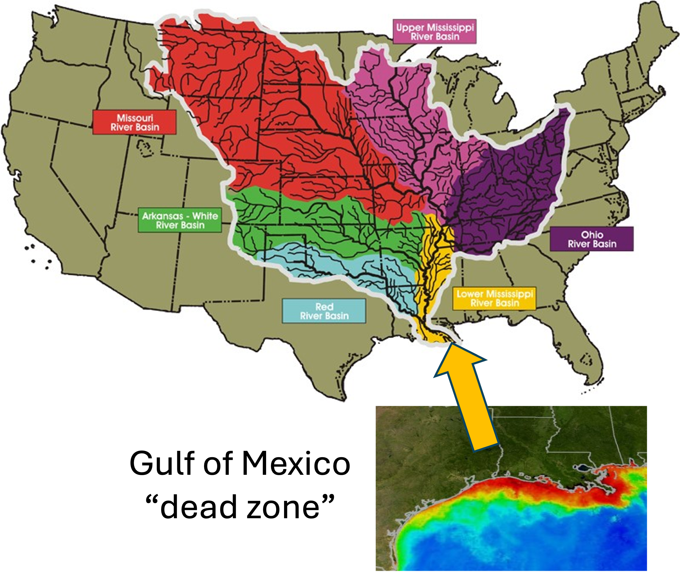
Eutrophication
Excess nitrogen and phosphorus fuels an overgrowth of algae, which deplete oxygen in water, killing aquatic life
Agriculture in the primary source:
  Animal waste
  Chemical fertilizers
  Pesticides
Source: Restore the Mississippi River Delta. (n.d). Explaining the Gulf of Mexico Dead Zone. Accessed September 19, 2025, from https://mississippiriverdelta.org/learning/explaining-the-gulf-of-mexico-dead-zone/
Notes:
Not only is water quantity a concern, but agriculture also impacts water quality. Agricultural runoff can overload waterways with excess nutrients such as nitrogen and phosphorus, fueling algae blooms and low-oxygen areas causing dead zones, where fish and other aquatic life can no longer survive. Runoff of animal waste, chemical fertilizers and pesticides are the leading sources of water contamination in the U.S. Globally, the number, size and severity of dead zones has been increasing, due primarily to the increased application of synthetic fertilizers. It’s also exacerbated by climate change. One of the world’s largest dead zones occurs in the Gulf of Mexico off the coasts of Louisiana and Texas, shown in this image.
As the Mississippi River flows down from Minnesota, it is joined by the smaller rivers and tributaries of 31 other states from across the midwest and south– states with a lot of agriculture. Most of what is grown is livestock or the corn and soybeans used for animal feed, sweeteners, and biofuels. The runoff of nitrogen and phosphorus impacts local waterways, and it accumulates as it travels towards the gulf, resulting in a low-oxygen zone approximately the size of Massachusetts in the gulf each summer.
-----
Graphic
Explaining the Gulf of Mexico Dead Zone. (2025). Restore the Mississippi River Delta. https://mississippiriverdelta.org/learning/explaining-the-gulf-of-mexico-dead-zone/

Slide 30
Biodiversity
The variability among living organisms from all sources including terrestrial and aquatic ecosystems and the ecological complexes of which they are a part.
—Convention on Biodiversity
Supports ecosystems services essential to food production (soil, pollination, etc.)
Protects food systems from climate change, extreme weather, pests, and diseases
The global food system is the primary driver of biodiversity loss
Sources: Secretariat of the Convention on Biological Diversity. (2006). Article 2. Use of Terms. In Convention on Biological Diversity. https://www.cbd.int/convention/articles?a=cbd-02; FAO, IFAD, UNICEF, WFP, & WHO. (2021). In Brief: The State of Food Security and Nutrition in the World 2021. ​https://doi.org/10.4060/cb5409en
Notes:
You may have heard the saying that our food system is destroying the very resources it relies upon. Nothing reflects this more than the issue of biodiversity. Biodiversity is the variability among living organisms from all sources including terrestrial and aquatic ecosystems and the ecological complexes of which they are a part. This biodiversity of life provides ecosystem services we rely on for the air we breathe, the water we drink and the food we eat. For example, we rely on insects and birds for pollination and pest control and hundreds of varieties of microbes, fungi, and other teeny tiny creatures that make up healthy soil.
With the loss of biodiversity, food systems become less resilient to climate change and extreme weather; and crops more vulnerable to pests and diseases.
Ironically, agriculture is the primary driver of biodiversity loss. Much of this is through extensive land use, pesticides, and overuse of synthetic fertilizers to support intensive farming practices.
-----
Definitions
CBD Biosafety Unit. (2006). Article 2. Use of Terms. Convention on Biological Diversity; Secretariat of the Convention on Biological Diversity. https://www.cbd.int/convention/articles?a=cbd-02
FAO, IFAD, UNICEF, WFP, & WHO. (2021). In Brief: The State of Food Security and Nutrition in the World 2021. ​FAO, IFAD, UNICEF, WFP and WHO. https://doi.org/10.4060/cb5409en

Slide 31
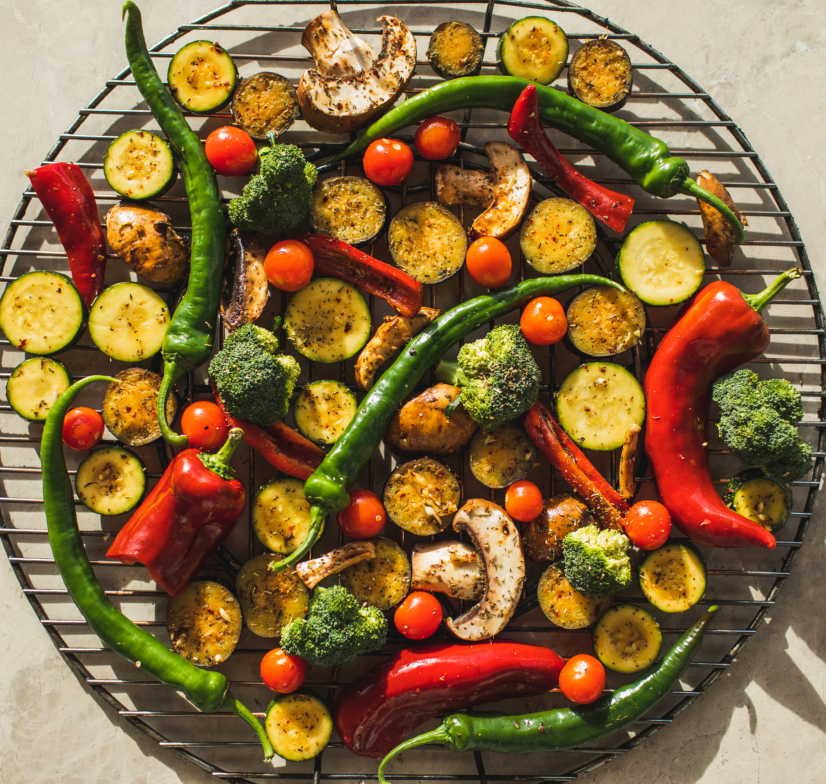
Diverse Diets are Healthy Diets
Of the 300,000 known edible plant species, only
150–200 are used by humans
Only three of these crops provide more than half of calorie needs
Today, 75% of the world’s food is generated from only 12 plants and five animal species
Sources: Lachat, C., Raneri, J., Walker Smith, K., Kolsteren, P., Van Damme, P., Verzelen, K., Penafiel, D., Vanhove, W., & Kennedy, G. (2018). Dietary species richness as a measure of food biodiversity and nutritional quality of diets. PNAS, 115(1), 127–132. https://doi.org/10.1073/pnas.1709194115; FAO, IFAD, UNICEF, WFP, & WHO. (2021). The State of Food Security and Nutrition in the World 2021: Transforming food systems for food security, improved nutrition and affordable healthy diets for all. FAO. https://doi.org/10.4060/cb4474en; Image source: Microsoft Office stock photo.
Notes:
Important to our work as nutrition professionals, a dimension of biodiversity relates to our diets and what we eat.​
​
Diverse diets are typically healthy diets. Dietary diversity– also described as Dietary Species Richness-- is the count of the number of species consumed in a given day or year, which aligns with the nutritional quality of diets. Unfortunately, the richness and diversity of our diets has declined dramatically over the past 100 years. ​
​
Currently, of the 300,000 known edible plant species, only 150 to 200 are used by humans. ​
​
In fact, only 12 plants and 5 animal species provide 75% of the world’s food. And Just rice, maize and wheat contribute 60% of plant calories. ​
​
Compounding this, in many low-and-middle income countries, low dietary diversity in addition to low protein intake leads to nutritional deficiencies – especially in women and children.
-----
Data
Lachat, C., Raneri, J., Walker Smith, K., Kolsteren, P., Van Damme, P., Verzelen, K., Penafiel, D., Vanhove, W., & Kennedy, G. (2018). Dietary species richness as a measure of food biodiversity and nutritional quality of diets. PNAS, 115(1), 127–132. https://doi.org/10.1073/pnas.1709194115
FAO, IFAD, UNICEF, WFP, & WHO. (2021). The State of Food Security and Nutrition in the World 2021: Transforming food systems for food security, improved nutrition and affordable healthy diets for all. FAO. https://doi.org/10.4060/cb4474en

Slide 32
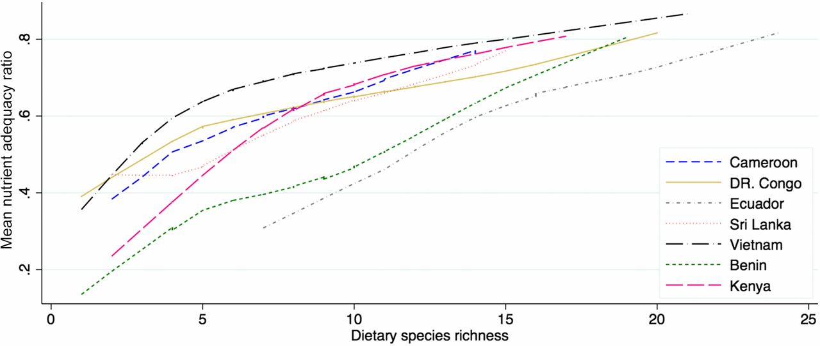
Association: Nutritional Quality, Number of Plant Species Eaten
Association of mean adequacy ratio (MAR) with species richness (SR)
for 6,226 women and children in seven countries (wet and dry season combined)
Image source: Lachat, C., Raneri, J., Walker Smith, K., Kolsteren, P., Van Damme, P., Verzelen, K., Penafiel, D., Vanhove, W., & Kennedy, G. (2018). Dietary species richness as a measure of food biodiversity and nutritional quality of diets. Figure 3, Association of MAR with SR for 6,226 women and children in seven countries (wet and dry season combined). [Chart]. PNAS, 115(1), 127–132. https://doi.org/10.1073/pnas.1709194115
Notes:
A study in 7 countries found an association of the nutritional quality with the number of plant species people ate. As a measure of nutritional quality, the mean adequacy ratio (MAR) was calculated as the arithmetic mean of the quantity of a nutrient consumed per its requirement for each individual on a daily basis. As the dietary species richness increased, so did the mean nutrient adequacy ratio. In other words, the diets with the most variety of plant foods were also the most nutritious.
-----
Graph
Lachat, C., Raneri, J., Walker Smith, K., Kolsteren, P., Van Damme, P., Verzelen, K., Penafiel, D., Vanhove, W., & Kennedy, G. (2018). Dietary species richness as a measure of food biodiversity and nutritional quality of diets. PNAS, 115(1), 127–132. https://doi.org/10.1073/pnas.1709194115

Slide 33
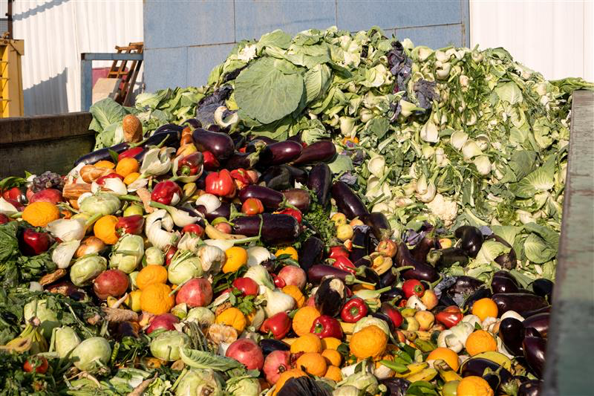
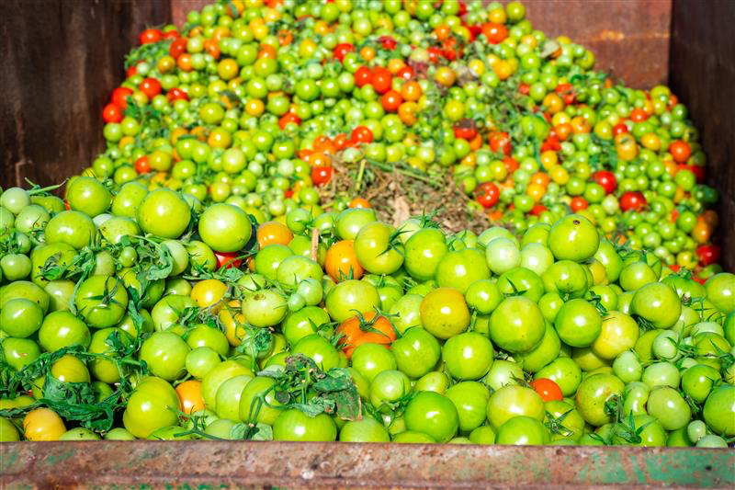
Wasted Food = Wasted Resources
Globally: 31–40%
United States: approximately 38%
Environmental impacts (US data)
  22% of freshwater consumption
  16% of cropland
  6% of greenhouse gas (GHG) emissions
  Largest component of municipal solid waste
Increased 50% in the US since the 1970s
Source: United Nations Environment Programme. (2021). Food Waste Index Report 2021. https://www.unep.org/resources/report/unep-food-waste-index-report-2021;
images of vegetables and fruits are from Shutterstock.
Notes:
Another important issue related to food systems and planetary health is wasted food. There is persistent hunger around the world, yet we’re wasting a tremendous amount of food—about 31 to 40% globally. You may notice that we’re using the term "wasted food" rather than "food waste.” This emphasizes that much of what is being discarded is not waste, it’s food.
In the U.S., we waste approximately 38% of all food. The waste of good quality food is not only a loss of food but it wastes all the resources that were used to produce that food—the water, the land, the energy, the seeds, the labor and time—all of that goes to waste too. Plus, the disposal of food in landfills leads to greenhouse gas emissions, contributing to climate change.
To grow the food that is then just thrown away, we use 22% of the freshwater consumption, 16% of U.S. cropland, and 6% of GHG emissions. In other words, one-quarter of water we use in the U.S. is to grow food that is thrown away.
Wasted food is the largest component of municipal solid waste. Once there, it releases methane, which is a powerful greenhouse gas.
What's also interesting is that we've had a 50% increase in waste in the United States since the 1970s. In theory, if we can increase the waste, we can also decrease it again.
Reducing the amount of food we waste is one of the primary strategies for making our food system more sustainable. And it’s one of those issues that generally has widespread support.
-----
Data
UNEP. (2021). Food Waste Index Report 2021. United Nations Environment Programme. https://www.unep.org/resources/report/unep-food-waste-index-report-2021

Slide 34
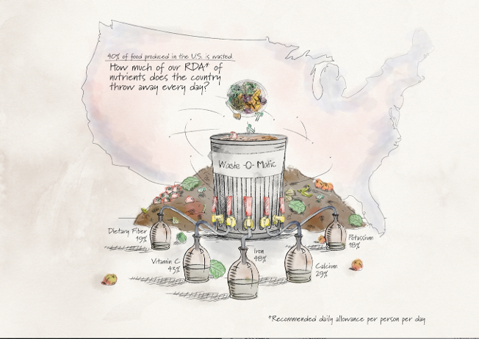
Impacts of Wasted Food on Nutrition in the United States
Image source: Adapted by the Johns Hopkins Center for a Livable Future from data in Spiker, M. L., Hiza, H. A. B., Siddiqi, S. M., & Neff, R. A. (2017). Wasted food, wasted nutrients: nutrient loss from wasted food in the United States and comparison to gaps in dietary intake. Journal of the Academy of Nutrition and Dietetics, 117(7), 1031–1040.e22. https://doi.org/10.1016/j.jand.2017.03.015
Notes:
In twenty seventeen, Johns Hopkins researchers calculated the nutritional value of wasted food at retail and consumer levels in the United States and compared it recommended micronutrient intake.
This graphic presents some of their findings. In terms of recommended daily allowance per person per day, almost twenty percent of fiber and potassium are wasted, as well as almost thirty percent of calcium and over forty percent of vitamin C and iron.
A more detailed breakdown of the data and analysis of the average recommended daily allowances for men and women is available in the paper by Spiker and colleagues.
Spiker ML, Hiza HAB, Siddiqi SM, Neff RA. Wasted Food, Wasted Nutrients: Nutrient Loss from Wasted Food in the United States and Comparison to Gaps in Dietary Intake. J Acad Nutr Diet. 2017 Jul;117(7):1031-1040.e22. doi: 10.1016/j.jand.2017.03.015. Epub 2017 May 15. PMID: 28522208.

Slide 35
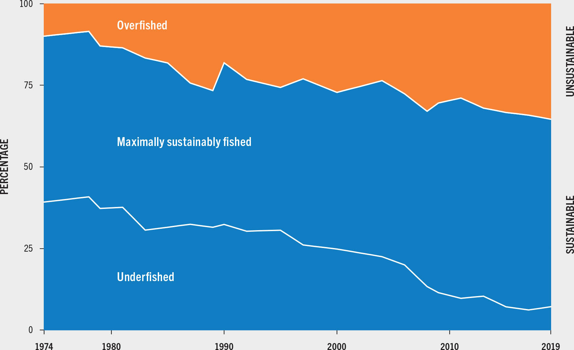
State of the World’s Fisheries
Image source: Food and Agriculture Organization of the United Nations. (2022). The State of World Fisheries and Aquaculture 2022. Towards Blue Transformation. Figure 23, Global trends in the state of the world’s marine fishery stocks, 1974–2019. [Chart]. Rome, FAO. https://doi.org/10.4060/cc0461en
Notes:
Aquatic foods are an important aspect of the food system and are part of the complex web of land-based agriculture. This data shows that we are exploiting global fish stocks in our vast marine resources to levels not considered sustainable. Based on FAO’s assessment, the percentage of fish stocks that are within biologically sustainable levels decreased from 90 percent in 1974 to 64 percent in 2019. Almost no fish are considered underfished. Though some progress is being made.
Seafood will be covered in greater depth in a separate module in this series.
-----
Graph
FAO. (2022). The State of World Fisheries and Aquaculture 2022: Towards Blue Transformation (The State of the World). Food and Agriculture Organization of the United Nations. https://doi.org/10.4060/cc0461en

Slide 36
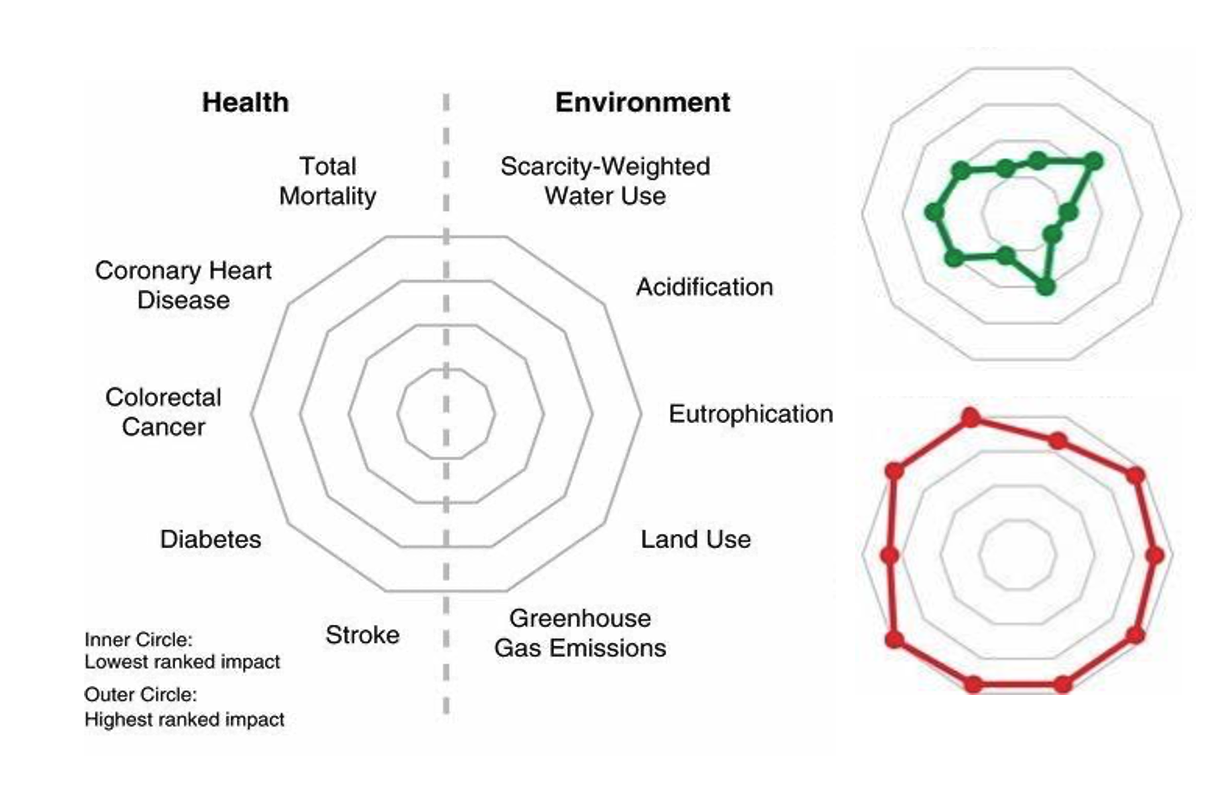
Health and Environmental Impacts of Foods—1
Image source: Clark, M., Springmann, M., Hill, J., & Tilman, D. (2019). Multiple health and environmental impacts of foods. Figure 2, Radar plots of rank-ordered health and environmental impacts per serving of food consumed per day. [Chart]. PNAS, 116(46), 23357–23362. https://doi.org/10.1073/pnas.1906908116
Notes:
Now we’ll shift gears and look at the impacts of specific foods on both health and our environment. What you see on the left side of this slide is an image that looks a bulls-eye. This is called a radar plot diagram. On the left side of the circle are the most prevalent and important health impacts per daily serving of the food groups we eat; the right side of the circle lists many of the most troubling environmental impacts per daily serving of various food groups. The inner circle indicates a lower-impact while the outer circle indicates higher-impact. The outer rings reflect a higher score of 15 and the inner rings reflect a lower score of 1.
Let’s look at two examples on the right side of the slide, based on one serving of different food groups.. The food group at the top has a low mean impact for most of the measures around the radar plot. The food group below has a high mean impact for almost all measures.
We’ll look at all of the results on the next slide. But can you guess which two food groups are represented here in these example radar plots on the right?
-----
Graphic

Slide 37
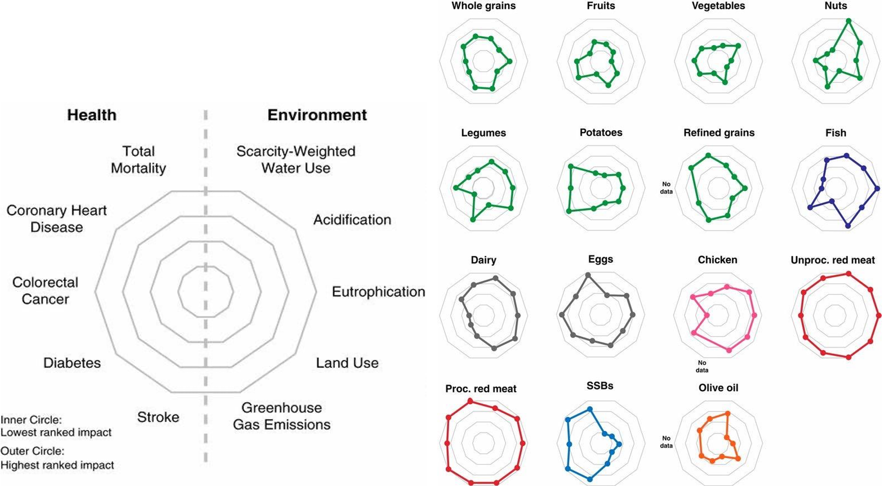
Health and Environmental Impacts of Foods—2
Image source: Clark, M., Springmann, M., Hill, J., & Tilman, D. (2019). Multiple health and environmental impacts of foods. Figure 2, Radar plots of rank-ordered health and environmental impacts per serving of food consumed per day. [Chart]. PNAS, 116(46), 23357–23362. https://doi.org/10.1073/pnas.1906908116
Notes:
Can you find those two radar plots from the previous slide? It was vegetables in the top row and processed red meat in the bottom row.
Other food groups that score lower are in green and are in the top half of the slide on the right side. These include whole grains, fruits, vegetables, nuts and legumes as well as olive oil hanging out down in the bottom row. Potatoes and refined grains have a bit of a mixed plot with some higher negative health impacts even though the study is showing them in green. Dairy – and to some extent fish – have high environmental impacts but also many health benefits. Eggs and chicken are also a bit of a mixed bag. Sugar sweetened beverages which seem okay for the environment, but no news to anyone that they did not score so high on the health measures.
It’s hard not to notice two of the standout categories: unprocessed and processed red meats in the bottom portion of the image. On every measure, they’re in the outermost of the circle, meaning they score poorly for every single health and environmental impact measured. Total mortality, coronary heart disease, colorectal cancers, diabetes, stroke, water use and eutrophication, land use and greenhouse gas emissions.
-----
Graphic
Clark, M., Springmann, M., Hill, J., & Tilman, D. (2019). Multiple health and environmental impacts of foods. PNAS, 116(46), 23357–23362. https://doi.org/10.1073/pnas.1906908116

Slide 38
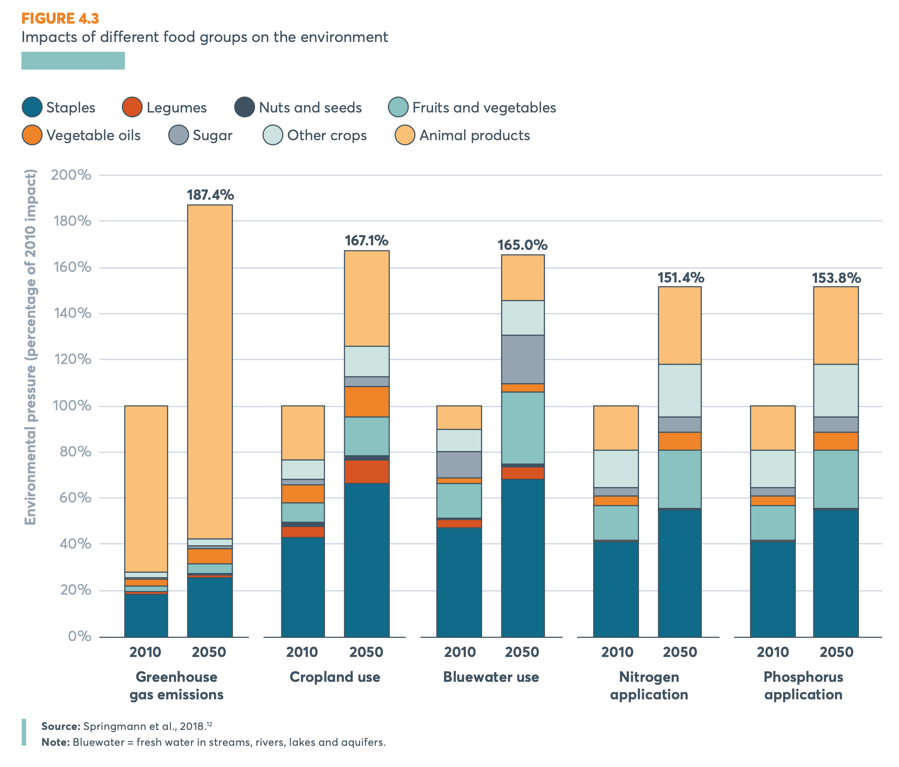
2050 Scenario
Source: 2020 Global Nutrition Report: Action on equity to end malnutrition. Figure 4.3, Impacts of different food groups on the environment. [Chart]. Bristol, UK: Development Initiatives. https://media.globalnutritionreport.org/documents/2020_Global_Nutrition_Report_2hrssKo.pdf
Notes:
So we saw in the past few slides that our food system currently has a very large and unsustainable impact on our planet’s natural resources, including our climate. But what about the future? What are the trends telling us? By 2050, if we don’t change the way we eat and manage our food resources, we’ll see increases in greenhouse gas emissions, cropland use, water use, and the application of nitrogen and phosphorus – as indicted across the bottom of this image. The increases come from virtually all food groups, with animal products, shown in dark red, having a large impact, particularly on greenhouse gas emissions, a staple crops on cropland use, water use and nutrient applications.
Feel free to pause and examine this image more carefully.
In the meantime, think about the following questions: Do you think these trends are inevitable? Do RDNs have a role in reversing these trends and preserving planetary health?
-----
Graph
Springmann, M., Clark, M., Mason-D’Croz, D., Wiebe, K., Bodirsky, B. L., Lassaletta, L., de Vries, W., Vermeulen, S. J., Herrero, M., Carlson, K. M., Jonell, M., Troell, M., DeClerck, F., Gordon, L. J., Zurayk, R., Scarborough, P., Rayner, M., Loken, B., Fanzo, J., … Willett, W. (2018). Options for keeping the food system within environmental limits. Nature, 562(7728), 519–525. https://doi.org/10.1038/s41586-018-0594-0

Slide 39
Section C: What Is a Sustainable Food System?
Notes:
In the previous section, we presented some of many ways that the Impacts and Outcomes we see from our current food systems are resulting in many challenges that are making our food systems unsustainable. What’s the alternative? What does a sustainable food system look like?

Slide 40
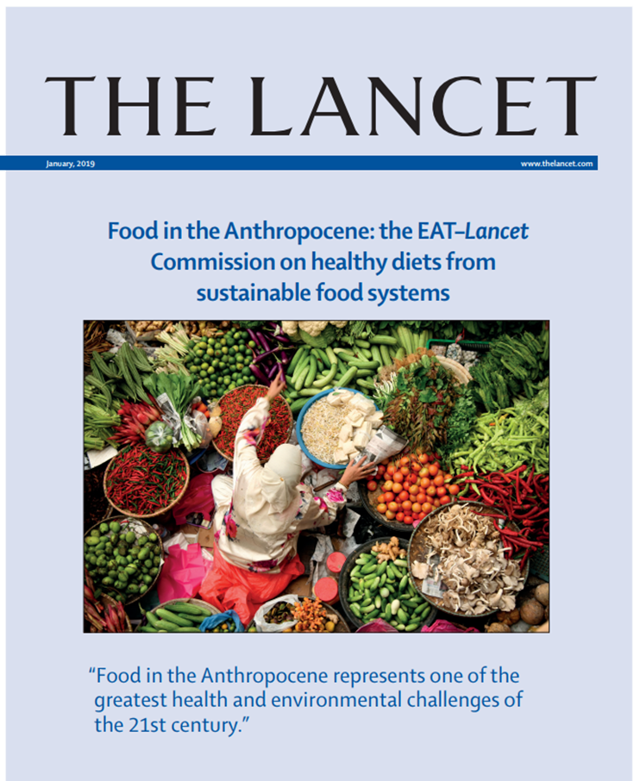
EAT-Lancet Commission
Food is the single strongest lever to optimize human health and environmental sustainability on Earth. However, food is currently threatening both people and the planet. An immense challenge facing humanity is to provide a growing world population with healthy diets from sustainable food systems.
Source: Willett, W., Rockström, et al. (2019). Food in the Anthropocene: The EAT–Lancet Commission on healthy diets from sustainable food systems. The Lancet, 393(10170), 447–492. https://doi.org/10.1016/S0140-6736(18)31788-4
Notes:
In 2019, the Lancet journal released a seminal report called Food in the Anthropocene: the EAT-Lancet Commission on Healthy Diets from Sustainable Food Systems.
The Lancet Commission consisted of dozens of scientists and stakeholders from a variety of disciplines. They assessed how feeding our global population affects earth’s natural systems and the importance of food for human and planetary health. They concluded that…Food is the single strongest lever to optimize human health and environmental sustainability on Earth. However, food is currently threatening both people and the planet. An immense challenge facing humanity is to provide a growing world population with healthy diets from sustainable food systems.”
-----
Quote
Willett, W., Rockström, J., Loken, B., Springmann, M., Lang, T., Vermeulen, S., Garnett, T., Tilman, D., DeClerck, F., Wood, A., Jonell, M., Clark, M., Gordon, L. J., Fanzo, J., Hawkes, C., Zurayk, R., Rivera, J. A., Vries, W. D., Sibanda, L. M., … Murray, C. J. L. (2019). Food in the Anthropocene: The EAT–Lancet Commission on healthy diets from sustainable food systems. The Lancet, 393(10170), 447–492. https://doi.org/10.1016/S0140-6736(18)31788-4

Slide 41
What Is a Sustainable Food System?
A sustainable food system … delivers food security and nutrition for all in such a way that the economic, social and environmental bases to generate food security and nutrition for future generations are not compromised.
—United Nations, 2015
Source: The Secretary-General’s High-Level Task for on Global Food and Nutrition Security. (2015). All Food Systems are Sustainable (Zero Hunger Challenge Working Groups). FAO, UNCTAD, UNIDO, World Bank, IFAD & UNEP. https://www.un.org/en/issues/food/taskforce/pdf/All%20food%20systems%20are%20sustainable.pdf
Notes:
One of the most commonly used definition of a sustainable food system is this one from the United Nations. A sustainable food system is a “food system that delivers food security and nutrition for all in such a way that the economic, social and environmental bases to generate food security and nutrition for future generations are not compromised.” What’s important to note is the recognition that sustainability goes beyond environmental impact – it includes economics and social sustainability. When we use “sustainable food systems” in this talk, we are using this broad lens.
-----
Quote
The Secretary-General’s High Level Task for on Global Food Nutrition Security. (2015). All Food Systems are Sustainable (Zero Hunger Challenge Working Groups). FAO, UNCTAD, UNIDO, World Bank, IFAD & UNEP. https://www.un.org/en/issues/food/taskforce/pdf/All%20food%20systems%20are%20sustainable.pdf

Slide 42
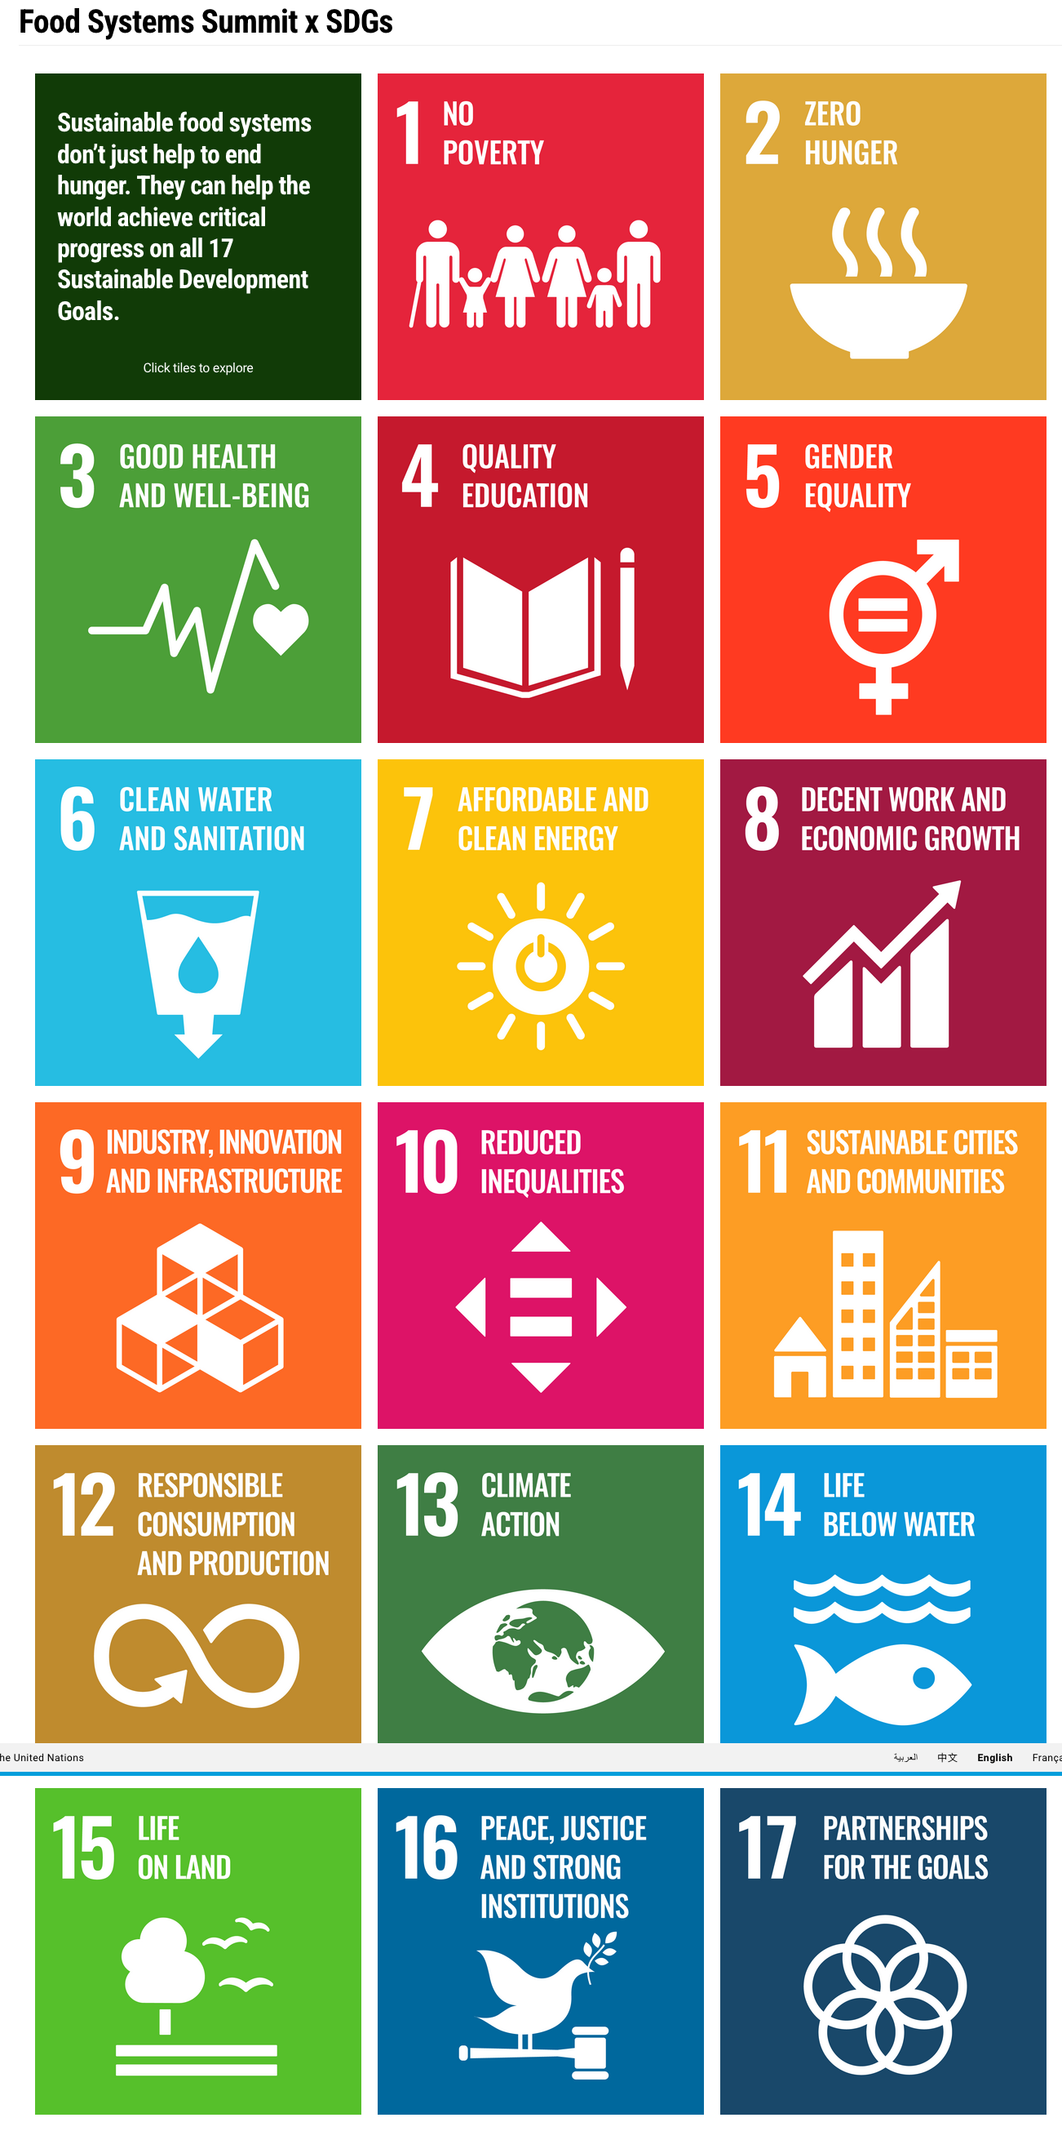
17 Sustainable Development Goals
Sustainable food systems don’t just help to end hunger. They can help the world achieve critical progress on all 17 Sustainable Development Goals.
Source: UN Food Systems Summit 2021. (2021). Food Systems Summit x SDGs. United Nations; United Nations. https://www.un.org/en/food-systems-summit/sdgs
Notes:
Sustainable food systems are central to the UN Sustainable Development Goals (SDGs), an ambitious initiative that seeks to end poverty and hunger and improve livelihoods around the world by 2030. In this image, Sustainable food systems are essential to economic prosperity, nurturing communities, and environmental preservation and tie into almost all of the other SDGs.
-----
Graphic & Quote
UN Food Systems Summit 2021. (2021). Food Systems Summit x SDGs. United Nations; United Nations. https://www.un.org/en/food-systems-summit/sdgs

Slide 43
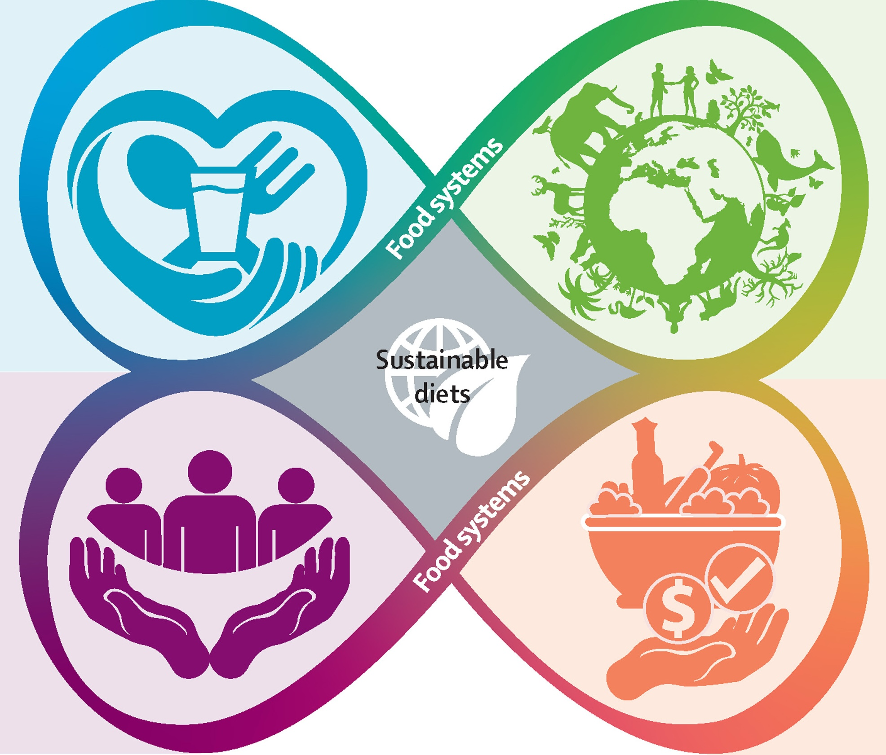
Principles for Sustainable Diets and Food Systems for Planetary Health—1
Human health
Nutritious and healthy
Balanced and diverse
Appealing and acceptable
Safe to consume
Image source: Kraak, V. I., & Stanley, K. C. (2023). An economic lens for sustainable dietary guidelines. The Lancet Planetary Health, 7(5), e350–e351. https://doi.org/10.1016/S2542-5196(23)00075-X
Notes:
Let’s dig further into what a sustainable food system is looking at four principles or domains.
Remember the food system framework introduced in the first section? The 4 outcomes of a food system align with these principles and can guide us in systems thinking: human health, economic, social equity and the environment.
The human health domain includes nutritious and healthy diets that are balanced and diverse, appealing and acceptable, and safe to consume.
-----
Infographic
Kraak, V. I., & Stanley, K. C. (2023). An economic lens for sustainable dietary guidelines. The Lancet Planetary Health, 7(5), e350–e351. https://doi.org/10.1016/S2542-5196(23)00075-X

Slide 44
Principles for Sustainable Diets and Food Systems for Planetary Health—2
Ecological health
Adaptive and agroecological
Resilient and regenerative
Protects/restores biodiversity
Humane, supports OneHealth
Image source: Kraak, V. I., & Stanley, K. C. (2023). An economic lens for sustainable dietary guidelines. The Lancet Planetary Health, 7(5), e350–e351. https://doi.org/10.1016/S2542-5196(23)00075-X
Notes:
Sustainable food systems promote ecological health. They are adaptive and agroecological. Another way to say this is that food systems – specifically agriculture – work WITH the ecological systems on which it depends, not against them. Sustainable food systems are resilient and regenerative – building soil, not depleting it. Protecting and restoring biodiversity, not killing it. It’s also humane and supports One Health, which is the recognition that the health of animals, humans and the environment are all connected and dependent on each other.
-----
Infographic
Kraak, V. I., & Stanley, K. C. (2023). An economic lens for sustainable dietary guidelines. The Lancet Planetary Health, 7(5), e350–e351. https://doi.org/10.1016/S2542-5196(23)00075-X

Slide 45
Principles for Sustainable Diets and Food Systems for Planetary Health—3
Social equity
Equitable and fair
Ethical and inclusive
Democratic, participatory
Rights-based approach
Image source: Kraak, V. I., & Stanley, K. C. (2023). An economic lens for sustainable dietary guidelines. The Lancet Planetary Health, 7(5), e350–e351. https://doi.org/10.1016/S2542-5196(23)00075-X
Notes:
Sustainable food systems should be ethical and inclusive, democratic and participatory and should be based on the notion that food is a human right. And they should be equitable and fair for all its participants. This includes the farmers and farmworkers who labor to grow our food and deserve a fair wage for their very hard work. Without them, we would not have food. But this also includes the many workers across the food system, which is one of the largest sectors of the US and global economy. Yet, as we’ll explore in another module, there is vast inequities across the food system with direct implications on food security, nutrition and health.
-----
Infographic
Kraak, V. I., & Stanley, K. C. (2023). An economic lens for sustainable dietary guidelines. The Lancet Planetary Health, 7(5), e350–e351. https://doi.org/10.1016/S2542-5196(23)00075-X

Slide 46
Principles for Sustainable Diets and Food Systems for Planetary Health—4
Economic prosperity
Profitable and sufficient
Distributive and shared
Livable wages
Accessible and affordable
Clean and green innovation
Image source: Kraak, V. I., & Stanley, K. C. (2023). An economic lens for sustainable dietary guidelines. The Lancet Planetary Health, 7(5), e350–e351. https://doi.org/10.1016/S2542-5196(23)00075-X
Notes:
This paper that the model is from focused on building out the facets of the fourth domain of sustainable food systems – economic prosperity. The authors describe this fourth domain as profitable and sufficient in economic prosperity, and the economic benefits are distributive and shared. Sustainable food systems provide livable wages. Sustainable food systems – especially sustainable diets – are accessible and affordable. They are based on clean and environmentally friendly innovation.
-----
Infographic
Kraak, V. I., & Stanley, K. C. (2023). An economic lens for sustainable dietary guidelines. The Lancet Planetary Health, 7(5), e350–e351. https://doi.org/10.1016/S2542-5196(23)00075-X

Slide 47
Principles for Sustainable Diets and Food Systems for Planetary Health—5
Human hands were purposefully incorporated into the images for each domain because humans have agency to facilitate or hinder actions toward sustainable diets.
Image source: Kraak, V. I., & Stanley, K. C. (2023). An economic lens for sustainable dietary guidelines. The Lancet Planetary Health, 7(5), e350–e351. https://doi.org/10.1016/S2542-5196(23)00075-X
Notes:
Finally, here is one particularly important quote from the paper to tie these areas together: Human hands were purposefully incorporated into the images for each domain because humans have agency to facilitate or hinder actions towards sustainable diets.
As an RDN, you will be particularly well positioned to facilitate actions towards sustainable diets. In the next section, we’ll explore how.
-----
Infographic
Kraak, V. I., & Stanley, K. C. (2023). An economic lens for sustainable dietary guidelines. The Lancet Planetary Health, 7(5), e350–e351. https://doi.org/10.1016/S2542-5196(23)00075-X

Slide 48
Section D: How Can RDNs Promote Sustainable Diets and Food Systems for Planetary Health?
Notes:
As an RDN, what can you do to promote sustainable diets and food systems for planetary health using more of a systems’ approach?

Slide 49

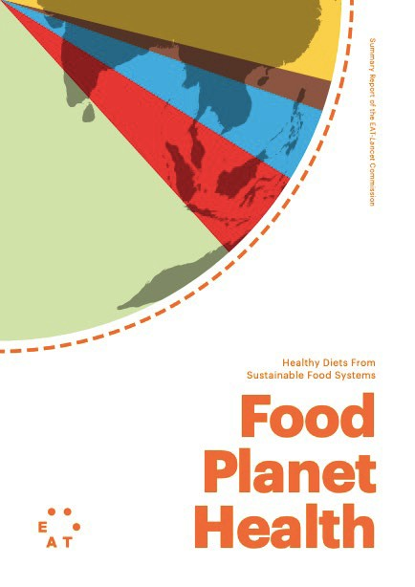
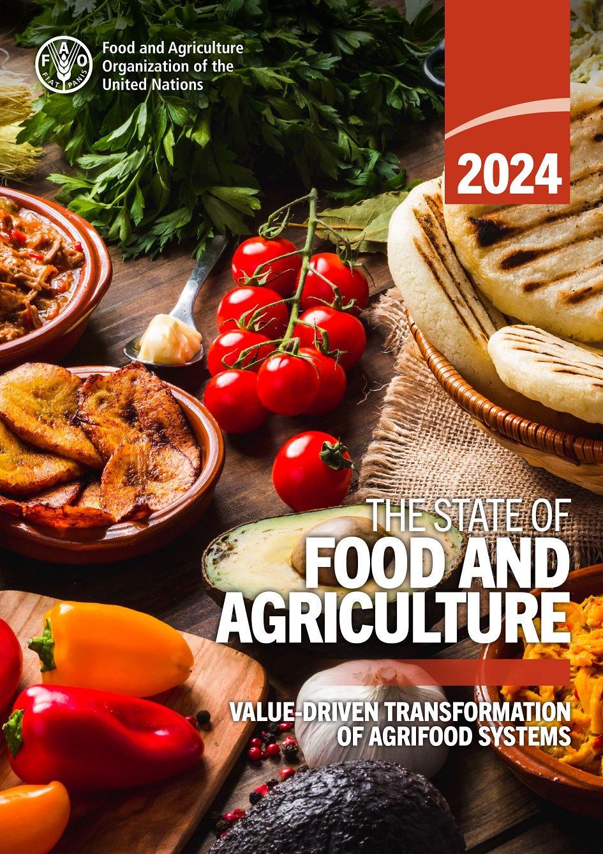
A New Way of Thinking About Healthy Diets
Nutritious diets
Diet + planetary health
Diet + planet + cost
Image sources: Report covers courtesy of Dietary Guidelines for Americans (DGA) 2020-2025; Food Planet Health: Healthy Diets from Sustainable Food Systems; The State of Food and Agriculture 2024: Value-driven transformation of agrifood systems.
Notes:
Incorporating sustainable diets into dietetics and nutrition practice requires a slight shift or broadening of perspective, which can be understood better through the nature of these 3 reports.
The Dietary Guidelines in the U.S. and many other countries focus solely on dietary patterns and nutrition outcomes.
The EAT Lancet Planetary Health diet addresses both the environmental and health impacts of diet patterns – including greenhouse gas emissions, water, land, and energy.
Going further, the annual, global State of Food and Agriculture report incorporates cost and price factors to understand the impacts of our food system on economic, social and environmental sustainability.

Slide 50
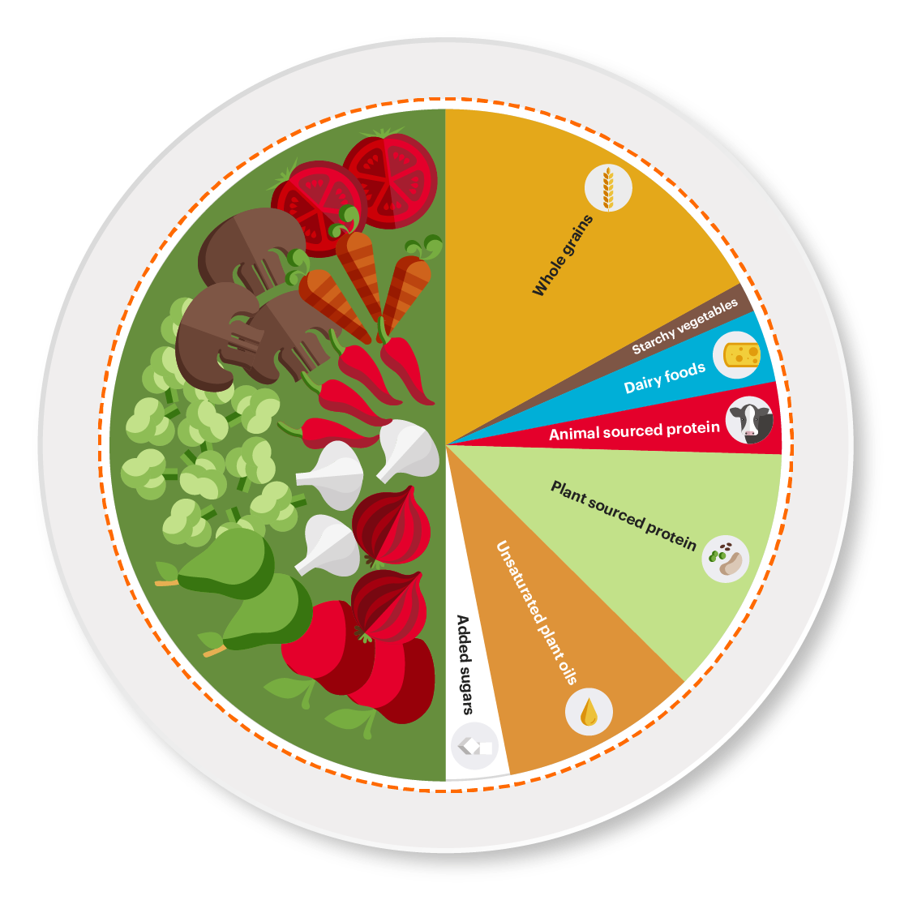
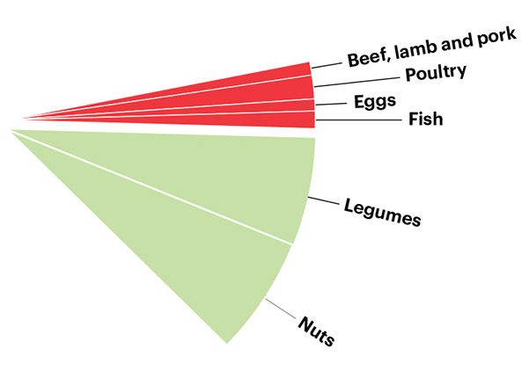
Planetary Health Diet
Image source: The EAT-Lancet Commission on Food, Planet, Health. (n.d.). The Planetary Health Diet. EATForum. Accessed July 24, 2025, from https://eatforum.org/eat-lancet-commission/the-planetary-health-diet-and-you/
Notes:
Let’s take a closer look at the Planetary Health Diet, designed by the EAT-Lancet commission on Food, Planet, and Health (in 2019). Like many dietary guidelines, the Planetary Health diet is plant-forward. It emphasizes vegetables, fruits, whole grains, legumes, and nuts as dietary staples and limits red meat, processed meats, sugar, refined grains, and processed foods. While the Planetary Health diet is designed to be flexible and adaptable for different cultural contexts, it has been criticized for being unaffordable for many and lacking in enough protein, iron and other important nutrients we get primarily from animal-source foods, potentially putting children, pregnant women, and the elderly at risk of nutritional deficiencies.
-----
Graphic
The EAT-Lancet Commission on Food, Planet, Health. (n.d.). The Planetary Health Diet. EATForum. Retrieved July 24, 2025, from https://eatforum.org/eat-lancet-commission/the-planetary-health-diet-and-you/

Slide 51
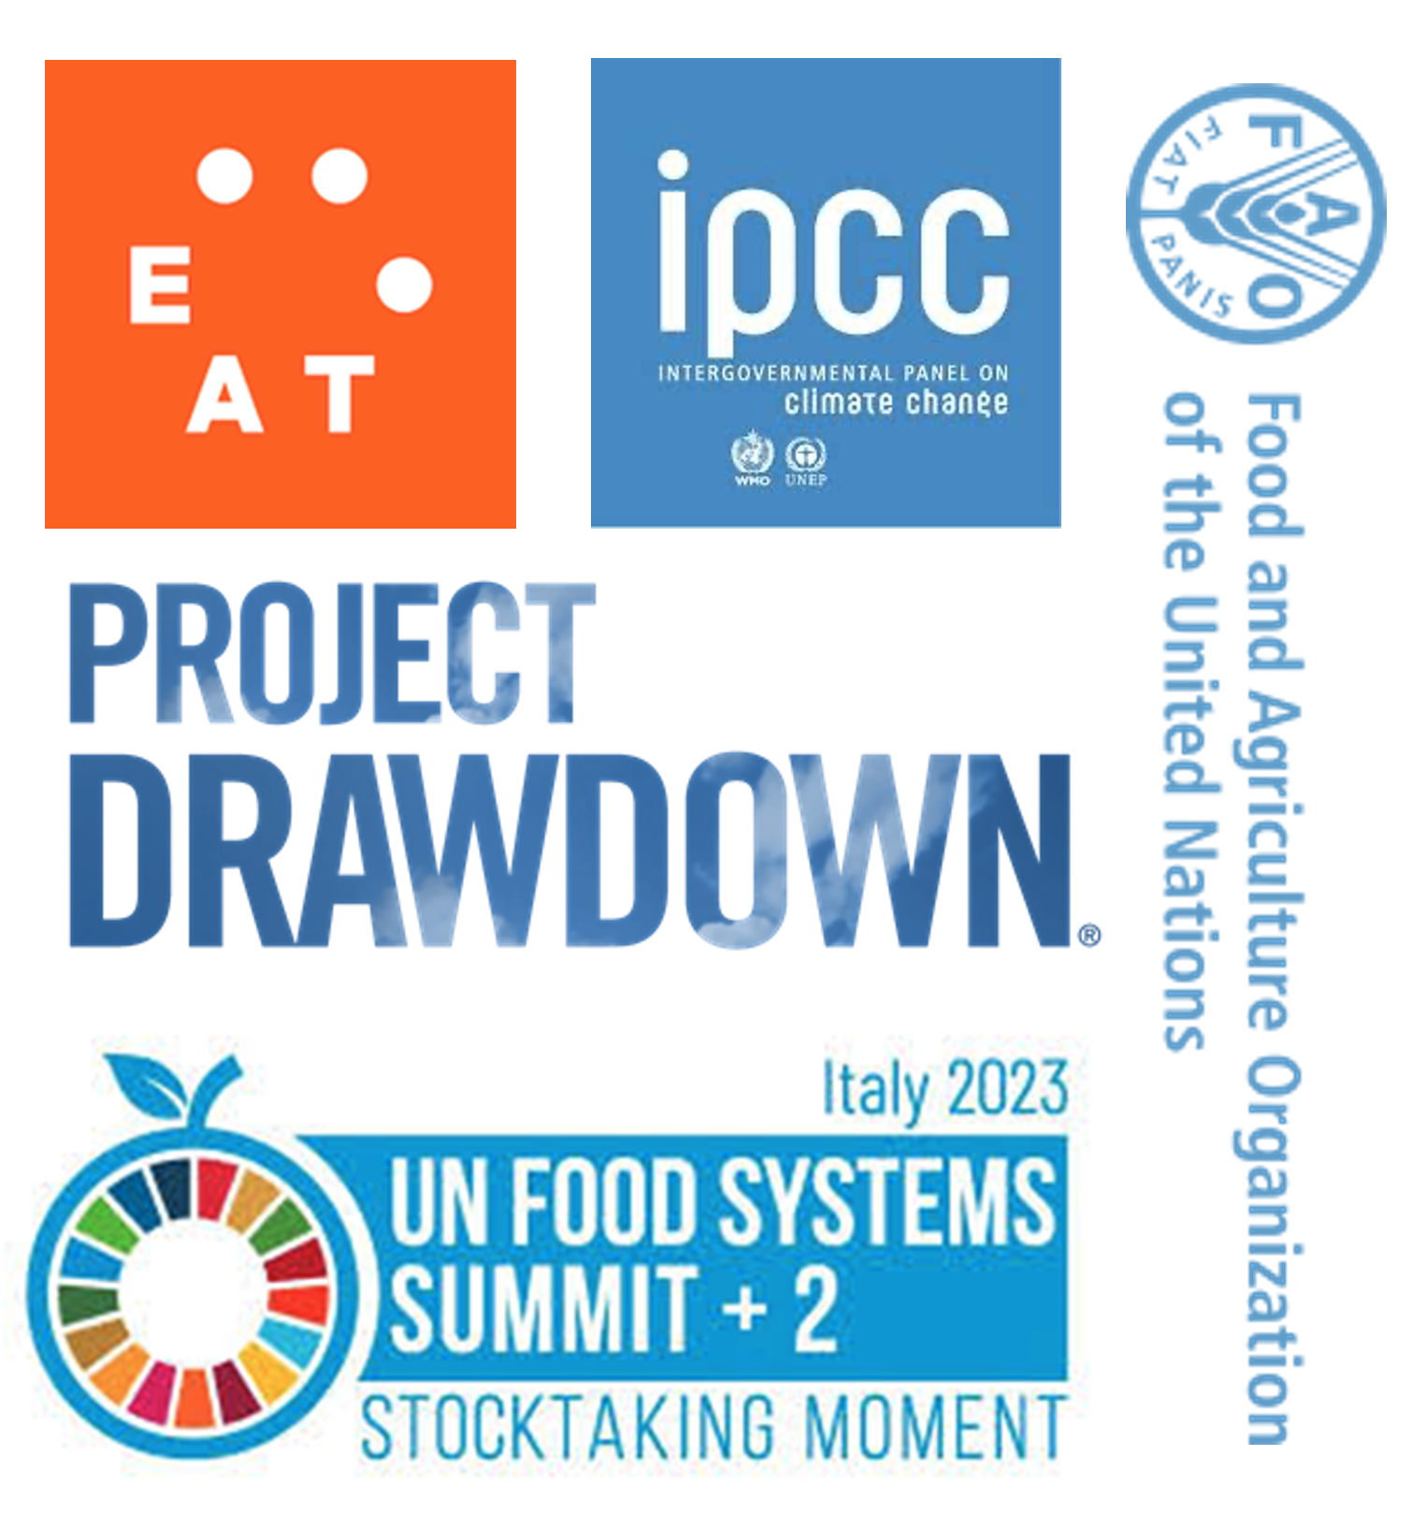
Key Strategies for Food System Sustainability
Significantly reduce wasted food
Shift diets towards plant-based
Improve food production practices without expanding agriculture onto new land
Image source: Collage of logos created by the Center for a Livable Future.
Notes:
Many expert groups, including the Eat-Lancet Commission that developed the Planetary Health diet – as well as the Intergovernmental Panel on Climate Change, Project Drawdown, and the FAO--have coalesced around these three key recommendations for shifting our food system to be healthier and more sustainable.
First– and perhaps most urgently-- we need to stop wasting the food that we already produce. That will ease some of the pressure on food systems to produce more and more to meet growing demand. This will help our food system operate more efficiently.
Second - we also need to shift demand away from animal protein that – as we’ve seen – is extremely resource intensive. Does this mean that we all need to stop eating meat? Absolutely not. Many people in the world need to increase their intake of high-quality animal protein to meet basic dietary recommendations. What that means is that those of us living in wealthier countries like the US, Australia, Europe and the UK who tend to eat relatively high-meat diets need to bear the burden of these shifts in demand towards plant-forward foods.
It’s worth noting that Project Drawdown consistently ranks these two strategies -- reducing wasted food and plant-based diets --in their top 4 strategies for mitigating climate change.
Also high on their list, are strategies for changing the way we grow food because we still WILL need to produce more, but we don’t want to expand onto new land, and we cannot continue to exploit natural resources and destroy our soil, air and water. There is a tremendous amount of debate about how to do this.

Slide 52
Recommendation 1: Reduce Wasted Food
Strategies for dieticians
  Promote meal planning and appropriate portion sizes
  Understand and educate about food safety and date labels
  Encourage creativity with leftovers
  Reduce waste in food service and encourage composting
  Support local food recovery initiatives
Notes:
So what does this mean for us as nutrition professionals? Here are some thoughts…
Wasted food may not feel like a nutrition issue, but keeping this issue in mind when providing guidance on food choices can go a long way reducing wasted foods, - such as shopping with meal plans and encouraging appropriate portion sizes, educating clients and others about proper food storage and safety and making sure they understand date labels. You can encourage creativity with leftovers, planning meals that utilize ingredients on hand. In food service setting, you can work to reduce waste and also encourage composting of wasted food as well as support local food recovery initiatives. These are just a few of the many ways you can help reduce wasted food as a consumer and as a nutrition professional.

Slide 53
Recommendation 2: Shift Towards Plant-Based Diets
Strategies for dieticians
  Provide guidance on healthy food choices that are plant-forward and culturally appropriate, affordable, available, and tasty
  Use the planetary health diet as a framework
  Support initiatives that introduce consumers to tasty, appealing plant-forward meals
    For example, Meatless Monday
  Balance plant-forward diets with life cycle nutrition needs
Notes:
To promote plant-forward choices across different audiences, RDNs can provide guidance on healthful food choices that are plant-forward yet are also culturally appropriate, affordable, available and appealing to your clients and patients. There are many initiatives that support small changes, taste and experimentation that increase confidence and comfort level with new food choices.
The Planetary Health diet pattern is a useful guide, but there are other frameworks, such as the DASH diet, the Mediterranean Diet or the DGA Vegetarian diet pattern. It is important to note that none of these promote a completely vegan diet, but rather a greater focus on healthy, diverse plant-rich diets while decreasing overall meat and dairy.
It is also important to accurately assess nutrition needs particularly across life-cycles when providing guidance on plant-forward choices. Guidance will look different for a growing child, an older adult and an athlete.

Slide 54
Recommendation 3: Improve Agricultural Practices
Strategies for dieticians
  Make the case for co-benefits (health, cost, sustainability, social)
  Bridge consumers to food from producers who integrate sustainable practices
  Provide guidance on making food choices that reflect best practices through labels, etc.
  Support diversification of our food system by promoting diverse diets
Notes:
Our work as RDNs can also support sustainable agricultural practices. Start by talking about sustainable diets and why they are important – for addressing climate change, supporting healthy air and water. There are often co-benefits for choosing foods that are produced more sustainably. Think about those radar plots of processed and unprocessed red meat – bad for health and bad for the environment. Beef often also costs more. There are tradeoffs, but one step might be to encourage people to eat less beef – they don’t necessarily have to eliminate it. Many choices that are good for the environment are good nutritionally – more vegetables and legumes, for example. You can encourage consumers to seek out local farmers and producers that use regenerative or organic practices. This may require some research and a little more effort to understand labels and certifications. We’ll provide some resources at the end of this module. Most important is to diversity diets and consumption of more whole foods.

Slide 55
Consumer Survey about Climate and Food
Three in four Americans are concerned about climate change
  Over 70% are concerned about food-related issues
Climate concern impacts foods and beverage choice in only 25%
  Health and cost play a larger role
2023 International Food and Information Center (IFIC) Climate Change Perceptions and Purchase Impact Survey
Half of Americans heard about food and climate change from the media
Labels that indicate recyclable or reusable packaging are perceived as very meaningful when looking for climate-friendly food and beverage options
Source: IFIC. (2023). Consumer climate change perceptions and purchase impacts. International Food Information Council. https://foodinsight.org/wp-content/uploads/2023/10/Oct23-IFIC-Climate-Change.pdf
Notes:
Our role is more evident and important because we have close interaction with consumers, who are trying to sort out seemingly conflicting information they hear from many disparate sources.
In a 2023 International Food and Information Center (IFIC) Climate Change Perceptions and Purchase Impact Survey: three-fourths of consumers shared a concern about climate, and of these, over 70% were particularly concerned about food related issues.
However, among these consumers, only 25% stated that climate concern influenced their food choices; rather, health and cost played a larger role in food choices.
Interestingly, half of Americans heard about food and climate change issues from the media. But consumers did look to labels when trying to make choices. These findings point to many opportunities for RDNs to help build awareness of the environmental impact of food
Other surveys that have been done by IFIC reveal questions about labels, organic v. conventional, plastics & packaging, p-b alternatives, local/seasonal, buying food on a budget, GMOs, seafood, food waste, where to get good information, and whether my actions make a difference?
Being informed and ready to provide simple and accurate guidance that supports a sustainable food is a valuable and important role we have as RDNs.
-----
Data
IFIC. (2023). Consumer Climate Change Perceptions and Purchase Impacts. International Food Information Council. https://foodinsight.org/wp-content/uploads/2023/10/Oct23-IFIC-Climate-Change.pdf

Slide 56
Nutrition Professionals Interest in Sustainability
In a 2024 Sustainability Insights survey, RDNs shared gaps in knowledge, practice, and confidence
Over half had no formal training in sustainability
Lowest confidence expressed in domains of food equity, production, and sourcing
Confidence is higher
in issues of food safety
Over 60 % highlighted consumer demand and awareness as challenge for integrating sustainability
56% lacking tools and educational resources for sustainability conversations
Source: Food + Planet, Today’s Dietician.
Notes:
Despite consumer and professionals’ interest in sustainability, in a 2024 Insights survey by Food and Planet, RDNs shared gaps in knowledge, practice and confidence.
(Read slide)

Slide 57
Opportunities for RDNs to Impact Food Systems
1
2
3
Leverage consumers’ growing interest in food systems and sustainability as an opportunity to guide individuals toward nutritious, sustainable choices
Amplify the effectiveness of individual level interventions (e.g., education and behavior change) that complement actions at policy, systems and environmental levels
Identify multi-level actions (institutions, policy) and food choices that generate positive changes in the food system (equitable access to culturally appropriate, affordable, tasty foods)
Source: Adapted from the Academy of Nutrition and Dietetics Foundation. (2021).
Notes:
Even though you may never work directly in sustainable food systems, being prepared with some background, is a win win. There are many opportunities for RDNs to make important and unique impacts:
RDN’s have many touchpoints with consumers and food shoppers, and consumers are interested but often confused.
Education and awareness have the potential to strengthen and amplify policies and systems level actions in order to align consumer food choices with a sustainable food system.
Finally, RDNs can help identify multi-level strategies that work together with individuals, institutions and communities to generate positive food system changes.

Slide 58


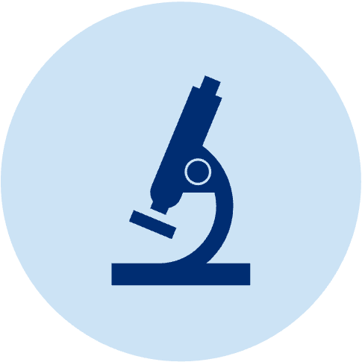

Core Skills of Nutrition and Dietetics Professionals
Helping people navigate dietary choices amid complexity and uncertainty
Fulfilling multiple goals through food: not just nutritious, but also safe, delicious, affordable
Critically evaluating and translating research from a variety of scientific disciplines
Collaborating as part of interprofessional teams and engaging with other sectors
Source: Adapted from the Academy of Nutrition and Dietetics Foundation. (2021).
Notes:
Finally, all of these strategies align with the core skills of nutrition and dietetics professionals:
READ

Slide 59
Discussion 3: Strategies for Action
What are some strategies for RDNs to …
… significantly reduce food waste?
… shift diets towards plant-based?
… improve food production practices without expanding agriculture onto new land?

Slide 60
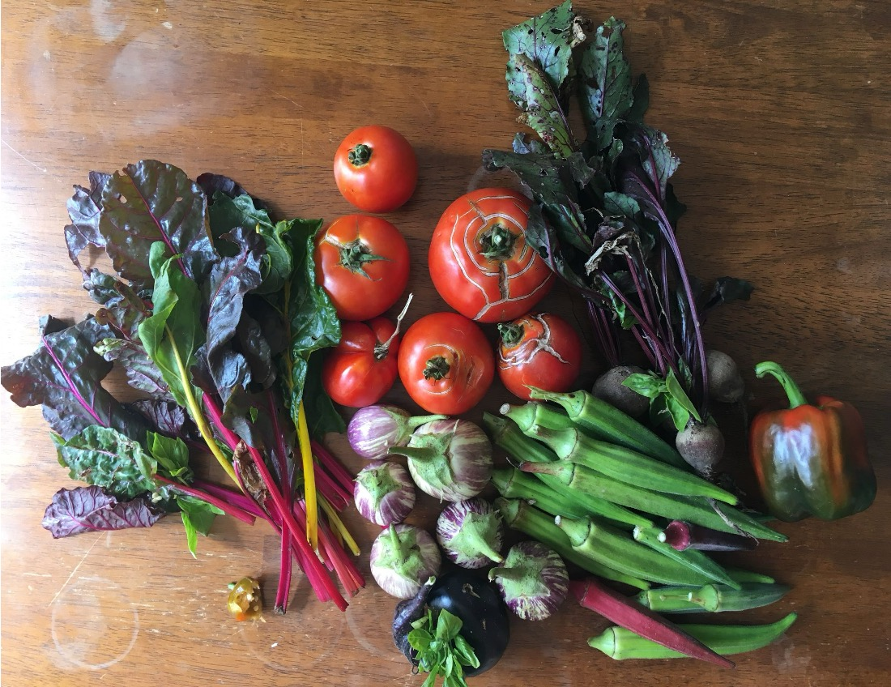
Thank You!

Slide 61

About This Presentation
© Copyright 2025 Johns Hopkins University.
Attribution-NonCommercial-ShareAlike 4.0 International
Produced by the Center for Teaching and Learning at the Johns Hopkins Bloomberg School of Public Health.
S2510

